Slide 1


FinTech @ IU Python Session #4 – Libraries & Algorithms
Prepared by
Gabriel Shores
Director of Technology – FinTech @ IU
https://www.linkedin.com/in/gabriel-shores-379b81291/
Cameron Nelson
Fund Equities Lead– FinTech @ IU
https://www.linkedin.com/in/cameron-j-nelson/
10/18/2024

Slide 2
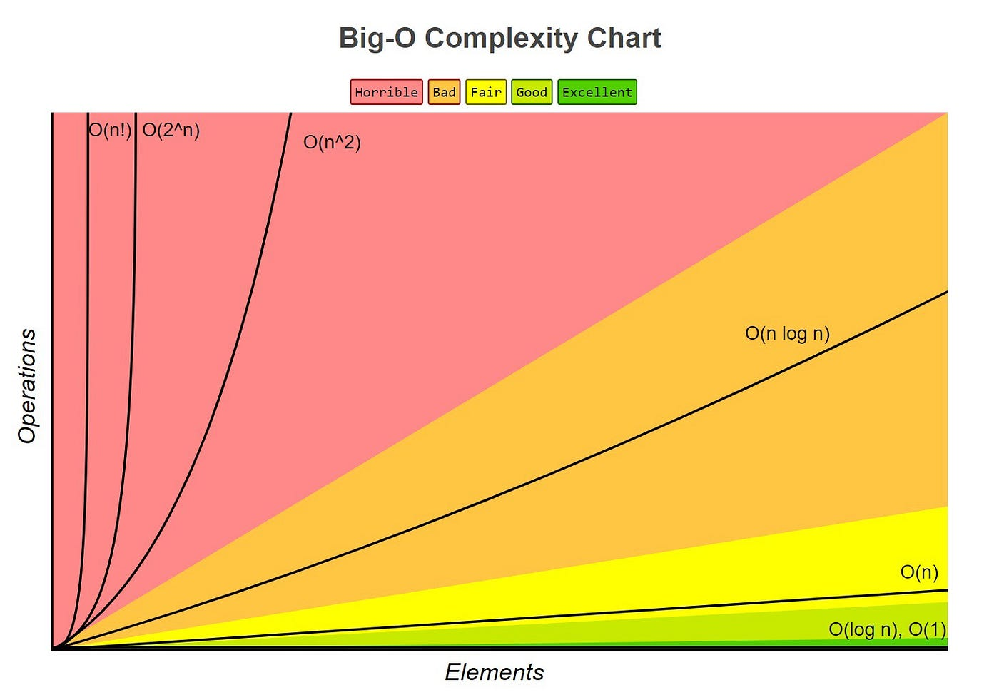
Algorithmic Complexities
Algorithms are used all the time in code
Especially when data sets contain thousands or
millions of items, efficiency is essential
Algorithmic complexity is measured in the worst-case scenario for a task in the form O(f(n))
We only include the costliest term, so 3n^2 +2n → O(n^2)
For finding the greatest item in a list iteratively, the worst case is the item is last, meaning you went through n items, so time complexity is O(n)
Comparing each item in the list to every other item using two for loops runs through the list of n items n times, and is O(n^2) time complexity
Think of looking through all closing prices for a year. O(n) means upwards of 365 operations and O(n^2) means upwards of 133,225

Slide 3
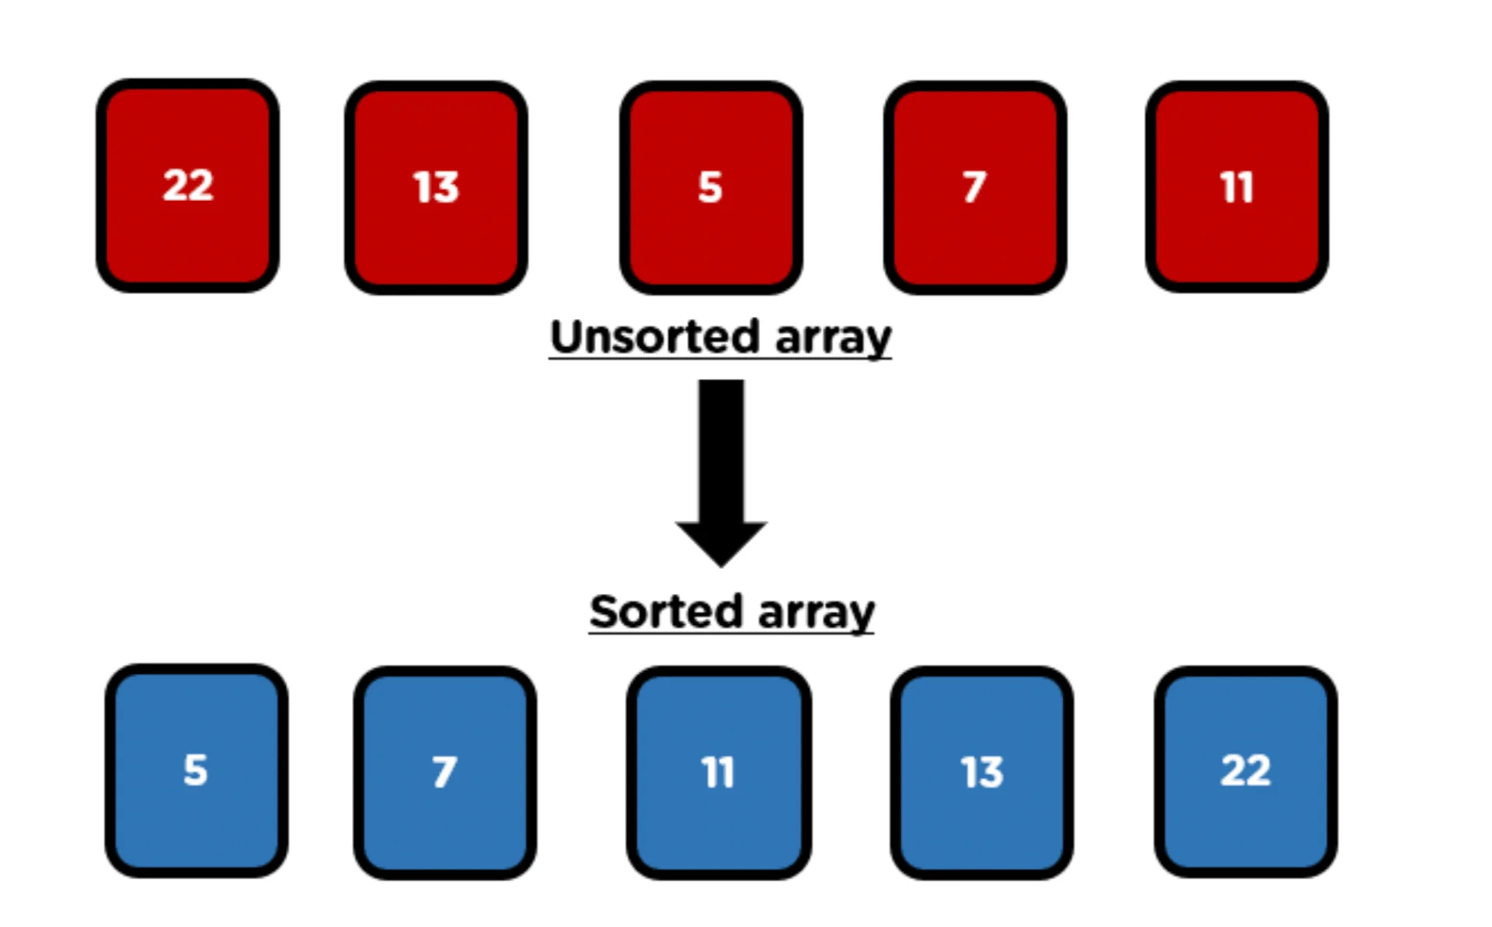
Algorithmic Complexities Cont.
Let’s think of searching through an unsorted list to find a given item. How do we do it and what’s the time complexity?
What about with a sorted list?

Slide 4
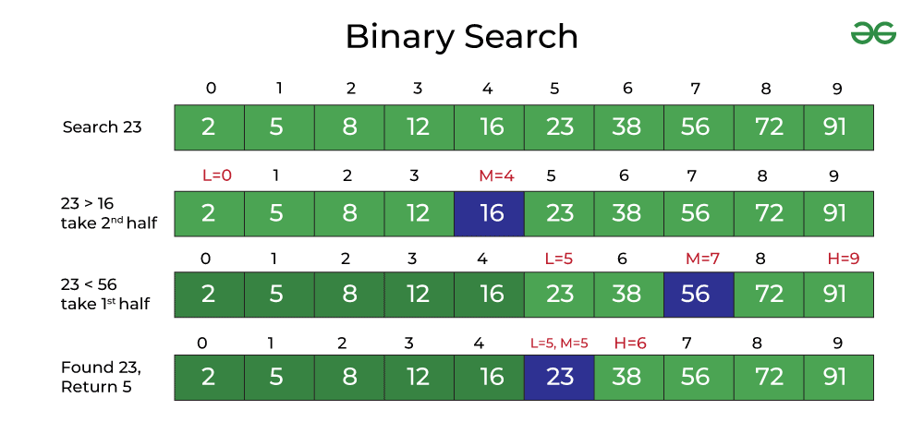
Solution: Binary Search
Think about looking through a dictionary
Turn to a page. If the word is lexicographically less than the current page, look in the first half, else look in the right half
By searching in the midpoint each time, we halve the operations each time
What’s the time complexity? (Hint: Halving is the opposite operation of squaring a number)

Slide 5
Complexity
O(logn)
8 items -> 4 items -> 2 -> 1
2^n = 8 ? log2(2^n) = n, log2(8) = 3
Better than O(n)
Let’s look at the effect in code

Slide 6



Classes
When writing code, we typically want to be able to share and reuse as much as possible
Objects allow us to group code together, representing something
Classes allow different objects to share and inherit code, while maintaining individuality
Classes are used in Object Oriented Programming
Let’s think of Minecraft (Actually uses OOP)
Entity Class
Skeleton Class
Extends Entity
Each Stray that spawns
Is an individual Stray Object
Stray Class
Extends Entity

Slide 7
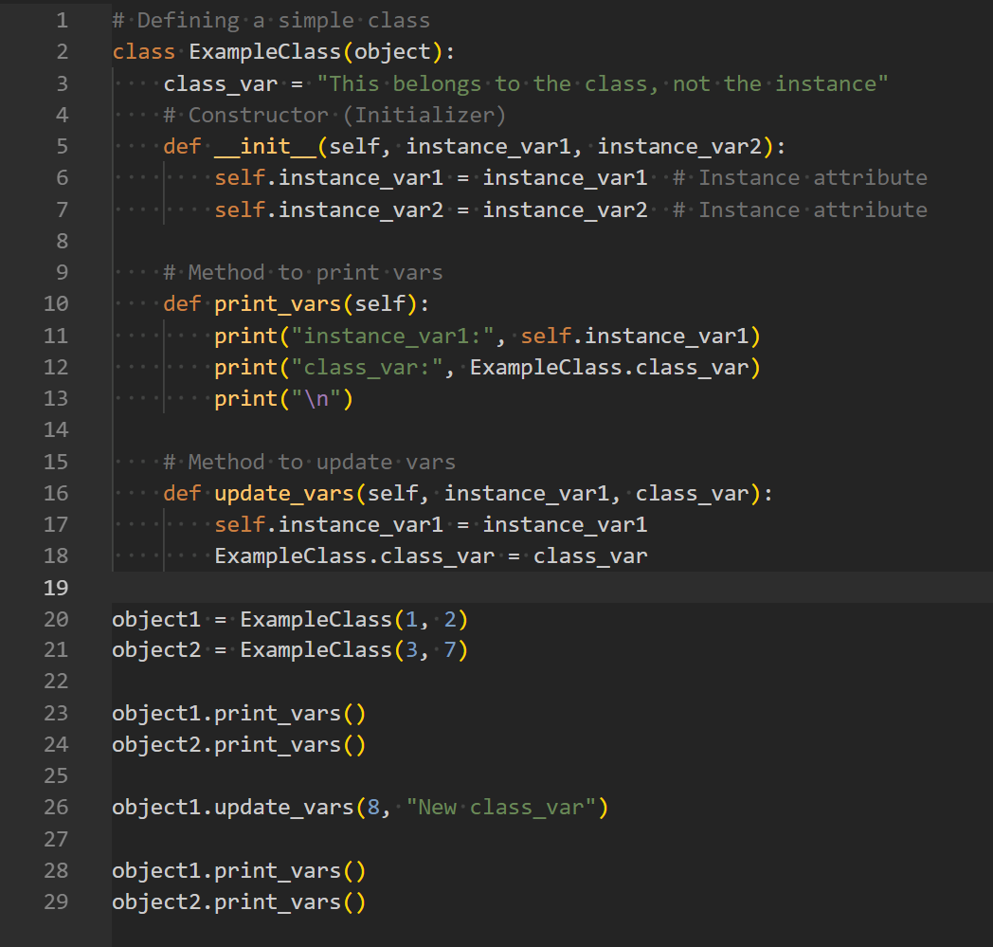
Classes
Declare Classes with Class
A parent class which a child class inherits from can be in parentheses
Self refers to the specific instance
Declare instance variables in __init__
method with self.instance_var
Class variables declared outside and accessed with ClassName.class_var
New instance declared with
instance = ClassName()

Slide 8
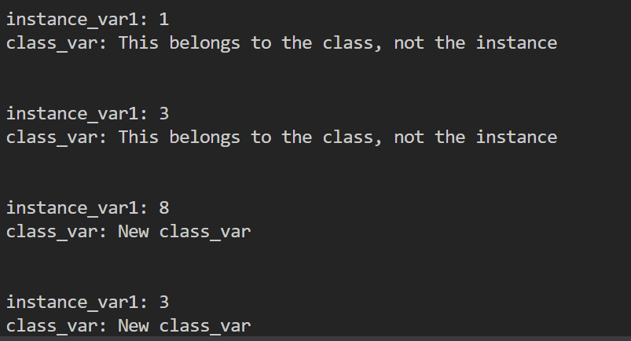
Output for Prev. Slide
Let’s dive into some more examples in code!

Slide 9
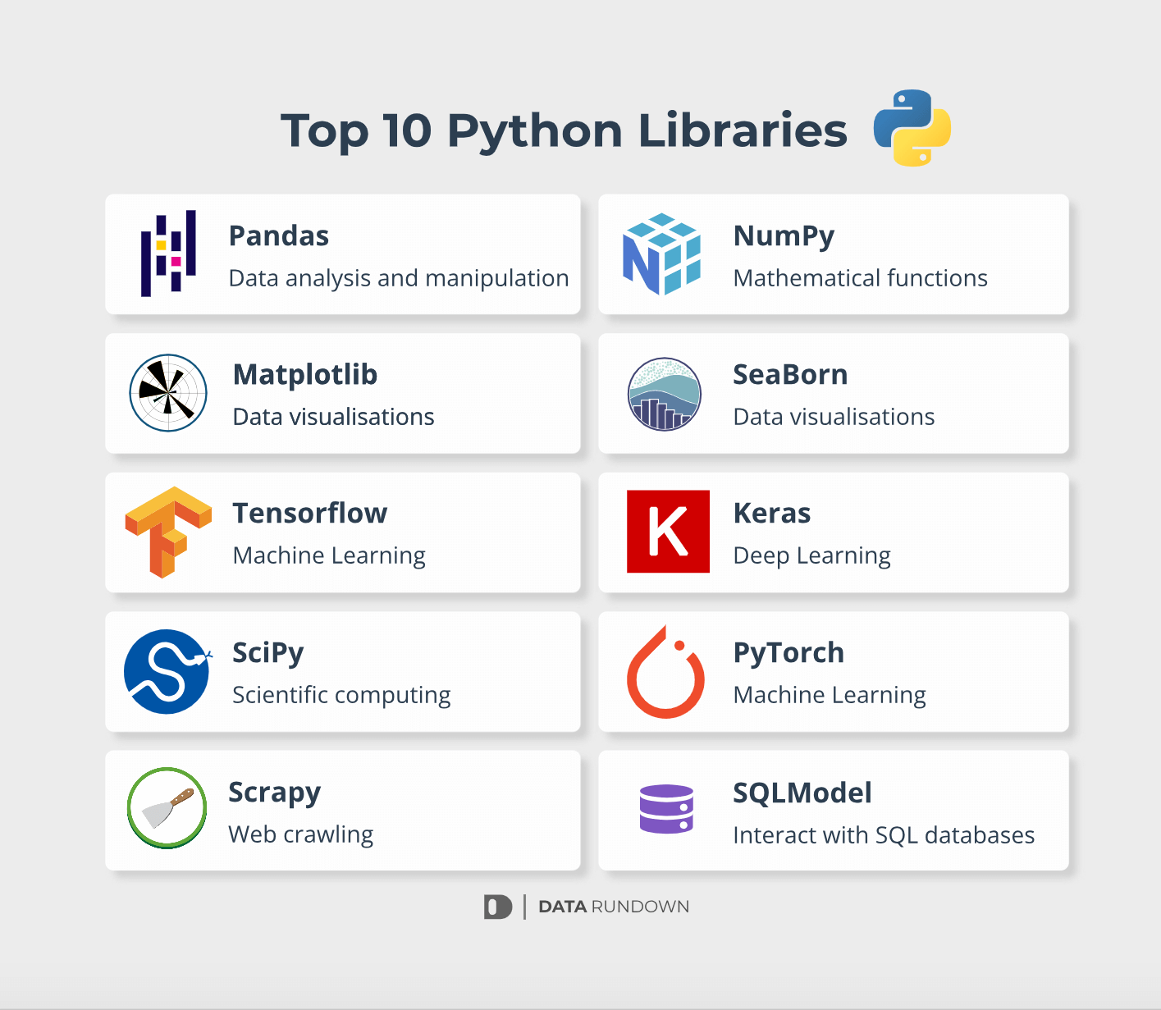
What are Libraries
Allows us to compartmentalize code
Makes programs more scalable
There are people who have written code for you. So use it!
Python provides several built-in libraries, 2 of which we’ll talk about today

Slide 10
csv (built-in library)
Gives us an easy way to interact with CSV (comma-separated values) files
Can read files row by row into arrays: “demo@email.org, notarealpassword” → [“demo@email.org”, “notarealpassword”]
Or into dicts: We’ll examine this in our code examples
CSV data is very common. Along with JSON, this will constitute a large amount of data you will see online - Sometimes data can be delimited (separated) with other characters, like tabs or | (pipes). But the csv library also can read these files, only by changing one argument
Can read/write in Excel, making it easy to edit

Slide 11
datetime (built-in library)
Allows us to convert to/from strings that describe dates to time objects
Like in Excel, dates in Python are represented numerically
To compare dates, calculate the difference between dates, etc., we cannot use dates in a string form
But sometimes we are given a date as a string and want to do operations with it, or print out that date after we do those operations
Further reading on programmatic date formatting: https://man7.org/linux/man-pages/man1/date.1.html

Slide 12
The End!
Thank you!

