Slide 1


FinTech @ IU Python Session #6 – Web Libraries
Prepared by
Gabriel Shores
Director of Technology – FinTech @ IU
https://www.linkedin.com/in/gabriel-shores-379b81291/
Cameron Nelson
Fund Equities Lead– FinTech @ IU
https://www.linkedin.com/in/cameron-j-nelson/
11/08/2024

Slide 2
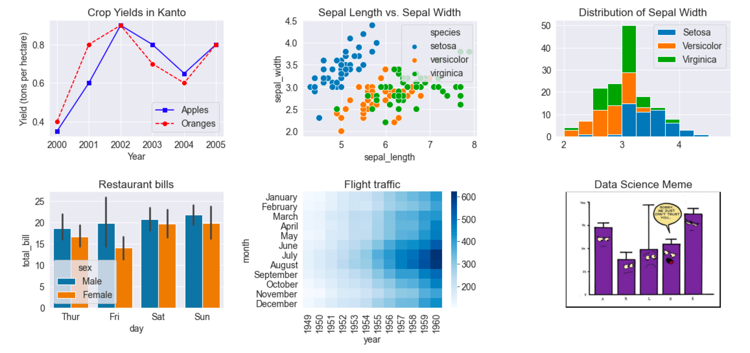
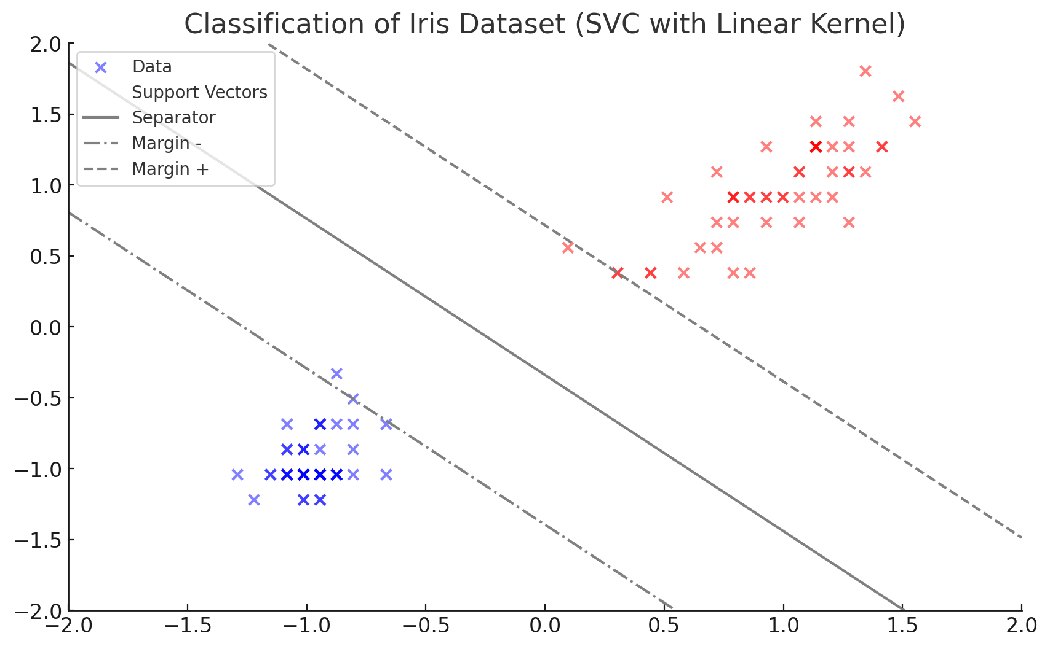
Why?
Analyzing data is often easier through visualizations
The matplotlib library allows users to make different types of graphs
3 parts to a graph
Figures are the backgrounds which everything lies upon
Axes contain the different axes, labels, titles, and gridlines
Plots/subplots are the visual representations of data and includes line charts, bar charts, and scatter plots

Slide 3
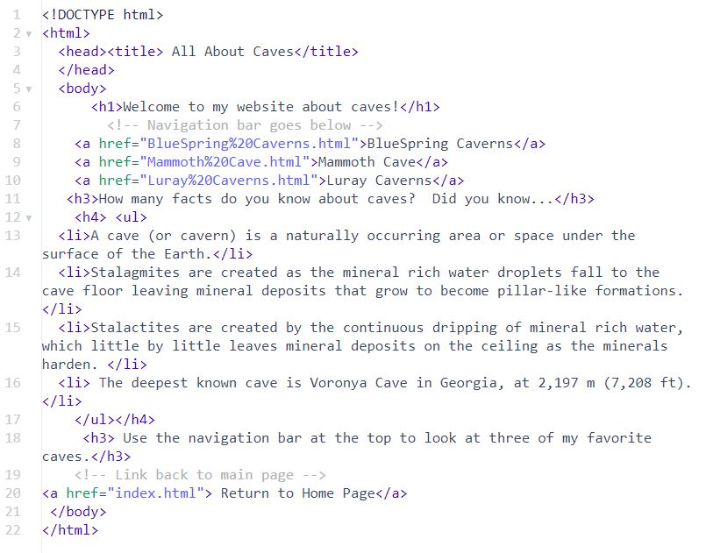
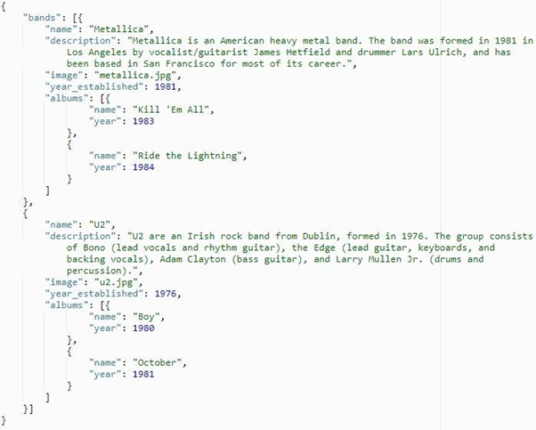
HTML & JSON
Web requests are going to be answered in one of two formats (most likely): HTML or JSON
HTML is a markup language (hence the ML) that is used to display the vast majority of web pages
- Not neatly formatted. Significantly harder to parse since it is inconsistently defined & implemented
JSON is basically a way to describe a dictionary or array through text
- Easy to parse. For this reason, APIs will usually be in JSON

Slide 4
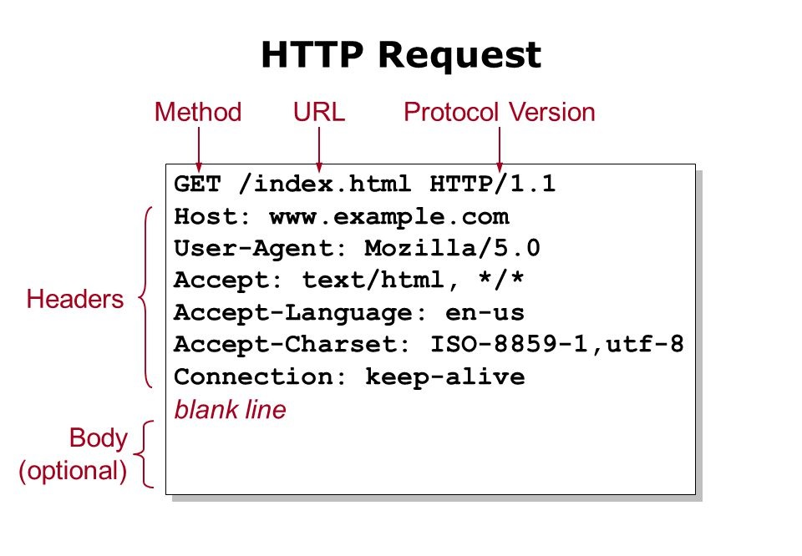
request & urllib
request is a simple library for making HTTP(S) requests
Can be as simple as requests.get(url)
Can be used to read either json or html
urllib3 is a lower level library for more complex/more specific requests.
You can see by the code we’ll look at that it is a little more complex than requests. But it gives you more flexibility over the requests you make!
If you search for urllib, the first page is docs to a previous version. These are the correct docs: https://urllib3.readthedocs.io/en/1.26.x/

Slide 5
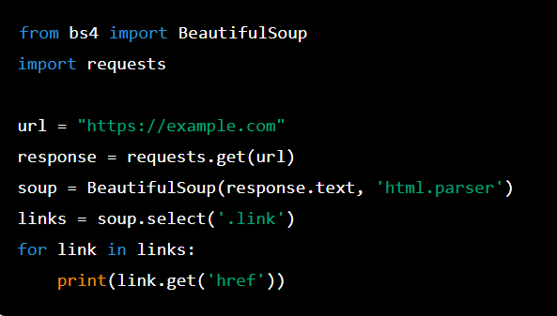
Beautiful soup
beautifulsoup, also called bs4, is a library to help parse html.
You can either feed bs4 with an open file or a string containing html code
Can be combined with request/urllib3 to parse pages on the internet
Very complex library that is immensely useful for web scraping

Slide 6
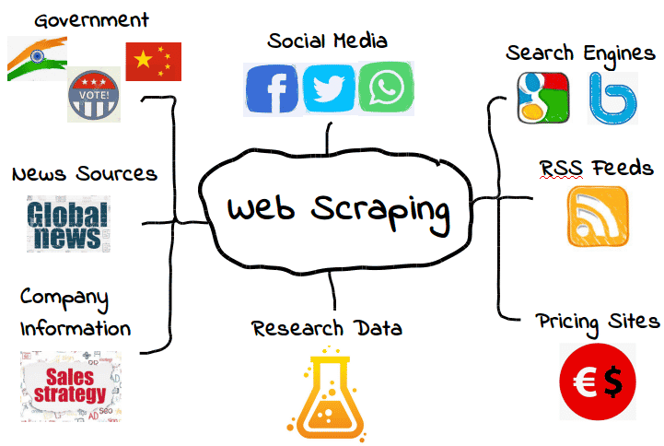
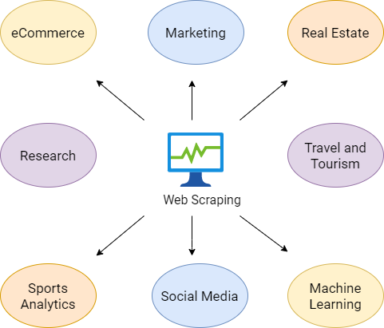
Applications
HTML requests are the basis of the modern web
request and urllib are two useful libraries to get data from the Internet
BS4 can help you parse poorly-formatted HTML data

Slide 7
The End!
Thank you!

