Slide 1


FinTech @ IU Python Session #6 – Web & ML
Prepared by
Cameron Nelson
Fund Equities Lead– FinTech @ IU
https://www.linkedin.com/in/cameron-j-nelson/
Gabriel Shores
Director of Technology – FinTech @ IU
https://www.linkedin.com/in/gabriel-shores-379b81291/
11/08/2024

Slide 2

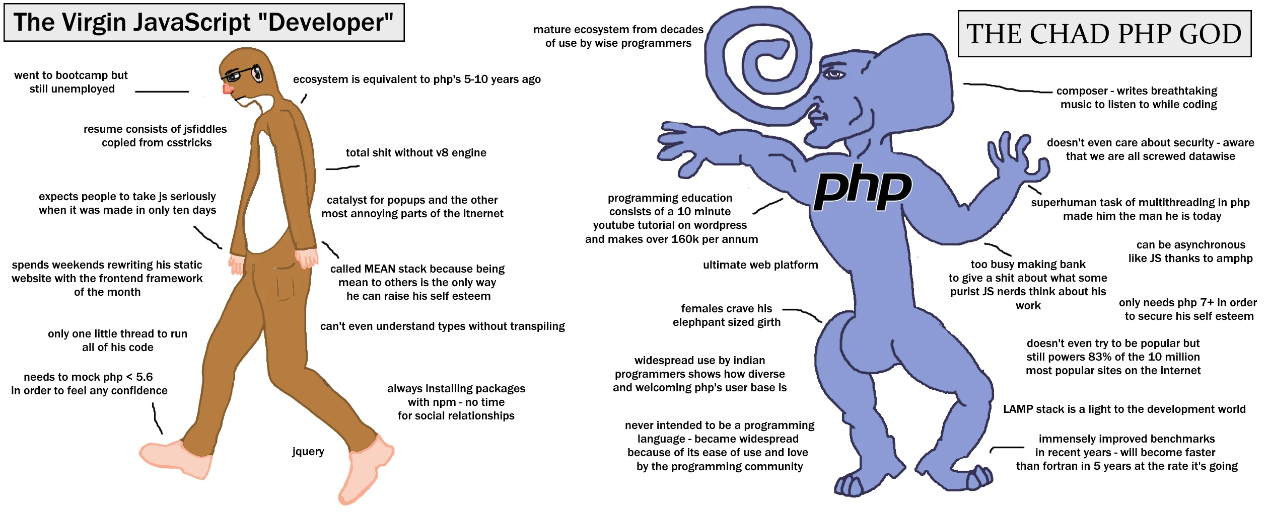
Why?
Web dev: Building your own website is rewarding on its own, but if you ever want to found a startup you are more likely than not to end up writing code that takes some kind of requests from the web, even if it’s just an API not truly what we think of as websites
Machine learning: Should be self-evident enough with the rise of AI, but being better able to harness the power of data leads to better outcomes

Slide 3


Flask
Flask is a python library to build webpages
Supports routing, templating, cookies, GET/POST/PUT requests, redirects, & more
Easy to get started, but offers a ton of flexibility to the programmer
Often used with nginx
Some websites that use Flask

Slide 4
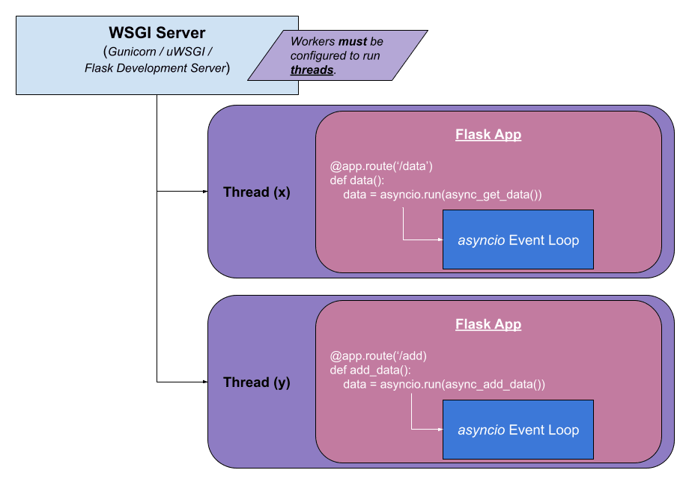
Routes
Routes allow you to tell flask what pages should be available to the web (‘/’, ‘/login’, etc.)
Created by putting @app.route(path, methods=[‘GET’]) one line above a function that returns the content of a page as a string

Slide 5
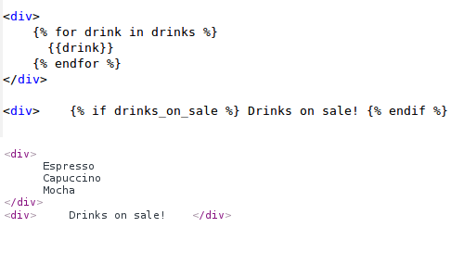
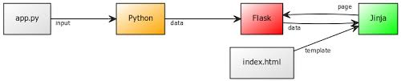
Jinja templating
Jinja is a library commonly used alongside flask to format HTML pages.
Instead of using f’strings or concatentating strings to each other, we can use templating to fill changing data to a mostly static webpage more easily

Slide 6
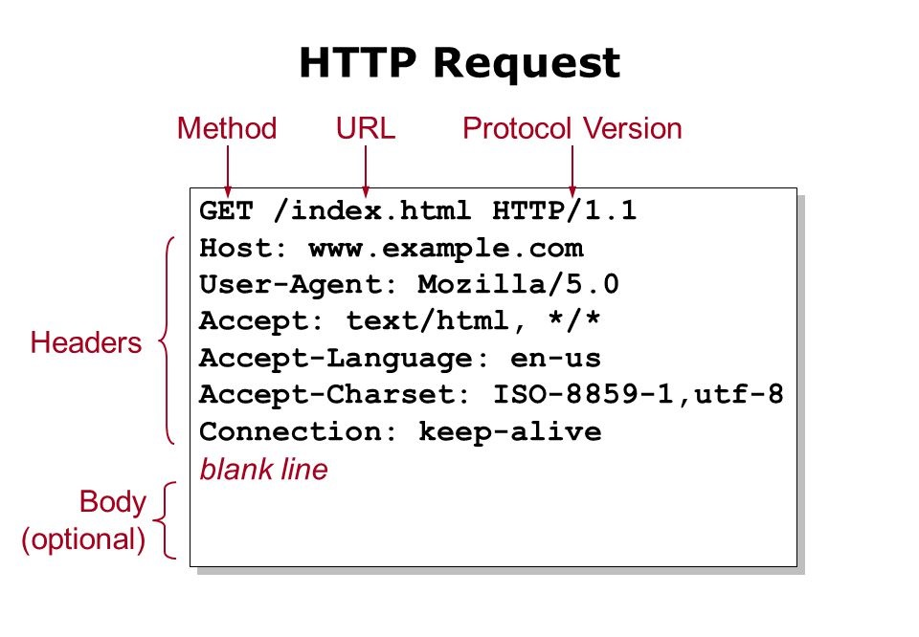
Handling request methods
GET requests for short parameters & insecure data. Args added to end of url
request.args.get(‘param_name’)
POST requests are used for larger requests, file upload, & contexts where the data must be secured like login screen where you receive a user’s password. Data sent in body of HTTP(s) request
request.form.get(‘param_name’)

Slide 7

scikit-learn
A python library for machine learning
Open source
Allows you to do classification, regression, clustering, and other types of analysis
Used by tons of big companies
https://scikit-learn.org/stable/testimonials/testimonials.html

Slide 8
The End!
Thank you!

