Slide 1


FinTech @ IU Python Session #6 – Web & ML
Prepared by
Cameron Nelson
Fund Equities Lead– FinTech @ IU
https://www.linkedin.com/in/cameron-j-nelson/
Gabriel Shores
Director of Technology – FinTech @ IU
https://www.linkedin.com/in/gabriel-shores-379b81291/
11/08/2024

Slide 2


Why?
Data could not be more important
The internet has a significant amount of data, some that isn’t neatly formatted for you (or the nearly formatted version is behind a paywall)
The web is also really important, and knowing how to interact with it in Python will enable you to write more interesting programs

Slide 3


Flask
Flask is a python library to build webpages
Supports routing, templating, cookies, GET/POST/PUT requests, redirects, & more
Easy to get started, but offers a ton of flexibility to the programmer
Often used with nginx
Some websites that use Flask

Slide 4
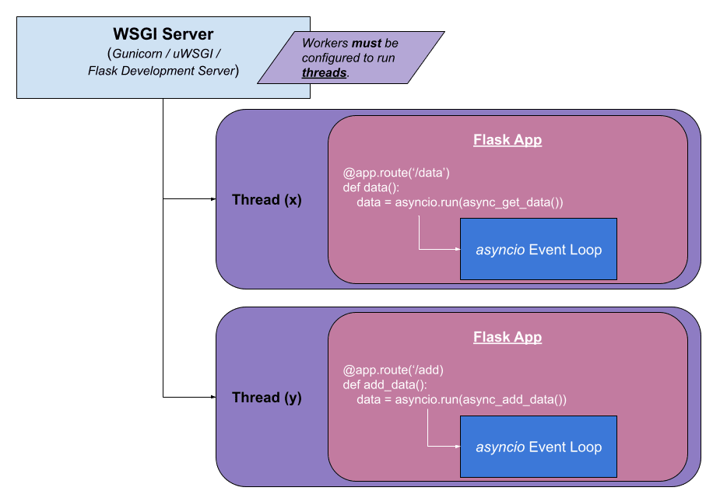
Routes
Routes allow you to tell flask what pages should be available to the web (‘/’, ‘/login’, etc.)
Created by putting @app.route(path, methods=[‘GET’]) one line above a function that returns the content of a page as a string

Slide 5
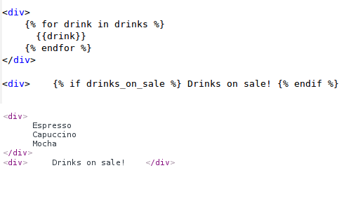
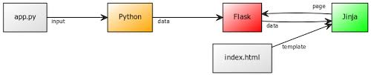
Jinja templating
Jinja is a library commonly used alongside flask to format HTML pages.
Instead of using f’strings or concatentating strings to each other, we can use templating to fill changing data to a mostly static webpage more easily

Slide 6
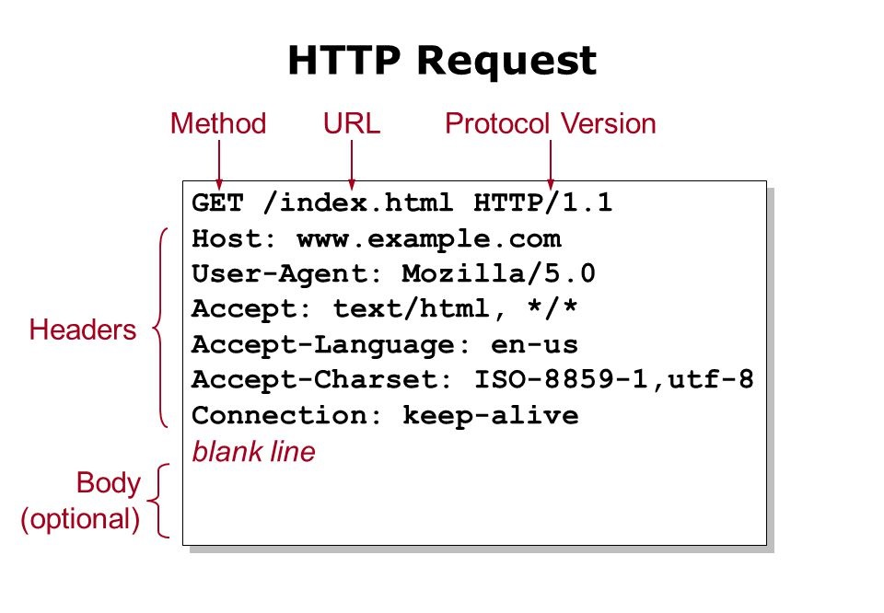
Handling request methods
GET requests for short parameters & insecure data. Args added to end of url
request.args.get(‘param_name’)
POST requests are used for larger requests, file upload, & contexts where the data must be secured like login screen where you receive a user’s password. Data sent in body of HTTP(s) request
request.form.get(‘param_name’)

Slide 7
The End!
Thank you!

