Slide 1


FinTech @ IU Python Session #4 – Libraries & Algorithms
Prepared by
Gabriel Shores
Director of Technology – FinTech @ IU
https://www.linkedin.com/in/gabriel-shores-379b81291/
Cameron Nelson
Fund Equities Lead– FinTech @ IU
https://www.linkedin.com/in/cameron-j-nelson/
10/18/2024

Slide 2
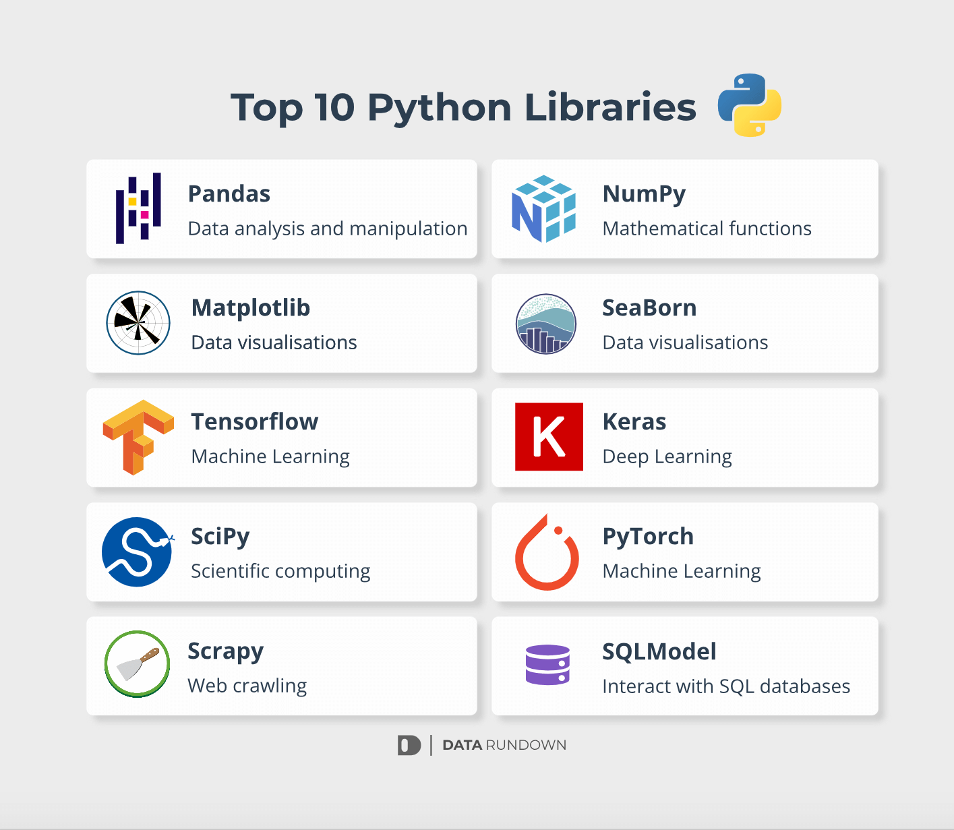
What are Libraries
Allows us to compartmentalize code
Makes programs more scalable
There are people who have written code for you. So use it!
Python provides several built-in libraries, 2 of which we’ll talk about today

Slide 3
csv (built-in library)
Gives us an easy way to interact with CSV (comma-separated values) files
Can read files row by row into arrays: “demo@email.org, notarealpassword” → [“demo@email.org”, “notarealpassword”]
Or into dicts: We’ll examine this in our code examples
CSV data is very common. Along with JSON, this will constitute a large amount of data you will see online - Sometimes data can be delimited (separated) with other characters, like tabs or | (pipes). But the csv library also can read these files, only by changing one argument
Can read/write in Excel, making it easy to edit

Slide 4
datetime (built-in library)
Allows us to convert to/from strings that describe dates to time objects
Like in Excel, dates in Python are represented numerically
To compare dates, calculate the difference between dates, etc., we cannot use dates in a string form
But sometimes we are given a date as a string and want to do operations with it, or print out that date after we do those operations
Further reading on programmatic date formatting: https://man7.org/linux/man-pages/man1/date.1.html

Slide 5
The End!
Thank you!

