Slide 1


FinTech @ IU Python Session #2 – Basics
Prepared by
Gabriel Shores
Director of Technology – FinTech @ IU
https://www.linkedin.com/in/gabriel-shores-379b81291/
09/27/2024

Slide 2
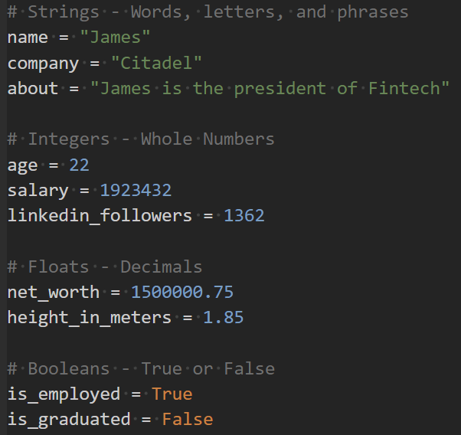
Variables
Variables have two parts: their name and value
Variables can be assigned and declared as such:
Variables can be reassigned new values
Python convention is to name_variables_like_this
Four main types right now: Strings, Integers, Floats, Booleans
Let’s dive in some more!

Slide 3
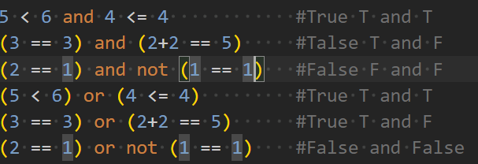
More on Booleans/Conditionals
Statements using >,>=,<,<=,==,evaluate to Boolean values, True or False
Chaining multiple statements with and / or creates more complex logic
Using not negates a statement: not True = False, not False = True

Slide 4
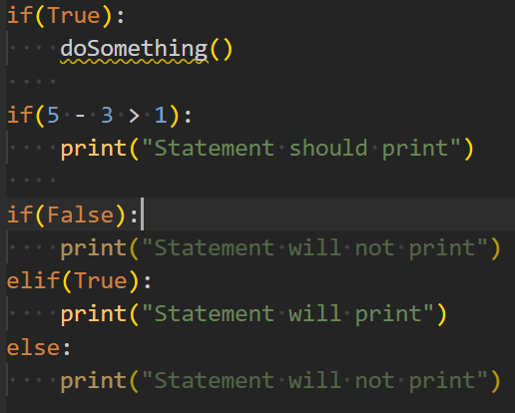
More on Booleans/Conditionals
If statements evaluate a block of code if the statement is true
elif executes only if the previous statements were false, and its statement is true
else executes if all previous statements evaluated to false
Following logic needs to be indented

Slide 5
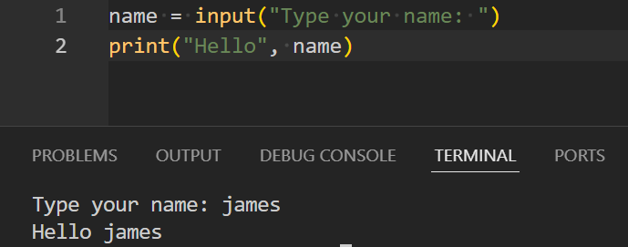
Input!
Much like with print(), we can use input(“string”)
Input will print out the given string and then take in responses via the terminal
Let’s try it all out!

Slide 6


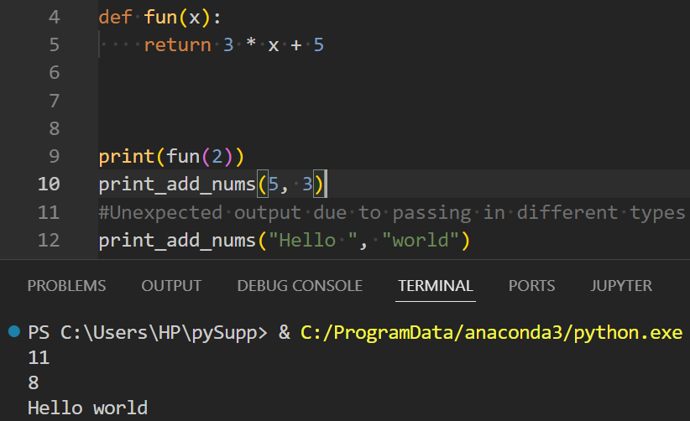
Functions!
Think, back to math, functions can take in inputs (parameters) and return an output
Let’s say we want to model f(x) = 3x+5 in code →
Functions also can have no variables or no return →
Output →

Slide 7
The End!
Next session we should be finishing up with Python basics, allowing us to dive into more workshop-styled sessions
Sites like EdaBit allow you to practice the basics of Python through solving problems
Other good resources include FreeCodeCamp and Codecademy
Feel free to reach out if you ever need any help
See you next time!

