Slide 1

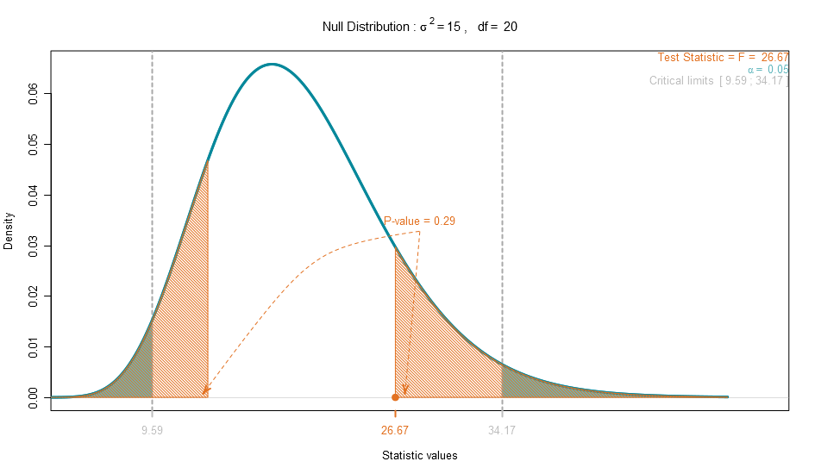
Plothtests
http://hexb.in/sticker.html
Plothtests

