Slide 1



ML PROJECT
FBI Crime Analysis

Slide 2


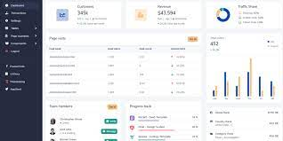






FBI – Crime Data Explorer
Server
Data Visualization
Supervised Machine Learning
Munging
Dashboard
HTML
RSD
(database-crime)
Training 75%
&
Testing 25%
Dashboard
ETL
ETL
SYNC
Texas Data
(2017-2020)
GitHub
(Organization Repo)
Storytelling
Efficiency of Algorithms

