Slide 1
Integrated Healthcare portal/app
PIP104 University Project-II
Review-1
Batch Number:
Roll Number | Student Name
20201CEI0141 | GEBIN B TOM
20201CEI0145 | AKASH M
20201CEI0146 | G HARSHAVARDHAN REDDY
20201CEI0137 | TANGUTURI AZAHAR
20201CEI0127 | PARVON SANTHAN
Under the Supervision of,
Mr.Muthuraju V
Assistant Professor
School of Computer Science & Engineering
Presidency University

Slide 2
Introduction
An integrated healthcare portal is a transformative digital solution that revolutionizes the way healthcare is delivered, managed, and experienced.
This innovative platform serves as a centralized hub connecting patients, healthcare providers, and various healthcare services in a seamless and efficient manner.
By merging cutting-edge technology, medical data, and communication tools, the integrated healthcare portal brings about a new era of healthcare accessibility, coordination, and patient engagement.
In an increasingly complex and data-driven healthcare landscape, the need for a unified and comprehensive healthcare portal has become paramount.
Patients expect convenient access to their medical records, the ability to schedule appointments, and a platform for secure communication with their healthcare providers.
On the other hand, healthcare professionals require efficient tools for managing patient care, accessing critical medical information, and collaborating with colleagues.

Slide 3
Literature Review
Paper Title | Published Year | Methodology Used | Advantages | Disadvantages
Engineering a software supported health risk methods | 2019 | Software based health risk assessment | To identify the risk involved in the early stage to avoid unnecessary suffering | Continues collection and analysing the health data
The need for outcome research | 2020 | RAD | Reduce preventable medical errors | Improvement in technology related policy
Key aspects of implementation | 2020 | Phenomenology | Early event detection information | Implementation of high-end detection software's

Slide 4
Literature Review
Paper Title | Published Year | Methodology Used | Advantages | Disadvantages
An analysis of the health care platform in the cloud environment | 2012 | Analysis | Scalability | Data security concerns
Integrating cloud computing in E-healthcare | 2021 | Comparative Analysis | Cost reduction , improved health care services. | Data security and system reliability challenges
Health care technology management applied to public primary care health | 2021 | Healthcare-Tech-management | impactful | limited

Slide 5
Literature Review
Paper Title | Published Year | Methodology Used | Advantages | Disadvantages
g
Development of Smart Elderly Care Mobile Application for Health Management System
Improved elderly health care management
Technology Adaptation barrier (digital literacy)
2022
Online Survey
Access to Smartphones and Technology Adaptation Barrier
U-Care for the elderly
Research & Analysis
User Friendly Interface,
Cost Effective
2007
e-Health networking to cater to Rural Health Care
and Health Care for the Aged
2007
Analysis
Lack of Detailed Simulation Information
Innovative Solution

Slide 6
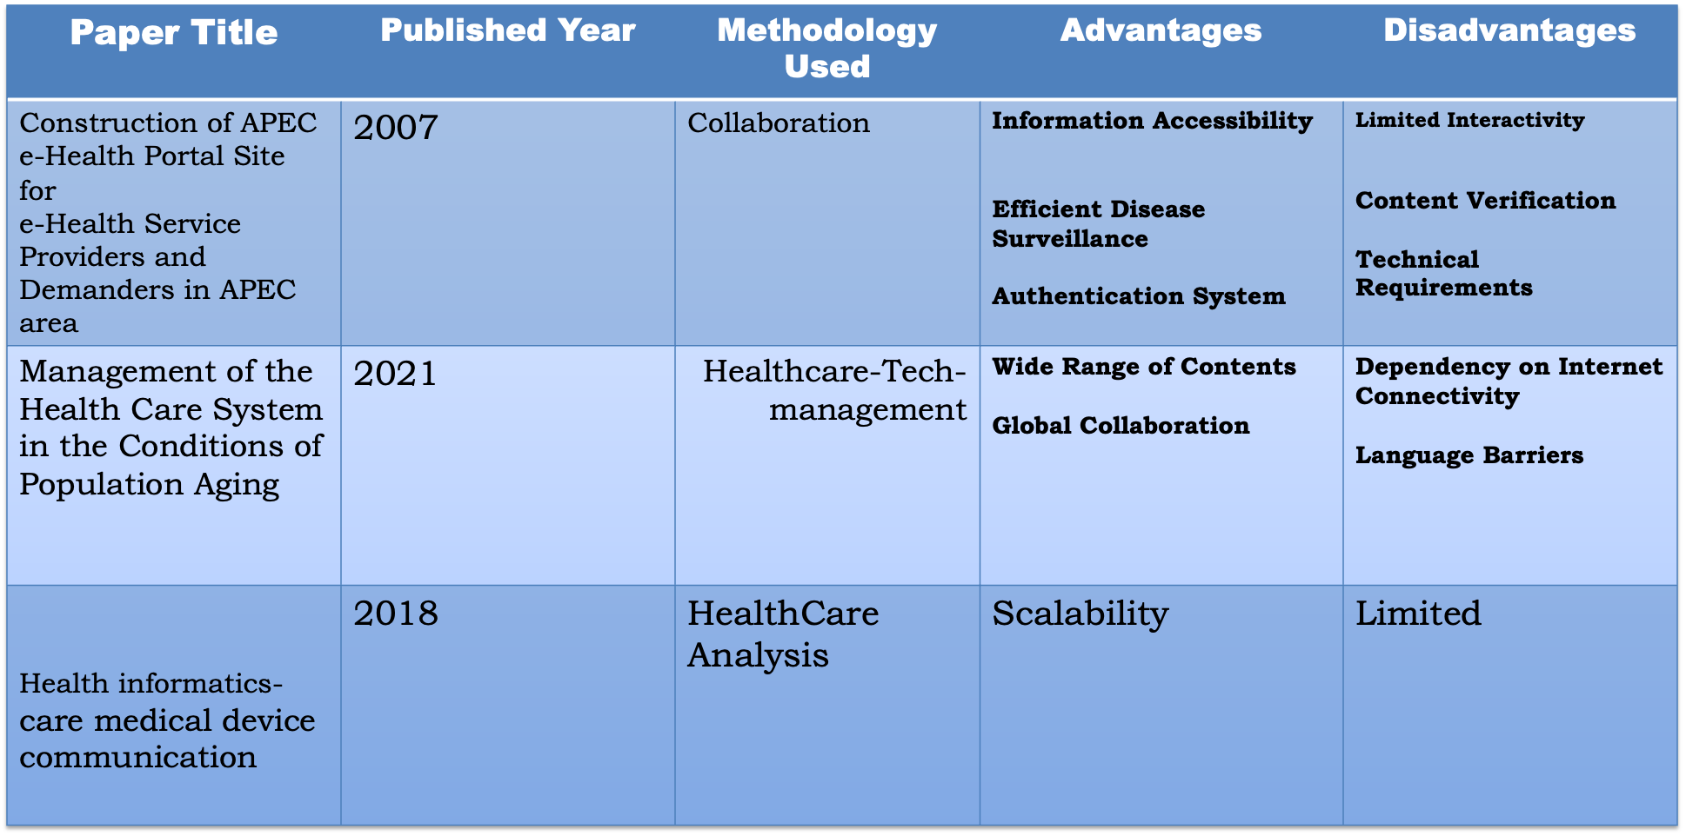
Literature Review
Paper Title | Published Year | Methodology Used | Advantages | Disadvantages

Slide 7
Literature Review
Paper Title | Published Year | Methodology Used | Advantages | Disadvantages

Slide 8
Proposed Method
Needs Assessment and Goal Setting - Identify the specific needs, goals, and objectives of the integrated healthcare portal. This stage involves engaging healthcare providers, administrators, patients, and other stakeholders to understand their requirements.
Regulatory Compliance - Ensure that the portal complies with healthcare regulations Complying with regulations is critical to safeguard patient data.
Stakeholder Engagement - Involve healthcare professionals, administrative staff, patients, and other stakeholders in the planning and development process. Gather their input to inform the portal's design and functionality.
User Experience (UX) Design - Design an intuitive and user-friendly interface that caters to the needs of both healthcare providers and patients. Focus on accessibility and mobile responsiveness

Slide 9
Objectives
Enhanced Patient Engagement - Empower patients to actively participate in their healthcare by providing easy access to their medical records, test results, and treatment plans. Enable patients to schedule appointments, request prescription refills, and communicate securely with healthcare providers.
Improved Communication and Collaboration: - Facilitate secure and efficient communication among healthcare professionals, allowing for better coordination of care and quicker decision-making. Support multidisciplinary teams and improve care continuity.
Efficient Healthcare Management - Streamline administrative processes by offering appointment scheduling, billing and payment functions, and insurance coordination.Simplify healthcare access and management for patients and providers.
Telehealth Integration - Incorporate telehealth capabilities for virtual consultations and remote monitoring, increasing access to care, especially in remote or underserved areas.

Slide 10
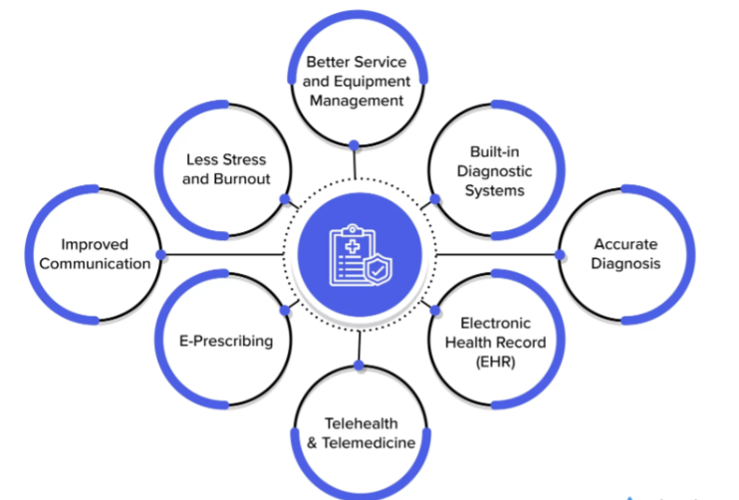
Methodology

Slide 11
Methodology
Needs Assessment and Planning - Identify the primary goals and objectives of the portal. Conduct a thorough needs assessment to understand the requirements of healthcare providers, patients, and other stakeholders.Develop a detailed project plan with timelines, resource allocation, and budget considerations.
Compliance and Regulation - Ensure that the portal complies with healthcare regulations, such as HIPAA (in the United States) or GDPR (in the European Union).Define and implement security and privacy measures to protect sensitive patient data.
Stakeholder Engagement - Engage healthcare providers, administrators, patients, and other stakeholders in the development process to gather their input and requirements.
User Experience (UX) Design - Design an intuitive and user-friendly interface that caters to the needs of both healthcare providers and patients. Focus on accessibility and mobile responsiveness to ensure the portal is usable across various devices.

Slide 12
Timeline of Project
Project Initiation Literature Review Requirement Collection
Requirement preprocessing and optimization
Selected App Implementation
App
Optimization
Performance Evaluation
Integration
Preparing Final Report
Live Demo
Project Submission
REVIEW - 1
REVIEW - 2
REVIEW - 3
REVIEW - 4

Slide 13
Expected Outcomes
Improved Patient Engagement - Patients become more actively engaged in their healthcare by having easy access to their medical records, test results, and treatment plans.Patients can conveniently schedule appointments, request prescription refills, and communicate securely with their healthcare providers.
Enhanced Communication and Collaboration - Healthcare professionals can communicate securely and efficiently, leading to better coordination of care and more informed decision-making.Collaboration among multidisciplinary teams is improved, supporting better care continuity.
Efficient Healthcare Management - Streamlined administrative processes reduce the time and resources required for appointment scheduling, billing, and insurance coordination. The portal simplifies healthcare access and management for both patients and providers.
Telehealth Integration - The inclusion of telehealth capabilities extends the reach of healthcare services, enabling virtual consultations and remote monitoring, especially in underserved or remote areas.

Slide 14
Conclusion
The integrated healthcare portal stands as a pivotal solution in the evolving landscape of healthcare delivery.
As we navigate the complexities of modern medicine, this digital platform represents a beacon of innovation, enhancing the quality of care, patient engagement, and overall healthcare efficiency.
Through seamless integration of technology, medical data, and communication tools, integrated healthcare portals offer a myriad of benefits to both patients and healthcare providers, fostering a paradigm shift in healthcare accessibility and coordination.
.

Slide 15
References
Shortell SM, Addicott R, Walsh N, Ham C. The NHS Five Year Forward View: lessons from the United States in developing new care models. BMJ 2015;350:h2005. 10.1136/bmj.h2005 [PubMed] [CrossRef]
Long T, Khan AM, Chana N. Achieving better value: primary care must lead on population health. Postgrad Med J 2015;91:59–60. 10.1136/postgradmedj-2015-133264 [PubMed] [CrossRef]
Ham C, Muray R. Implementing the NHS Five Year Forward View: Aligning Policies with the Plan. London: The King’s Fund; 2015
Ahmed F, Mays N, Ahmed N, Bisognano M, Gottlieb G. Can the Accountable Care Organization model facilitate integrated care in England? J Health Serv Res Policy 2015;20:261–4. 10.1177/1355819615590845 [PubMed] [CrossRef]
Robertson H. Integration of Health and Social Care: A Review of Literature and Models – Implications for Scotland. Edinburgh: Royal College of Nursing; 2011.

Slide 16
Thank You

