Slide 1

BMS INSTITUTE OF TECHNOLOGY & MANAGEMENT,
YELAHANKA, BANGALORE.
Department of Computer Science & Engineering
PROJECT TITLE ATTENDANCE SYSTEM USING FACIAL RECOGNITION
STUDENTS NAME(USN)
Abhilash S (1BY17CS005)
M Raja Rajeswari (1BY17CS093)
Ramya B G (1BY17CS133)
Keerthana T A (1BY18CS407)
UNDER THE GUIDANCE OF
Mrs. Chethana C
Assistant Professor, CSE
BMSIT&M, 2020-21

Slide 2
CONTENT
Abstract
Requirement Analysis
System Design
References

Slide 3
ABSTRACT
The Management of the Attendance can be a great burden on the teachers if it is done by hand.
To resolve this problem, smart and auto attendance management system is being utilized.
By utilizing this framework, the problem of proxies and students being marked present even though they are not physically present can easily be solved.
The Open CV based face recognition approach has been proposed.
This model integrates a camera that captures an input image, an algorithm for detecting face from an input image, encoding and identifying the face, marking the attendance in a spreadsheet.

Slide 4
ABSTRACT
The Training dataset is created by training the system with the faces of the authorized students.
The cropped images are then stored in a Folder.
The features are extracted using HOG(Histogram Of Oriented Gradient) algorithm.
This model will be a successful technique to manage the attendance of students.
This system saves time of marking attendance.
Notes:
<number>

Slide 5
REQUIRMENT ANALYSIS
Model : Facial recognition
Face recognition is the problem of identifying and verifying people by their face. Face recognition is a process comprised of detection, alignment, feature extraction, and a recognition task.
Method : Histogram of Gradient
The histogram of oriented gradients (HOG) is a feature descriptor used in computer vision and image processing for the purpose of object detection
Library : HOG uses OpenCV
The HOG feature descriptor counts the occurrences of gradient orientation in localized portions of an image. Implementing HOG using tools like OpenCV is extremely simple.
Notes:
<number>

Slide 6
REQUIRMENT ANALYSIS
Operating System : Ubuntu
Ubuntu is an open source Debian-based Linux distribution. Sponsored by Canonical Ltd., Ubuntu is considered a good distribution for beginners.
Coding Language : Python
Face-recognition library in Python can perform a large number of tasks: Find all the faces in a given image. Find and manipulate facial features in an image. Identify faces in images.
Backend/Framework : Django
Django is a collection of Python libs allowing you to quickly and efficiently create a quality Web application, and is suitable for both frontend and backend.
Notes:
<number>

Slide 7
REQUIRMENT ANALYSIS
Frontend : HTML, CSS and Javascript
These three main front-end coding languages are HTML, CSS and JavaScript. Together, they create the underlying scaffolding that web browsers use to render the web pages that we interact with every day.
Database : SQL
SQL is used to communicate with a database. According to ANSI (American National Standards Institute), it is the standard language for relational database management systems
Tools : Camera
The Camera is used to identify distinctive features on the surface of a face and it can track a subject's face in real-time and be able to face detect and recognize.
Notes:
<number>

Slide 8
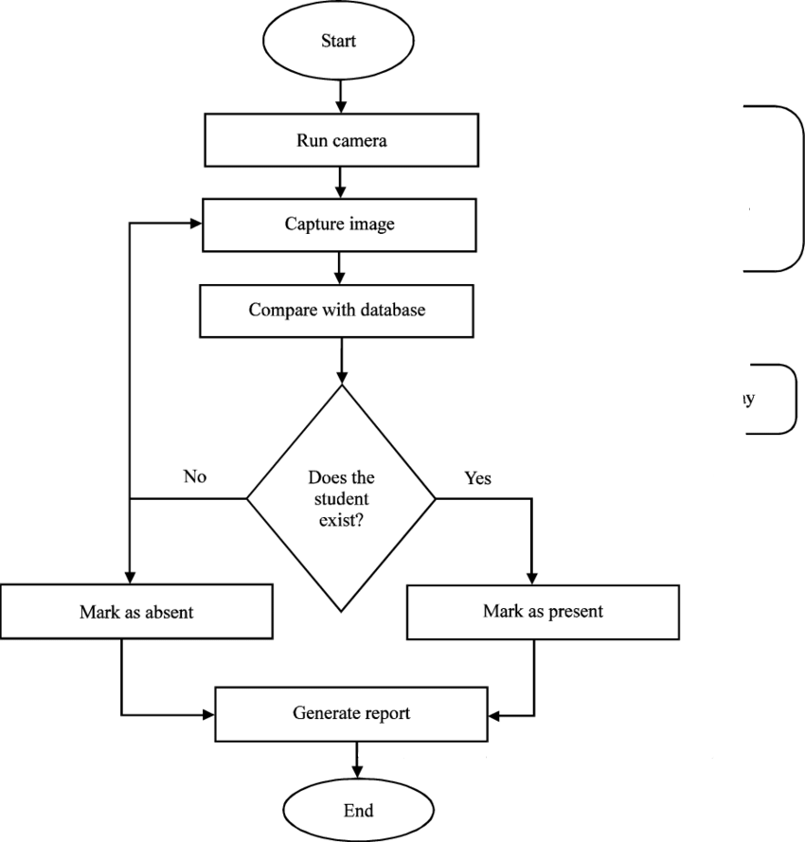
SYSTEM DESIGN
A. Data Flow Diagram

Slide 9
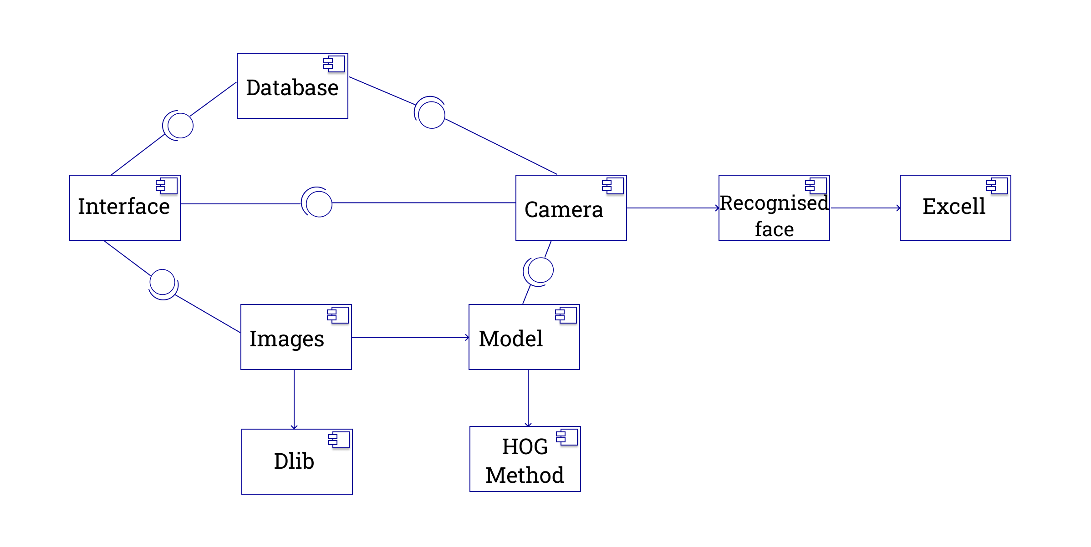
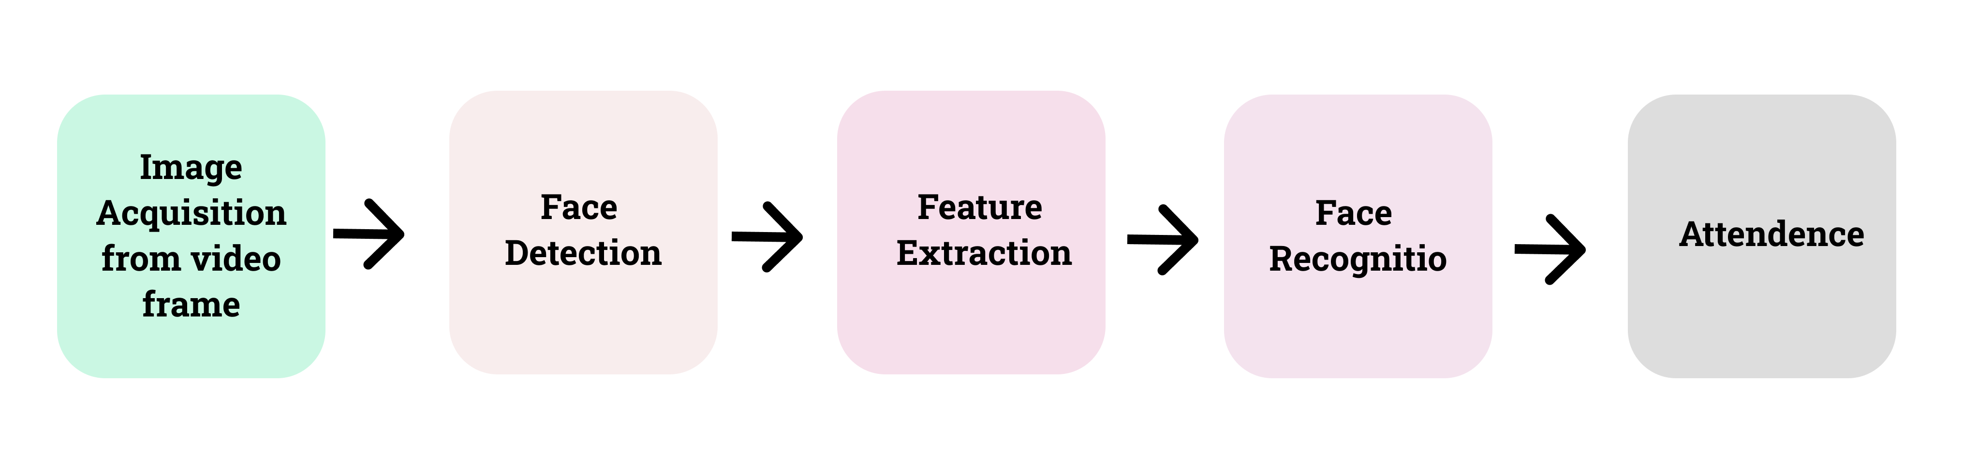
SYSTEM DESIGN
B. Architectural Design
Block Diagrams

Slide 10
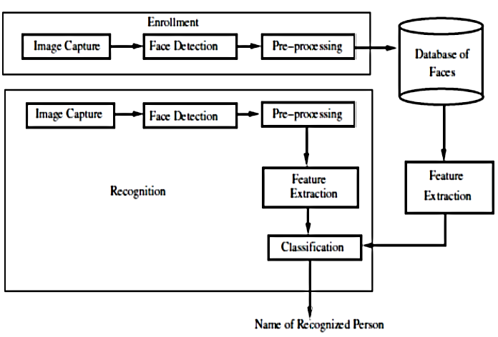
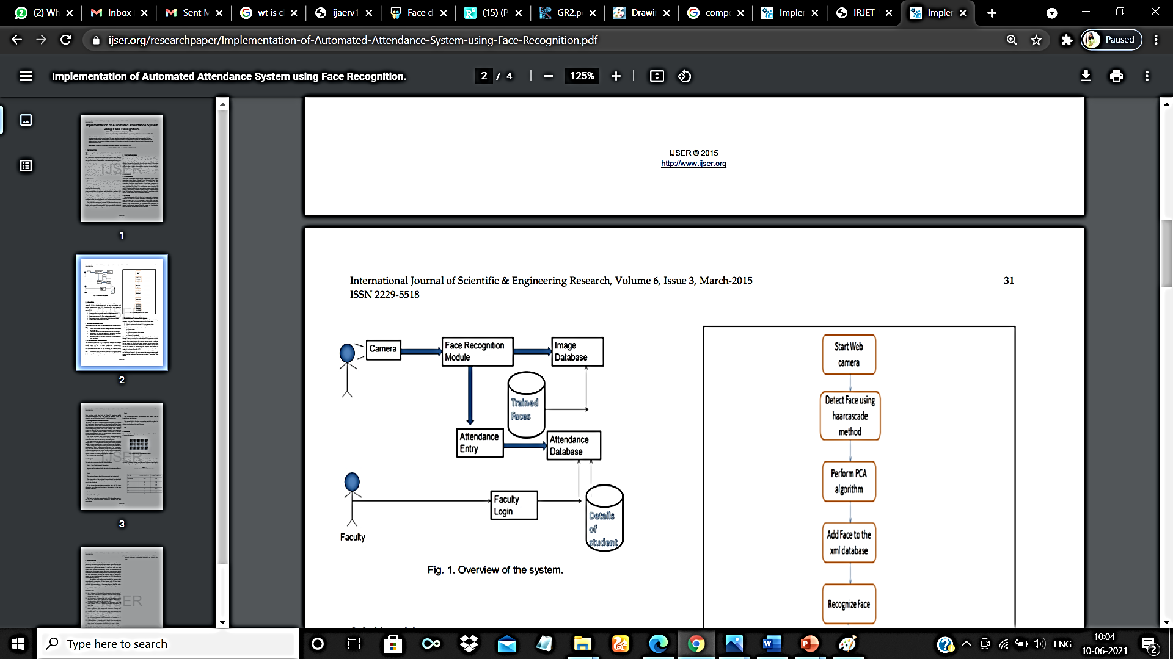
SYSTEM DESIGN
C. Component Design
Component Diagrams

Slide 11
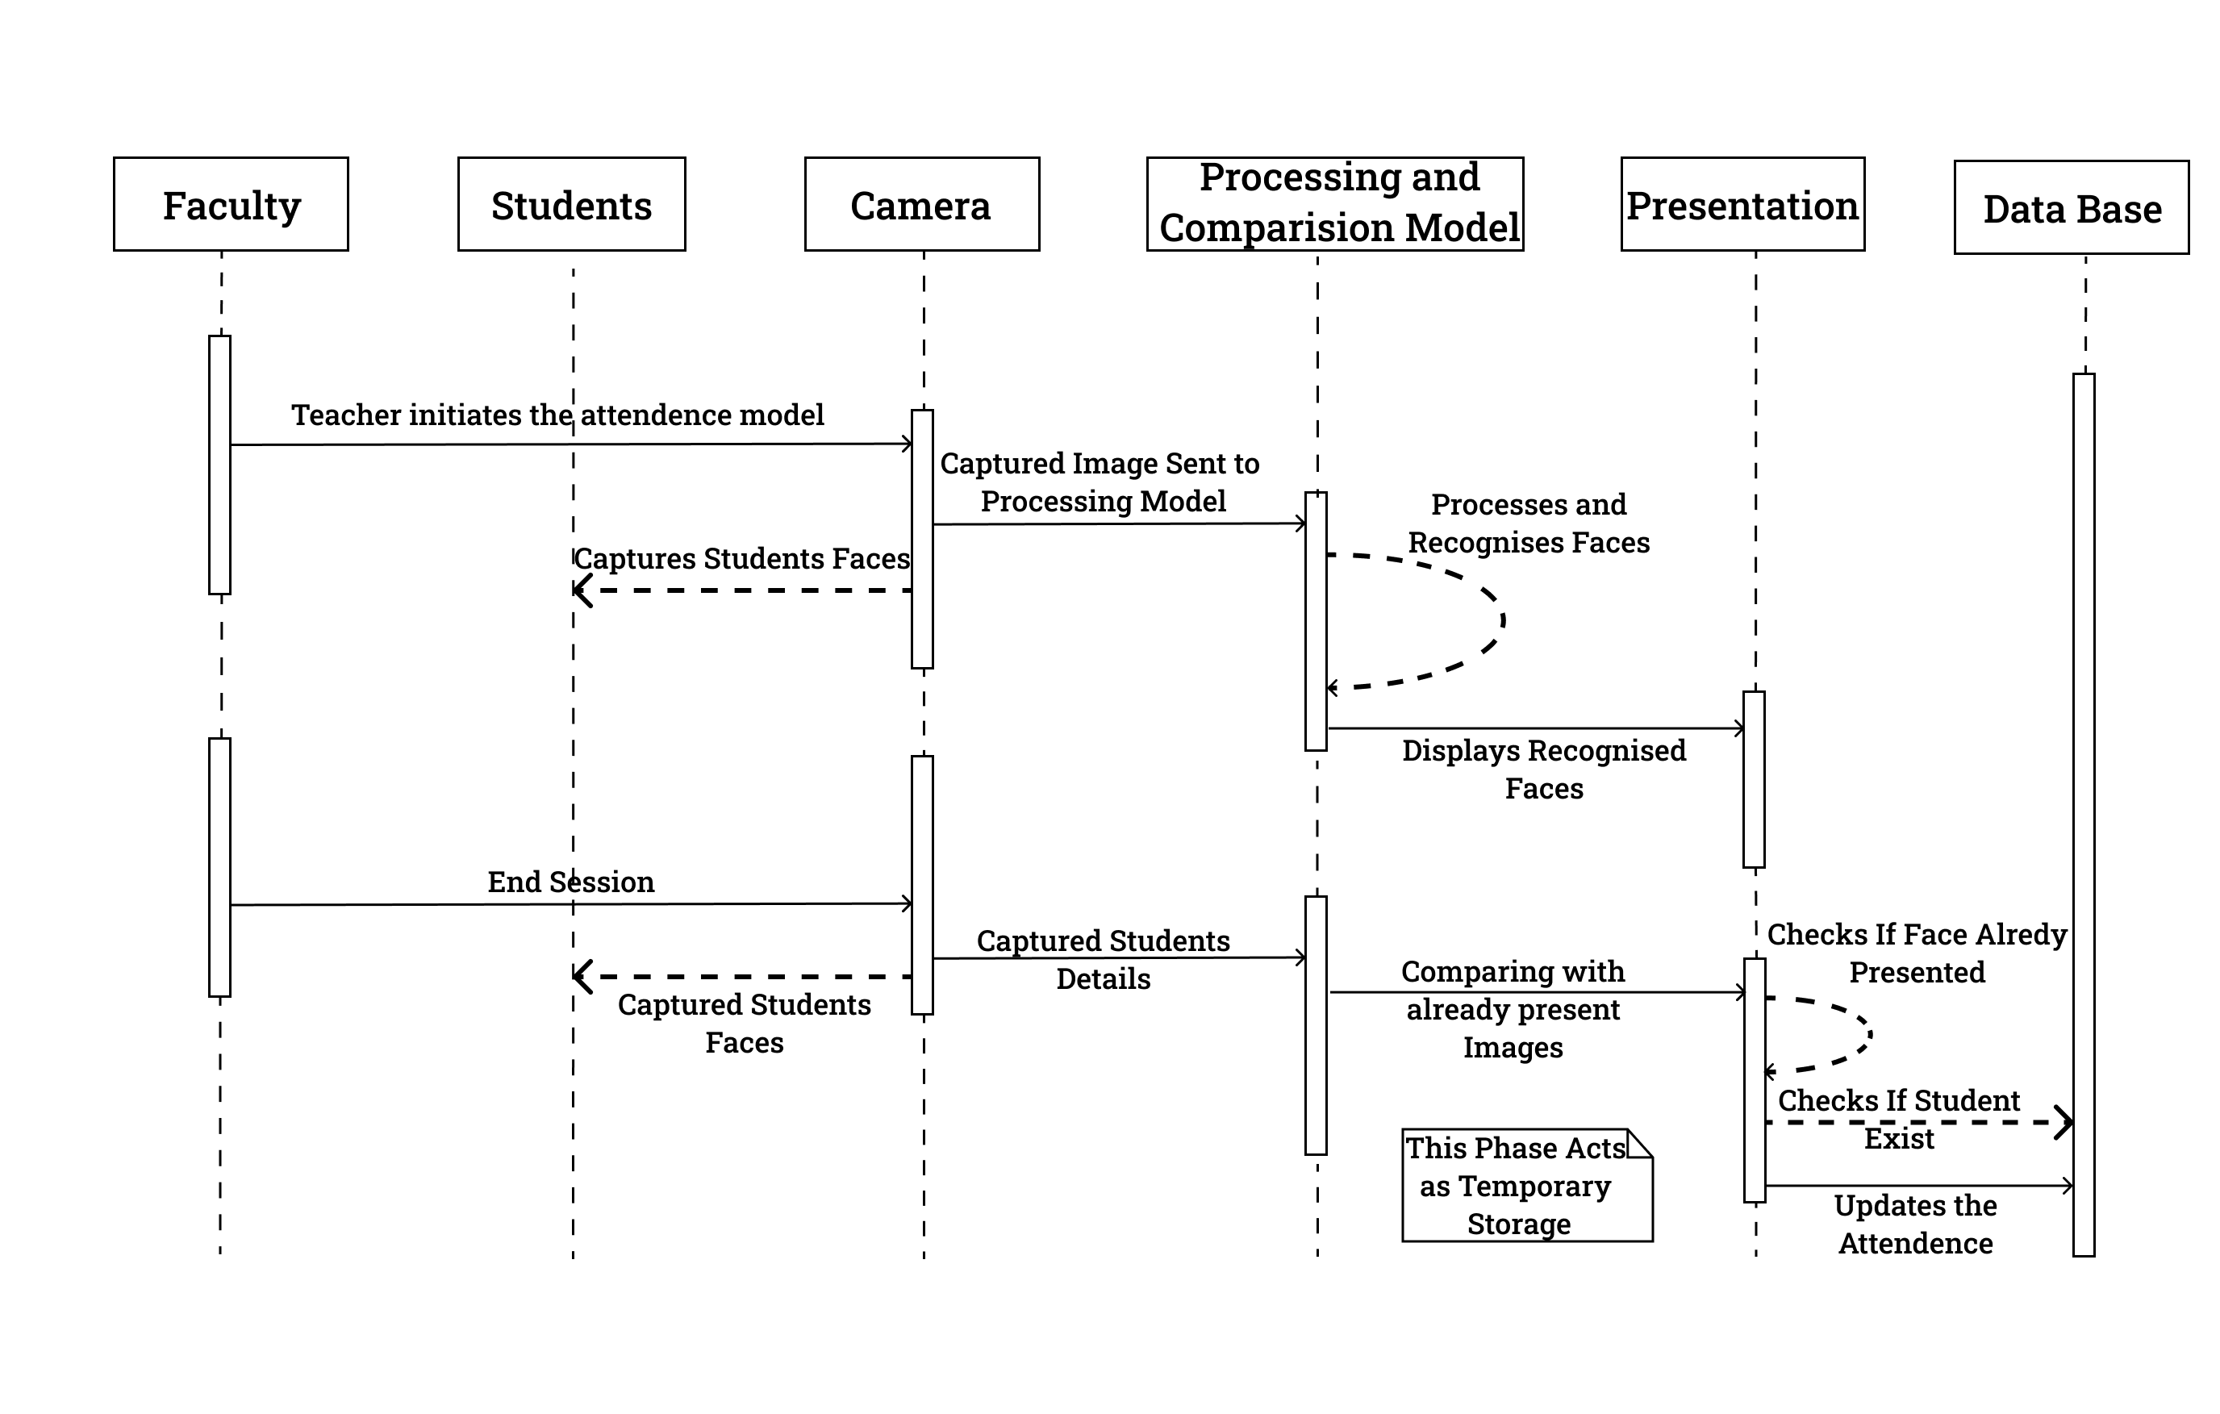
SYSTEM DESIGN
D. Behavioral Design
Sequence Diagram

Slide 12
REFERENCES
[1]
[2]
[3]
[4]
Tejas Vedak , Devanshu Sharma , Vedang Koli, 2021, Object Detection based Attendance System, INTERNATIONAL JOURNAL OF ENGINEERING RESEARCH & TECHNOLOGY (IJERT) Volume 10, Issue 04 (April 2021).
Dnyaneshwari Mahajan , Mangesh Limbitote , Kedar Damkondwar , Pushkar Patil, Madhura Kalbhor, 2021, Contactless Attendance for Employees using Different Techniques, INTERNATIONAL JOURNAL OF ENGINEERING RESEARCH & TECHNOLOGY (IJERT) Volume 10, Issue 01 (January 2021).
Tandrima Goswami, Divyanshi Sharma, Rahul Pratyush, Ankit Kumar, 2020, Attendance Monitoring System using Facial Recognition, INTERNATIONAL JOURNAL OF ENGINEERING RESEARCH & TECHNOLOGY (IJERT) ENCADEMS – 2020 (Volume 8 – Issue 10).
Sudhir Bussa , Ananya Mani , Shruti Bharuka , Sakshi Kaushik, 2020, Smart Attendance System using OPENCV based on Facial Recognition, INTERNATIONAL JOURNAL OF ENGINEERING RESEARCH & TECHNOLOGY (IJERT) Volume 09, Issue 03 (March 2020).
Notes:
<number>

Slide 13
REFERENCES
[5]
[6]
[7]
Akshay M P, Hemanth Kumar B S, Tejas N, Varun Kumar H S, Anisha P S, 2020, Smart Attendance System using DLIB, INTERNATIONAL JOURNAL OF ENGINEERING RESEARCH & TECHNOLOGY (IJERT) IETE – 2020 (Volume 8 – Issue 11).
Shyam Sunder Bahety, Kishan Kumar, Vishwadeep Tejaswi, Sharad R Balagar, Anil B C, 2020, Implementation of Automated Attendance System using Facial Identification from Deep Learning Convolutional Neural Networks, INTERNATIONAL JOURNAL OF ENGINEERING RESEARCH & TECHNOLOGY (IJERT) NCAIT – 2020 (Volume 8 – Issue 15).
Kumuda S, Meghashree M N, Harish S V, 2020, Smart Group Attendance Monitoring System using Face Recognition, INTERNATIONAL JOURNAL OF ENGINEERING RESEARCH & TECHNOLOGY (IJERT) NCCDS – 2020 (Volume 8 – Issue 13).
Notes:
<number>

Slide 14
REFERENCES
[8]
[9]
[10]
Suman Kumar Jha, Aditya Tyagi, Kundan Kumar, Madhvi Sharma, 2020, Attendance Management System using Face Recognition, INTERNATIONAL JOURNAL OF ENGINEERING RESEARCH & TECHNOLOGY (IJERT) ENCADEMS – 2020 (Volume 8 – Issue 10).
Sharanya T , Sucharith P , Trisheeka Mahesh , Ujwal Kasturi, Dhivya V, 2020, Online Attendance using Facial Recognition, INTERNATIONAL JOURNAL OF ENGINEERING RESEARCH & TECHNOLOGY (IJERT) Volume 09, Issue 06 (June 2020).
Helmi, R., Yusuf, S., & Jamal, A. (2019). Face recognition automatic class attendance system (FRACAS). In IEEE international conference on automatic control and intelligent systems (I2CACIS 2019), Selangor, Malaysia, June 29, 2019.
Notes:
<number>

Slide 15
THANK YOU

