Slide 1
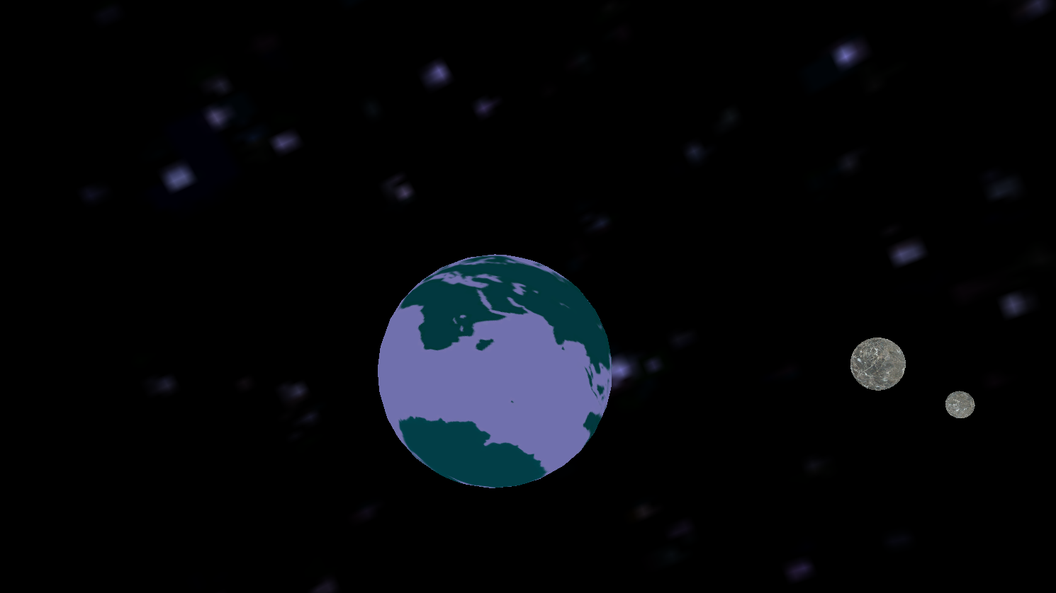
NIE2211 – Computer Games Programming 2 Semester 1 Assessment
By Oliver Sheard

Slide 2
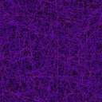
Texturing the skysphere
Applying the texture normally
Applying the texture to an inverted sphere
[Transforming by a scale of (-x,-y,-z)]

Slide 3
Creating orbital paths
X Position = cos(±rotation)
Y Position = sin(±rotation)
Y Position = cos(±rotation)
Z Position = sin(±rotation)
X Position = cos(±rotation)
Z Position = sin(±rotation)
Notes:
Changing any of the +rotation values to – will flip the path of the circle (CW->ACW) etc.
Multiplying the cos(theta) value enlarges the circle path, ellipses occur when one multiplier != the other
Adding to the rotation value shifts the phase in relation to other rotating values
Multiplying rotation (or dividing) changes the time taken to complete one rotation

Slide 4
Limiting the camera to a sphere
Distance from point (0,0,0) = √(xPosition^2+yPosition^2+zPosition^2)
If the magnitude is greater than what you wish the limit of movement to be:
Make a unit vector of the current position by dividing the x, y and z values by the magnitude
Multiply this vector by the limit of the sphere
Set the camera position to the new vector
Notes:
Pythagoras and Trig
By restraining the camera AFTER the movement update, the camera will slide around the edge of the sphere rather than jump about a little.

