Slide 1
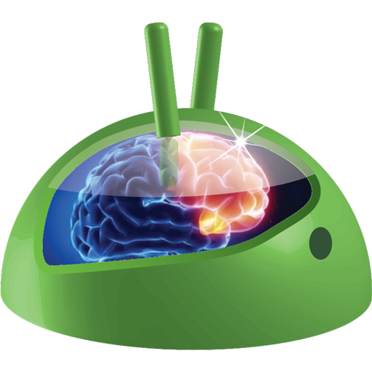


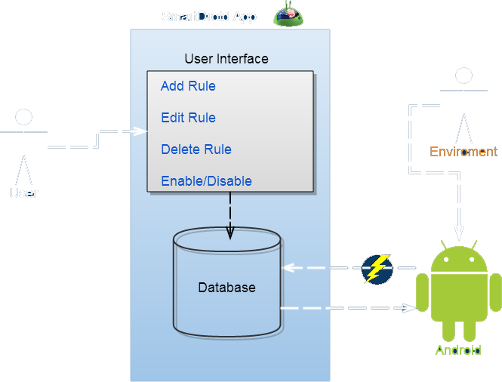

SmartDroid
Automation Application
for Android
Introduction
SmartDroid is an application that expose the smartphones abilities to react dynamically to event that occur manually by the user, internally by android OS or external events (location, time, light…).
Project Essence
Existing Solutions
Todays smartphones isn’t really smart as they can be.
Each time we need to set our device to a citrine state we do it manually.
The need of an automatic operation to save the time of the operation and make sure we will not forget for example, to silence our device when starting a meeting, seems very essence.
Tasker – Android app
Complex UI
On{X} – javascirpt API
- Require programming knowledge
Use Case
User add Rule contain Triggers and actions.
Rule saved locally.
External or Internal event occur.
Event is translated to Trigger.
Database is queried for Rules that contained the trigger.
All actions for the returned Rules are preformed.
1
3
2
4
6
5
SmartDroid Today
Providing the Ability to add/remove/edit
Triggers
Rules
Actions
Out going call to specific number.
Power connected/disconnected.
Boot completed.
User activity changes (still, walk, run).
Battery level low.
Ringer mode changed.
Change Bluetooth state.
Change Wi-Fi state.
Change ringer mode
Generate custom notification.
Change wallpaper.
Start specific application.
Change audio volume.
Supervisor : Dr. Levy Avivit
Presenters : Ran Haveshush & Lior Ginsberg

