Slide 1
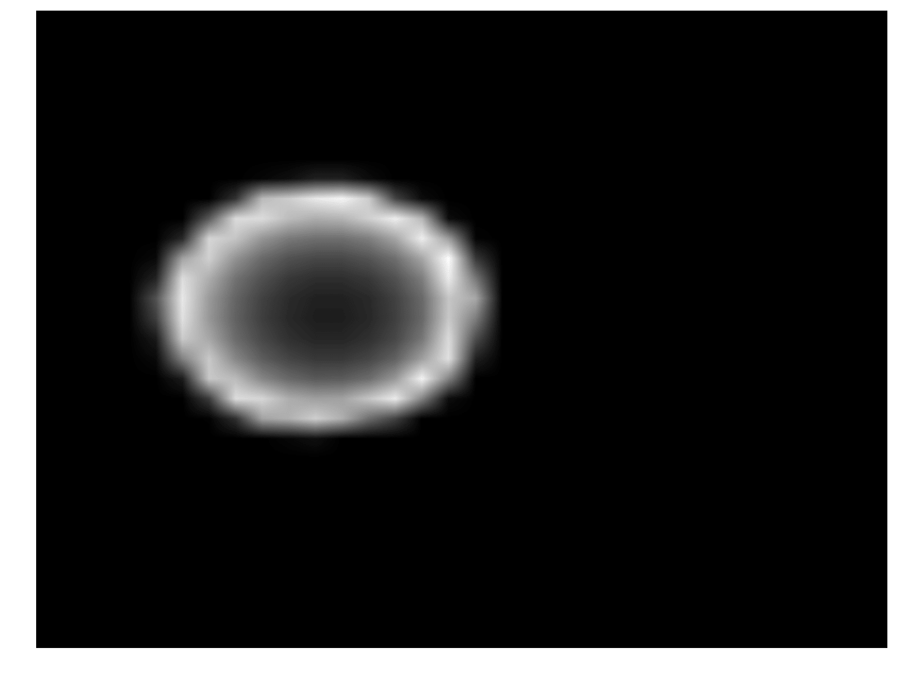
Conv
BN
Conv
Concat
MP
BN
Drop
GAP
Depth Image
Concat
FC
FC
Output
Z-Value
Notes:
Inception net

Slide 2
Conv
BN
Conv
BN
Conv
BN
Add
BN
Conv
BN
GAP
Depth Image
Concat
FC
Output
Z Value
Notes:
Res net

Slide 3
Conv
Max-Pool
Depth Image
Sum
Conv
Max-Pool
FC
FC
ReLu
Output
ReLu
ReLu
FC
Tile
Z Value
ReLu
Notes:
Andreas net

