Slide 1
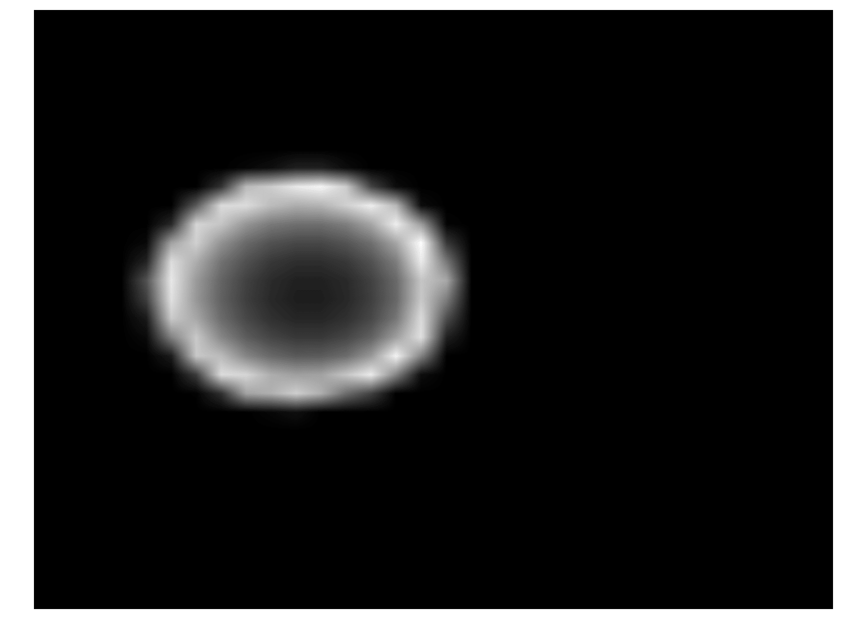
Conv
BN
Conv
Concat
MP
BN
Drop
GAP
Depth Image
Concat
FC
FC
Output
Z-Value
ARCHIVE
Notes:
Inception net

Slide 2
Conv
BN
Conv
BN
Conv
BN
Add
BN
Conv
BN
GAP
Depth Image
Concat
FC
Output
Z Value
ARCHIVE
Notes:
Res net

Slide 3
Conv
Max-Pool
Depth Image
Sum
Conv
Max-Pool
FC
FC
ReLu
Output
ReLu
ReLu
FC
Tile
Z Value
ReLu
ARCHIVE
Notes:
Andreas net

Slide 5
Conv
BN
Conv
Concat
MP
BN
Drop
GAP
ReLu
Depth Image
Concat
FC
FC
ReLu
ReLu
Output
ReLu
SM
Z-Value
Notes:
Inception net

Slide 6
Conv
BN
Conv
BN
Conv
BN
Add
BN
Conv
BN
GAP
Depth Image
Concat
FC
ReLu
ReLu
ReLu
ReLu
Output
SM
Z Value
Notes:
Res net

Slide 7
Conv
BN
Max-Pool
Depth Image
Sum
Conv
Drop
Max-Pool
FC
FC
LR
Output
LR
LR
SM
FC
Tile
Z Value
LR
Notes:
Andreas net

