Slide 1

Organ Donation Management and Collaboration Platform
Team Members:
Daxil Vala
Viral Suchak
Aakruti Ghatole
Nihar Dabhi

Slide 2

Problem Statement
Organ donation is a complex process requiring efficient coordination between various stakeholders such as hospitals, organ banks, donor families, and recipients. Challenges like organ scarcity, logistical inefficiencies, lack of communication, and insufficient public awareness exacerbate the issue.

Slide 3
Objectives
- Streamline organ donation and transplantation processes
- Enhance transparency and accountability in organ allocation
- Minimize organ wastage through efficient logistics
- Increase public awareness and registrations for organ donation campaigns
- Ensure ethical compliance and secure handling of sensitive data

Slide 4
Proposed Solution
A centralized platform to streamline organ donation and transplantation processes. Features include:
- Real-time tracking and logistics coordination
- Role-based access for various stakeholders
- Cross-network collaboration
- Data visualization and reporting
- Public registration campaigns
- Secure handling of sensitive medical data

Slide 5
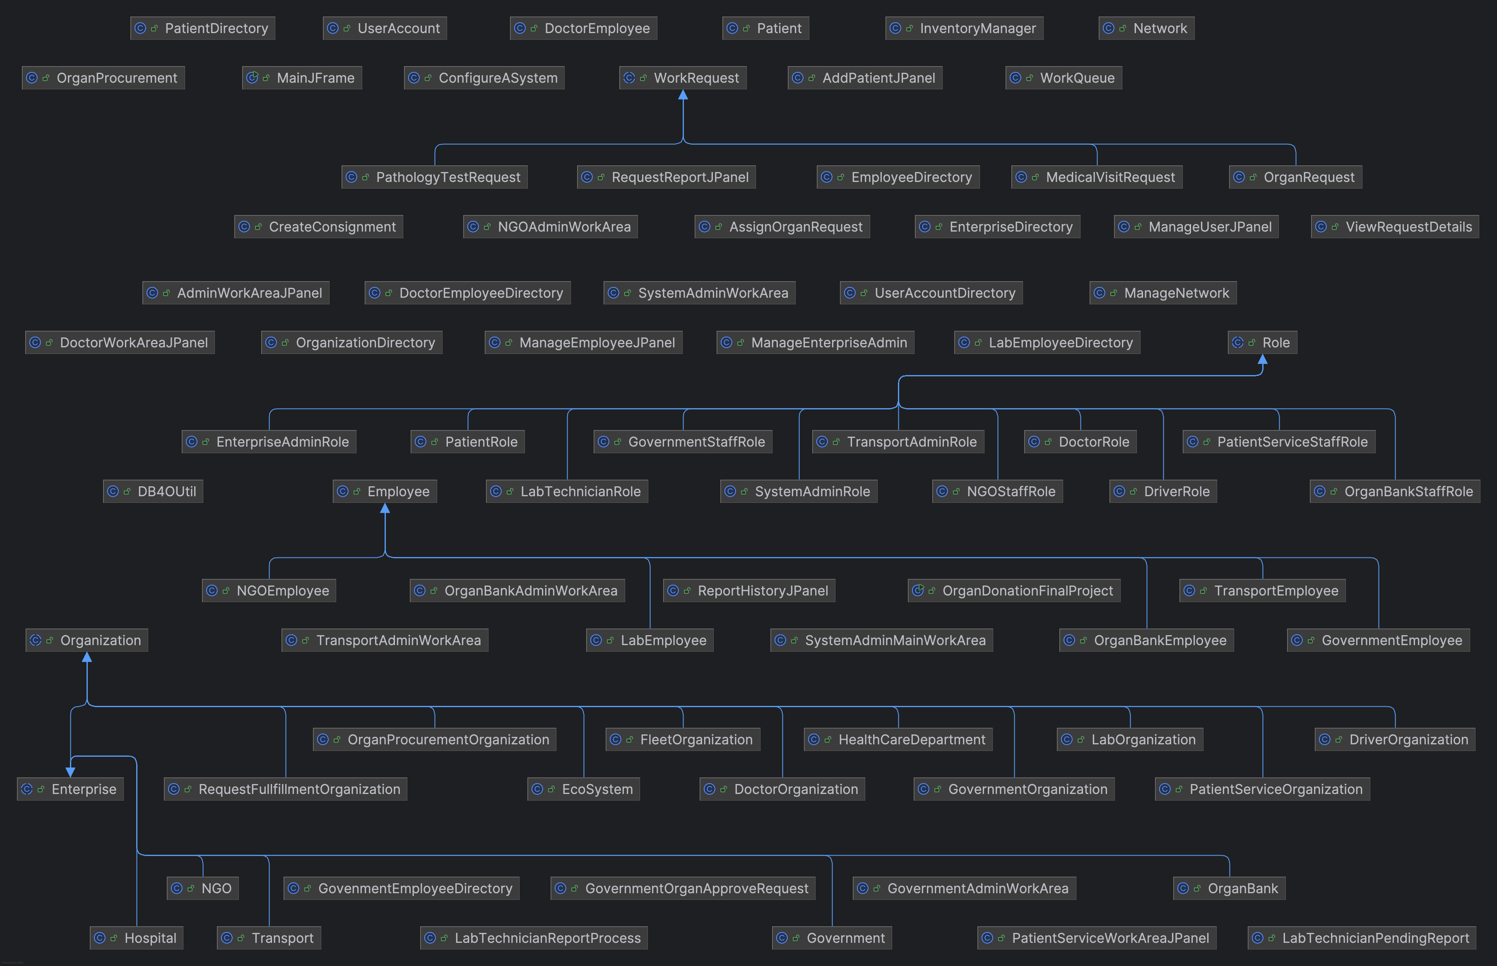
UML Diagram

Slide 6
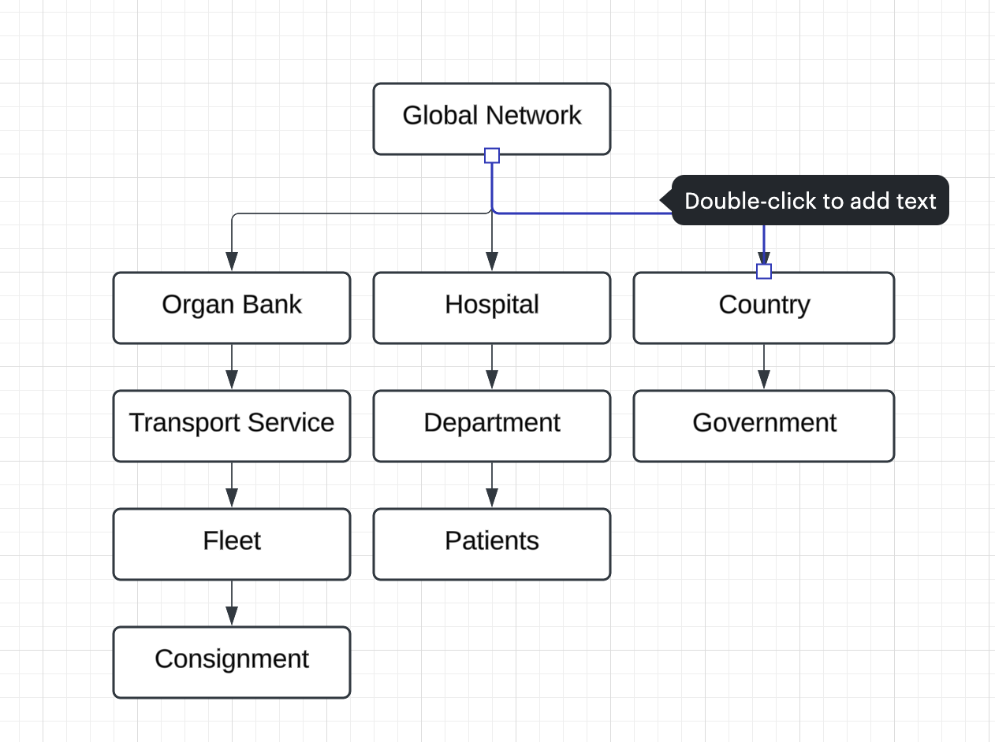
High-Level Component Design

Slide 7

Key Features
Centralized database for managing donor, recipient, and organ information
Real-time organ availability tracking
Cross-network collaboration between hospitals, organ banks, and transport services
Data visualization for policy planning
Public registration module for awareness campaigns
Secure, regulation-compliant data handling

Slide 8

System Architecture
The system comprises the following components:
User Management: Role-based access for stakeholders
Central Database: Stores and manages donor, recipient, and organ data
Real-Time Tracking: Logistics and organ location updates
Reporting Module: Insights for policy-making and awareness campaigns

Slide 9

Benefits
Saves lives by minimizing delays and ensuring organ viability
Promotes ethical practices and transparency in organ allocation
Enhances public trust in the organ donation ecosystem
Simplifies logistics and reduces wastage of available organs

Slide 10

Conclusion
The Organ Donation Management and Collaboration Platform aims to streamline the organ donation ecosystem, ensuring ethical, timely, and transparent processes. By leveraging technology, it connects stakeholders and saves lives through efficient decision-making and collaboration.

