Slide 1
Stock analysis of increase or decrease of amd
Team Members: Justin Nim

Slide 2
Project Details
Take Information from the stock market and see if you can predict if the stock will increase in price.
Predict based on general information from the stock market based on general information.
I was given Dates,Open,Close,Low,High,ADJ close, and Volume
I had to calculate the moving day average,which alot individuals uses as a reference for stocks
I had to research information about the company for news events/releases
Added Press release information as a yes or no
Added Quarterly earning as a yes or no based on certain dates

Slide 3
Goals and Obstacles
The goal was to be able to predict if the stock would increase or decrease and check its accuracy
Obstacles include:
Find more information about the company(AMD)
Find out how individuals analyze stocks
Understanding how news/events affect a stock
Dealing with Global news that affects a stock's price

Slide 4
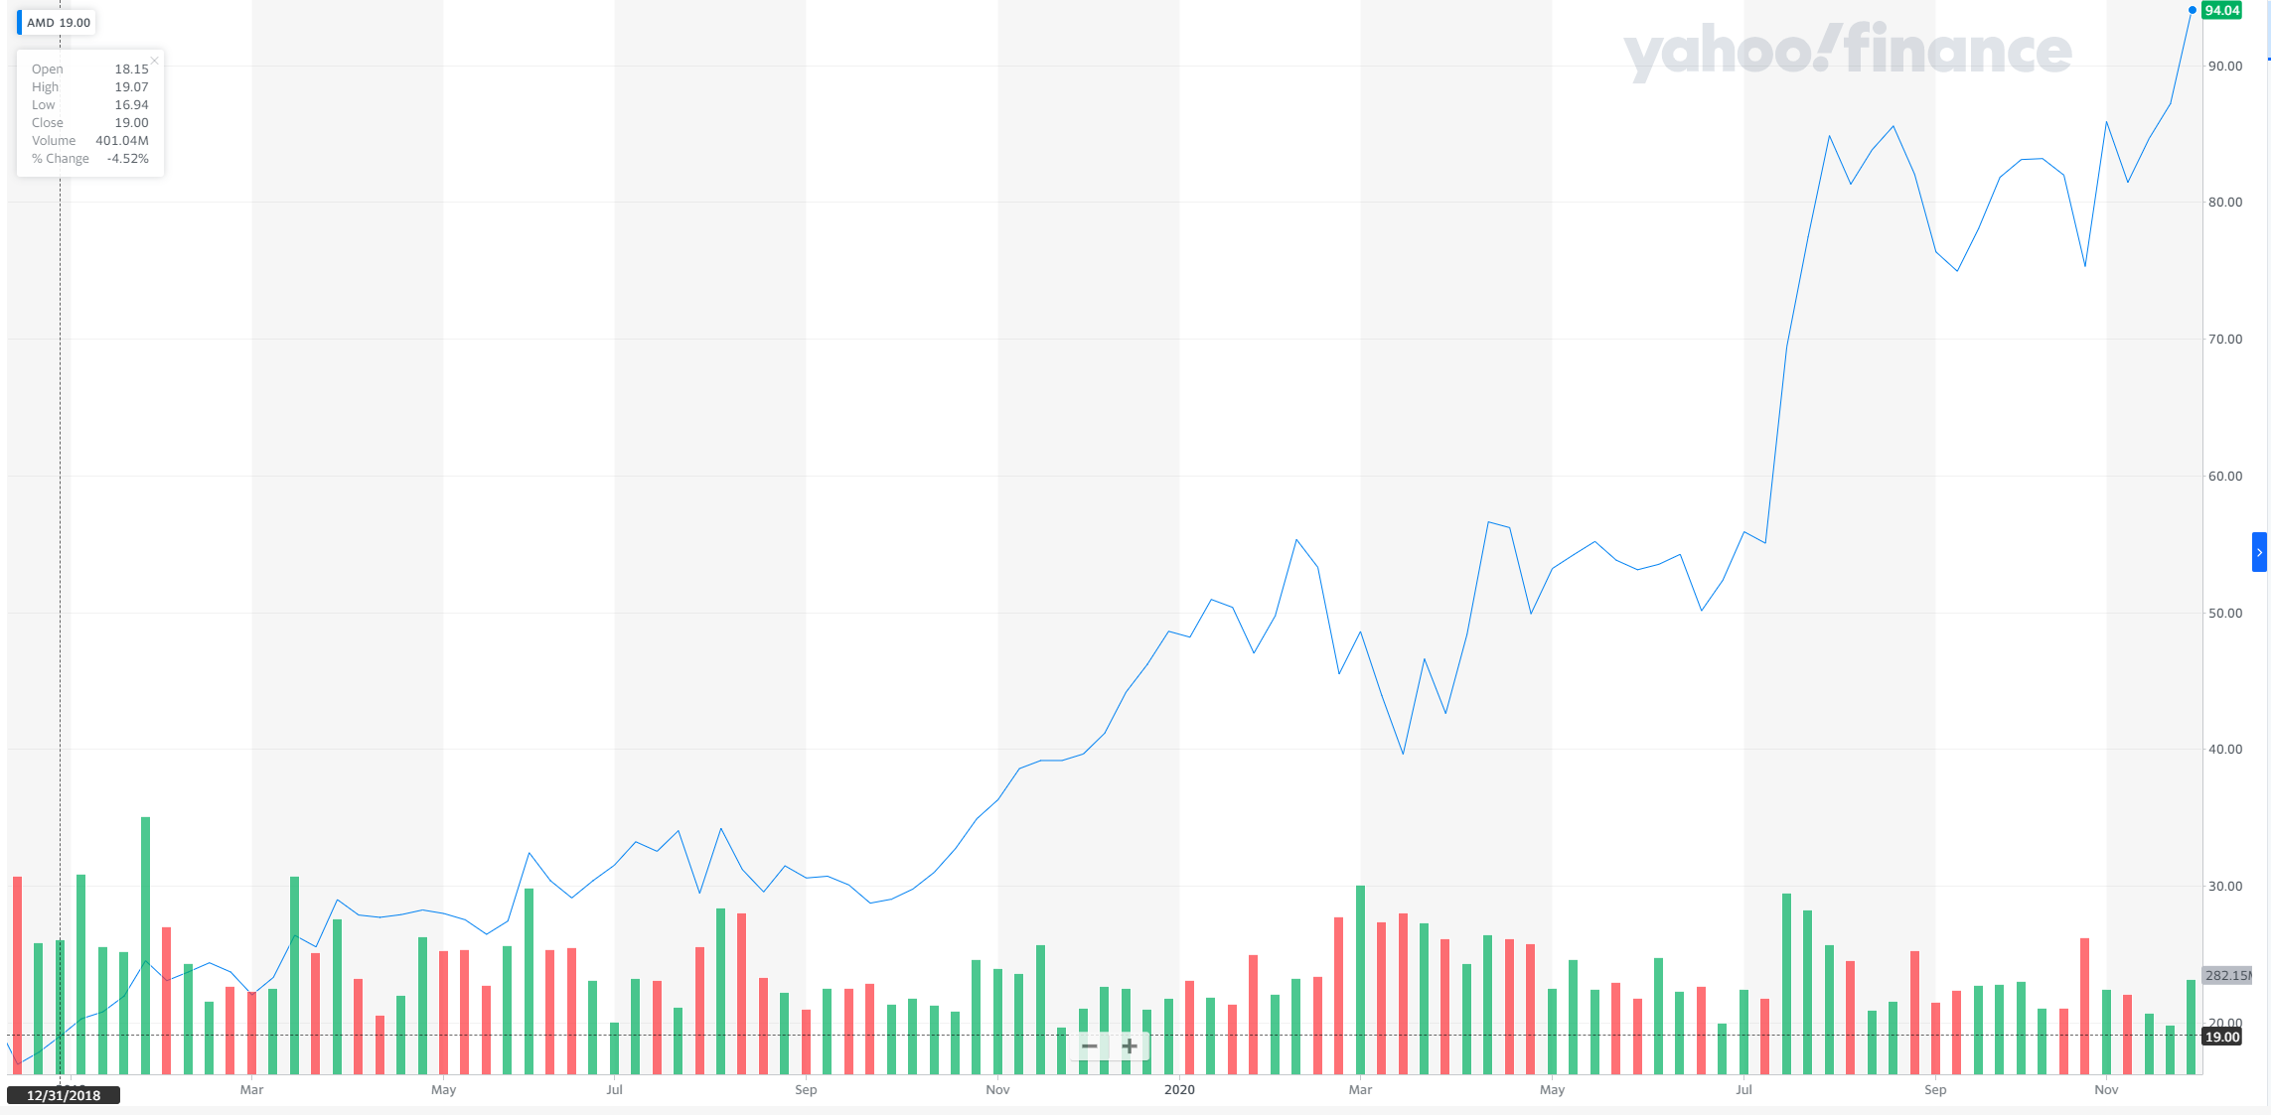
The stock graph of amd

Slide 5
Data
Moving average 50 day
[current close day + previous 49 close day ]/50
Moving average 100
[‘current’ close day + previous 100 close day ]/100
News/events
https://ir.amd.com/news-events/press-releases
Used the site for reference on date that had new release cause this impact stock price
Quarterly earning for amd
https://ir.amd.com/news-events/press-releases?category=financial
Used the site for reference on date that had new release cause this impact stock price

Slide 6
Data
Data was normalized by changing them into a true of false statement
Moving day average
Checked if the moving day average was higher or lower than current closing
Increase and decrease
Checked if the closing was higher or lower than opening
News
Referenced website to see if there was news that day
Quarterly earning
Reference website to see if there was a earning report that day

Slide 7
Linear regression
my_linreg = LinearRegression()
my_linreg.fit(X_train, y_train)
y_predict_LR = my_linreg.predict(X_test)
mse = metrics.mean_squared_error(y_test, y_predict_LR)
rmse = np.sqrt(mse)
Linear Regression: .5000987293110674

Slide 8
Logistic regression
my_logreg = LogisticRegression()
my_logreg.fit(X_train, y_train)
y_predict_lor = my_logreg.predict(X_test)
score_lor = accuracy_score(y_test, y_predict_lor)
Logistic regress:0.488

Slide 9
Decision Tree Classifier
my_decisiontree = DecisionTreeClassifier()
my_decisiontree.fit(X_train, y_train)
y_predict_dt = my_decisiontree.predict(X_test)
score_dt = accuracy_score(y_test, y_predict_dt)
Decision Tree: 0.504

Slide 10
K Neighbors Classifier
knn = KNeighborsClassifier(n_neighbors=4)
knn.fit(X_train, y_train)
y_predict = knn.predict(X_test)\
accuracy = accuracy_score(y_test, y_predict)
KNN: 0.448

Slide 11
Random Forest Classifier
my_RandomForest = RandomForestClassifier()
my_RandomForest.fit(X_train, y_train)
y_predict_rt = my_RandomForest.predict(X_test)
score_rt = accuracy_score(y_test,y_predict_rt)
Random Forest= .552

Slide 12
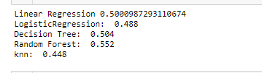
ML Model Results

Slide 13

Cross Validation ML Model

Slide 14
Final Results
Using the mention ML models in the slides would not be a great way to predict stock prices. The reason is that none of the percentage is high enough to take the risk. In the end, the ml models averaged around 50% mean was not a accurate way to predict stock prices.

