Slide 1



DELIVERABILITY STRATEGY CALL
[Date]
PREPARED FOR
[Client name]
Better inbox results.
Zero platform changes.
Darren Blumenfeld
Matt Rice
Founder & CEO
Senior Deliverability Coach

Slide 2
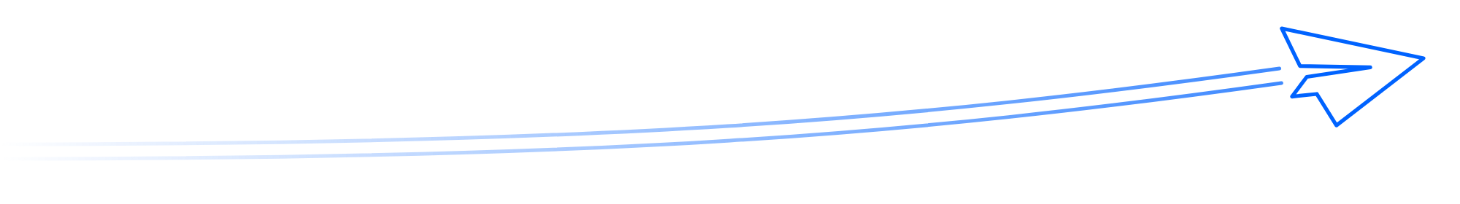
Aligning on your deliverability goals
Much more than warming up a list.
2019 · Origins
The problem
The solution
Darren founded InboxAlly in 2019 after spending 10 years running an Email Service Provider (ESP).
Legitimate senders with clean lists were still consistently landing in spam.
So Darren built InboxAlly to fix placement visibility, reputation repair, and the engagement signals mailbox providers use to decide who to trust.

Slide 3
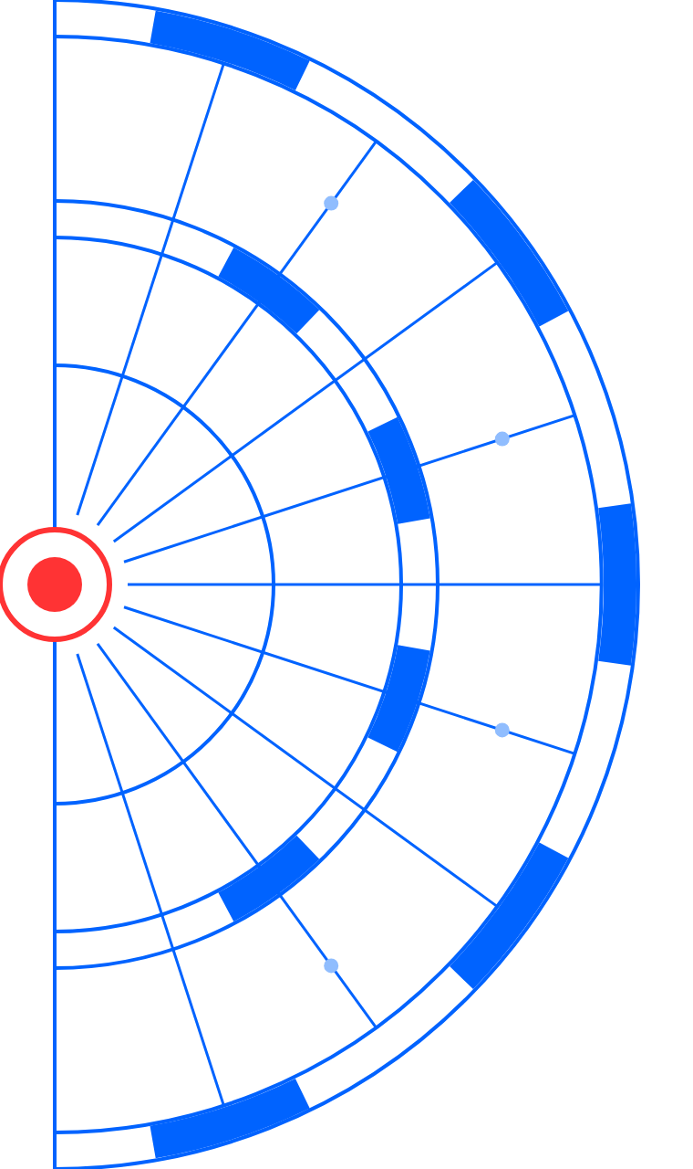
The platform & customer-reported results
1
Live seed engagement
1
Real interactions in Gmail, Workspace, Microsoft consumer, M365, and Yahoo.
Results customers report
“Emails went from 60% spam to 0% in about two months”
2
2
Native integration
Direct Google Postmaster Tools integration for authoritative health metrics.
“Domain reputation from Bad to High in roughly six weeks”
3
Intelligence suite
3
List verification, IA Assistant, IA Score, and automated AI digest.
“By end of month, 100% of emails to inbox, 50–96% daily to Primary”
4
Works with any ESP
4
Zero friction — no API keys, no credentials, and no DNS changes required.
“Open rates from ~30% to 70%+”
5
Ecosystem & training
Published case studies: Seido Knives, Surveylab, Mas Vashu
5
11 free tools and complete Platform Certification program.

Slide 4
Track record & industry recognition
Continuous operation
Scale & adoption
Data processing
Industry trust
Deliverability platform in continuous operation since 2019.
Hundreds of customers, from self-service senders to enterprise programs.
Billions of email messages processed across placement monitoring, list verification, and creative observation.
Relied on by agencies, ESPs, and deliverability consultants, as well as brands.
SAMMY AWARDS
CUSTOMER RATINGS
YOU MAY HAVE SEEN US AT
Growth Catalyst – Email: Winner 2025 and 2026
4.8
4.6
MailCon, Email Innovator Summit, Affiliate Summit, Traffic & Conversion Summit, MediaPost, Email Marketing Daily
Trustpilot
G2
G2 High Performer

Slide 5
Section title
SECTION 01
One line that sets up what this section covers.

Slide 6
Section title
SECTION 02
One line that sets up what this section covers.

Slide 7
Slide title
A short supporting line.
Explain what the image or screenshot shows and why it matters. Two or three sentences is plenty.
1
First point to call out
2
Second point to call out
3
Third point to call out

Slide 8
Slide title
A short supporting line.
Use this layout when a slide needs a proper paragraph. Lead with the main point, then add the context or detail that supports it. Keep paragraphs to four or five lines so they still read well on a shared screen.
KEY POINTS
1
First supporting point
2
Second supporting point
A second short paragraph can carry an example, a caveat or what happens next.
3
Third supporting point
4
Fourth supporting point

Slide 9
“
One line the audience should remember.
Name, Job Title, Company

Slide 10
Slide title
A short supporting line.
00%
0.0
00x
000
Short label
Short label
Short label
Short label
One line of context
One line of context
One line of context
One line of context
Source: add where these figures come from

Slide 11

Questions?
Let's talk it through.

Slide 12
Next steps
Here's what happens after today.
1
Next step
GET IN TOUCH
Owner and timing
Darren Blumenfeld
2
Founder & CEO
Next step
[email address]
Owner and timing
Matt Rice
3
Senior Deliverability Coach
Next step
[email address]
Owner and timing

