Slide 1
SIT AI Platform
SINGAPORE INSTITUTE OF TECHNOLOGY
One conversational-AI home for the campus: a grounded assistant, a persona debate arena and voice mentoring, with lip-synced avatars and Singaporean voices.
🦦 Assistant
🎭 Debate Arena
🎧 Advisor Studio
Notes:
Welcome — this is the unified redesign of our four conversational-AI prototypes into one platform for SIT.

Slide 2
Four prototypes, built apart
THE STARTING POINT
AI-debate-bot
SIT-chatbot
Institute-Chatbot-RAG
Personality-Voice
Voice debates with celebrity personas
Otter-mascot Q&A for the campus
Retrieval-grounded SIT chat
Finance-advisor voice chat
What that cost us
Roughly 16,000 lines of duplicated vanilla-JS across four backends doing the same job
Every app locked to its own ElevenLabs dashboard agent, nothing ran without per-app setup
No tests, no shared design language, four deployments to babysit
Notes:
Each prototype proved an idea, but they shared nothing. The rewrite consolidates all of it.

Slide 3



One platform, three experiences
THE REDESIGN
Assistant
Debate Arena
Advisor Studio
Ask Ollie the Otter anything about SIT. Answers are grounded in the real SIT website, cite their sources, and are spoken aloud.
Argue live, by voice, against Singapore's voices of society: statesman, pop idol, professor, kopitiam uncle.
One-on-one voice mentoring tuned for Singapore — CPF & HDB finance, learning science and exam strategy.
Everything streams: tokens, speech, and avatar motion.
Notes:
Three experiences, one codebase, one design language. The streaming point matters: nothing in the UI waits for a full response.

Slide 4

Single process, end-to-end streaming
ARCHITECTURE
Browser
Hybrid RAG
LLM · Ollama
React 19 + Tailwind 4 SPA
Conversation engine (SSE)
Lip-synced SVG avatars via WebAudio
FastAPI
LanceDB vectors + BM25
Warm models, fast-turn routing
SSE chat streaming
STT / TTS endpoints
Serves the built SPA
ElevenLabs
Local fallback
scribe STT + turbo TTS
faster-whisper + Piper
Zero cloud keys required: degrades gracefully to a fully local stack · deployed on the lab GPU server
Notes:
One FastAPI process serves the SPA and every API. Cloud voice services are an env-var upgrade, not a dependency.

Slide 5
Retrieval that holds up
GROUNDING
Crawler renders SIT pages in real Chrome (the site blocks plain HTTP)
Pages chunked and indexed as LanceDB vectors + BM25, merged and deduped
SIT abbreviation expander: IWSP, SNAIC, AAI, OIP
Every answer cites its sources, on screen
The ready-built index ships with the repo
"SIT offers… Accountancy, Aviation Management, Communications and Digital Media, Hospitality and Tourism Management, Food Business Management…"
Grounded, not guessed. Straight from the live demo.
🔗 admissions
🔗 singaporetech.edu.sg
Notes:
The corpus is real SIT web content. The hybrid retriever merges semantic and keyword hits, and the model is instructed to stay inside the context.

Slide 6
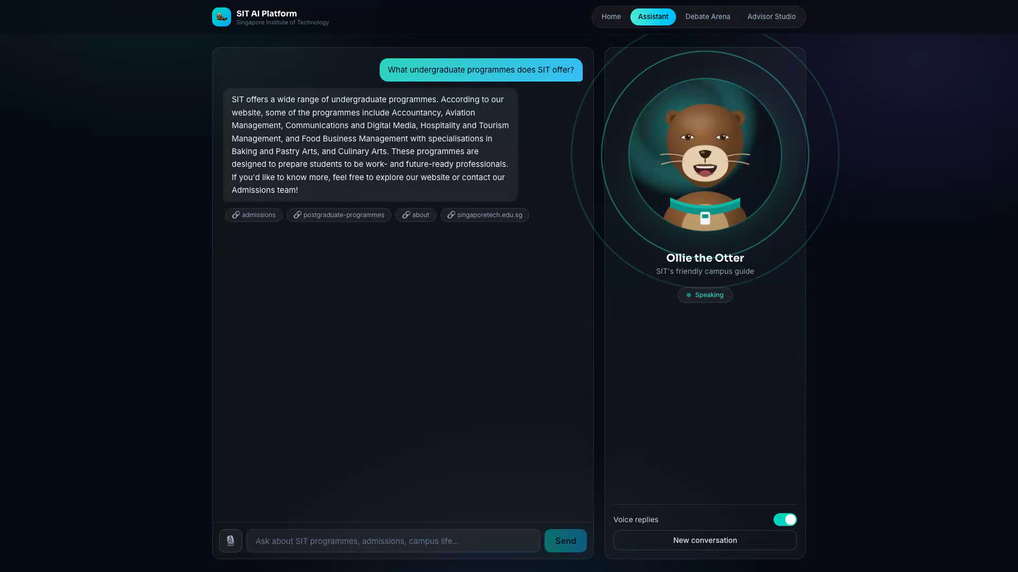
Characters that speak with real lip sync
AVATARS
Semi-realistic parametric SVG characters: skull proportions, gradient skin, layered hair, clothing and age lines, with blinking, gaze drift and breathing.
Driven by the live audio signal
Speech-energy envelope → jaw drop
High-frequency share → lip spread
Teeth and tongue revealed with openness
Runs in the browser at 60 fps, with zero server cost and zero added latency
Notes:
The mouth is not an animation loop. It follows the actual audio playing, via a WebAudio analyser, which is why it stays in sync with any voice.

Slide 7
Singapore-first voices
VOICE PROFILING
Persona | Voice | Accent
Ollie · Assistant | Lexi | Singaporean
Singapore Uncle | David · Casual | Singaporean
Mr. Tan | Gavin · Warm, Clear | Singaporean
Jia Hui | Cynthia | Singaporean
Prof. Devi | Jane · Diplomatic | Singaporean
Dr. Mei | Emma · Warm | Singaporean
Arjun · Finance | Gaurav · Professional | Indian English
Demo narration
US conversational voices (Jack John and Abhi) are reserved for the voiceover, never the avatars.
Audition kit
One sample clip per persona ships in the repo, so accents are verified by ear, not by library tags.
No API key?
Piper + faster-whisper take over automatically. The platform never goes silent.
Notes:
Voice library accent tags proved unreliable, so every pick is auditioned by ear with the sample kit before it ships.

Slide 8
It answers before you expect it to
LATENCY ENGINEERING
Technique | Effect
Sentence-streamed speech | Speaking starts after the first sentence
Warm models, kept alive | No cold start on the first question
Fast-model routing for short turns | Full debate reply in about 1.5 s
Turbo TTS + SSE token streaming | Audio begins while text still streams
~2 s
from send to first spoken audio
Notes:
The big win is sentence streaming: the reply is spoken while the rest is still being generated, so perceived latency collapses.

Slide 9
Tested end-to-end, by a real browser
QUALITY
12/12
2
1080p
browser E2E checks passing, driven with a fake microphone
deployments under the same smoke suite: local and the GPU server
demo video produced by the same automation that tests the app
The E2E suite exercises the full voice loop: speak, transcribe, reply, summarize
It also verifies RAG citations, the first-audio latency budget and console hygiene
Demo soundtrack is rebuilt from real captured voices, with overlap-free narration
Notes:
Nothing in the demo is staged by hand. If the tests cannot drive the app through a scenario, it does not go in the video.

Slide 10
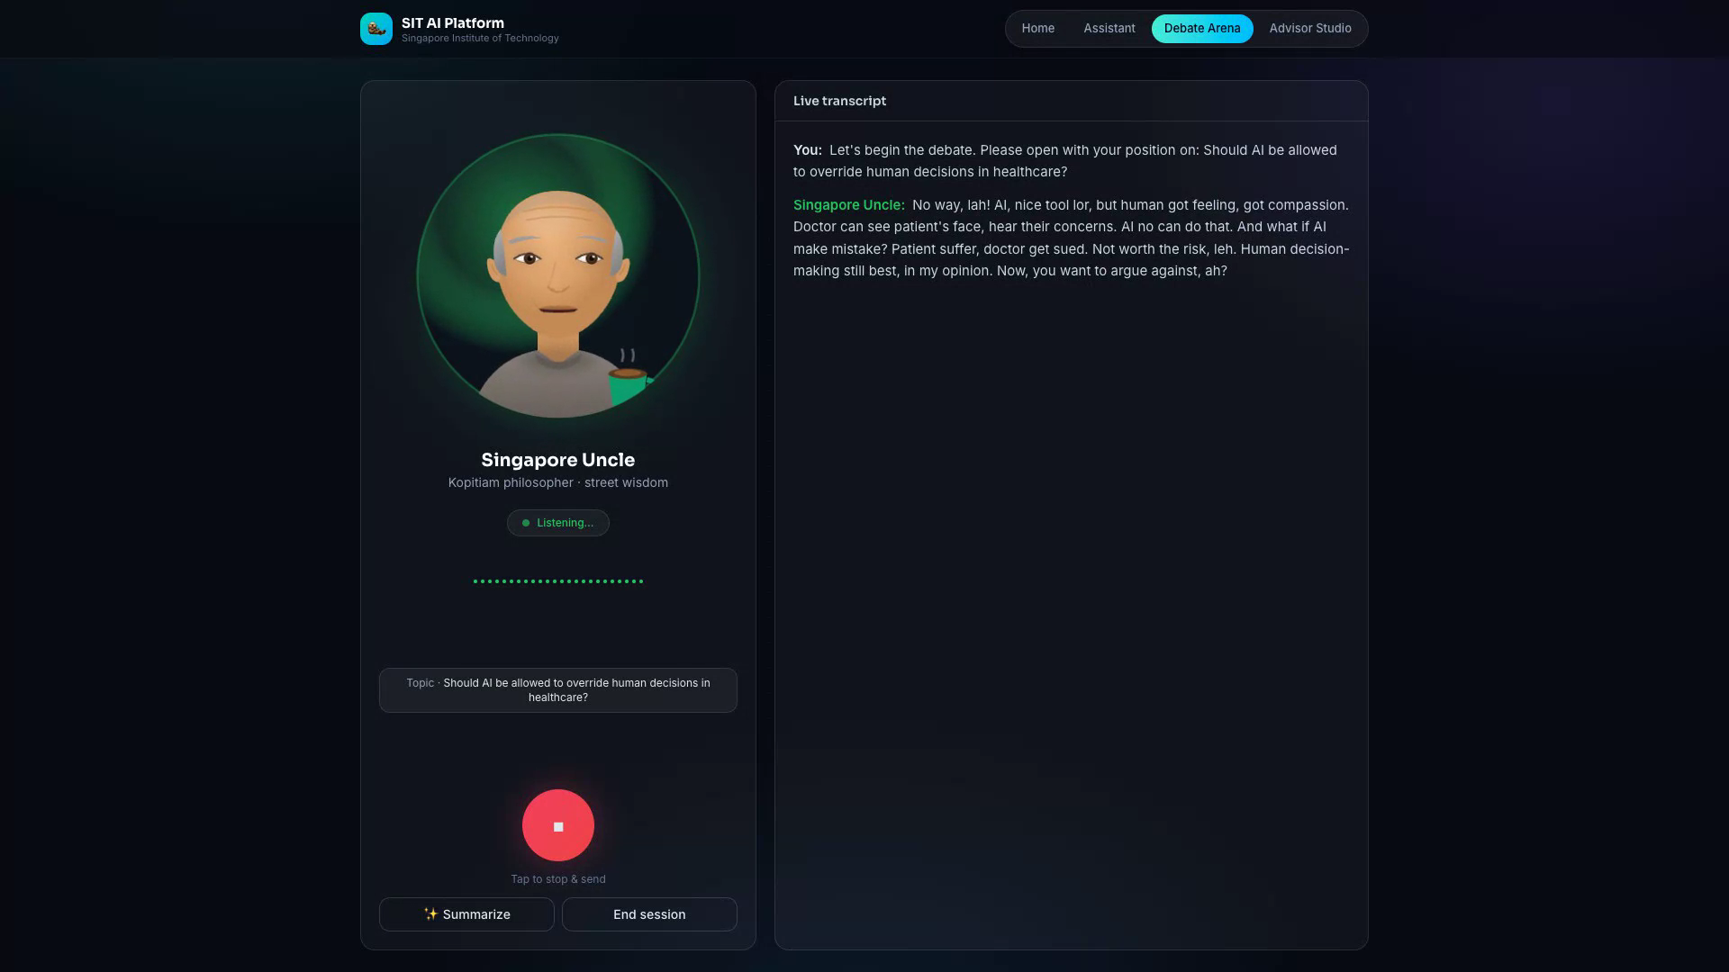
Three minutes, every feature live
DEMO
Home: the three experiences
Assistant: grounded answer, cited sources, spoken in sync
Debate: Uncle opens, the user argues back by voice
One-tap summary of the whole exchange
Advisor: a CPF mentoring session
Narrated end to end, with the product's real voices underneath
Notes:
Play the video here. The debate turn is the highlight: real speech recognition, an in-character rebuttal, and the avatar lip-syncing through it.

Slide 11
Where this goes next
ROADMAP
Photoreal talking heads
Multilingual voice loops
Lip-sync models running on the lab GPUs, or streaming avatar APIs, as a premium avatar tier.
Mandarin, Malay and Tamil speech in and out, matching Singapore's language landscape.
A larger, fresher corpus
Campus kiosk mode
Nightly re-crawl of the SIT site and a wider page set, so answers stay current by themselves.
A walk-up, hands-free configuration with usage analytics for open houses and the library.
Notes:
All four items build on what exists: the avatar tier swaps the renderer, the languages swap voices and STT models, the corpus swaps data.

Slide 12
Thank you
The SIT AI Platform: built for Singapore, ready for the campus.
Live demo available
Full source + video in the repository
Notes:
Close by offering the live demo. The platform is running and can take questions from the room.

