Slide 1

SMU Bootcamp Project 1
Group 2 (The Best Group😁)

Slide 2


Overview
The purpose of this analysis is to explore the best locations to visit by ratings in North America and Canada.
These recommendations were gathered from Yelp.com

Slide 3
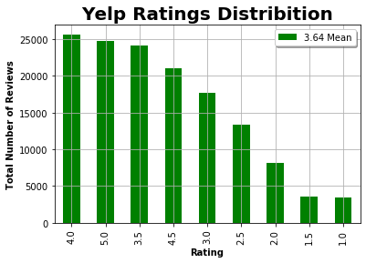

Slide 4
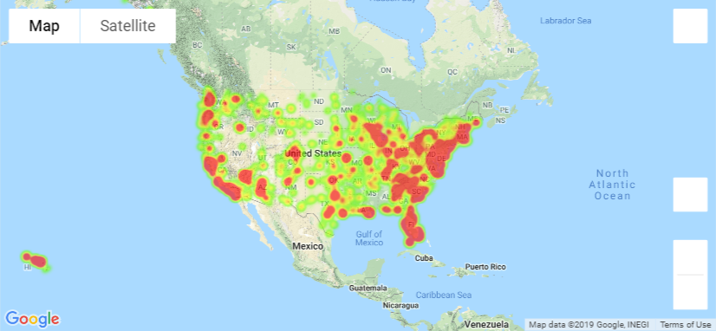
Hotels Map by Reviews

Slide 5
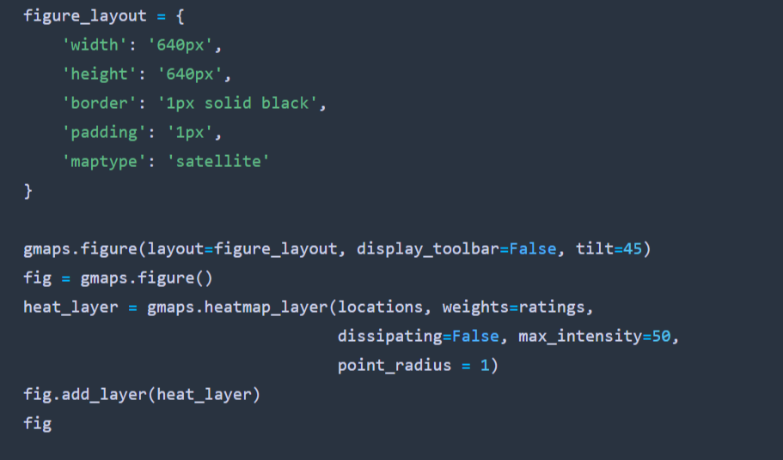
Code Behind the Map

Slide 6
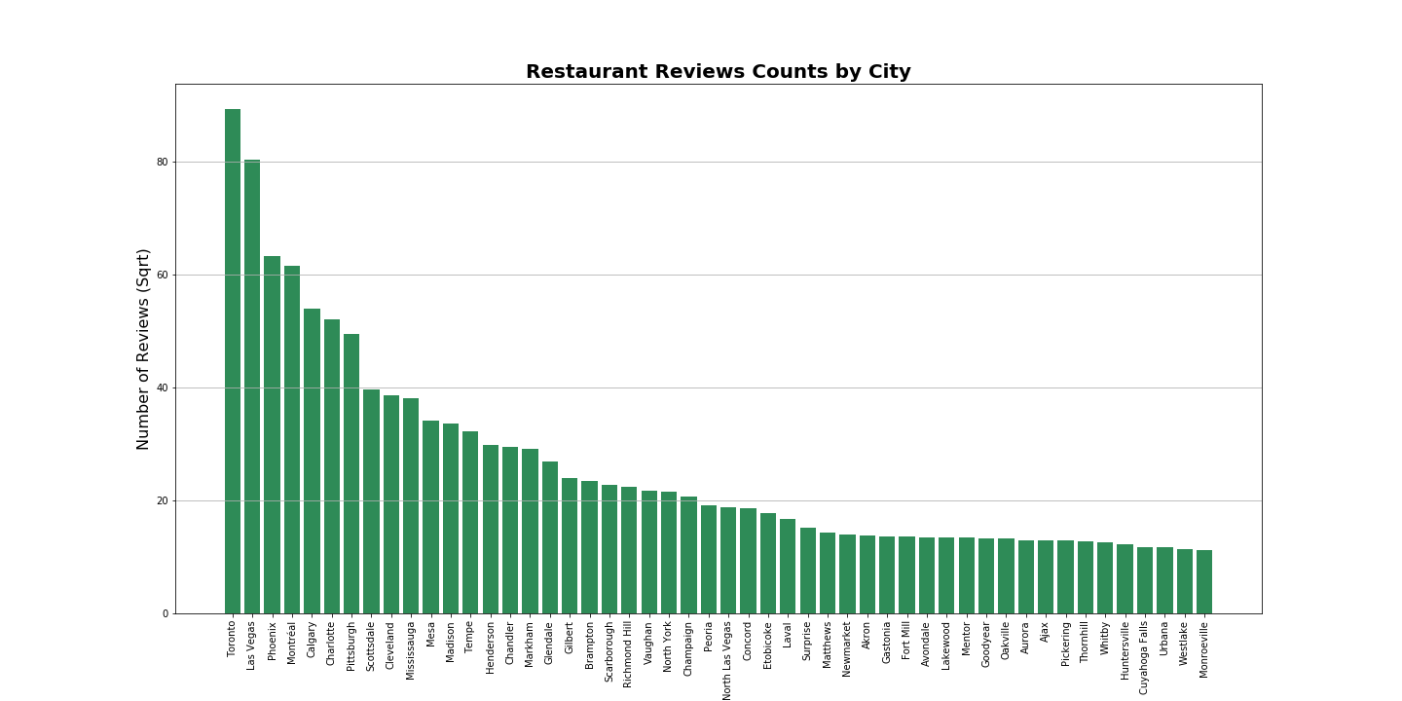

Slide 7
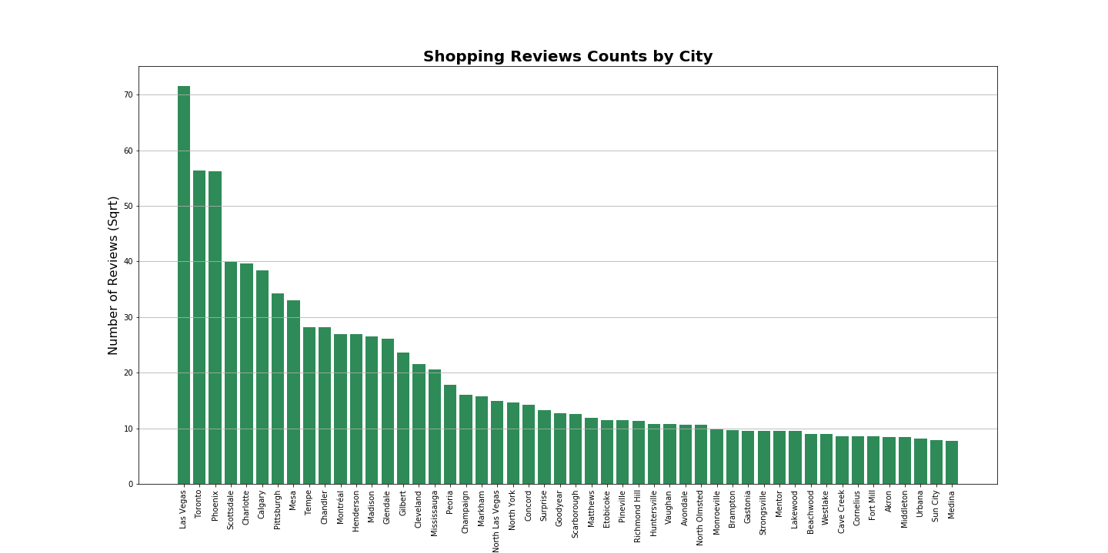

Slide 8
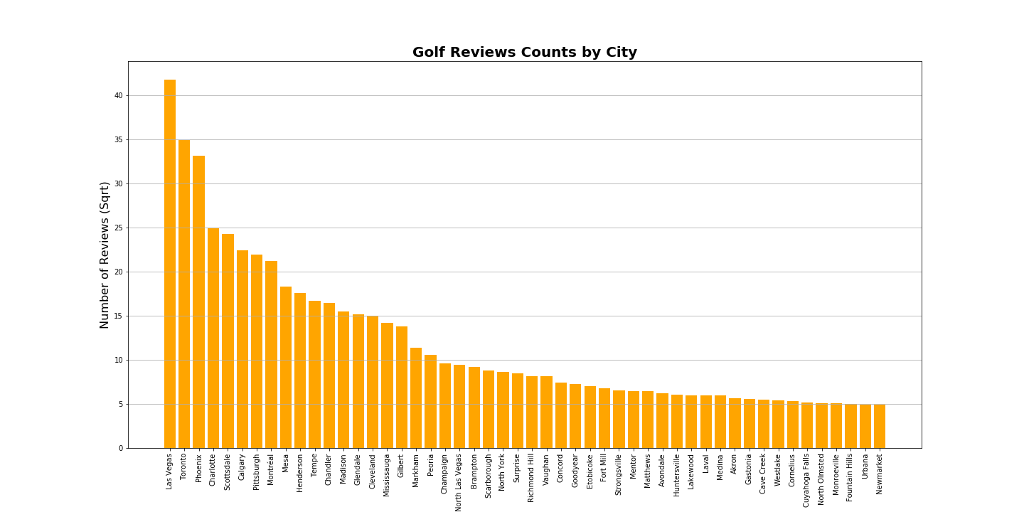

Slide 9
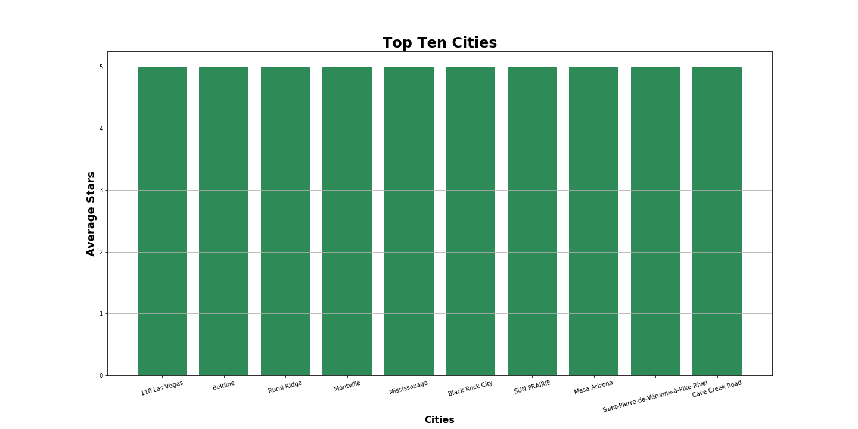

Slide 10
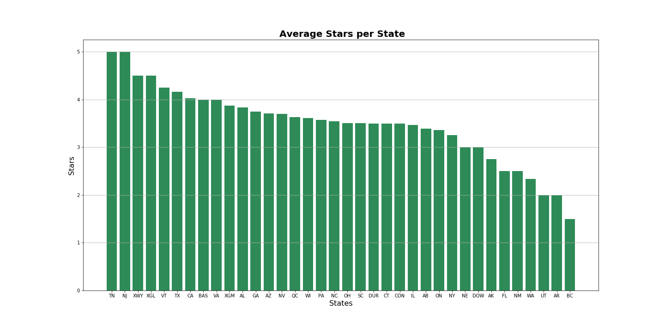

Slide 11
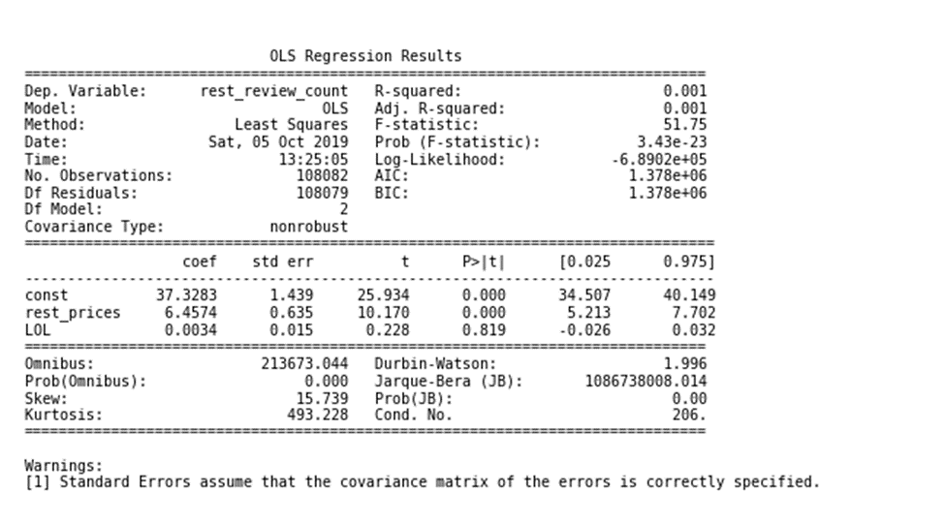
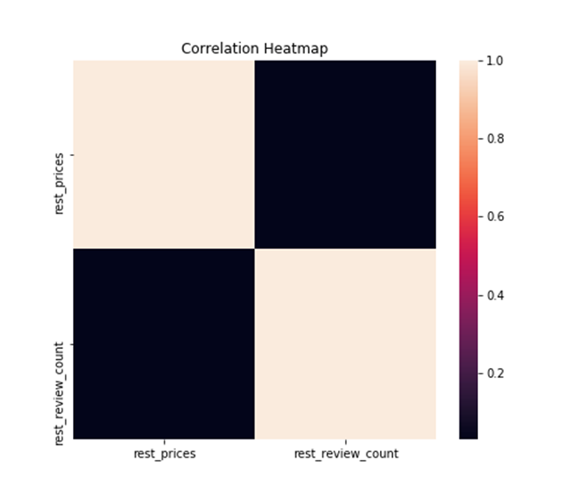
P value is 0.
Therefore, we would normally reject the null hypothesis.
However, knowing that the R-squared is 0.001 this dataset is useless because no linear relationship exists. This is illustrated below:

Slide 12
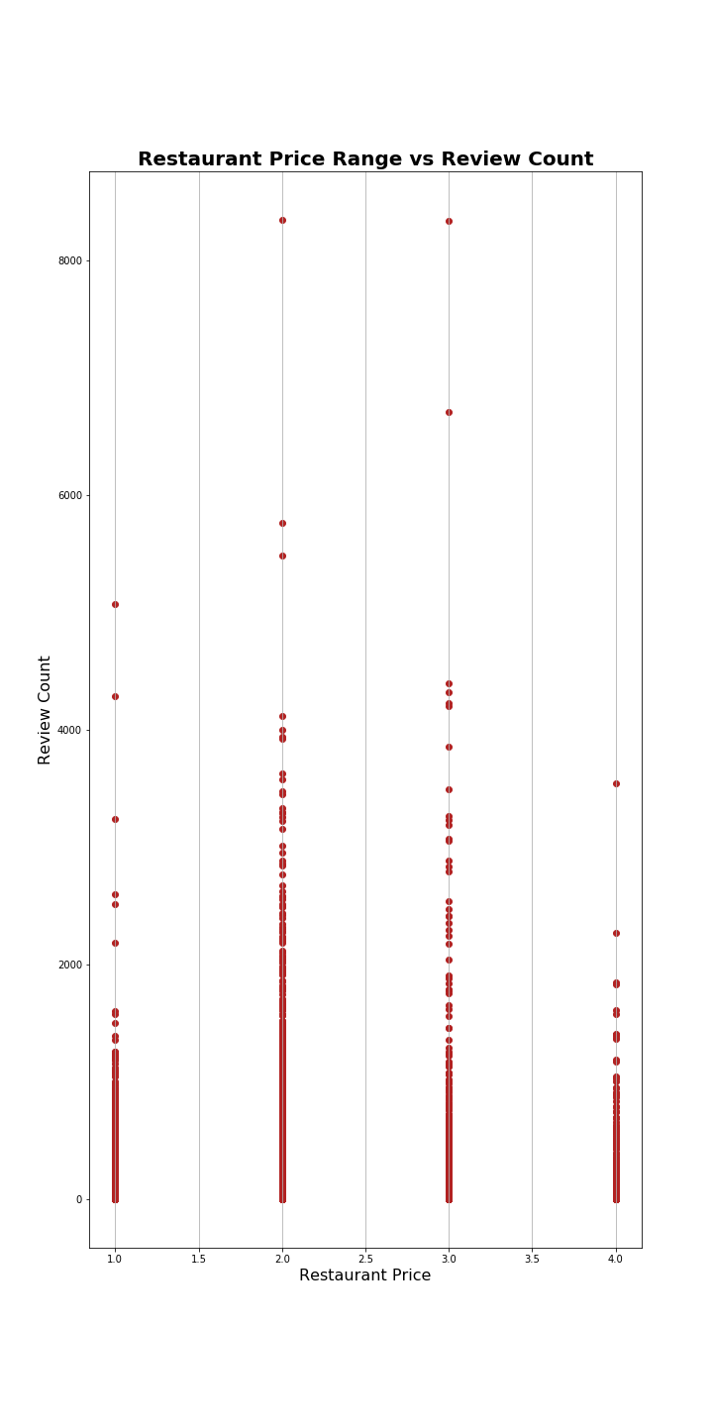
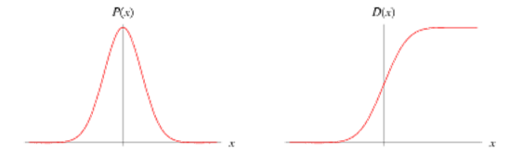

The relationship was recognizable when graphed: Restuarant Price Range vs the Review Count.

Slide 13
Data limitations:
Yelp data is from 8 months ago
The data does not include all 50 states in the United States
There is a total of 29 United States and 7 Canadian States and Manchester U.K.
Concluded that the data is bias since we are missing 42% of the states in the United States and missing 30% for Canada
We suspect that Canada states abbreviations are inaccurate

Slide 14
Conclusion:
Based on the data the recommended vacation place is Las Vegas Nevada.
In conclusion Yelp data is incomplete most of the ratings are concentrated in Nevada, Arizona and Canada consequently causing limitations to provide objective recommendations.
The Hotel data is all-encompassing when compared to Yelp data. The most popular visited places were in the east coast and west coast, near beaches of the US.

