Slide 1






















Financial Markets 101
The Physics of Finance
Anagd Singh Sone

Slide 2
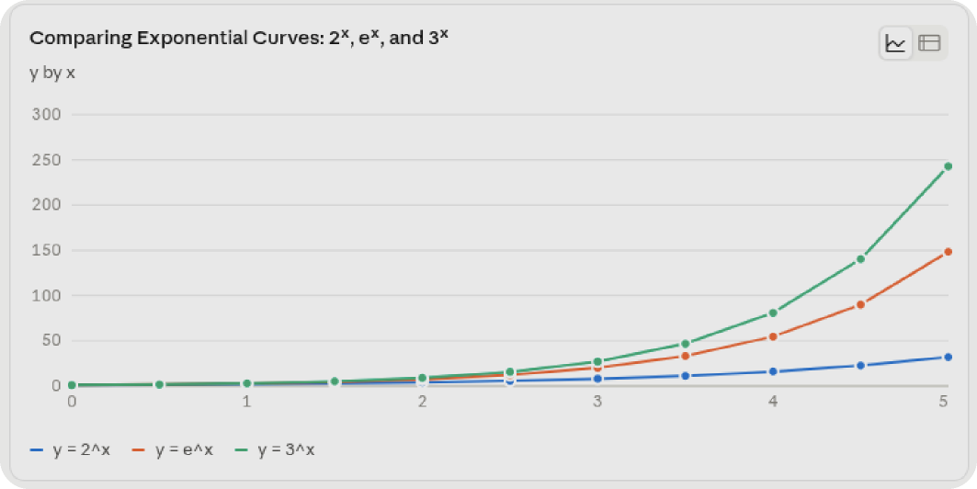
Back to Basics
Master the fundamentals before
touching the complicated stuff

Slide 3
Find Out
100 | 💥
90 | /
80 | /
70 | /
60 | /
50 | /
40 | /
30 | /
20 | /
10 | /
0 +---------------------------------->
0 2 4 6 8 10
Fuck Around
V2.. Rotate..
Vertical Take OFF

Slide 4
more resources in the description
🪙
Notes:
agar app ye series ke 27 videos nahi dekh shakte toh ajj tak dekh kyu aadha adhura karne vale log vo hi dekhte hai

Slide 5








THE ROAD NOT TAKEN
BY ROBERT FROST

Slide 6
Technical Analysis
Getting on the Market’s Nerves

Slide 7
Aa Pan Ek Wave Che
Technical
Market Mechanics
III derivation of x
Not Certainties. Only Probabilities.
M = f(P, V, S)
Ε, Σ, Π

Slide 8


































I WILL INVENT AN WHOLE NEW FIELD OF MATHEMATICS
JUST SOLVE MY OWN IMAGINATION
BUT YOU ARE NOT NERDY ENOUGH TO UNDERSTAND
ANGAT SINGH SONE

Slide 9


Slide 10
Price Action
SR
Reflecting Real Time sentiment of market
Capacitors and Resistor
Market Structure
Momentum or Exhaustion
Marking Turning points on price chart
Markets loves the trends or not.
TECHNICAL
CH3OCH3
Swings
Trend Continuation or Change of Character
EXCHANGE OF ANYTHING BTN ENTITIES
Dynamic Levels
Trend ke Range?
MONEY INTO HARD ASSETS
LOCKING FUTURE PRICE OF AN ASSET

Slide 11

























After Apple Picking
BY ROBERT FROST

Slide 12


Slide 13
Liquidity
BID & ASK
Liquidity, Stop Clusters & Sweeps
BUY AND SELL ORDERS BY MP
Order’s Chaos
MARKET CAPITALIZATION
Market vs Limit Orders, Spread & Slippage
TOTAL VALUE OF ALL STOCK w.r.t PRICE
Market Mechanics
Volume
Decibels
Volume, Relative Volume,
Confirmation & Divergence
Accumulation vs Distribution,
VWAP & Volume Profile
Bell Curve
Indicator Reality
Tools to smooth price data
OPEN HIGH LOW CLOSE

Slide 14










A Psalm of Life
Henry Wadsworth Longfellow

Slide 15






















Slide 16
Volatility
Vixed Stop Loss
OHLC
BUY AND SELL ORDERS BY MP
Risk Per Trade
SL
PERSONAL VIEW POINT
YOU WOULD NEVER TAKE -VE LOG?? RIGHT???
MATHS
WIN RATE
Expectancy
ESTIMATING TIMING OF EVENTS
MATHEMATICAL WAY OF GETTING LEVELS
80%* Rule
Myths
40%*2
........
Notes:
Expectancy proves if a system makes money over a large sample size based on average win size vs average loss size, regardless of win rate.
Simple: If you make ₹3,000 when you win and lose ₹1,000 when you lose, you can be wrong more than half the time and still get wealthy.
Practical: Stop obsessing over a 90% win rate. A 40% win rate strategy with a 1:2.5 Risk:Reward ratio is a highly profitable mathematical machine.
RANT ABOUT INVESTMENT BANKING

Slide 17



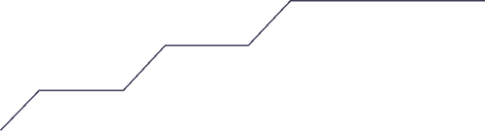












The Journey
By Mary Oliver

Slide 18










Nothing Gold Can Stay
By Robert Frost

Slide 19

















उद्यमेन हि सिध्यन्ति कार्याणि न मनोरथैः |।
न हि सुप्तस्य सिंहस्य प्रविशन्ति मुखे मृगाः ||॥
Notes:
Tasks are accomplished only through persistent effort and hard work, not by mere daydreams or wishes. Even a mighty lion cannot catch prey if it lies asleep—deer will not enter its mouth on their own.

