Slide 1




Homepage
Search for user
Consult profile
Initiate conversation

Slide 2




Login
Homepage
Navigate to product page
Download product
Success

Slide 3



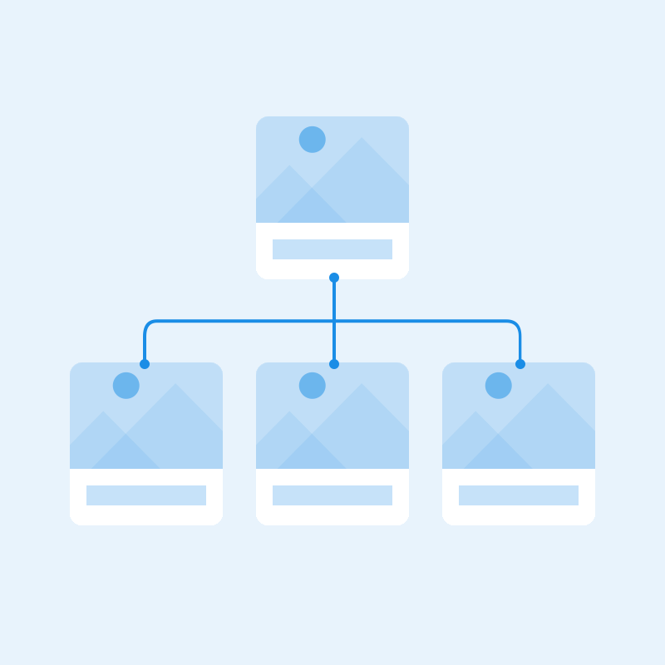
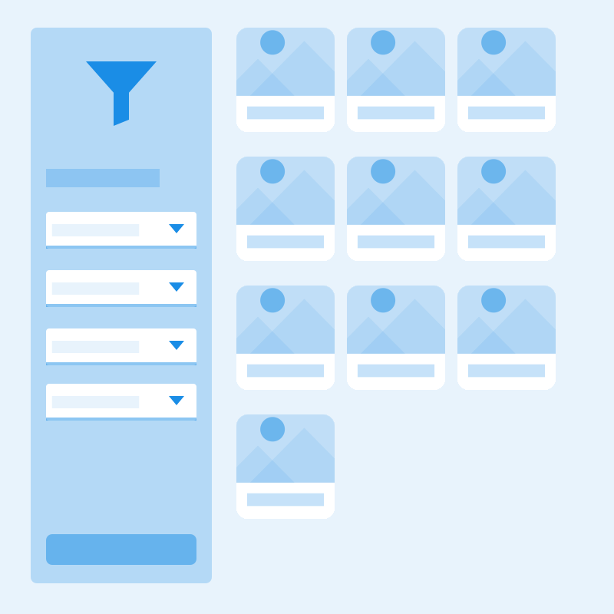





Upload
Text
Team
Success
Sitemap
Search
Profile
About
Filter
Line chart
Alert
Compare
File
Calendar
Chat

Slide 4

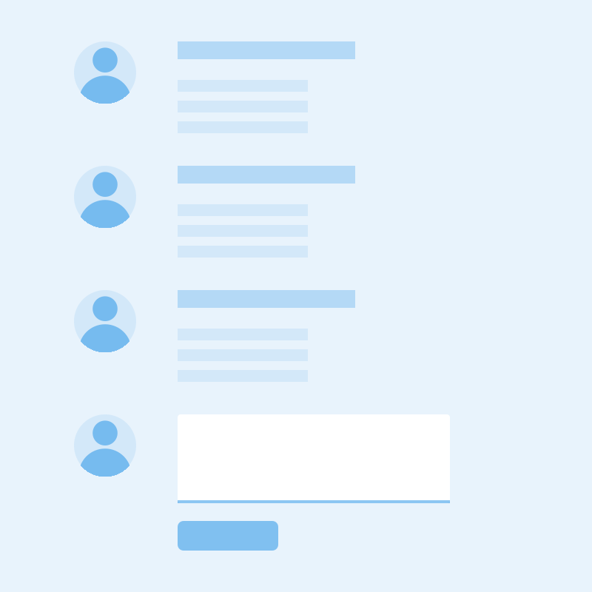

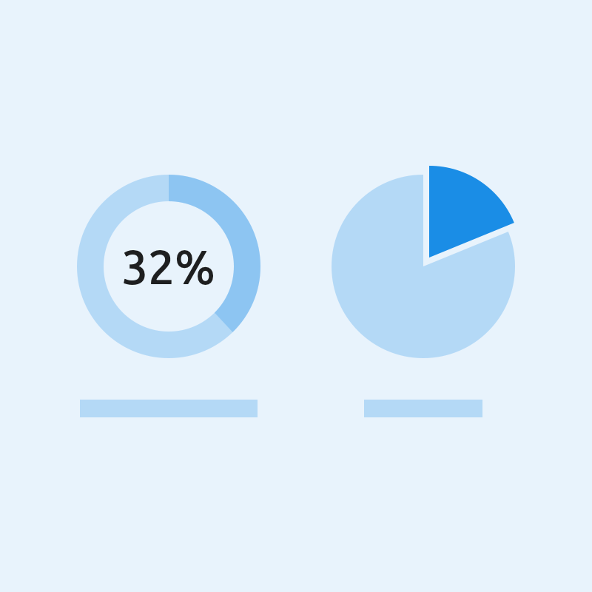


Files
Comments
Article
Download
Gallery
Pie chart
Modal
Login
Form

