Slide 1
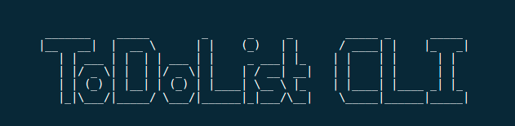
A todo list application for the lazy dev

Slide 2
TDD and my obsession with ‘best practice’

Slide 3
“Stop coding and start thinking” M.Bamford

Slide 4
Features of CRUD
- New (create)
- List (read)
- Show (read)
- Update (update)
- Delete (delete)

Slide 5
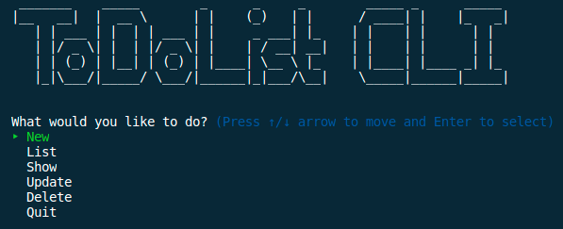

Slide 6
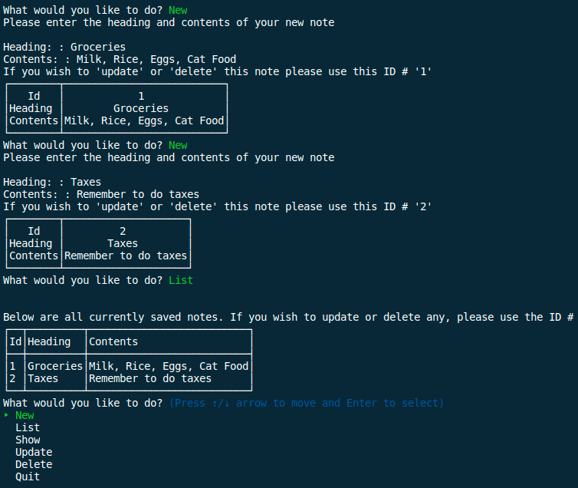

Slide 7
Main tasks remaining
- ID’s with TTY Prompt
- YAML database
- Input validation
- RSPEC testing
- Documentation
- Make everything look nice

