Slide 1

Reviews
–the good, the bad, the meh By William Finch

Slide 2

Goal:
To create time for business owners
To simplify life
Notes:
Create time by building a system that will easily sort reviews into actionable categories (negative, positive, neutral)

Slide 3
The Process
Preprocessing
Tested different methods for handling text
Representation
Trialed different models
Pre-Trained Model
Trialed a Pre-Trained Model
Deployment
Optimization
Trained a new model
Tested the new model
Notes:
Preprocessing text – tried lemmatization and stemming to clean up the data
Representation – ran multiple different models (linear and ensemble)
Pre-trained – used Cardiffnlp’s model that has been trained on the twitter dataset
Optimization – started with a clean distilbert model and fine-tuned it on our dataset
Deployment – Would like to eventually launch it with an API to make it easy to call and use.

Slide 4
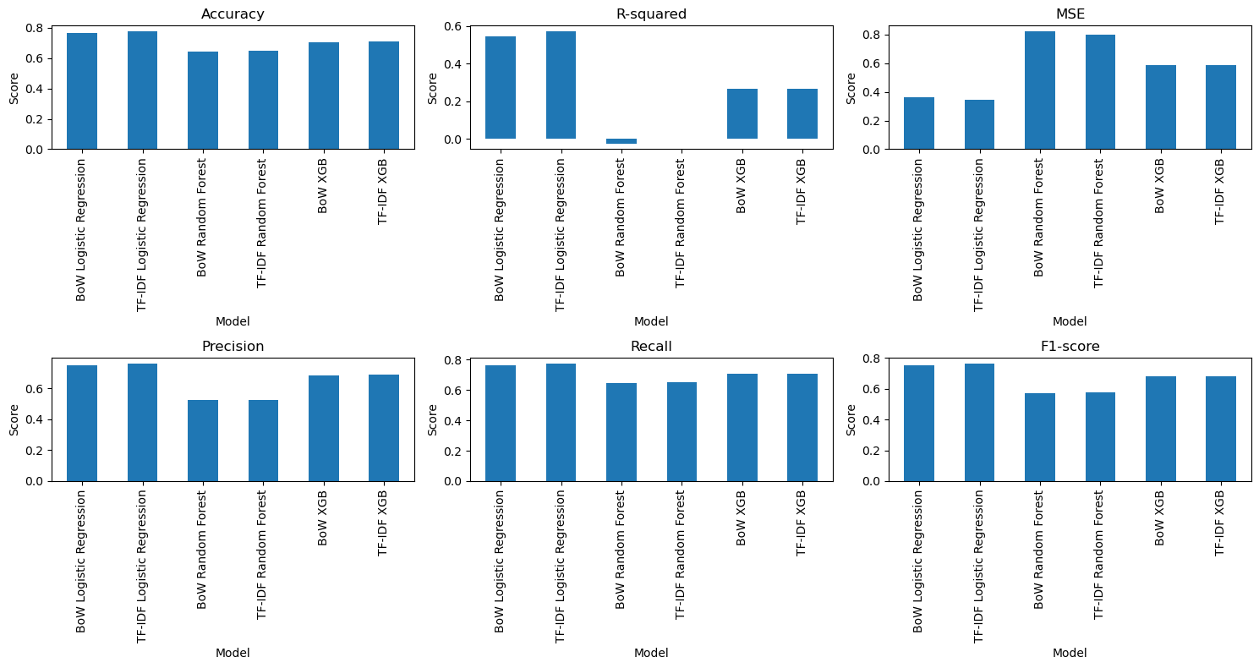
Linear and Ensemble methods
Notes:
A lot of information there but when it comes down to it the best accuracy I was able to get out of these models was 77% from Logistic Regression

Slide 5
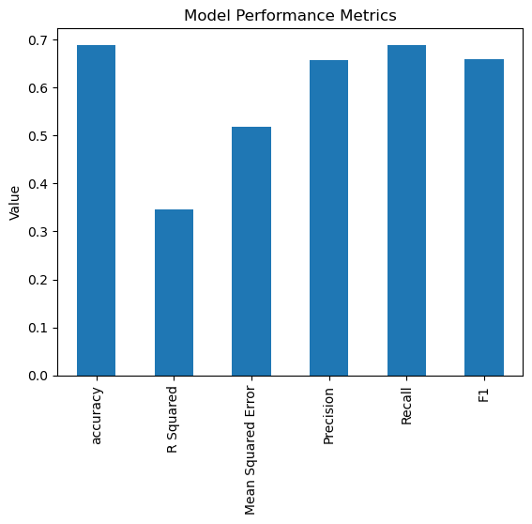
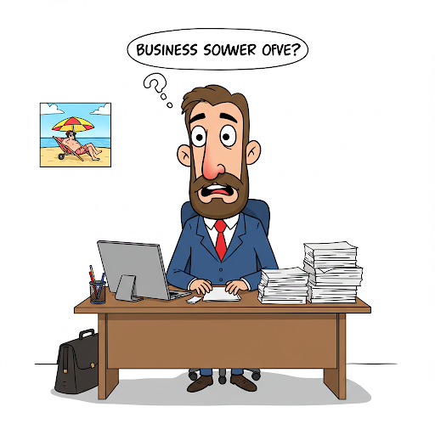
Pre-Trained Model
Notes:
Best Accuracy from this model: 68%, so without any fine tuning we were better off with the logistic regression model, but we can do better.

Slide 6

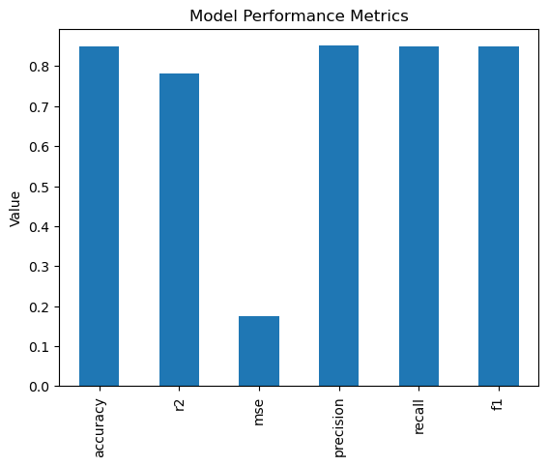
Personal Model
Notes:
85% of the time it was able to predict things into the correct classes. Majority being incorrectly classed as neutral instead of either good or bad with less than 1% of positive reviews being marked as negative and

Slide 7
Conclusions
With our trained model we could effectively sort all of our reviews by Positive, Negative and Neutral
This allows Managers and Business owners to quickly and effectively just see the ones they need at any time,
Staff morale? Let's get more positive reviews to show them!
Need to reply to negative reviews? Let's focus on those!

