Slide 1
DS Midterm Project
Rim Barbar William Finch

Slide 2
Project Overview
Objective: build a machine learning model to predict housing prices by processing raw JSON data, experimenting with different algorithms, and creating a reproducible pipeline.
Key Steps:
Load and clean dataset
Experiment with multiple ML models
Perform hyperparameter tuning
Build pipelines for automation

Slide 3
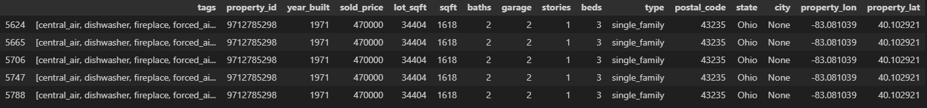
Insights and Data Utilization - EDA
Exploration of the data has shown many useless columns and data stored repetitively, we cleaned it up with various practices, such as the mean of the columns or exploration of the data to fill in based on other cells.

Slide 4
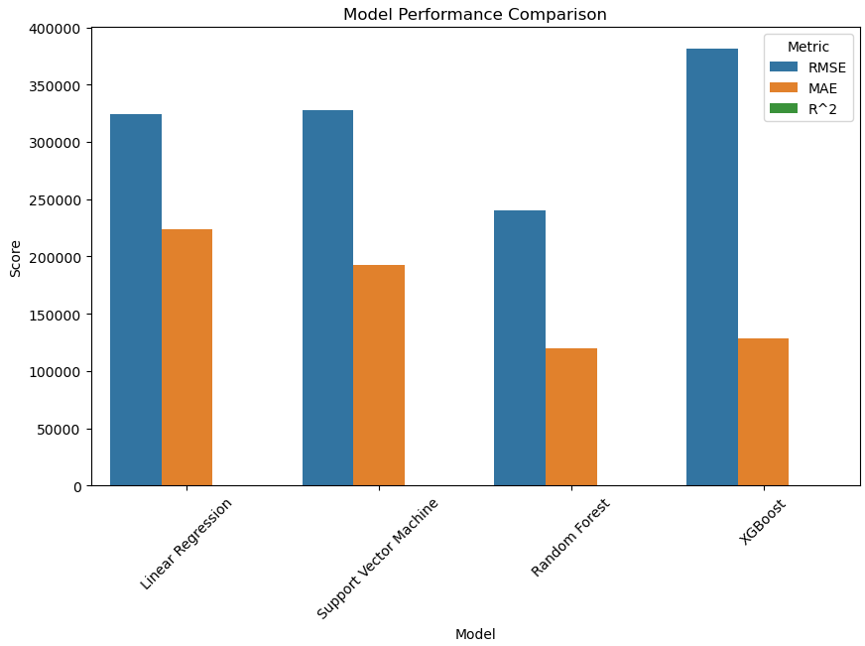
Insights and Data Utilization - Model Selection + Evaluation
ML Models Tested:
Linear regression
Decision Trees
Random Forest
XGBoost
Support Vector Machines

Slide 5
Insights and Data Utilization - Hyperparameter Tuning
To optimize model performance, we performed tuning using:
GridSearchCV: exhaustive search for best parameters
RandomizedSearchCV: more efficient, random sampling

Slide 6
Future Goals
We would like to explore adding additional data sources, such as:
Average income and age of populations in different areas.
Proximity to major landmarks (forests, oceans, theme parks, etc.).
Additionally, we hope to experiment more with feature selection to determine which parts of the dataset are most useful and which could be dropped without significant impact on model performance.
Notes:
Havent bc of time + resources, huge time investment

Slide 7
Our Model
Performance
Our model has an accuracy +- about $120,000 and the data we have supplied explains about 65% of the swing in pricing.

Slide 8

Thank You!
Do you have any questions?

