Slide 1
Linux System Programming
Part 1 - Linux Basics
IBA Bulgaria
2021

Slide 2
What is System Programming?
The art of writing system software.
System software lives at a low level, interfacing directly with the kernel and core system libraries.
Assists general use application programs.
System programmers must have a strong awareness of the hardware and operating system on which they are working.
In Linux usually the system utilities are in ‘/sbin’ and ‘/usr/sbin’.
Application Software
Text Processor, Internet Browser, etc.
System Software
OS, Utilities, Drivers
Hardware
CPU, Memory, Disks, Keyboard, etc.
Notes:
System software includes your shell and your text editor, your compiler and your debugger,
your core utilities and system daemons. These components are entirely system software,
based on the kernel and the C library. Much other software (such as high-level GUI
applications) lives mostly in the higher levels, delving into the low level only on occasion, if at
all.
Depending on the "level" of the stack at
which an application is written, the two may not actually be very interchangeable, but,
generally speaking, moving from application programming to system programming (or vice
versa) is not hard. Even when the application lives very high up the stack, far from the lowest
levels of the system, knowledge of system programming is important. And the same good
practices are employed in all forms of programming.

Slide 3
Our Work Environment
Home Client User 1
ssh
Linux Server
46.10.253.12
User 1
ssh
University Windows Client User 1
User 2
ssh
University Windows Client User 2
...
...
User N
ssh
University Windows Client User N

Slide 4
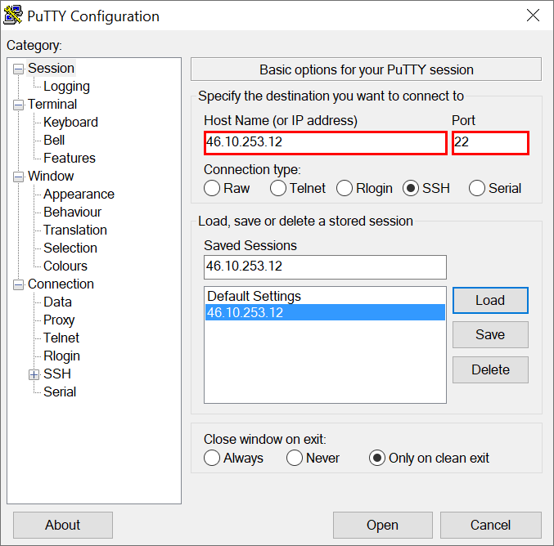
Remote Connection
telnet (Teletype Network)
ssh (Secure Shell)
PuTTY - has no official meaning.
Notes:
Telnet was developed in 1969 beginning with RFC 15, extended in RFC 854, and standardized as Internet Engineering Task Force (IETF) Internet Standard STD 8, one of the first Internet standards. The name stands for "teletype network".^{[1][2]}
Historically, Telnet provided access to a command-line interface (usually, of an operating system) on a remote host, including most network equipment and operating systems with a configuration utility (including systems based on Windows NT).^{[clarification needed]} However, because of serious security concerns when using Telnet over an open network such as the Internet, its use for this purpose has waned significantly in favor of SSH.
SSH uses public-key cryptography to authenticate the remote computer and allow it to authenticate the user, if necessary.^{[2]} There are several ways to use SSH; one is to use automatically generated public-private key pairs to simply encrypt a network connection, and then use password authentication to log on.
SSH is typically used to log into a remote machine and execute commands, but it also supports tunneling, forwarding TCP ports and X11 connections; it can transfer files using the associated SSH file transfer (SFTP) or secure copy (SCP) protocols.^{[2]} SSH uses the client-server model.

Slide 5
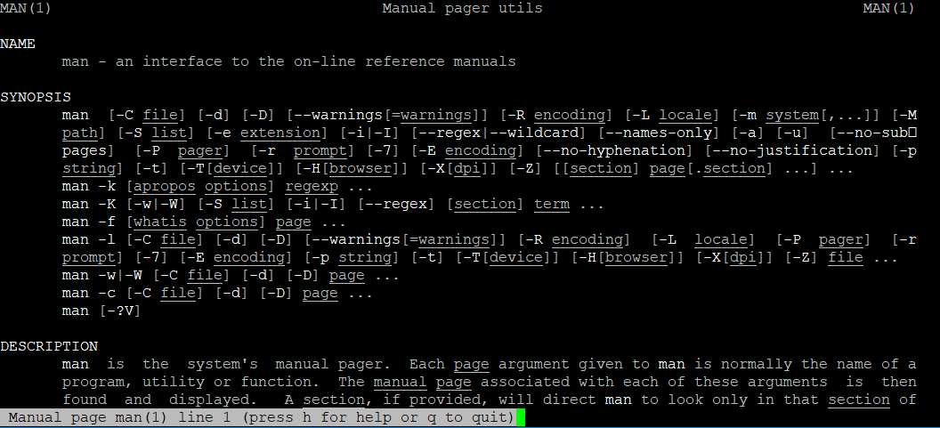
How to get Help in Linux?
man - an interface to the on-line reference manuals.
man [option(s)] keyword(s)
man man
Most important keys :PgUp, PgDn, q
Of course you could always google it.

Slide 6
Files and Directories in Linux
pwd - print the name of the current working directory.
ls - list directory contents.
mkdir - make directories.
cd - change the shell working directory.
rmdir - remove directory, this command will only work if the folders are empty.
cp - copy files and directories.
mv - move (rename) files.
rm - remove files or directories.
ln - make links between files.
cat - concatenate files and print on the standard output.
Notes:
Add cat, echo maybe?

Slide 7
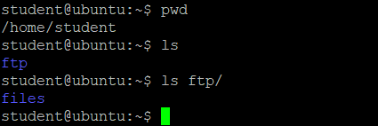
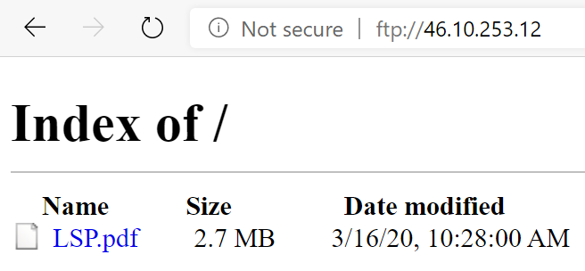
Transferring Files
The File Transfer Protocol (FTP) is a standard network protocol used for the transfer of computer files between a client and server on a computer network.
You can copy files into your ‘~/ftp/files’ directory.
You can download those files with any browser - ‘ftp://46.10.253.12’ and login with your Linux credentials.
You can manage your ‘~/ftp/files’ directory with any ftp client (like FileZilla).
Notes:
https://www.digitalocean.com/community/tutorials/how-to-set-up-vsftpd-for-a-user-s-directory-on-ubuntu-16-04
http://www.ducea.com/2006/07/27/allowing-ftp-access-to-files-outside-the-home-directory-chroot/

Slide 8
Example
Files and directories management
Notes:
Show all commands from the last page in man and use them with simple examples.

Slide 9
Processes in Linux
Processes are object code in execution: active, alive, running programs.
Processes consist of data, resources, state, and a virtualized computer.
Each process is represented by a unique identifier, the process ID (pid).
The process that the kernel "runs" when there are no other runnable processes is the idle process (pid=0).
The process that spawns a new process is known as the parent; the new process is known as the child.
Each process is owned by a user and a group.
Notes:
If files are the most fundamental abstraction in a Unix system, processes are the second most
fundamental. Processes are object code in execution: active, alive, running programs. But
they're more than just object code—processes consist of data, resources, state, and a
virtualized computer.
Processes begin life as executable object code, which is machine-runnable code in an
executable format that the kernel understands (the format most common in Linux is ELF). The
executable format contains metadata, and multiple sections of code and data. Sections are
linear chunks of the object code that load into linear chunks of memory. All bytes in a section
are treated the same, given the same permissions, and generally used for similar purposes.
The most important and common sections are the text section, the data section, and the bss
section. The text section contains executable code and read-only data, such as constant
variables, and is typically marked read-only and executable. The data section contains
initialized data, such as C variables with defined values, and is typically marked readable and
writable. The bss section contains uninitialized global data. Because the C standard dictates
default values for C variables that are essentially all zeros, there is no need to store the zeros
in the object code on disk. Instead, the object code can simply list the uninitialized variables in
the bss section, and the kernel can map the zero page (a page of all zeros) over the section
when it is loaded into memory. The bss section was conceived solely as an optimization for
this purpose. The name is a historic relic; it stands for block started by symbol, or block
storage segment. Other common sections in ELF executables are the absolute section (which
contains nonrelocatable symbols) and the undefined section (a catchall).
A process is also associated with various system resources, which are arbitrated and managed
by the kernel. Processes typically request and manipulate resources only through system calls.
Resources include timers, pending signals, open files, network connections, hardware, and IPC
mechanisms. A process' resources, along with data and statistics related to the process, are
stored inside the kernel in the process' process descriptor.
A process is a virtualization abstraction. The Linux kernel, supporting both preemptive
multitasking and virtual memory, provides a process both a virtualized processor, and a
virtualized view of memory. From the process' perspective, the view of the system is as
though it alone were in control. That is, even though a given process may be scheduled
alongside many other processes, it runs as though it has sole control of the system. The
kernel seamlessly and transparently preempts and reschedules processes, sharing the
system's processors among all running processes. Processes never know the difference.
Similarly, each process is afforded a single linear address space, as if it alone were in control
of all of the memory in the system. Through virtual memory and paging, the kernel allows
many processes to coexist on the system, each operating in a different address space. The
kernel manages this virtualization through hardware support provided by modern processors,
allowing the operating system to concurrently manage the state of multiple independent
processes.

Slide 10
Users and Groups
Authorization in Linux is provided by users and groups.
Each user is associated with a unique positive integer called the user ID (uid).
The users are often referred by usernames, not numerical values.
Each user may belong to one or more groups, including a primary or login group.
Notes:
During login, the user provides a username and password to the login(1) program. If given a
valid username and the correct password, the login(1) program spawns the user's login shell,
which is also specified in /etc/passwd, and makes the shell's uid equal to that of the user.
Child processes inherit the uids of their parents.
In addition to the real uid, each process also has an effective uid, a saved uid, and a
filesystem uid. While the real uid is always that of the user who started the process, the
effective uid may change under various rules to allow a process to execute with the rights of
different users. The saved uid stores the original effective uid; its value is used in deciding
what effective uid values the user may switch to. The filesystem uid, which is usually equal to
the effective uid, is used for verifying filesystem access.

Slide 11
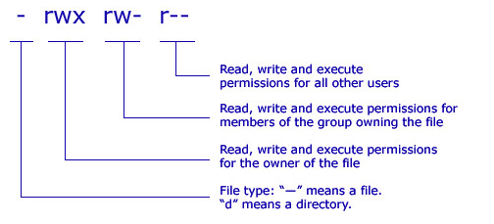
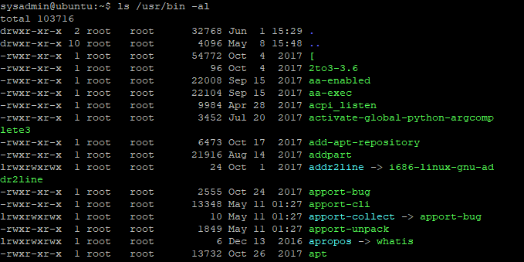
File Permissions
The traditional system defines three modes to use a file - (r)ead, (w)rite or e(x)ecute.
There are three levels of access rights for the file operations - owner, group and public.
Set-user Identification (SUID) - identified with (s) instead of (x) at owner level.
When a command has SUID bit set, its effective UID becomes that of the owner of the file, rather than of the user who is running it.
chmod 4555 [path_to_file]
Notes:
https://www.techrepublic.com/blog/linux-and-open-source/quick-introduction-to-suid-what-you-need-to-know/
https://www.thegeekdiary.com/what-is-suid-sgid-and-sticky-bit/
Now, it also happens that you execute a setuid program, and besides running as another user (e.g. root) the setuid program is also supposed to do something on your behalf. How does this work?
After executing the setuid program, it will have your real id (since you're the process owner) and the effective user id of the file owner (for example root) since it is setuid.
The program does whatever magic it needs to do with superuser privileges and then wants to do something on your behalf. That means, attempting to do something that you shouldn't be able to do should fail. How does it do that? Well, obviously by changing its effective user id to the real user id!
# ls -lrt /usr/bin/passwd
# ls -l /bin/su

Slide 12
File Permissions
ls /usr/bin -al
Set-group identification (SGID) - identified with (s) instead of (x) at group level.
When a command with SGID is run, it runs as if it were a member of the same group in which the file is a member.
chmod 2555 [path_to_file]
When SGID permission is set on a directory, files created in the directory belong to the group of which the directory is a member.
chmod g+s [path_to_directory]
Sticky Bit - identified with (t) instead of (x) at public level and is primarily used on shared directories. Users can create files, read and execute files owned by other users, but are not allowed to remove files owned by other users.
chmod +t [path_to_directory]
Notes:
SGID on a directory
– When SGID permission is set on a directory, files created in the directory belong to the group of which the directory is a member.
– For example if a user having write permission in the directory creates a file there, that file is a member of the same group as the directory and not the user’s group.
– This is very useful in creating shared directories.
Sticky Bit
– The sticky bit is primarily used on shared directories.
– It is useful for shared directories such as /var/tmp and /tmp because users can create files, read and execute files owned by other users, but are not allowed to remove files owned by other users.
– For example if user bob creates a file named /tmp/bob, other user tom can not delete this file even when the /tmp directory has permission of 777. If sticky bit is not set then tom can delete /tmp/bob, as the /tmp/bob file inherits the parent directory permissions.
– root user (Off course!) and owner of the files can remove their own files.

Slide 13
Managing Users and Groups
id - print real and effective user and group IDs.
chmod - change file mode bits.
umask - set file mode creation mask.
chown - change file owner and group.
chgrp - change group ownership.
passwd - change user password.

Slide 14
Example
Manage users and groups.

Slide 15
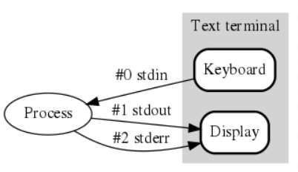
Standard Streams
Every program we run on the command line automatically has three data streams connected to it.
STDIN (0) - Standard input (data fed into the program)
STDOUT (1) - Standard output (data printed by the program, defaults to the terminal)
STDERR (2) - Standard error (for error messages, also defaults to the terminal)
Notes:
https://ryanstutorials.net/linuxtutorial/piping.php

Slide 16
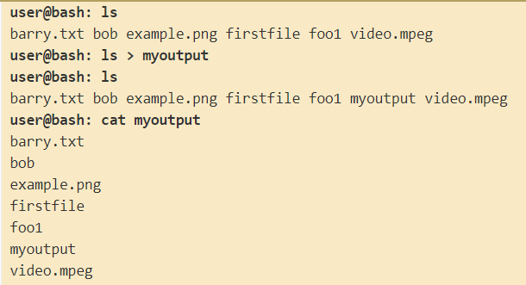
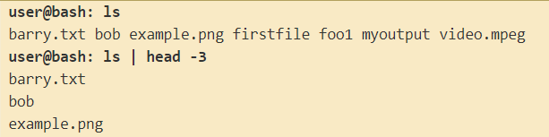

Redirection and Piping
The greater than operator ( > ) redirects programs output (or whatever it sends to STDOUT) to be saved in a file instead of printed to the screen.
If we save into a file which already exists, it's contents will be cleared, then the new output saved to it.
The double greater than operator ( >> ) redirects the output and appends it to a file.
The piping operator ( | ) feeds the output from the program on the left as input to the program on the right.
Notes:
You'll also notice that the file we created to save the data into is also in our listing. The way the mechanism works, the file is created first (if it does not exist already) and then the program is run and output saved into the file.

Slide 17
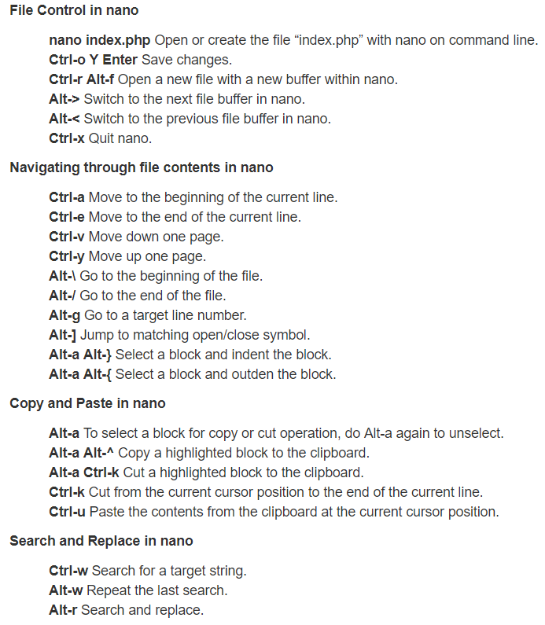
Nano text editor
nano - Nano's ANOther editor, an enhanced free Pico clone.
select - drag mouse.
paste - right mouse button.
https://www.howtogeek.com/howto/42980/the-beginners-guide-to-nano-the-linux-command-line-text-editor/
http://www.codexpedia.com/text-editor/nano-text-editor-command-cheatsheet/

Slide 18
Exercise
Establish a remote connection (with PuTTY) to our server (46.10.253.12), your initial password is ‘password123’.
Go to ‘ftp/files’ (you can use the ‘cd’ command) and copy there the file ‘/home/students/ 01_Linux_Basics.pdf’ (you can use the ‘cp’ command).
Open your ftp directory in a Windows browser (ftp://46.10.253.12) and download the ‘01_Linux_Basics.pdf’ and open it to read this lecture.
In your Linux environment:
Change your password.
In your home (‘~/’) directory create a new one for the exercises (like ‘exercises’) and a sub-directory in it for this lecture (‘day01’).
Go to the last folder (‘day01’) and create a file (‘listing.txt’) there, which contains the list of the files in ‘/sbin’ folder.
Open the listing file with nano and add your names at the beginning.
In your home directory create a link to the ‘/home/students/’ directory.
Notes:
cp /home/students/day01/LSPp1.pdf .
passwd
cd ~
mkdir exercises
mkdir exercises/day01
cd exercises/day01/
ls -l /sbin/ > listing.txt
nano listing.txt
cd ~
ln -s /home/students/ shared

