Slide 1
Linux System Programming
Part 2 - Programming
IBA Bulgaria
2021

Slide 2
The compilation process
HLL
source
assembly
source
object
file
(binary)
executable
compiler
assembler
linker
Notes:
https://www.youtube.com/watch?v=N2y6csonII4
Preprocessor maybe?

Slide 3
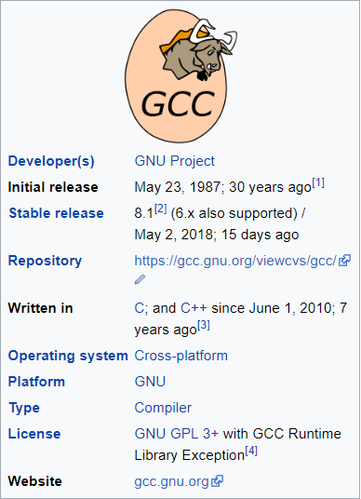
The GNU Compiler Collection (GCC)
А compiler system produced by the GNU Project supporting various programming languages.
Originally named the GNU C Compiler, when it only handled the C programming language.
We will use it to make our C sources into executables.
Notes:
https://en.wikipedia.org/wiki/GNU_Compiler_Collection

Slide 4
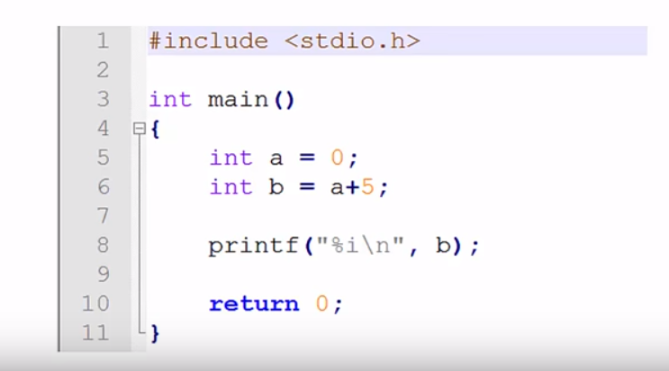
Example code (first.c)

Slide 5
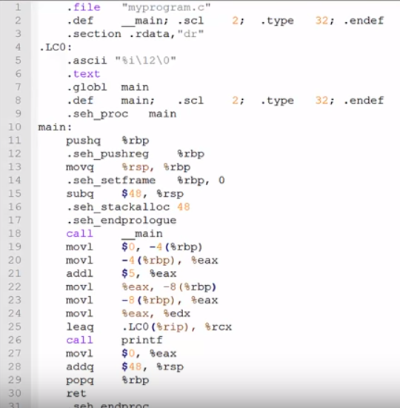
Compile to assembly
gcc -S first.c
‘-S’: Stop after the stage of compilation proper; do not assemble.
The output is ‘first.s’.
Notes:
-S Stop after the stage of compilation proper; do not assemble. The
output is in the form of an assembler code file for each non-
assembler input file specified.
By default, the assembler file name for a source file is made by
replacing the suffix .c, .i, etc., with .s.
Input files that don't require compilation are ignored.

Slide 6
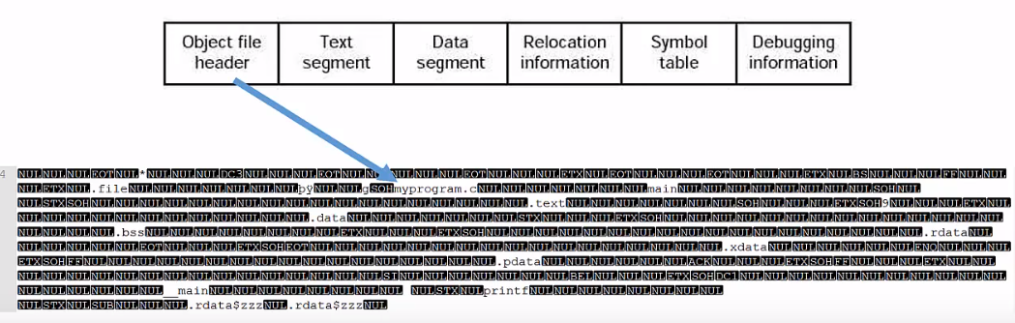
Compile and assemble to object file
gcc -c first.c
first.o
Notes:
-c Compile or assemble the source files, but do not link. The linking
stage simply is not done. The ultimate output is in the form of an
object file for each source file.
By default, the object file name for a source file is made by
replacing the suffix .c, .i, .s, etc., with .o.
Unrecognized input files, not requiring compilation or assembly,
are ignored.

Slide 7
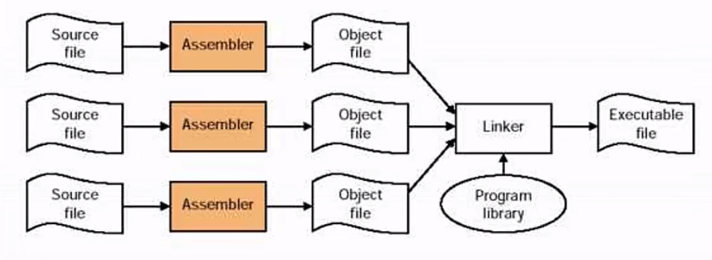
Compile, assemble, and link to executable
gcc first.c -o first
‘./first’ to execute.
Notes:
-o file
Place output in file file. This applies to whatever sort of output
is being produced, whether it be an executable file, an object
file, an assembler file or preprocessed C code.
If -o is not specified, the default is to put an executable file in
a.out, the object file for source.suffix in source.o, its assembler
file in source.s, a precompiled header file in source.suffix.gch,
and all preprocessed C source on standard output.

Slide 8
Example
Using GCC.

Slide 9
Linux C/C++ Libraries
Groups together multiple compiled object code files into a single one known as a library.
Some benefits:
Component reuse: update one library, shared resource takes up less disk space.
Version management: Linux libraries can cohabitate old and new versions on a single system.
Component specialization: niche and specialized developers can focus on their core competency on a single library.
Types:
Static libraries (.a): Library of object code which is linked with, and becomes part of the application.
Dynamically linked shared object libraries (.so): Can be dynamically linked at run time or loaded/unloaded and linked during execution.

Slide 10
GNU archiver (ar)
ar - create, modify, and extract from archives.
Create library:
ar rcs <library-name>.a <module-1>.o <module-2>.o …
List files in library:
ar -t <library-name>.a

Slide 11
Example library structure
/part2/libexample
/src
/bin
/addlib
/static
add.c
/shared
add.h
gcc + ar
answer.c
answer.h
main.c
Notes:
https://renenyffenegger.ch/notes/development/languages/C-C-plus-plus/GCC/create-libraries/index

Slide 12
Create the object files
First, we create the object files (in ‘libexample’ directory):
gcc -c src/main.c -o bin/main.o
Create the object files for the static library:
gcc -c src/addlib/add.c -o bin/static/add.o
gcc -c src/addlib/answer.c -o bin/static/answer.o
Object files for shared libraries need to be compiled as position independent code (-fPIC) because they are mapped to any position in the address space.
gcc -c -fPIC src/addlib/add.c -o bin/shared/add.o
gcc -c -fPIC src/addlib/answer.c -o bin/shared/answer.o

Slide 13
Create static library and link statically
Combine the objects files into a single library/archive:
ar rcs bin/static/libadd.a bin/static/add.o bin/static/answer.o
Statically link main.o with the library:
gcc bin/main.o -Lbin/static -ladd -o bin/statically-linked
The -L flag indicates (non standard) directory where the libraries can be found.
The -l flag indicates the name of the library. Note, that it assumes the library to start with lib and end with .o (so lib and .o must not be specified).

Slide 14
Create shared library and link dynamically
A shared library is with GCC's -shared flag and naming the resultant file with the suffix .so rather than .a:
gcc -shared bin/shared/add.o bin/shared/answer.o -o bin/shared/libadd.so
Link dynamically with the shared library (Note: -ladd-shared needs to be placed AFTER main.c):
gcc bin/main.o -Lbin/shared -ladd -o bin/use-shared-library
Move the shared library to a default location:
sudo mv bin/shared/libadd.so /usr/lib
sudo chmod u=rwx,go=rx /usr/lib/libadd.so
Use the shared library with LD_LIBRARY_PATH:
LD_LIBRARY_PATH=$(pwd)/bin/shared bin/use-shared-library

Slide 15
Example
Build a library and use it.

Slide 16
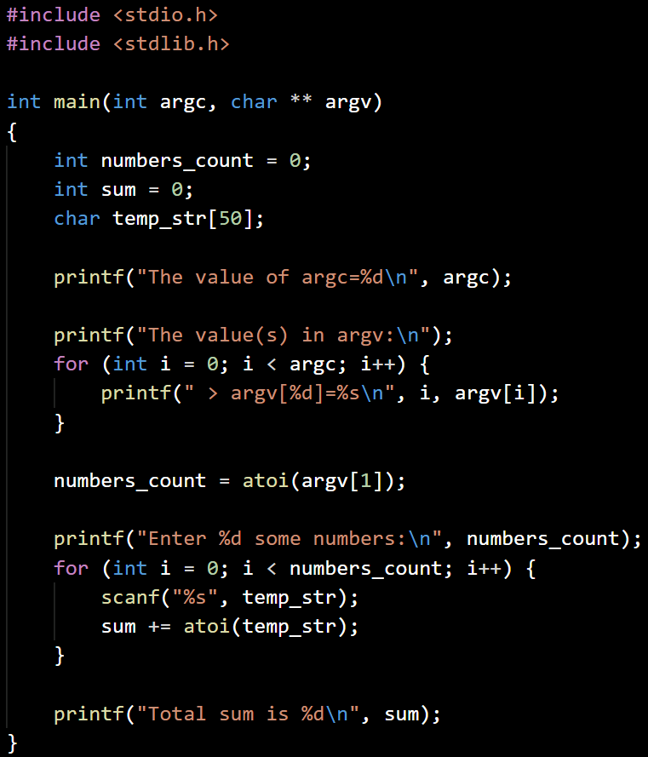
Process input example
processinp.c
Initialize variables, sum=0
Print the value of argc
Print the values in argv
num_count= the second value in argv
Do num_count times:
Read a number from the keyboard and add it to sum
Print the value of sum

Slide 17
Debugging with GDB
h | Help
n | Step forward one block of code
s | Step forward one line of code
p [variable] | Print out the value of variable
info locals | Print out the value of all local variables
bt | Show the sequence of the functions called up to this point of execution
q | Quit gdb
Compile for debug:
gcc -g <program name>.c
Start the GDB environment:
gdb a.out
Set a breakpoint, where the program will pause execution:
b [function name, line number]
Run the program:
r [command line arguments]
Notes:
https://www.youtube.com/watch?v=sCtY--xRUyI
https://www.youtube.com/watch?v=y5JmQItfFck

Slide 18
Example
Use GDB to debug ‘processinp.c’.

Slide 19
Exercise
Program MultiAdd:
Write a program (‘multiadd.c’), which takes one or more numbers as arguments, then calculates the total sum and prints the answer to the standard output. Compile the program and execute it. Compile for debug and play with GDB.
Program ReverseTest:
Write a program (‘reversetest.c’), which reads a string line from the keyboard and prints it backwards. To reverse the input string you have to use the library ‘reverse’, which sources are provided in ‘/day02/reverse/’ directory. The function you have to use is:
You have all the sources, so you can compile and link the library statically. Or you could choose the option to use the shared library ‘reverse’ in ‘/usr/lib/libreverse.so’. The best is if you try both approaches.
void inplace_reverse(char * str)

