Slide 1
Linux System Programming
Part 3 - Filesystem and Files
IBA Bulgaria
2021

Slide 2
Files in Linux
“Everything is a file.”
inode - data structure that describes a filesystem object.
Files are always opened from user space by a name.
A name and inode pair is called a link.
Regular files - bytes of data.
Directories - mapping between filenames and inodes (links).
Hard links - multiple links map different names to the same inode.
Symbolic links - like regular files which contain the complete pathname of the linked-to files.
Special files - block device files, character device files, named pipes, Unix domain sockets.

Slide 3
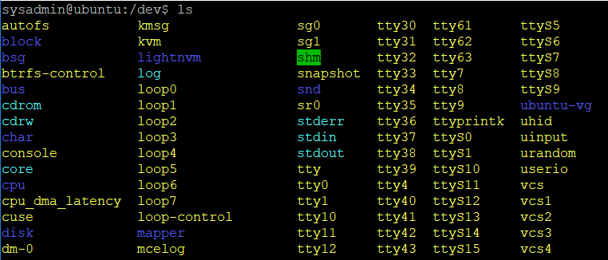
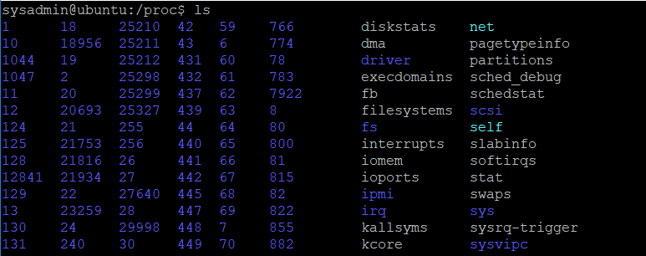
Filesystems and namespaces
Linux provides a global and unified namespace of files and directories (with a root ‘/’).
A filesystem is a collection of files and directories in a formal and valid hierarchy.
Filesystems may be individually added (mounted) to and removed (unmounted) from the global namespace of files and directories.
Some special filesystems - ‘/dev’ and ‘/proc’.
Notes:
Each process directory has these special entries: cmdline, cwd, environ, exe, fd, root, stat

Slide 4
Working with Files in C
Before a file can be read from or written to, it must be opened.
Each open instance of a file is given a unique file descriptor (fd).
File descriptors are represented by the C int type.
A single file can be opened more than once, by a different or even the same process.
open() / fopen()- opens file and returns its file descriptor.
read() / fread() - reads data from a file.
write() / fwrite() - writes data into a file.
fflush() - flushes a stream.
close() - unmaps the a file descriptor with the associated file.
lseek() / fseek() - set the file position of a file descriptor to a given value.
fcntl() - manipulate file descriptor, for example for locking.
errno - number of last error.
Notes:
Before a file can be read from or written to, it must be opened. The kernel maintains a perprocess list of open files, called the file table. This table is indexed via nonnegative integers known as file descriptors (often abbreviated fds). Each entry in the list contains information about an open file, including a pointer to an in-memory copy of the file's backing inode and associated metadata, such as the file position and access modes. Both user space and kernel space use file descriptors as unique per-process cookies. Opening a file returns a file descriptor, while subsequent operations (reading, writing, and so on) take the file descriptor as their primary argument.

Slide 5
Buffered vs unbuffered streams
Stream is a representation of flow of data from one side to another e.g. from disk to memory and from memory to disk.
File is a representation to store data on disk file. File uses streams to store and load data.
Buffer is (often) used to hold stream data temporarily.
Characters written to or read from an unbuffered stream are transmitted individually to or from the file as soon as possible.
Characters written to or read from a fully buffered stream are transmitted to or from the file in blocks of arbitrary size.
Characters written to a line buffered stream are transmitted to the file in blocks when a newline character is encountered.

Slide 6
Buffered vs unbuffered streams
Unbuffered:
Low-level file routines (unbuffered streams):
open(), read(), write(), lseek(), etc.
Part of <unistd.h> library.
Work with file descriptors of type int.
Treat the input/output as binary data.
High-level file routines (buffered streams):
fopen(), fread(), fwrite(), fseek(), etc.
Part of <stdio.h> library.
Use the object type FILE.
Treat the input/output as text streams.
The read/write of the accumulated buffer can be forced with fflush().
Hi!
Contents immediately available to the program
!iH
Buffered:
Buffer contents available to the program when:
Hi!
I’m robot
Buffer
H
i
!
full buffer
closed stream
program terminates
new line (*)
flush
Characters accumulated into a buffer
Notes:
Flushing output on a buffered stream means transmitting all accumulated characters to the file. There are many circumstances when buffered output on a stream is flushed automatically:
When you try to do output and the output buffer is full.
When the stream is closed. See Closing Streams.
When the program terminates by calling exit. See Normal Termination.
When a newline is written, if the stream is line buffered.
Whenever an input operation on any stream actually reads data from its file.
If you want to flush the buffered output at another time, call fflush, which is declared in the header file stdio.h.

Slide 7
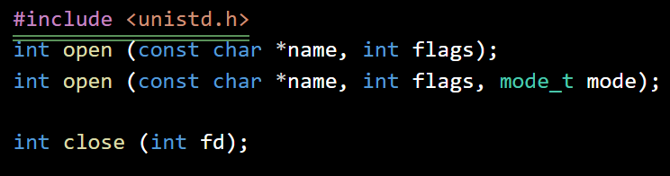
Basic file processing
flags parameter is a bit mask of the following bits:
O_APPEND | The file will be opened in append mode.
O_ASYNC | SIGIO generated when readable or writable.
O_CREAT | If the file doesn’t exist - create it.
O_DIRECT | Opened for direct I/O.
O_DIRECTORY | If name is not a directory, open( ) will fail.
O_EXCL | If O_CREAT and file exists, open( ) will fail.
O_LARGEFILE | A file larger than 2G to be opened.
O_NOCTTY | This flag is not frequently used.
O_NOFOLLOW | If name is a symbolic link, open( ) will fail.
O_NONBLOCK | If possible, open in nonblocking mode.
O_SYNC | The file will be opened for synchronous I/O.
O_TRUNC | If the file exists, truncated it to zero length.
If flags has O_CREAT set, the mode is a bit mask of:
S_IRWXU | S_IWGRP
S_IRUSR | S_IXGRP
S_IWUSR | S_IRWXO
S_IXUSR | S_IROTH
S_IRWXG | S_IWOTH
S_IRGRP | S_IXOTH
Notes:
We can open a second file “/proc/self/stat” to show that it gets the next number as a fd.

Slide 8
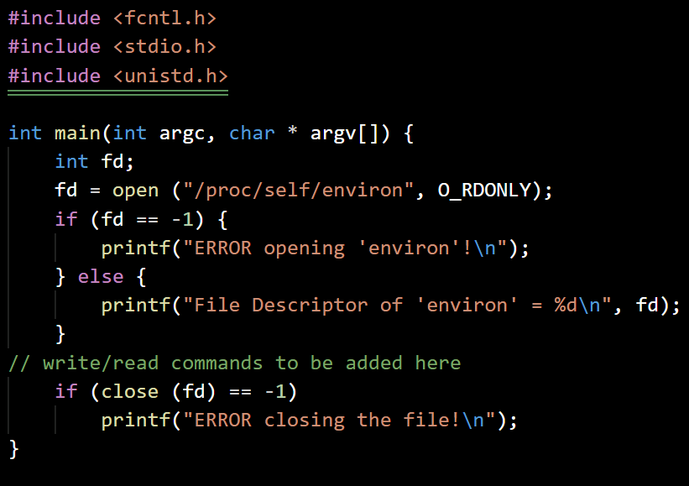
Open and close a file
openclose.c
Initialize the variables
Open the file as read-only and get the fd
If the fd is -1, print error message
Otherwise, print the value of fd (success)
Close the file
If the close failed, print error message

Slide 9

Reading file contents
Each call reads up to len bytes into buf from the current file offset of the file referenced by fd.
On success, the number of bytes written into buf is returned.
On error, the call returns -1 and errno is set.
Notes:
Indeed, a call to read( ) can result in many possibilities:
• The call returns a value equal to len. All len read bytes are stored in buf. The results are as intended.
• The call returns a value less than len, but greater than zero. The read bytes are stored in buf. This can occur because a signal interrupted the read midway, an error occurred in the middle of the read, more than zero, but less than len bytes' worth of data was available, or EOF was reached before len bytes were read. Reissuing the read (with correspondingly updated buf and len values) will read the remaining bytes into the rest of the buffer, or indicate the cause of the problem.
• The call returns 0. This indicates EOF. There is nothing to read.
• The call blocks because no data is currently available. This won't happen in nonblocking mode.
• The call returns -1, and errno is set to EINTR. This indicates that a signal was received before any bytes were read. The call can be reissued.
• The call returns -1, and errno is set to EAGAIN. This indicates that the read would block because no data is currently available, and that the request should be reissued later. This happens only in nonblocking mode.
• The call returns -1, and errno is set to a value other than EINTR or EAGAIN. This indicates a more serious error.

Slide 10
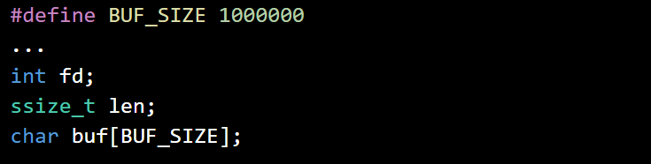
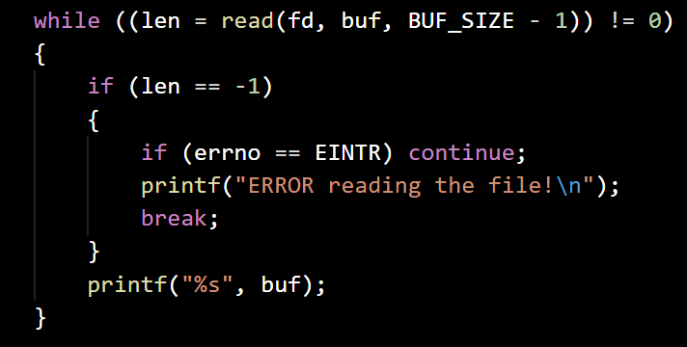
Read and print a file
readfile.c
Initialize the variables
Open ‘./readfile.c’, if failed print error & exit
While reading from file returns length <> 0
If length is -1 and errno is EINTR, try to read again
If length is -1 and errno <> EINTR, print error and finish reading
Otherwise print the buffer
Close the file and notify on error

Slide 11
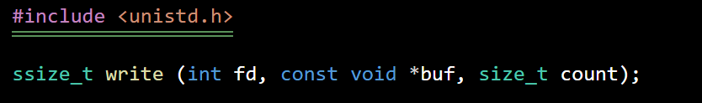
Create and write into a file
Writes up to count bytes starting at buf to the current file position of the file referenced by the file descriptor fd.
On success, the number of bytes written is returned, and the file position is updated.
On error, the call returns -1 and errno is set.
Notes:
2.3.6. Behavior of write( )
When a call to write( ) returns, the kernel has copied the data from the supplied buffer into a kernel buffer, but there is no guarantee that the data has been written out to its intended destination. Indeed, write calls return much too fast for that to be the case. The disparity in performance between processors and hard disks would make such behavior painfully obvious.
Instead, when a user-space application issues a write( ) system call, the Linux kernel performs a few checks, and then simply copies the data into a buffer. Later, in the background, the kernel gathers up all of the "dirty" buffers, sorts them optimally, and writes them out to disk (a process known as writeback). This allows write calls to occur lightning fast, returning almost immediately. It also allows the kernel to defer writes to more idle periods, and batch many writes together.
The delayed writes do not change POSIX semantics. For example, if a read is issued for a piece of just-written data that lives in a buffer and is not yet on disk, the request will be satisfied from the buffer, and not cause a read from the "stale" data on disk. This behavior actually improves performance, as the read is satisfied from an in-memory cache without having to go to disk. The read and write requests interleave as intended, and the results are as expected—that is, if the system does not crash before the data makes it to disk! Even though an application may believe that a write has occurred successfully, in this event, the data will never make it to disk.

Slide 12

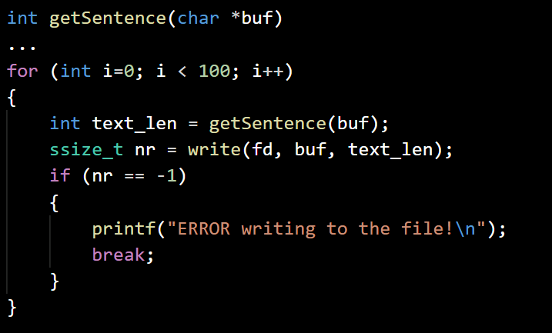
Write sentences into file
writefile.c
Initialize the variables
Create empty ‘./sentences.txt’, if failed print error & exit
Do 100 times
Call getSentence() to get a new text into the buffer and its length
Write the buffer into the file and get the number of bytes written
If the number of written bytes is -1, print error and stop writing.
Close the file and notify the error or success

Slide 13
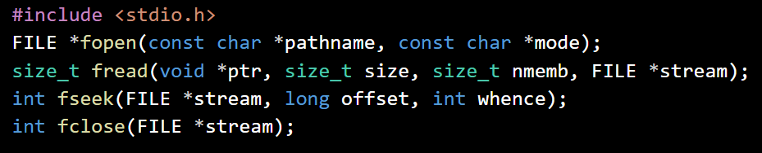
Seeking in files and Sparse files
The behavior of fseek() depends on the origin argument: SEEK_CUR, SEEK_END or SEEK_SET.
The call returns the new file position on success.
On error, the call returns -1 and errno is set.
Seeking after the end of a file and then writing in it causes holes padded with zeros.
Files with holes are called sparse files.
Holes do not occupy any physical disk space.
du - estimate file space usage.
Notes:
SEEK_CUR: The current file position of fd is set to its current value plus pos, which can be negative, zero, or positive. A pos of zero returns the current file position value.
SEEK_END: The current file position of fd is set to the current length of the file plus pos, which can be negative, zero, or positive. A pos of zero sets the offset to the end of the file.
SEEK_SET: The current file position of fd is set to pos. A pos of zero sets the offset to the beginning of the file.
https://en.wikipedia.org/wiki/Sparse_file
ls –al
du bighole.txt

Slide 14
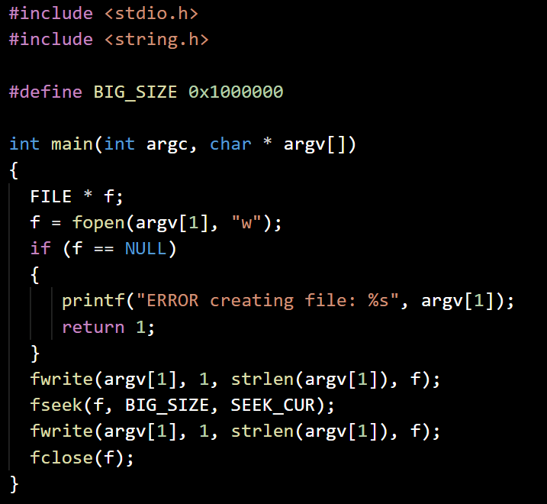
Make a file with a hole
makesparse.c
Initialize the variables
Create a file, its name is the first argument passed to the program
If failed to open - notify error and exit
Write the name of the file into the file
Jump 16777216 bytes forward into the file
Write the name of the file into the file again
Close the file

Slide 15
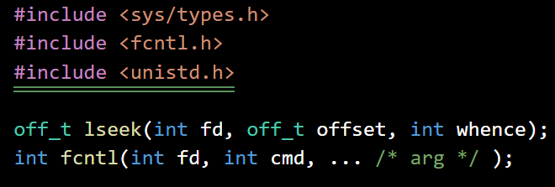
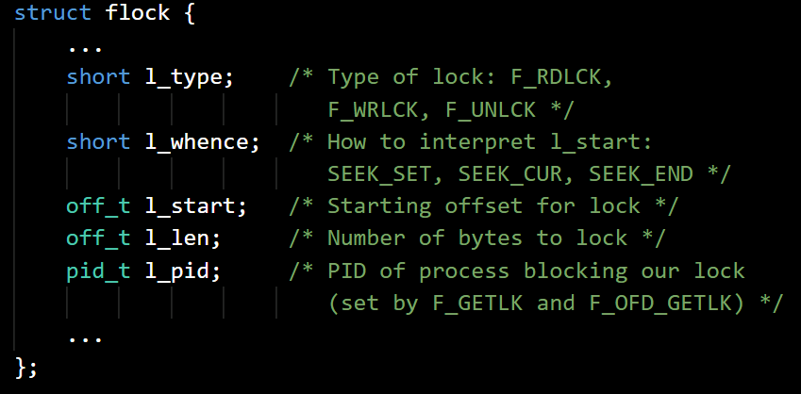
Locking files
Use the fcntl() call providing a pointer to a flock structure. This call manipulates the file descriptor fd, depending on the command cmd:
To lock a block of a file use F_SETLK.
If the block is already locked use F_GETLK to get information about the locking process.
To unlock a block of a file use F_SETLK but set flock.l_type = F_UNLCK.

Slide 16
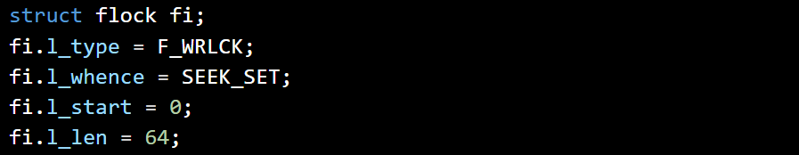
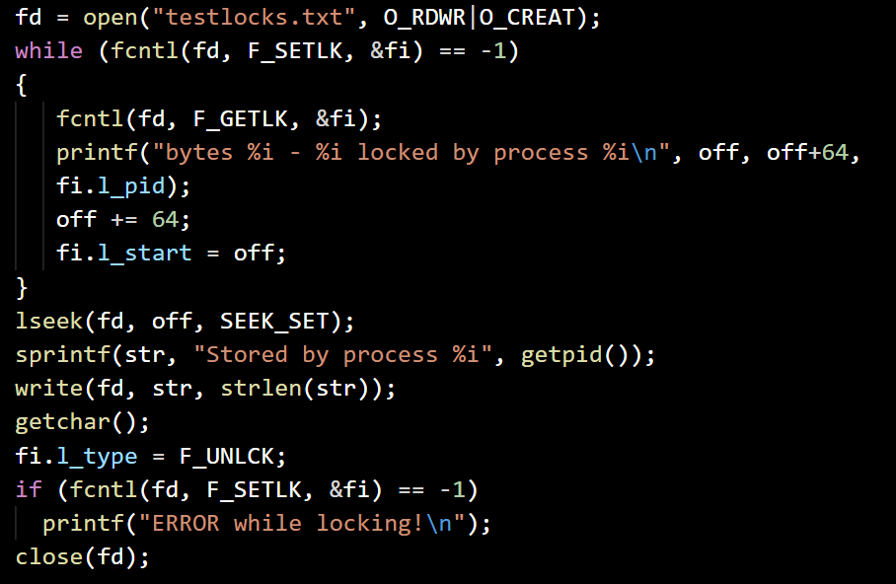
Lock and write in there
lockfile.c
Initialize the variables
Open for writing or create ‘./testlocks.txt’
While lock of 64 bytes from offset fails:
Get information about the locking process and print info about it
Move the offset 64 bytes further
Move offset bytes from the start of the file and write info about the current process
Wait for Enter key press
Unlock the 64 locked bytes, notify if failed
Close the file

Slide 17
Exercise
Program FileManipulator:
Write a program (‘fmanipulator.c’), which takes 3 arguments: words_count, min_length, max_length. The program should generate a file called ‘words.txt’, which contains words_count words (separated with spaces). To generate the words use the following function from the code files in ‘/day03/rndword/’ (note that the function will not generate real words, but rather random sequences of characters):
Then the program should print the generated file to the screen.
After the program creates ‘words.txt’ and before writing into it it should lock the first 100 bytes of the file. When the program prints out the generated words it should wait for Enter key press and then unlock the file. Respectively, if the file was already locked by another process, the program should notify about this and wait for Enter key press, before trying again (to lock, generate and write).
Compile and run a couple of instances to test.
char * rndword(int min_length, int max_length);

