Slide 1
Linux System Programming
Part 5 - Interprocess Communication (IPC)
IBA Bulgaria
2021

Slide 2
IPC Methods
File | A record stored on disk, or a record synthesized on demand by a file server, which can be accessed by multiple processes.
Signal | A system message sent from one process to another, not usually used to transfer data but instead used to remotely command the partnered process.
Socket | Data sent over a network interface, either to a different process on the same computer or to another computer on the network. Stream-oriented (TCP; data written through a socket requires formatting to preserve message boundaries) or more rarely message-oriented (UDP, SCTP).
Unix domain socket | Similar to an internet socket but all communication occurs within the kernel. Domain sockets use the file system as their address space. Processes reference a domain socket as an inode, and multiple processes can communicate with one socket.
Notes:
https://en.wikipedia.org/wiki/Inter-process_communication

Slide 3
IPC Methods (2)
Message queue | A data stream similar to a socket, but which usually preserves message boundaries. Typically implemented by the operating system, they allow multiple processes to read and write to the message queue without being directly connected to each other.
Pipe | A unidirectional data channel. Data written to the write end of the pipe is buffered by the operating system until it is read from the read end of the pipe. Two-way data streams between processes can be achieved by creating two pipes utilizing standard input and output.
Named pipe | A pipe implemented through a file on the file system instead of standard input and output. Multiple processes can read and write to the file as a buffer for IPC data.
Shared memory | Multiple processes are given access to the same block of memory which creates a shared buffer for the processes to communicate with each other.

Slide 4
Signals
Signals are a mechanism for one-way asynchronous notifications.
The Linux kernel implements about 30 signals (the exact number is architecture-dependent).
With the exception of SIGKILL (which always terminates the process), and SIGSTOP (which always stops the process), processes may control what happens when they receive a signal.
Handled signals cause the execution of a user-supplied signal handler function.
Notes:
1.4.5. Signals
Signals are a mechanism for one-way asynchronous notifications. A signal may be sent from
the kernel to a process, from a process to another process, or from a process to itself. Signals
typically alert a process to some event, such as a segmentation fault, or the user pressing
Ctrl-C.
The Linux kernel implements about 30 signals (the exact number is architecture-dependent).
Each signal is represented by a numeric constant and a textual name. For example, SIGHUP,
used to signal that a terminal hangup has occurred, has a value of 1 on the i386 architecture.
With the exception of SIGKILL (which always terminates the process), and SIGSTOP (which
always stops the process), processes may control what happens when they receive a signal.
They can accept the default action, which may be to terminate the process, terminate and
coredump the process, stop the process, or do nothing, depending on the signal. Alternatively,
processes can elect to explicitly ignore or handle signals. Ignored signals are silently dropped.
Handled signals cause the execution of a user-supplied signal handler function. The program
jumps to this function as soon as the signal is received, and (when the signal handler returns)
the control of the program resumes at the previously interrupted instruction.

Slide 5
Most important signals
SIGHUP (1) | Process's controlling terminal was closed (most frequently, the user logged out). | Terminate
SIGINT (2) | User generated the interrupt character (Ctrl-C). | Terminate
SIGABRT (6) | The abort() function sends this signal to the process that invokes it. The process then terminates and generates a core file. | Terminate with core dump
SIGKILL (9) | This signal is sent from the kill() system call; it exists to provide system administrators with a surefire way of unconditionally killing a process. | Terminate
SIGSEGV (11) | This signal, whose name derives from segmentation violation, is sent to a process when it attempts an invalid memory access. | Terminate with core dump
SIGTERM (15) | This signal is sent only by kill(); it allows a user to gracefully terminate a process (the default action). | Terminate

Slide 6
Most important signals (2)
SIGCHLD (17) | Whenever a process terminates or stops, the kernel sends this signal to the process' parent. A handler for this signal generally calls wait() to determine the child's pid and exit code. | Ignored
SIGCONT (18) | The kernel sends this signal to a process when the process is resumed after being stopped (by SIGSTOP). | Ignored
SIGSTOP (19) | This signal is sent only by kill(). It unconditionally stops a process, and cannot be caught or ignored. | Stop
SIGTSTP (20) | The kernel sends this signal to all processes in the foreground process group when the user provides the suspend character (usually Ctrl-Z). | Stop
SIGIO (29) | This signal is sent when an asynchronous I/O event is generated. | Terminate
SIGUSR1 (10) and SIGUSR2 (12) | These signals are available for user-defined purposes; the kernel never raises them. Processes may use SIGUSR1 and SIGUSR2 for whatever purpose they like. | Terminate

Slide 7
Signal management in C
sigemptyset() - initializes an empty signal set, with all signals excluded from the set.
sigfillset() - initializes a full signal set, including all signals.
sigaddset() - adds a signal to a set.
sigdelset() - removes a signal from a set.
sigprocmask() - fetches and/or changes the signal mask of the calling thread.
sigaction() - changes a signal action.
sigwait() - wait for a signal.
strsignal() - return string describing signal.

Slide 8
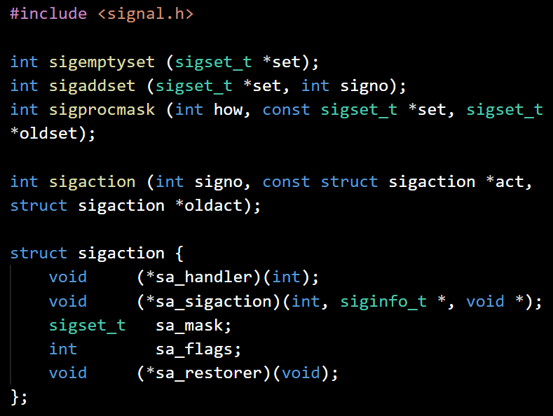
Managing Signals
The behavior of sigprocmask( ) depends on the value of how, which is one of the following:
SIG_SETMASK - the signal mask for the invoking process is changed to set.
SIG_BLOCK - The signals in set are added to the invoking process' signal mask.
SIG_UNBLOCK - The signals in set are removed from the invoking process' signal mask.
struct sigaction:
sa_handler - address of the handler, SIG_IGN or SIG_DFL;
sa_mask - signals to block;
sa_flags - additional flags, like SA_RESETHAND
SA_RESETHAND - enables "one-shot" mode. The behavior of the given signal is reset to the default once the signal handler returns.
Notes:
Скомпилируйте и запустите программу в окне терминала. В другом окне скомандуйте kill <PID> где PID – идентификатор процесса программы. Вы увидите, что перед тем как завершиться, программа выдает диагностическое сообщение, тогда как при завершении с помощью Ctrl-C никакого сообщения не выводится.
Послать нашей программе сигнал SIGHUP вы можете с помощью консольной команды
kill –s 1 <PID>
sigemptyset( ) initializes the signal set given by set, marking it empty (all signals excluded from the set).
sigaddset( ) adds signo to the signal set given by set, while sigdelset( ) removes signo from the signal set given by set. Both return 0 on success, or -1 on error, in which case errno is set to the error code EINVAL, signifying that signo is an invalid signal identifier.
The behavior of sigprocmask( ) depends on the value of how, which is one of the following
flags:
SIG_SETMASK
The signal mask for the invoking process is changed to set.
SIG_BLOCK
The signals in set are added to the invoking process' signal mask. In other words,
the signal mask is changed to the union (binary OR) of the current mask and set.
SIG_UNBLOCK
The signals in set are removed from the invoking process' signal mask. In other
words, the signal is changed to the intersection (binary AND) of the current mask,
and the negation (binary NOT) of set. It is illegal to unblock a signal that is not
blocked.
A call to sigaction( ) changes the behavior of the signal identified by signo, which can be any value except those associated with SIGKILL and SIGSTOP. If act is not NULL, the system call changes the current behavior of the signal as specified by act. If oldact is not NULL, the call stores the previous (or current, if act is NULL) behavior of the given signal there.
SA_RESETHAND
This flag enables "one-shot" mode. The behavior of the given signal is reset to the
default once the signal handler returns.

Slide 9
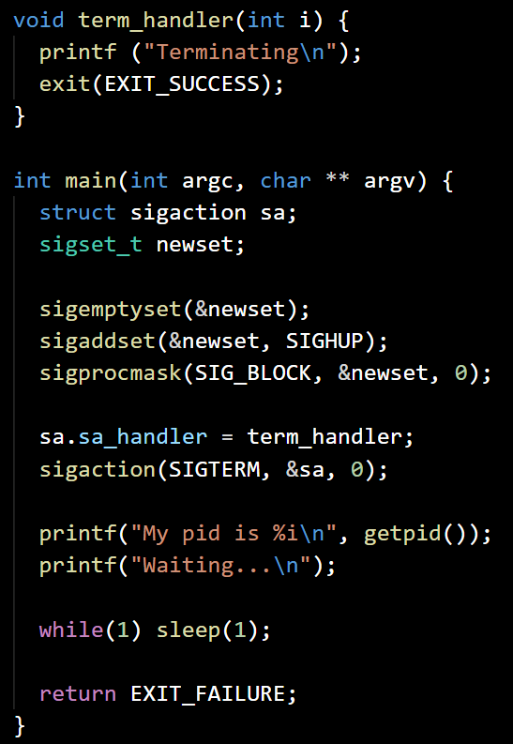
Handle a signal
simplehdlr.c
Define the SIGTERM handler function
Init a signal set, only SIGHUP is on and block the signal processing
Set the handler for SIGTERM
Print the pid of the process
Enter endless loop

Slide 10
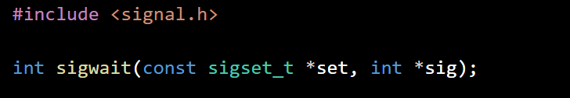
Waiting for Signals
The sigwait() function suspends execution of the calling thread until one of the signals specified in the signal set set becomes pending.
The function accepts the signal (removes it from the pending list of signals), and returns the signal number in sig.
On success, sigwait() returns 0. On error, it returns a positive error number.

Slide 11
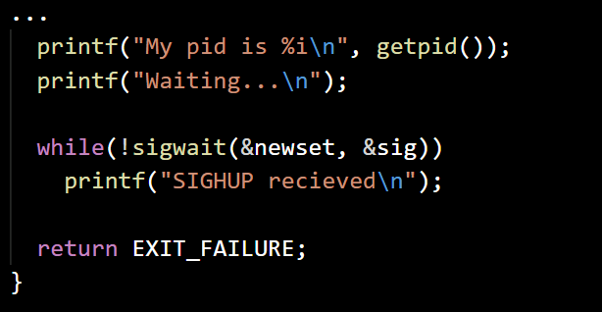
Wait for signal
waitsignal.c
Define the SIGTERM handler function
Init a signal set, only SIGHUP is on and block the signal processing
Set the handler for SIGTERM
Print the pid of the process
Wait for incoming SIGHUPs and notify
If error occured exit with failure

Slide 12
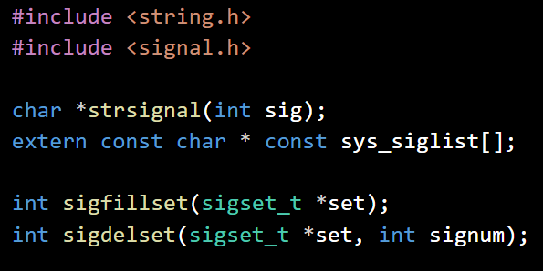
Examine Signals
sys_siglist is an array of strings holding the names of the signals supported by the system, indexed by signal number.
A call to strsignal( ) returns a pointer to a description of the signal given by signo.
Notes:
#define _GNU_SOURCE

Slide 13
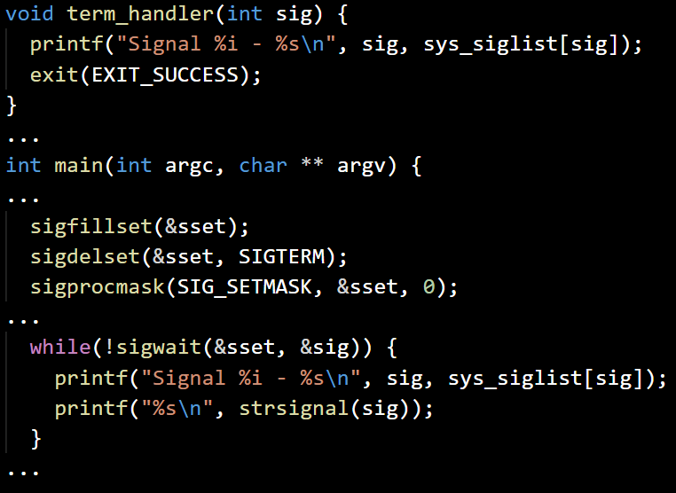
Show signals info
siginfo.c
Define the SIGTERM handler function
Init a full signal set, with only SIGTERM excluded
Set the handler for SIGTERM
Print the pid of the process
Wait and show info for the incoming signals
If error occured exit with failure

Slide 14
Reentrancy
When the kernel raises a signal, a process can be executing code anywhere. The process might even be handling another signal. Signal handlers cannot tell what code the process is executing when a signal hits- the handler can run in the middle of anything. It is thus very important that any signal handler your process installs is a reentrant function.
A reentrant function is a function that is safe to call from within itself (or concurrently, from another thread in the same process). In order to qualify as reentrant, a function must not manipulate static data, must manipulate only stack-allocated data or data provided to it by the caller, and must not invoke any non-reentrant function.
Notes:
When the kernel raises a signal, a process can be executing code anywhere. For example, it
might be in the middle of an important operation that, if interrupted, would leave the process
is an inconsistent state—say, with a data structure only half updated, or a calculation only
partially performed. The process might even be handling another signal.
Signal handlers cannot tell what code the process is executing when a signal hits; the handler
can run in the middle of anything. It is thus very important that any signal handler your
process installs be very careful about the actions it performs and the data it touches. Signal
handlers must take care not to make assumptions about what the process was doing when it
was interrupted. In particular, they must practice caution when modifying global (that is,
shared) data. In general, it is a good idea for a signal handler never to touch global data; in
an upcoming section, however, we will look at a way to temporarily block the delivery of
signals, as a way to allow safe manipulation of data shared by a signal handler and the rest of
a process.
What about system calls and other library functions? What if your process is in the middle of
writing to a file or allocating memory, and a signal handler writes to the same file or also
invokes malloc( )? Or what if a process is in the middle of a call to a function that uses a
static buffer, such as strsignal( ), when a signal is delivered?
Some functions are clearly not reentrant. If a program is in the middle of executing a
nonreentrant function, a signal occurs, and the signal handler then invokes that same
nonreentrant function, chaos can ensue. A reentrant function is a function that is safe to call
from within itself (or concurrently, from another thread in the same process). In order to
qualify as reentrant, a function must not manipulate static data, must manipulate only stackallocated
data or data provided to it by the caller, and must not invoke any nonreentrant
function.

Slide 15
Reentrancy
The standard C reentrant functions, which are safe to use:
accept, access, aio_error, aio_return, aio_suspend, alarm, bind, cfgetispeed, cfgetospeed, cfsetispeed, cfsetospeed, chdir, chmod, chown, clock_gettime, close, connect, creat, dup, dup2, execle, execve, _Exit & _exit, fchmod, fchown, fcntl, fdatasync, fork, fpathconf, fstat, fsync, ftruncate, getegid, geteuid, getgid, getgroups, getpeername, getpgrp, getpid, getppid, getsockname, getsockopt, getuid, kill, link, listen, lseek, lstat, mkdir, mkfifo, open, pathconf, pause, pipe, poll,posix_trace_event, pselect, raise, read, readlink, recv, recvfrom, recvmsg, rename, rmdir, select, sem_post, send, sendmsg,sendto, setgid, setpgid, setsid, setsockopt, setuid, shutdown, sigaction, sigaddset, sigdelset, sigemptyset, sigfillset,sigismember, signal, sigpause, sigpending, sigprocmask, sigqueue, sigset, sigsuspend, sleep, socket, socketpair, stat, symlink, sysconf, tcdrain, tcflow, tcflush, tcgetattr, tcgetpgrp, tcsendbreak, tcsetattr, tcsetpgrp, time, timer_getoverrun,timer_gettime, timer_settime, times, umask, uname, unlink, utime, wait, waitpid, write.

Slide 16
Anonymous and Named Pipes
In computer science, an anonymous pipe is a simplex FIFO communication channel that may be used for one-way interprocess communication (IPC).
Typically a parent program opens anonymous pipes, and creates a new process that inherits the other ends of the pipes.
An anonymous pipe lasts only as long as the process lives.
A named pipe (FIFO) is an extension to the traditional (anonymous) pipe concept.
A named pipe can be identified by a name and appear as a file in the system.
A named pipe can last as long as the system is up, beyond the life of the process. It can be deleted if no longer used.

Slide 17
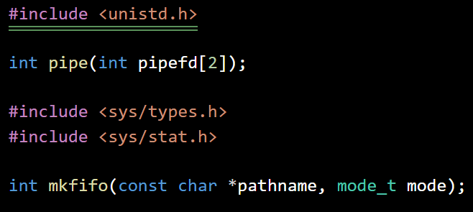
Working with pipes
pipe() - creates anonymous pipe.
The array pipefd is used to return two file descriptors referring to the ends of the pipe.
pipefd[0] refers to the read end of the pipe, pipefd[1] refers to the write end.
mkfifo() - makes a named pipe (FIFO).
mode specifies the FIFO's permissions. It is modified by the process's umask in the usual way: the permissions of the created file are (mode & ~umask).

Slide 18
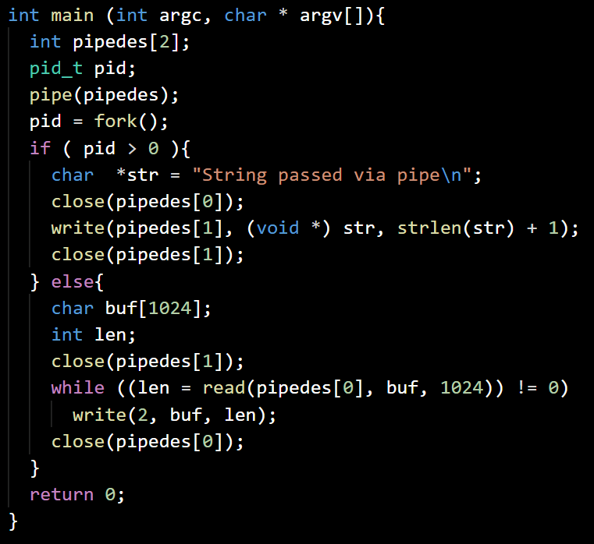
Anonymous pipe usage
passmsg.c
Open a pipe and store the I/O fds
Fork the process
The parent: close the input/read fd
Write a message to the output fd and closes it
The child: close the output/write fd
Read a message from the input fd
Print the message to stdout and close input fd

Slide 19
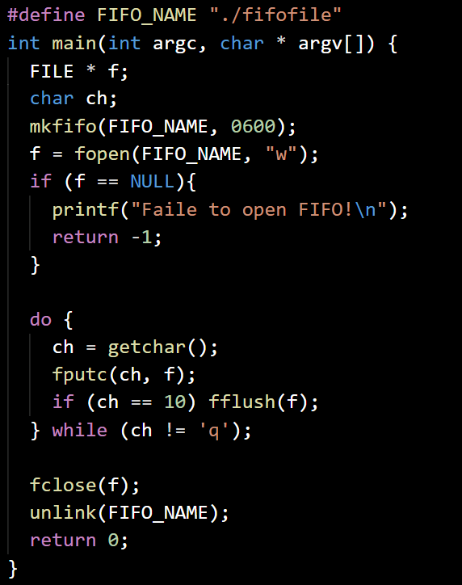
Chat server
chatsrv.c
Make a FIFO named ‘./fifofile’
Open for write ‘./fifofile’ and exit on error
Do until we receive ‘q’ from the keyboard
Read a symbol (key) and write it to the FIFO file
Flush the FIFO file if the key was Enter
Close and delete the FIFO file

Slide 20
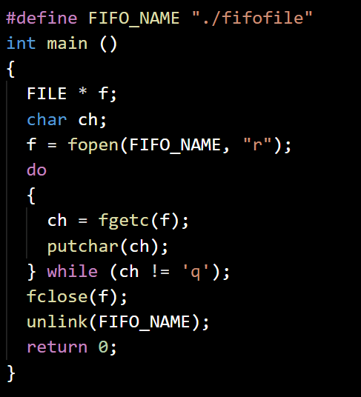
Chat client
chatclnt.c
Open for read the file named ‘./fifofile’
Do until we receive ‘q’ from the keyboard
Read a symbol (key)
Write the received symbol to the console
Close and delete the FIFO file

Slide 21
Exercise
Program ReverseEncryptorDecryptor:
Let’s define “Reverse Encryption” (RE) as a method to secure text messages - the messages are simply reverted, before they are sent further. Write a program (‘revendec.c’), which have 2 processes communicating through an anonymous pipe:
Process 1 should read text lines from the keyboard, then apply RE to it and send the encrypted message to Process 2.
Process 2 should await for incoming messages, print the encrypted messages to the screen, then decrypt them and store into a file (‘messages.log’).
Project EncryptedChat:
Write a server/client pair of programs (‘echatsrv.c’ and ‘echatclnt.c’). The server should mimic the behaviour of Process 1 from the previous task and the client - Process 2, respectively. The programs should use a FIFO (named pipe) as a communication method between them.

