Slide 1
Linux System Programming
Part 6 - IPC (synchronization)
IBA Bulgaria
2021

Slide 2
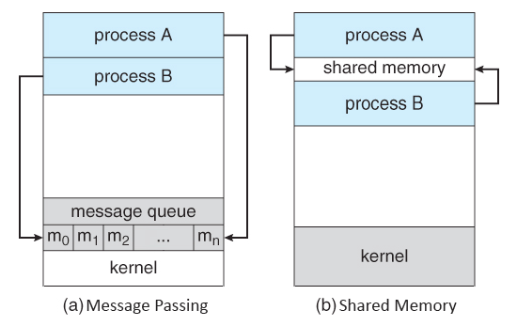
Message queue
Message queues can be described as an internal linked list within the kernel's addressing space.
Messages can be sent to the queue in order and retrieved from the queue in several different ways.
Each message queue (of course) is uniquely identified by an IPC identifier.
Notes:
https://www.tldp.org/LDP/lpg/node27.html

Slide 3
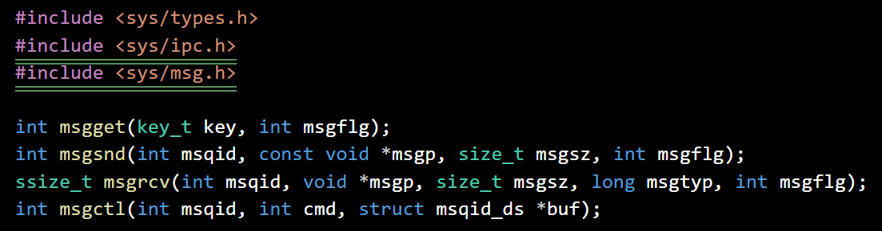
Messaging in C
The msgget() system call returns the System V message queue identifier associated with the value of the key argument.
The msgsnd() and msgrcv() system calls are used, respectively, to send messages to, and receive messages from, a System V message queue. The calling process must have write permission on the message queue in order to send a message, and read permission to receive a message.
msgctl() and cmd = IPC_RMID removes a message queue.

Slide 4
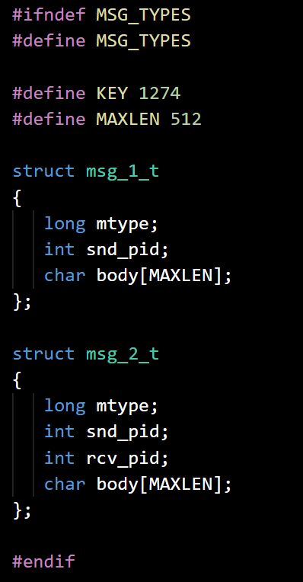
Define common data
msgtypes.h
Define KEY - the queue unique ID
Define MAXLEN - max length of message
Define msg_1_t for the client message
Define msg_1_2 for the server response

Slide 5
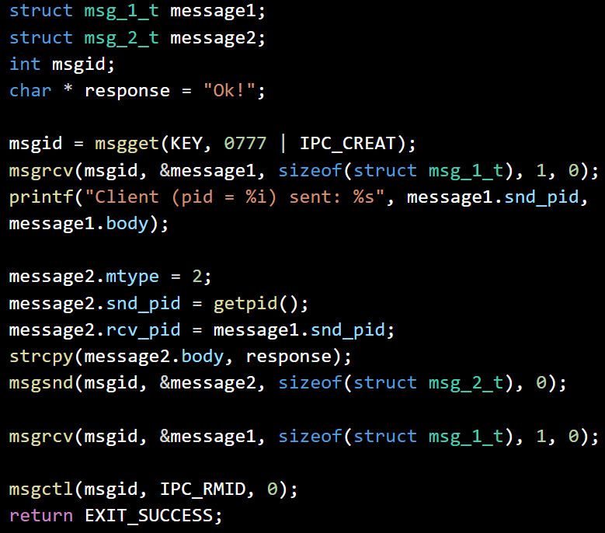
Message Server
msgsrv.c
Create a message queue with a given KEY
Wait for a message of type msg_1_t from the queue
Print the received message data
Prepare and send answer of type msg_2_t
Wait for confirmation msg_1_t
Remove the message queue

Slide 6
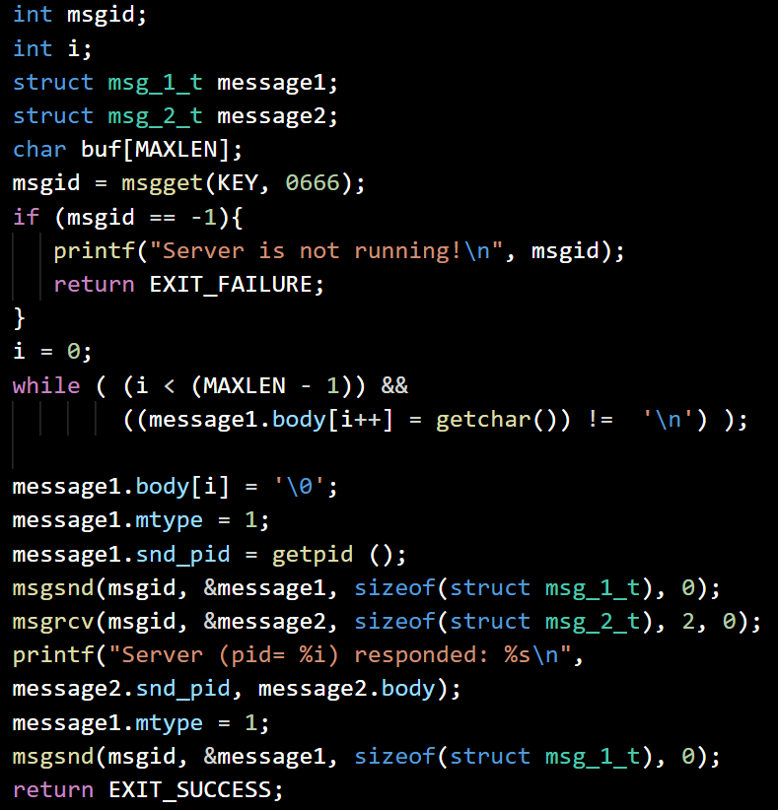
Message Client
msgcli.c
Open a message queue with a given KEY and notify and exit if failed
Read a message body from the keyboard and set the other parameters of msg_1_t
Send msg_1_t message to the queue
Wait for msg_2_t and print it
Send back a confirmation msg_1_t

Slide 7
Shared Memory
Shared memory can be described as the mapping of an area (segment) of memory that will be mapped and shared by more than one process.
This is by far the fastest form of IPC, because there is no intermediation - information is mapped directly from a memory segment into the addressing space of the calling process.
A segment can be created by one process, and subsequently written to and read from by any number of processes.
Notes:
https://www.tldp.org/LDP/lpg/node65.html

Slide 8
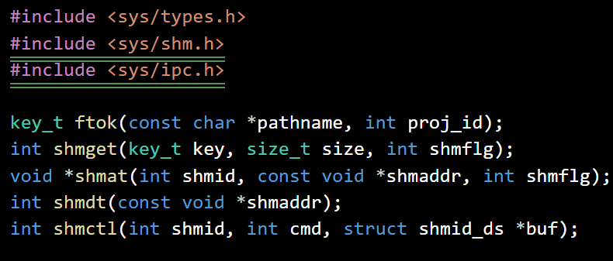
Shared memory in C
ftok() - convert a pathname and a project identifier to a System V IPC key.
shmget() - allocates a System V shared memory segment.
shmat() - attaches the System V shared memory segment identified by shmid to the address space of the calling process.
shmdt() - detaches the shared memory segment located at the address specified by shmaddr from the address space of the calling process.
shmctl() with cmd = IPC_RMID - marks the segment to be destroyed.

Slide 9
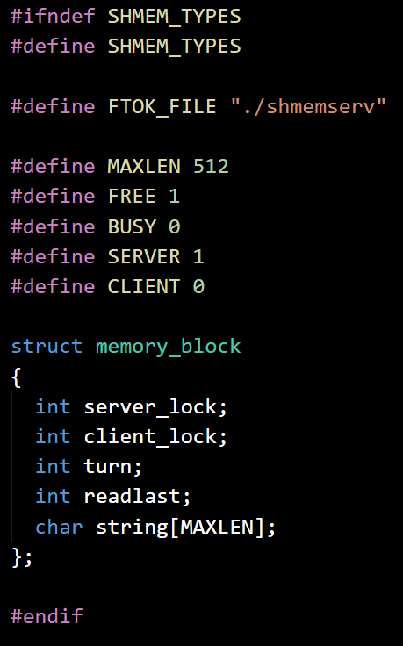
Define common data
shmemtypes.h
Define FTOK_FILE - the queue unique ID
Define the shared memory structure memory_block:
server_lock is 1 when server uses the memory
client_lock is 1 when client uses the memory
turn is 0 when waiting for client message
turn is 1 when waiting for server message
readlast is 0 when client received last message
readlast is 1 when server received last message
string holds the current message

Slide 10
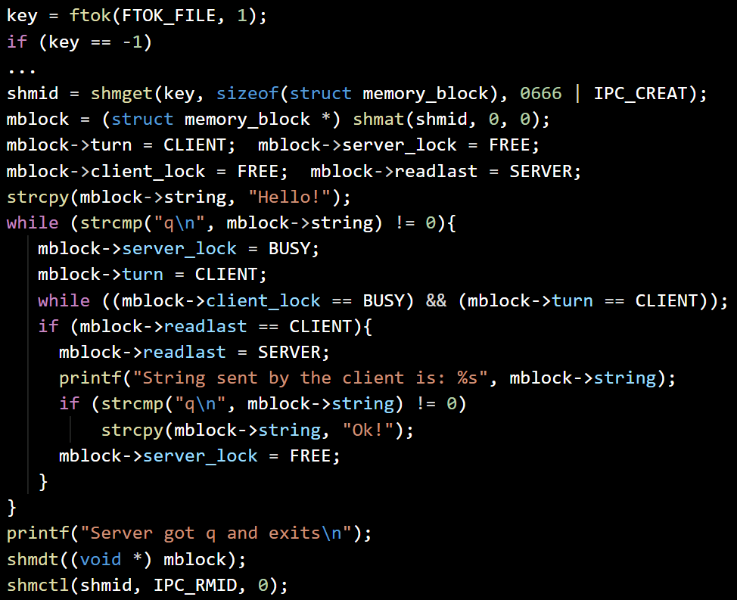
Memory Server
shmemserv.c
Create token ‘./shmemserv’, exit on error
Allocate and attach shared memory
Configure the memory for client turn and write ‘Hello!’ message in it
While current message is not ‘q’:
Lock memory for server, set client’s turn
Wait if client is using the memory
If client processed last message - indicate server processed the current one, print the client’s message, return ‘Ok!’, and release the server lock
Detach and remove the shared memory

Slide 11
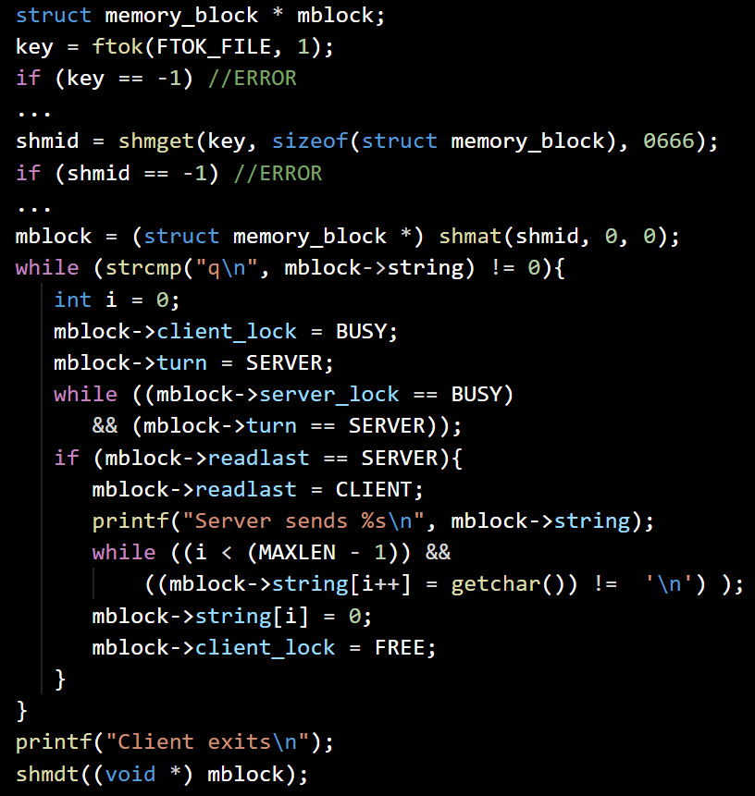
Memory Client
shmemcli.c
Create token ‘./shmemserv’, exit on error
Attach the shared memory
While current message is not ‘q’:
Lock memory for client, set server’s turn
Wait if server is using the memory
If server processed last message - indicate client processed the current one, print the server’s message, read a line from keyboard, and release the client lock
Detach the shared memory

Slide 12
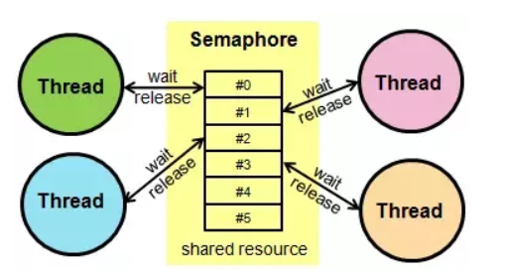
Semaphore
Semaphores are counters used to control access to shared resources by multiple processes (resource counters).
They are used as a locking mechanism to prevent processes from accessing a particular resource while another process is performing operations on it.
A resource counter is decreased when a process starts using a resource and increased back, when the resource is released.
When the counter = 0, the resource is unavailable at the moment.
Notes:
https://www.tldp.org/LDP/lpg/node65.html

Slide 13
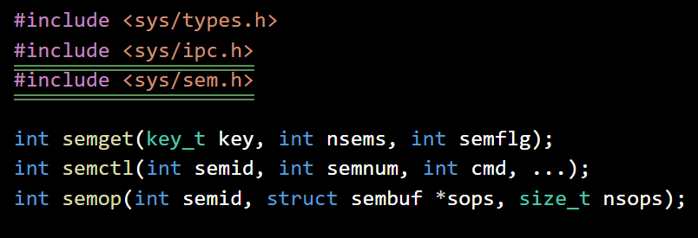
Using semaphores
semget() - returns the System V semaphore set identifier associated with the argument key.
semctl() with cmd = SETVAL - Sets the value of semval to arg.val for the semnum-th semaphore of the set.
semctl() with cmd = IPC_RMID - removes the semaphore set.
semop() performs operations on selected semaphores in the set indicated by semid.

Slide 14
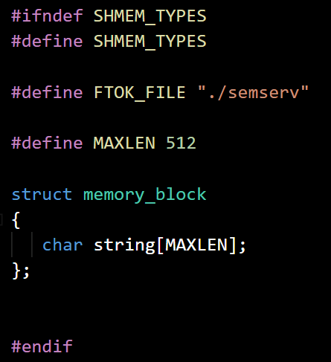
Define common data
semtypes.h
Define FTOK_FILE = ‘./semserv’
Define the shared memory structure memory_block:
string holds the current message

Slide 15
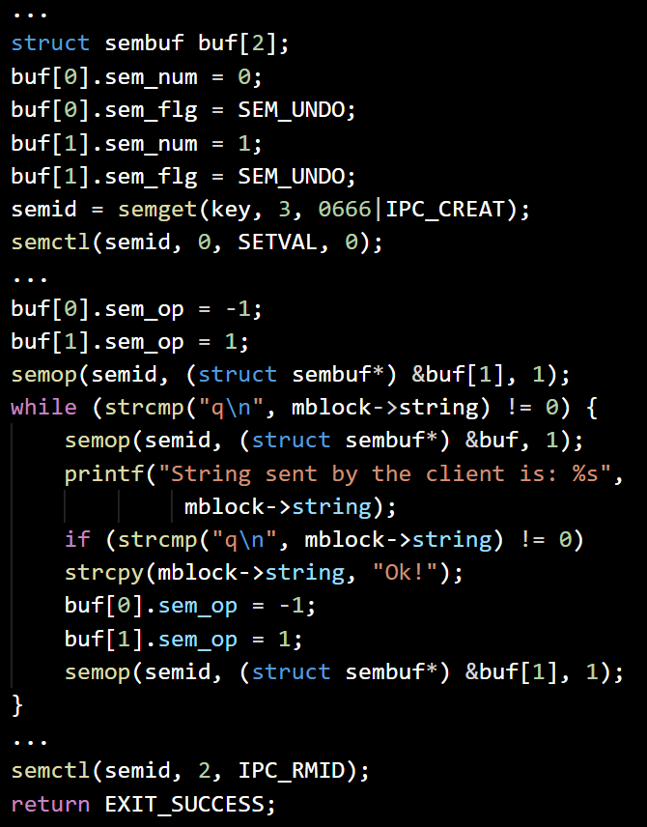
Semaphore Server
semserv.c
Set 2 semaphores - first indicating that the server has to read, second for the client
Create token ‘./shmemserv’, exit on error
Allocate and attach shared memory and write ‘Hello!’
Release the client semaphore
While current message is not ‘q’:
Request server semaphore resource
If current message is not ‘q’, write ‘Ok!’ in memory and release the client sem.
Detach and remove the shared memory and the semaphores

Slide 16
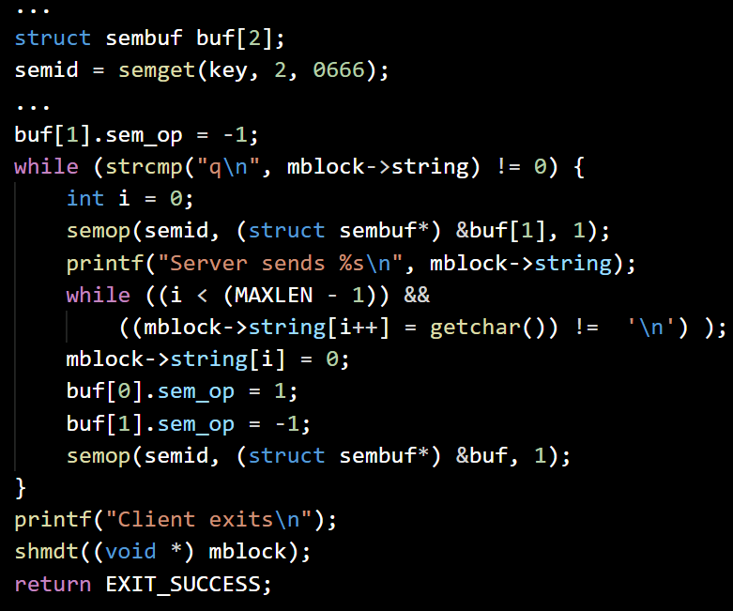
Semaphore Client
semcli.c
Set 2 semaphores - first indicating that the server has to read, second for the client
Create token ‘./shmemserv’, exit on error
Attach the shared memory
While current message is not ‘q’:
Request client semaphore resource and print the next message
Read a new line from the keyboard to the shared memory
Release the server semaphore
Detach the shared memory

Slide 17
Exercise
Project DoubleSharedMemory:
Write a server/client pair of programs (‘dblmemsrv.c’ and ‘dblmemcli.c’), which share blocks of memory between them. The server supports up to 2 client instances in parallel execution, which should not interfere with each other. The server initializes the shared memory with welcoming messages for the clients and waits for them to modify the memory with their messages. When a new message from the client is written, the server answers with the same message, but with ‘Confirmed!” at the end.
The client is started with a single argument: client_number, which identifies the client (1 or 2) for the server. The client should continuously print the message from the shared memory, read a line from the keyboard and write it to the shared memory. The program should quit when ‘q’ message is entered.
Program DoubleDumper:
Write a program (‘dbldump.c’), which in real time shows the changes in the shared memory from the DoubleSharedMemory project. You may need to modify the server and/or client programs to support this functionality.

