Slide 1
Linux System Programming
Part 8 - Threads
IBA Bulgaria
2021

Slide 2
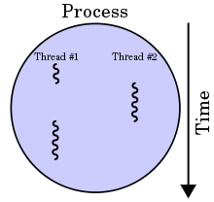
Threads
A thread in computer science is short for a thread of execution. Threads are a way for a program to divide (termed "split") itself into two or more simultaneously (or pseudo-simultaneously) running tasks.
Threads and processes differ from one operating system to another but, in general, a thread is contained inside a process and different threads in the same process share same resources while different processes in the same multitasking operating system do not.
Threads are lightweight, in terms of the system resources they consume, as compared with processes.

Slide 3
libpthreads (POSIX threads)
pthreads defines a set of C programming language types, functions and constants that support applications with requirements for multiple flows of control, called threads, within a process. It is implemented with a pthread.h header and a pthread library.
There are around 100 threads procedures, all prefixed pthread_ and they can be categorized into four groups:
Thread management - creating, joining threads etc.
Mutexes
Condition variables
Synchronization between threads using read/write locks and barriers
We’re only going to cover “Thread management” in this part.

Slide 4
Thread management functions - basics
int pthread_create(pthread_t *thread, const pthread_attr_t *attr, void *(*start_routine) (void *), void *arg); starts a new thread in the calling process
int pthread_join(pthread_t thread, void **retval); waits for the thread specified by thread to terminate
void pthread_exit(void *retval); terminates the calling thread and returns a value via retval that (if the thread is joinable) is available to another thread in the same process that calls pthread_join(3).

Slide 5
Creating threads
Initially, your main() program comprises a single, default thread. All other threads must be explicitly created by the programmer. pthread_create creates a new thread and makes it executable. This routine can be called any number of times from anywhere within your code.
pthread_create arguments:
thread: An opaque, unique identifier for the new thread returned by the subroutine.
attr: An opaque attribute object that may be used to set thread attributes. You can specify a thread attributes object, or NULL for the default values.
start_routine: the C routine that the thread will execute once it is created.
arg: A single argument that may be passed to start_routine. It must be passed by reference as a pointer cast of type void. NULL may be used if no argument is to be passed.

Slide 6
Finishing threads
Terminating Threads & pthread_exit():
There are several ways in which a thread may be terminated:
The thread returns normally from its starting routine. Its work is done.
The thread makes a call to the pthread_exit subroutine - whether its work is done or not.
The thread is canceled by another thread via the pthread_cancel routine.
The entire process is terminated due to making a call to either the exec() or exit()
If main() finishes first, without calling pthread_exit explicitly itself

Slide 7
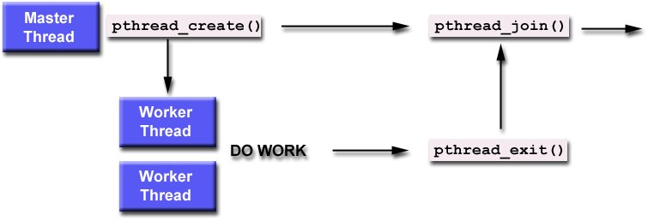
Joining threads

Slide 8
Joining threads
The pthread_join() subroutine blocks the calling thread until the specified threadid thread terminates.
The programmer is able to obtain the target thread's termination return status if it was specified in the target thread's call to pthread_exit().

Slide 9
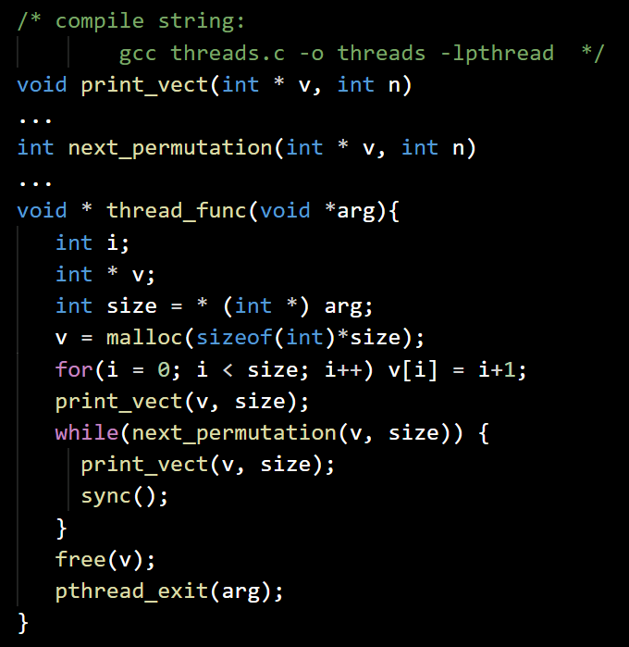
Joining two Threads
threads.c
Define the helper permutations generation functions
Define the threads function:
Allocate a vector of size arg
Initialize the vector with the first permutation and print it
While there is next permutation:
Generate it, print it and synchronize
Deallocate the vector and exit thread

Slide 10
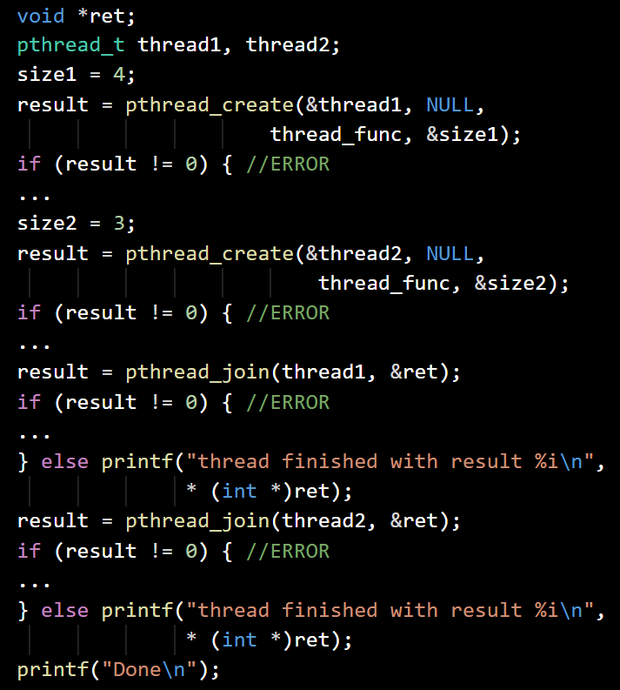
Joining two Threads (2)
threads.c
In the main function function:
Start thread function with size 4, exit on error
Start thread function with size 3, exit on error
Wait for the first thread and print a notification, exit on error
Wait for the second thread and print a notification, exit on error
Print “Done” and quit

Slide 11
Thread management functions - cancellations
int pthread_cancel(pthread_t thread); sends a cancellation request to the thread thread.
int pthread_setcancelstate(int state, int *oldstate); sets the cancelability state of the calling thread to the value given in state - PTHREAD_CANCEL_ENABLE or PTHREAD_CANCEL_DISABLE
int pthread_setcanceltype(int type, int *oldtype); sets the cancelability type of the calling thread to the value given in type - PTHREAD_CANCEL_DEFERRED or PTHREAD_CANCEL_ASYNCHRONOUS

Slide 12
Thread management functions - types
The pthread_cancel() function sends a cancellation request to a thread. Whether and when the target thread reacts to the cancellation request depends on two attributes that are under the control of that thread: its cancelability state (enabled/disabled) and type:
Deferred (default behaviour) cancelability means that cancellation will be delayed until the thread next calls a function that is a cancellation point (pthread_testcancel() and others).
Asynchronous cancelability means that the thread can be canceled at any time (usually immediately, but the system does not guarantee this).

Slide 13
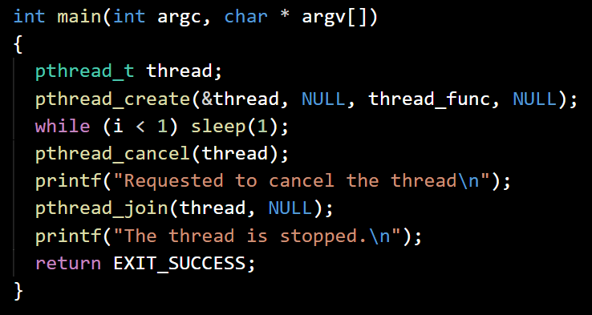
Thread cancellations - basic scenario
canceltest.c
Create a thread
Try to cancel it
Wait for it to finish

Slide 14
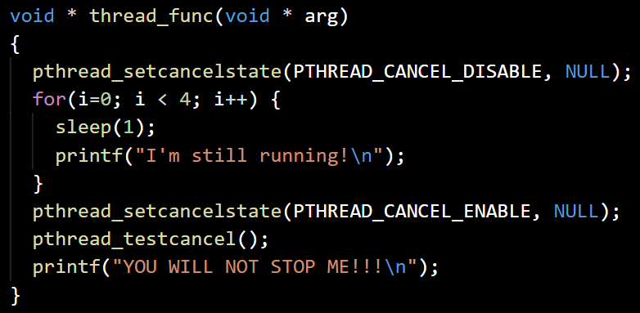
Thread cancellability STATE
canceltest.c
Mark the thread as uncancellable
… while it’s working
… and until we enable cancellations
… AND reach a cancelability point

Slide 15
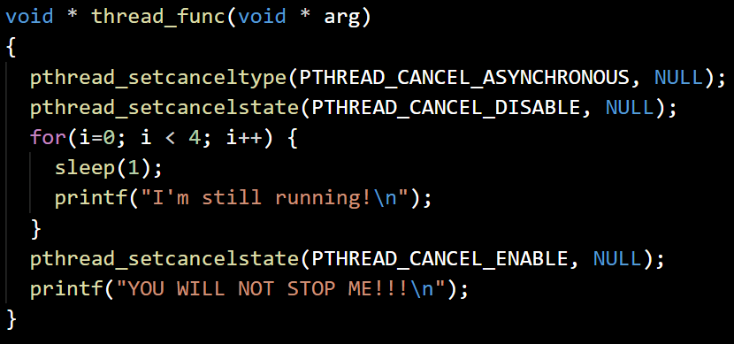
Thread cancellability type
canceltest2.c
Make the thread cancellable at any time
But mark it in a noncancelable state for now
… while it’s working
… and until we enable cancellations
The thread gets cancelled automatically, no need to reach a cancellation point

Slide 16
Exercise
Project ThreadedChat:
Refactor the network server/client pair of programs from the previous lecture with the following changes:
The multi-user handling in the server should be done using of threads.
The server stops when one of the clients sends “!quitserver” to the server.

