Slide 1
Linux System Programming
Part 4 - Processes
IBA Bulgaria
2018

Slide 2
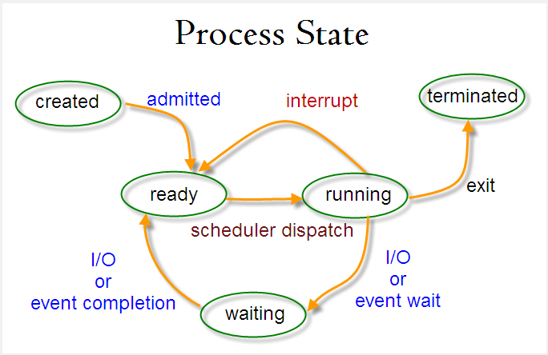
Processes in Linux
The process state:
Processes are object code in execution: active, alive, running programs.
Processes consist of data, resources, state, and a virtualized computer.
Each process is represented by a unique identifier, the process ID (pid).
The process that the kernel "runs" when there are no other runnable processes is the idle process (pid=0).
The process that spawns a new process is known as the parent; the new process is known as the child.
Each process is owned by a user and a group.
Notes:
If files are the most fundamental abstraction in a Unix system, processes are the second most
fundamental. Processes are object code in execution: active, alive, running programs. But
they're more than just object code—processes consist of data, resources, state, and a
virtualized computer.
Processes begin life as executable object code, which is machine-runnable code in an
executable format that the kernel understands (the format most common in Linux is ELF). The
executable format contains metadata, and multiple sections of code and data. Sections are
linear chunks of the object code that load into linear chunks of memory. All bytes in a section
are treated the same, given the same permissions, and generally used for similar purposes.
The most important and common sections are the text section, the data section, and the bss
section. The text section contains executable code and read-only data, such as constant
variables, and is typically marked read-only and executable. The data section contains
initialized data, such as C variables with defined values, and is typically marked readable and
writable. The bss section contains uninitialized global data. Because the C standard dictates
default values for C variables that are essentially all zeros, there is no need to store the zeros
in the object code on disk. Instead, the object code can simply list the uninitialized variables in
the bss section, and the kernel can map the zero page (a page of all zeros) over the section
when it is loaded into memory. The bss section was conceived solely as an optimization for
this purpose. The name is a historic relic; it stands for block started by symbol, or block
storage segment. Other common sections in ELF executables are the absolute section (which
contains nonrelocatable symbols) and the undefined section (a catchall).
A process is also associated with various system resources, which are arbitrated and managed
by the kernel. Processes typically request and manipulate resources only through system calls.
Resources include timers, pending signals, open files, network connections, hardware, and IPC
mechanisms. A process' resources, along with data and statistics related to the process, are
stored inside the kernel in the process' process descriptor.
A process is a virtualization abstraction. The Linux kernel, supporting both preemptive
multitasking and virtual memory, provides a process both a virtualized processor, and a
virtualized view of memory. From the process' perspective, the view of the system is as
though it alone were in control. That is, even though a given process may be scheduled
alongside many other processes, it runs as though it has sole control of the system. The
kernel seamlessly and transparently preempts and reschedules processes, sharing the
system's processors among all running processes. Processes never know the difference.
Similarly, each process is afforded a single linear address space, as if it alone were in control
of all of the memory in the system. Through virtual memory and paging, the kernel allows
many processes to coexist on the system, each operating in a different address space. The
kernel manages this virtualization through hardware support provided by modern processors,
allowing the operating system to concurrently manage the state of multiple independent
processes.

Slide 3
Managing the processes
ps - report a snapshot of the current processes.
top - display Linux processes.
kill - send a signal to a process.
pgrep, pkill - look up or signal processes based on name and other attributes.
killall - kill processes by name.
Ctrl-C - kill the foreground process.
Ctrl-Z - suspend the foreground process.
jobs - display status of jobs.
fg - returns the suspended process to the foreground.
Notes:
https://www.tecmint.com/linux-process-management/
$ pgrep -u tecmint top $ kill 2308 $ pgrep -u tecmint top $ pgrep -u tecmint glances $ pkill glances $ pgrep -u tecmint glances

Slide 4
Process programming in C
getpid() - get the pid of the calling process.
getppid() - get the pid of the parent process.
execl(), execlp(), execle(), execv(), execvp(), execvpe() - execute a file.
fork() - create a child process.
exit() - cause normal process termination.
wait(), waitpid(), waitid() - wait for process to change state.

Slide 5
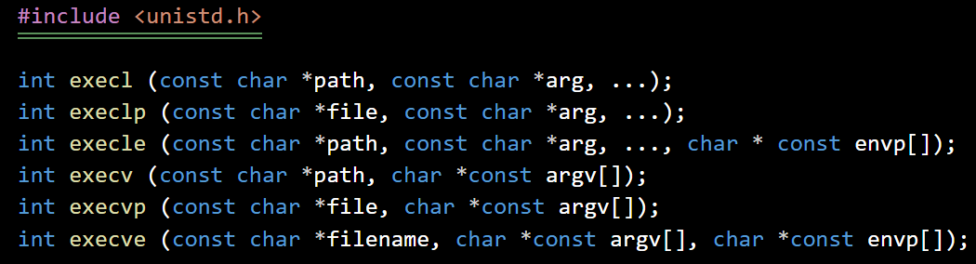
Execute a command
The mnemonics are simple:
l and v delineate whether the arguments are provided via a list or an array (vector).
p denotes that the user's full path is searched for the given file. Commands using the p variants can specify just a filename, so long as it is located in the user's path.
e notes that a new environment is also supplied for the new process.
Notes:
5.2.1.2. Error values
On success, the exec system calls do not return. On failure, the calls return -1, and set errno to one of the following values:
E2BIG
The total number of bytes in the provided arguments list (arg) or environment
(envp) is too large.
EACCESS
The process lacks search permission for a component in path; path is not a
regular file; the target file is not marked executable; or the filesystem on which
path or file resides is mounted noexec.
EFAULT
A given pointer is invalid.
EIO
A low-level I/O error occurred (this is bad).
EISDIR
The final component in path, or the interpreter, is a directory.
ELOOP
The system encountered too many symbolic links in resolving path.
EMFILE
The invoking process has reached its limit on open files.
ENFILE
The system-wide limit on open files has been reached.
ENOENT
The target of path or file does not exist, or a needed shared library does not
exist.
ENOEXEC
The target of path or file is an invalid binary, or is intended for a different
machine architecture.
ENOMEM
There is insufficient kernel memory available to execute a new program.
ENOTDIR
A nonfinal component in path is not a directory.
EPERM
The filesystem on which path or file resides is mounted nosuid, the user is not
root, and path or file has the suid or sgid bit set.
ETXTBSY
The target of path or file is open for writing by another process.

Slide 6
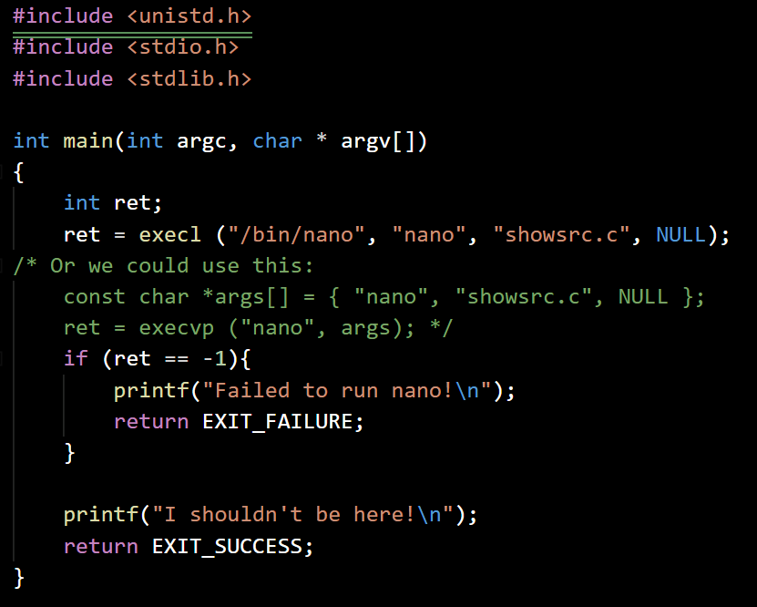
Show own source file
showsrc.c
Initialize the variables
Execute ‘nano showsrc.c’
If execution failed, write a message and exit
Print unreachable message for demo purposes

Slide 7
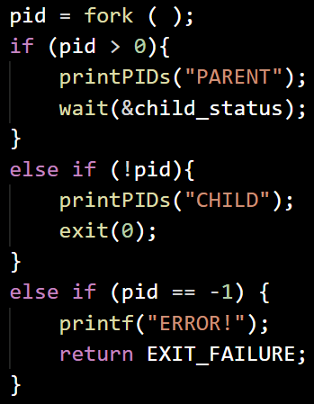
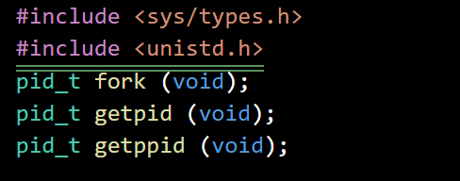
Running a child process
Parent process
pid = 15
Child process
pid = 16
A successful call to fork( ) creates a new process, identical in almost all aspects to the invoking process.
The parent process gets the pid of the child process and the child process gets 0.
On error, a child process is not created, fork( ) returns -1, and errno is on of:
EAGAIN - The kernel failed to allocate certain resources, such as a new pid.
ENOMEM - Insufficient kernel memory was available to complete the request.
Notes:
https://www.slideshare.net/EmertxeSlides/linux-programming-36666547
There are two possible errno values, with three possible meanings:
EAGAIN
The kernel failed to allocate certain resources, such as a new pid, or the RLIMIT_NPROC resource limit (rlimit) has been reached (see Chapter 6).
ENOMEM
Insufficient kernel memory was available to complete the request.

Slide 8
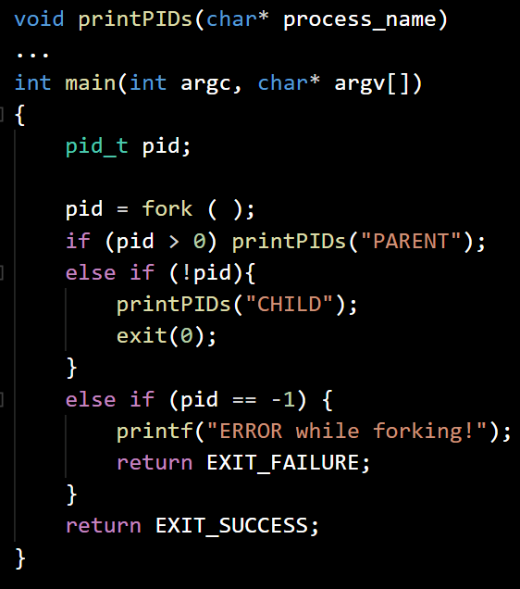
Write sentences into file
printpids.c
Initialize the functions and variables
Fork the process and store the pid(s)
If pid is positive (parent):
Print parent pid and ppid
If pid is zero (child):
Print child pid and ppid
If pid is -1 print error and exit

Slide 9
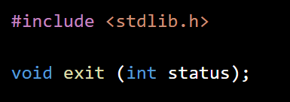
Waiting and Terminating child processes
Parent process
pid = 15
Child process
pid = 16
A call to exit() performs some basic shutdown steps, and then instructs the kernel to terminate the process.
The status parameter is used to denote the process' exit status.
When a process terminates, the kernel sends the signal SIGCHLD to the parent.
Notes:
Before terminating the process, the C library performs the following shutdown steps, in order:
1. Call any functions registered with atexit( ) or on_exit( ), in the reverse order
of their registration. (We will discuss these functions later in this chapter.)
2. Flush all open standard I/O streams (see Chapter 3).
3. Remove any temporary files created with the tmpfile( ) function.
These steps finish all the work the process needs to do in user space, so exit( ) invokes the
system call _exit( ) to let the kernel handle the rest of the termination process:
#include <unistd.h>
void _exit (int status);
A process can also terminate if it is sent a signal whose default action is to terminate the
process. Such signals include SIGTERM and SIGKILL (see Chapter 9).
5.3.4. SIGCHLD
When a process terminates, the kernel sends the signal SIGCHLD to the parent. By default, this
signal is ignored, and no action is taken by the parent. Processes can elect to handle this
signal, however, via the signal( ) or sigaction( ) system calls. These calls, and the rest of
the wonderful world of signals, are covered in Chapter 9.

Slide 10
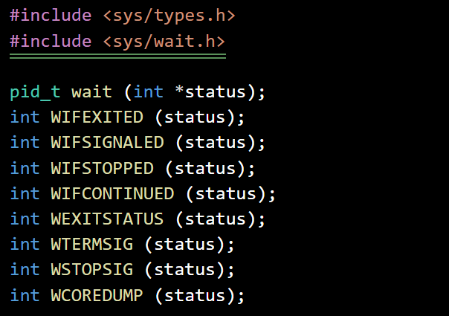
Waiting and Terminating child processes
A call to wait() returns the pid of a terminated child, or -1 on error.
If no child has terminated, the call blocks until a child terminates.
WIFEXITED returns true if the process terminated normally.
In terminated normally, WEXITSTATUS provides the loworder eight bits that were passed to _exit.
WIFSIGNALED returns true if a signal caused the process' termination.
In case of signal termination, WTERMSIG returns the number of that signal.
In case of signal termination, WCOREDUMP returns true if the process dumped core in response to receipt of the signal.
WIFSTOPPED and WIFCONTINUED return true if the process was stopped or continued, respectively.
If WIFSTOPPED is true, WSTOPSIG provides the number of the signal that stopped the process.
Notes:
On error, there are two possible errno values:
ECHILD
The calling process does not have any children.
EINTR
A signal was received while waiting, and the call returned early.
------
int WIFEXITED (status);
int WIFSIGNALED (status);
int WIFSTOPPED (status);
int WIFCONTINUED (status);
int WEXITSTATUS (status);
int WTERMSIG (status);
int WSTOPSIG (status);
int WCOREDUMP (status);
Either of the first two macros may return true (a nonzero value), depending on how the
process terminated. The first, WIFEXITED, returns true if the process terminated normally—
that is, if the process called _exit( ). In this case, the macro WEXITSTATUS provides the loworder
eight bits that were passed to _exit( ).
WIFSIGNALED returns true if a signal caused the process' termination (see Chapter 9 for
further discussion on signals). In this case, WTERMSIG returns the number of the signal that
caused the termination, and WCOREDUMP returns true if the process dumped core in response to
receipt of the signal. WCOREDUMP is not defined by POSIX, although many Unix systems, Linux
included, support it.
WIFSTOPPED and WIFCONTINUED return true if the process was stopped or continued,
respectively, and is currently being traced via the ptrace( ) system call. These conditions are
generally applicable only when implementing a debugger, although when used with waitpid( )
(see the following subsection), they are used to implement job control, too. Normally, wait( )
is used only to communicate information about a process' termination. If WIFSTOPPED is true,
WSTOPSIG provides the number of the signal that stopped the process. WIFCONTINUED is not
defined by POSIX, although future standards define it for waitpid( ). As of the 2.6.10 Linux
kernel, Linux provides this macro for wait( ), too.

Slide 11
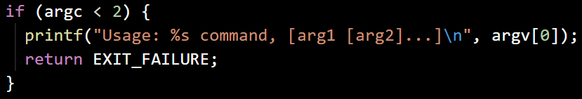
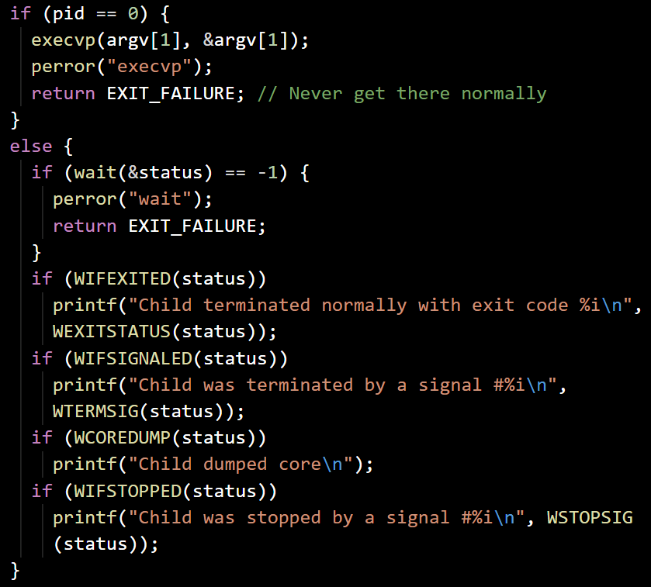
Execute and print status
execstat.c
Verify we have enough arguments
Fork the process and store the pid(s)
The parent waits for the child and exits on error
On success, prints the status of the termination
The child executes the command in the arguments
Exit with success

Slide 12
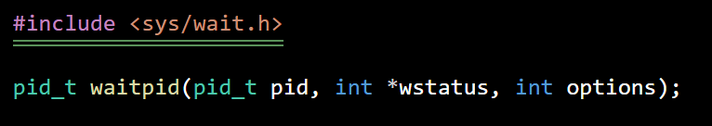
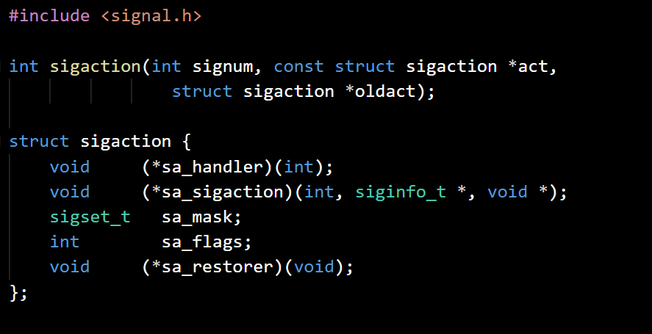
Zombies and simple signals handling
When a child dies before its parent, the kernel puts the child into a special process state - the process is then called a zombie.
A process in this state waits for its parent to inquire about its status and only after this the child process cease to exist even as a zombie.
If the parent never inquires about a child’s status then the zombie becomes a ghost - very bad practice.
If the parent process terminates before its children, then they a reparented to the init process.
The init process, in turn, periodically waits on all of its children, ensuring that none remain zombies for too long.
Notes:
What happens, however, if the parent process dies before the child, or if it dies before it has a
chance to wait on its zombie children? Whenever a process terminates, the Linux kernel walks
a list of its children, and reparents all of them to the init process (the process with a pid value
of 1). This guarantees that no process is ever without an immediate parent. The init process,
in turn, periodically waits on all of its children, ensuring that none remain zombies for too
long—no ghosts! Thus, if a parent dies before its children or does not wait on its children
before exiting, the child processes are eventually reparented to init and waited upon, allowing
them to fully exit. Although doing so is still considered good practice, this safeguard means
that short-lived processes need not worry excessively about waiting on all of their children.

Slide 13
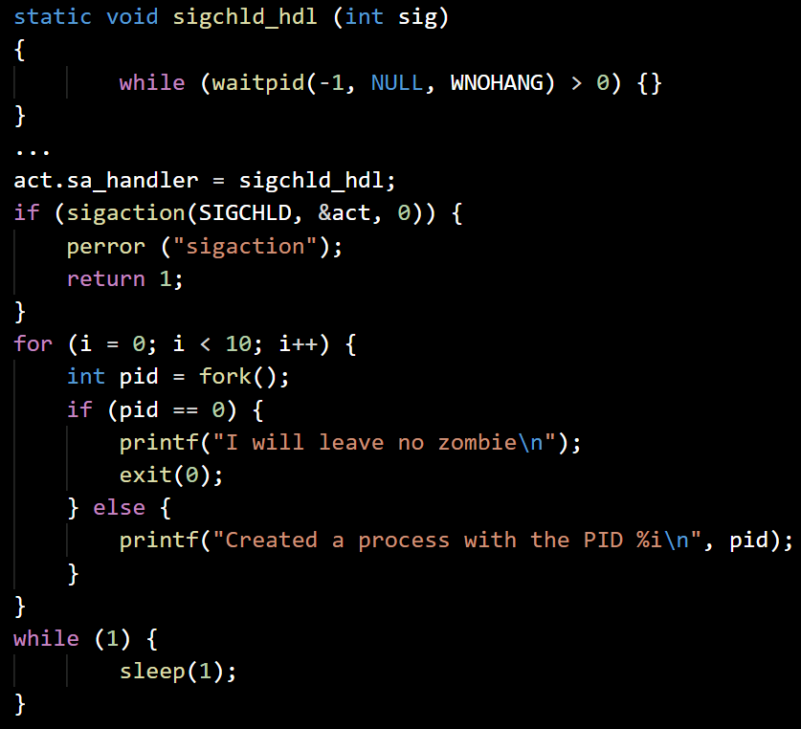
Play with zombies
zombietest.c
Define the termination signal handler
Initialize variables to use the signal handler
Set action for SIGCHLD,exit on error
Do 10 times:
Fork the process and store the pid(s)
The parent prints the pid of the new child
The child prints a message and exits
Enter endless loop

Slide 14
Exercise
Program TempFileGenerator:
Write a program (‘tempgen.c’), which takes 1 argument: files_count. The program should generate files_count files called ‘temp<nr>.tmp’ (where nr is between 1 and files_count). Each file is created by a separate process and contains 1000 times the pid of the corresponding process as text (pid=1001 should take 4 bytes per ID).
The parent process should notify after each file is created.
Modify the program or write a new one, in which the processes write only in one file, where the pid sequences do not overlap (we have 1000 times pid_file_1, then 1000 times pid_file_2… then 1000 times pid_files_cound).

