Slide 1
Linux System Programming
Part 7 - Sockets
IBA Bulgaria
2018

Slide 2
Sockets in Linux
Most interprocess communication uses the client-server model. One of the two processes, the client, connects to the other process, the server, typically to make a request for information. Each end of such communication can be represented in IPC with a socket. The client and server processes each establish their own socket.
A Unix domain socket is a data communications endpoint for exchanging data between processes executing on the same host operating system.
A network socket is an internal endpoint for sending or receiving data within a node on a computer network.
Sockets support transmission of a reliable stream of bytes, as well as ordered and reliable transmission of datagrams. Stream sockets treat communications as a continuous stream of characters, while datagram sockets have to read entire messages at once.

Slide 3
Working with Sockets in C
socket() - creates an endpoint for communication.
bind() - binds a name to a socket.
recv(), recvfrom(), recvmsg() - receives a message from a socket.
send(), sendto(), sendmsg() - sends a message on a socket.
socketpair() - creates a pair of connected sockets.
listen() - listens for connections on a socket.
accept() - accepts a connection on a socket.
connect() - initiates a connection on a socket.
htons() - converts unsigned short integer to network byte order.
gethostbyname() - returns a structure of type hostent for the given host name.

Slide 4
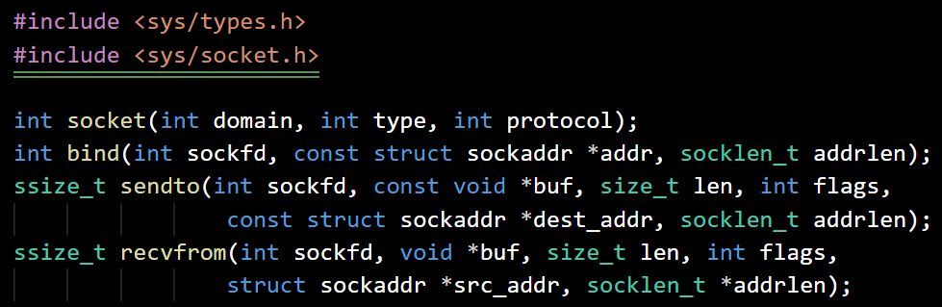
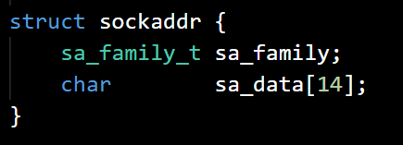
Unix Sockets usage
socket() creates an endpoint for communication and returns a file descriptor that refers to that endpoint.
domain specifies the protocol family which will be used (AF_UNIX, AF_LOCAL, AF_INET, etc.).
type specifies the communication semantics (SOCK_STREAM, SOCK_DGRAM, etc.).
When a socket is created with socket(), it exists in a name space (address family) but has no address assigned to it.
bind() assigns the address specified by addr to the socket referred to by the file descriptor sockfd (returned from socket()).
sockaddr is the following structure:

Slide 5
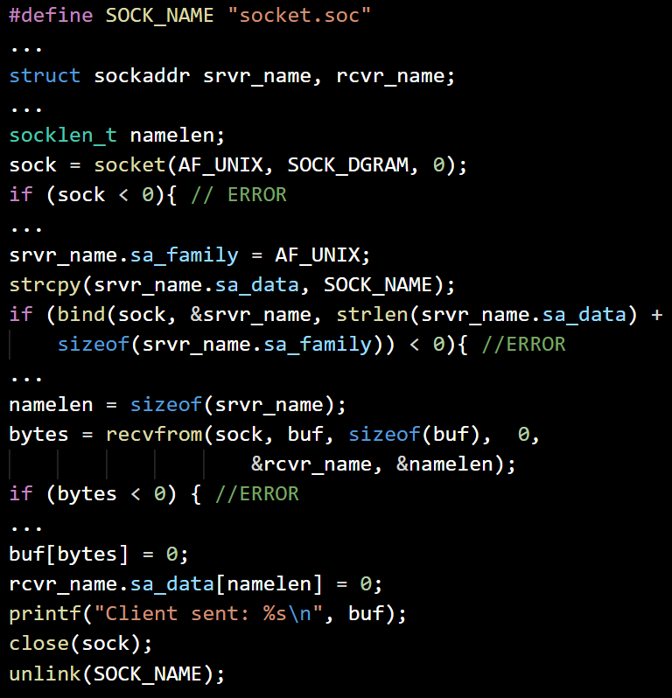
File socket server
fsserver.c
Open Unix datagram socket, exit on error
Bind socket with ‘socket.soc’, exit on error
Get a message from socket, exit on error
Print the message
Close the socket
Remove the socket file

Slide 6
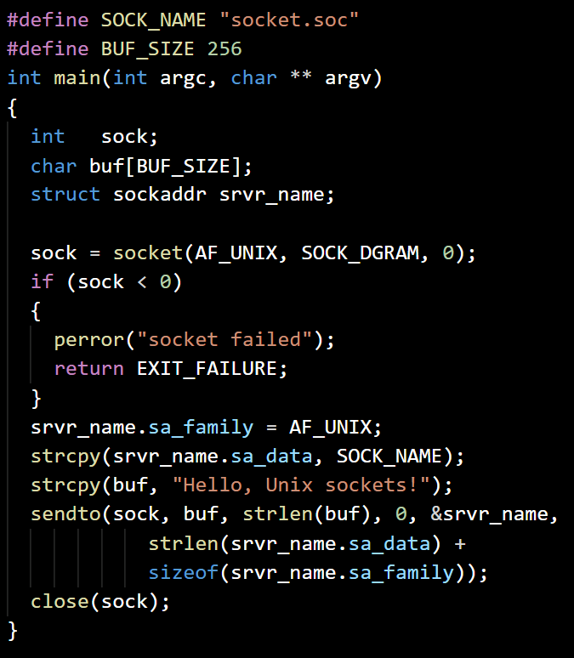
File socket client
fsclient.c
Open Unix datagram socket, exit on error
Setup the server name structure for Unix socket and name ‘socket.soc’
Send a message to the server
Close the socket

Slide 7
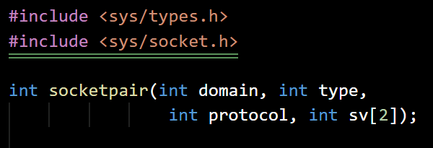
Sockets pair
The socketpair() call creates an unnamed pair of connected sockets in the specified domain, of the specified type, and using the optionally specified protocol.
The file descriptors used in referencing the new sockets are returned in sv[0] and sv[1]. The two sockets are indistinguishable.
On success, zero is returned. On error, -1 is returned, and errno is set appropriately.

Slide 8
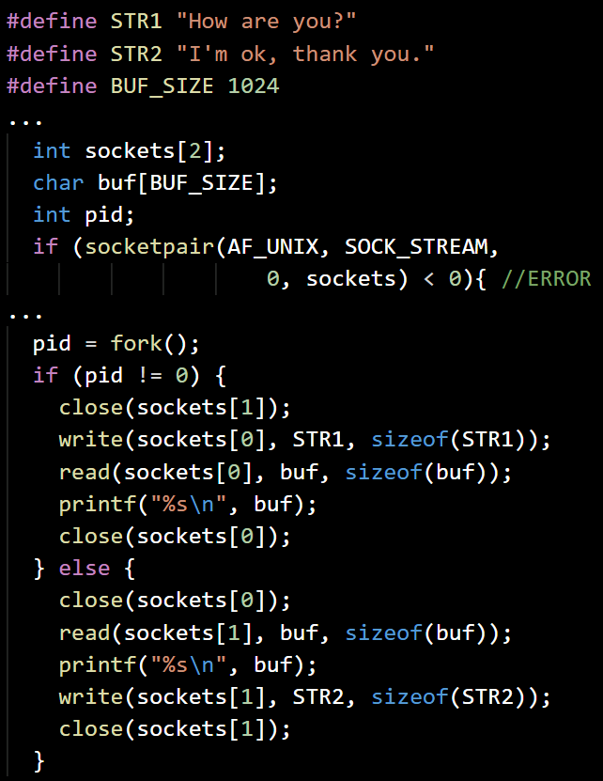
Unix Sockets Pair
sockpair.c
Open a sockets pair, exit on error
Fork the process
The parent: close the “second” socket
Write initial message to the “first” socket
Read answer from “first” socket, prit it and close the socket
The child: close the “first” socket
Read a message from the “second” socket and print it
Write answer to the “second” socket and close it

Slide 9
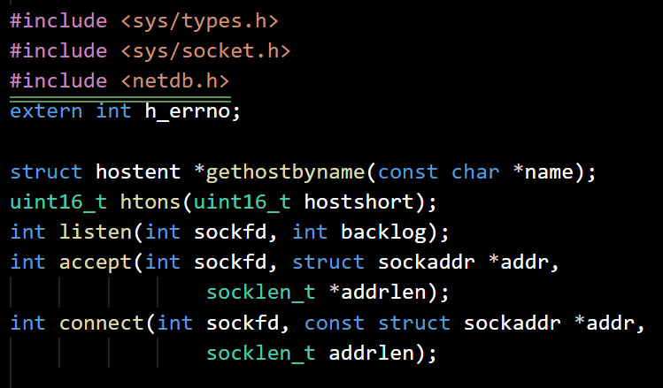
Network Sockets
To accept connections, the following steps are performed:
A socket is created with socket().
The socket is bound to a local address using bind(), so that other sockets may be connect()-ed to it.
A willingness to accept incoming connections and a queue limit for incoming connections are specified with listen().
Connections are accepted with accept().

Slide 10
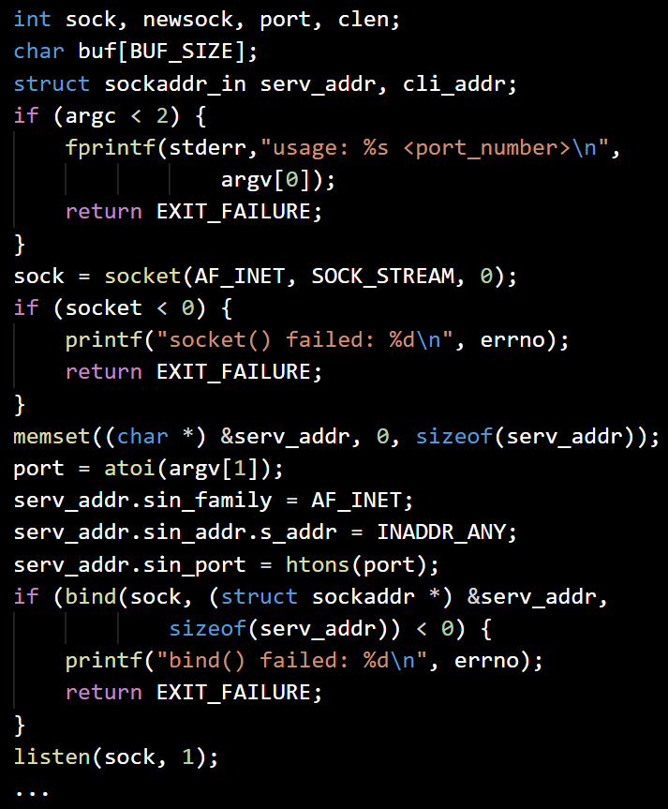
File socket server
netserver.c
Check the input arguments, exit on error
Open INET, STEAM socket, exit on error
Initialize sockaddr_in structure for server
Bind the socket to the configured port, exit on error
Start listening, allow 1 connection

Slide 11
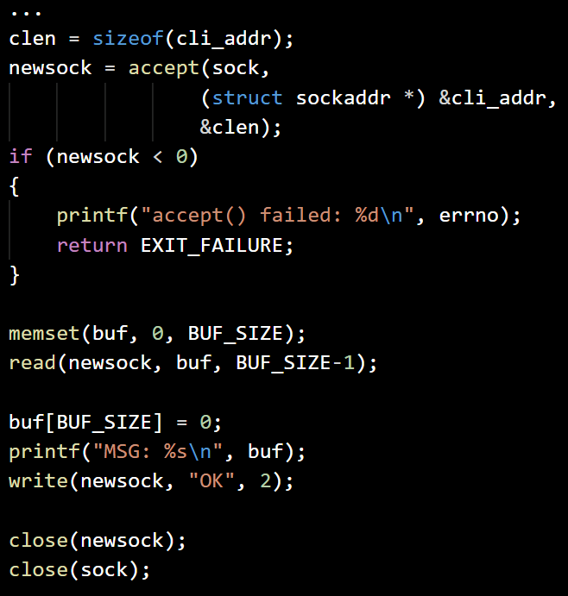
File socket server (2)
netserver.c
Accept a new connection, exit on error
Read from the connection socket in buffer
Print the message from the buffer
Write ‘OK’ to the connection socket
Close the connection and listening sockets

Slide 12
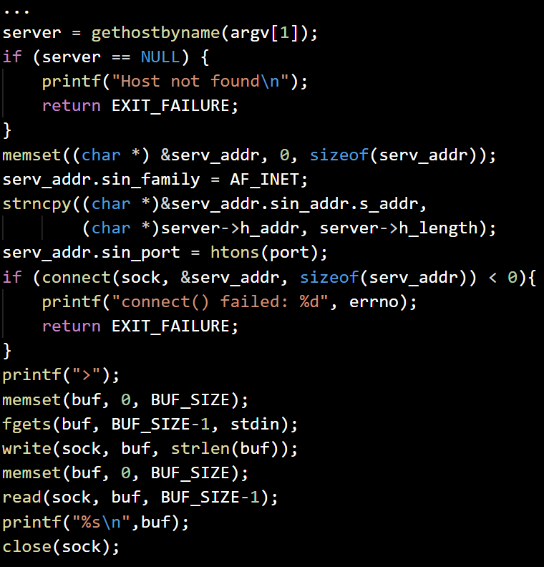
File socket client
netclient.c
Check the input arguments, exit on error
Open INET, STEAM socket, exit on error
Get the server host, exit on error
Configure and connect the socket to the server address and port, exit on error
Indicate on the screen that input is expected and get a new text line
Write the entered text to the socket
Read an answer text from the socket, print it and close the socket

Slide 13
Exercise
Project BetterChat:
Modify the network server/client pair of programs (‘netserver.c’ and ‘netclient.c’) from this lecture with the following improvements:
Allow multiple messages conversation, until the client sends “!quit” to the server.
The server should support multiple parallel clients connections.

