Slide 1
Linux System Programming
Part 9 - Threads (synchronization)
IBA Bulgaria
2018

Slide 2
Exiting the Threads
A thread can arrange for functions to be called when it exits. These functions are known as thread cleanup handlers. More than one cleanup handler can be established for a thread. The handlers are recorded in a stack, which means that they are executed in the reverse order from that with which they were registered.
When a thread is canceled or terminates by calling pthread_exit(), all of the stacked clean-up handlers are popped and executed in the reverse of the order in which they were pushed onto the stack.

Slide 3
Managing thread exit with C
The pthread_cleanup_push() function pushes routine onto the top of the stack of clean-up handlers. When routine is later invoked, it will be given arg as its argument.
The pthread_cleanup_pop() function removes the routine at the top of the stack of clean-up handlers, and optionally executes it if execute is nonzero.

Slide 4
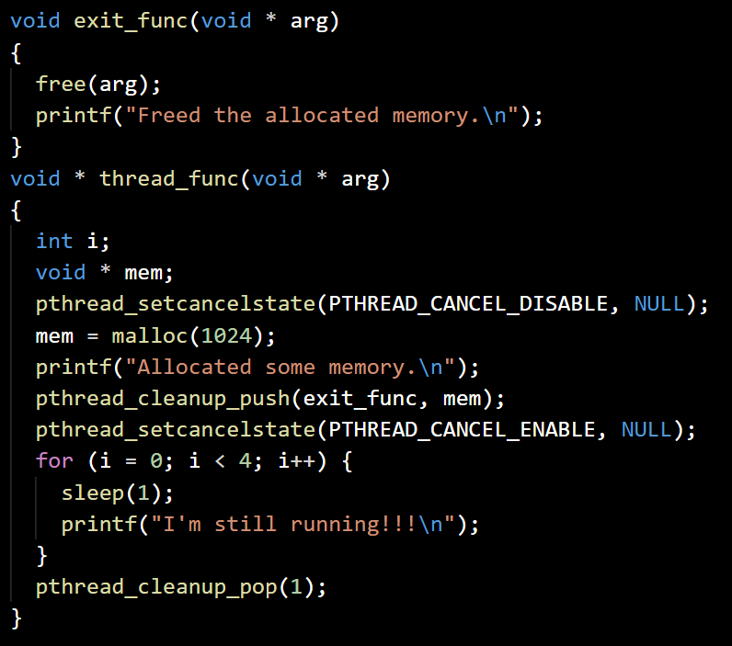
Clean thread exit
exittest.c
Define exit function, which frees up the allocated memory
Define thread function:
Lock the thread cancellation
Allocate 1K memory and print notification
Add exit function passing the new memory as parameter
Unlock the thread cancellation
Print 4 messages in 4 seconds
Pop exit function, executing it

Slide 5
Why is synchronization needed?
Thread synchronization is the concurrent execution of two or more threads that share critical resources.
Threads should be synchronized to avoid critical resource use conflicts.
Otherwise, conflicts may arise when parallel-running threads attempt to modify a common variable at the same time.

Slide 6
Synchronization mechanisms
The threads library provides three synchronization mechanisms:
mutexes - Mutual exclusion lock: Block access to variables by other threads. This enforces exclusive access by a thread to a variable or set of variables.
joins - Make a thread wait till others are complete (terminated).
condition variables - While mutexes implement synchronization by controlling thread access to data, condition variables allow threads to synchronize based upon the actual value of data.
We already know about joins, so we’ll focus on mutexes now...

Slide 7
Mutexes
Mutexes are used to prevent data inconsistencies due to operations by multiple threads upon the same memory area performed at the same time or to prevent race conditions where an order of operation upon the memory is expected.
A contention or race condition often occurs when two or more threads need to perform operations on the same memory area, but the results of computations depends on the order in which these operations are performed.
Mutexes are used for serializing shared resources such as memory. Anytime a global resource is accessed by more than one thread the resource should have a Mutex associated with it.

Slide 8
Mutex example
Thread 1 | Thread 2 | Balance
Read balance: $1000 |  | $1000
 | Read balance: $1000 | $1000
 | Deposit $200 | $1000
Deposit $200 |  | $1000
Update balance $1000+$200 |  | $1200
 | Update balance $1000+$200 | $1200
In the above example, a mutex should be used to lock the "Balance" while a thread is using this shared data resource.

Slide 9
Mutex example
Thread 1 | Thread 2 | Balance
Read balance: $1000 |  | $1000
Deposit $200 |  | $1000
Update balance $1000+$200 |  | $1200
 | Read balance: $1200 | $1200
 | Deposit $200 | $1200
 | Update balance $1200+$200 | $1400
In the above example, thread 1 locks the balance resource and thread 2 is blocked until the mutex is released.

Slide 10
Typical use of mutexes
A typical sequence in the use of a mutex is as follows:
Create and initialize a mutex variable
Several threads attempt to lock the mutex
Only one succeeds and that thread owns the mutex
The owner thread performs some set of actions
The owner unlocks the mutex
Another thread acquires the mutex and repeats the process
Finally the mutex is destroyed
When several threads compete for a mutex, the losers block at that call - an unblocking call is available with trylock() instead of the lock call.
When protecting shared data every thread that needs to use a mutex should do so. For example, if 4 threads are updating the same data, but only one uses a mutex, the data can still be corrupted.

Slide 11
Problems with threads - race conditions
Race conditions: While the code may appear on the screen in the order you wish the code to execute, threads are scheduled by the operating system and are executed at random. It cannot be assumed that threads are executed in the order they are created.
They may also execute at different speeds. When threads are executing (racing to complete) they may give unexpected results (race condition).
Mutexes and joins must be utilized to achieve a predictable execution order and outcome.

Slide 12
Problems with threads - thread safe code
Thread safe code: The threaded routines must call functions which are "thread safe".
This means that there are no static or global variables which other threads may clobber or read assuming single threaded operation. If static or global variables are used then mutexes must be applied or the functions must be re-written to avoid the use of these variables.
In C, local variables are dynamically allocated on the stack. Therefore, any function that does not use static data or other shared resources is thread-safe.
Thread-unsafe functions may be used by only one thread at a time in a program and the uniqueness of the thread must be ensured.

Slide 13
Problems with threads - mutex deadlock
Mutex Deadlock: This condition occurs when a mutex is applied but then not "unlocked".
This causes program execution to halt indefinitely. It can also be caused by poor application of mutexes or joins.
Be careful when applying two or more mutexes to a section of code. If the first pthread_mutex_lock is applied and the second pthread_mutex_lock fails due to another thread applying a mutex, the first mutex may eventually lock all other threads from accessing data including the thread which holds the second mutex.
The threads may wait indefinitely for the resource to become free causing a deadlock. It is best to test and if failure occurs, free the resources and stall before retrying.

Slide 14
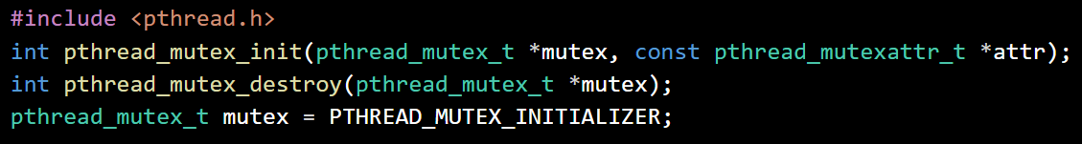
Creating and destroying mutexes
Mutex variables must be declared with type pthread_mutex_t, and must be initialized before they can be used. There are two ways to initialize a mutex variable:
Statically, when it is declared.
Dynamically, with the pthread_mutex_init() routine. This method permits setting mutex object attributes, attr. The mutex is initially unlocked.

Slide 15
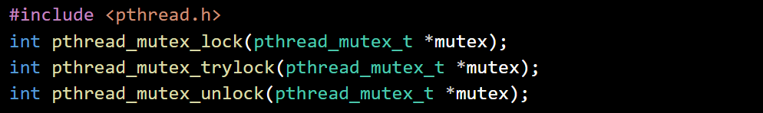
Locking and unlocking mutexes
pthread_mutex_lock() - used by a thread to acquire a lock on the specified mutex variable. If the mutex is already locked by another thread, this call will block the calling thread until the mutex is unlocked.
pthread_mutex_trylock() - will attempt to lock a mutex. However, if the mutex is already locked, the routine will return immediately with a "busy" error code. This routine may be useful in preventing deadlock conditions, as in a priority-inversion situation.
pthread_mutex_unlock() - will unlock a mutex if called by the owning thread. Calling this routine is required after a thread has completed its use of protected data if other threads are to acquire the mutex for their work with the protected data.

Slide 16
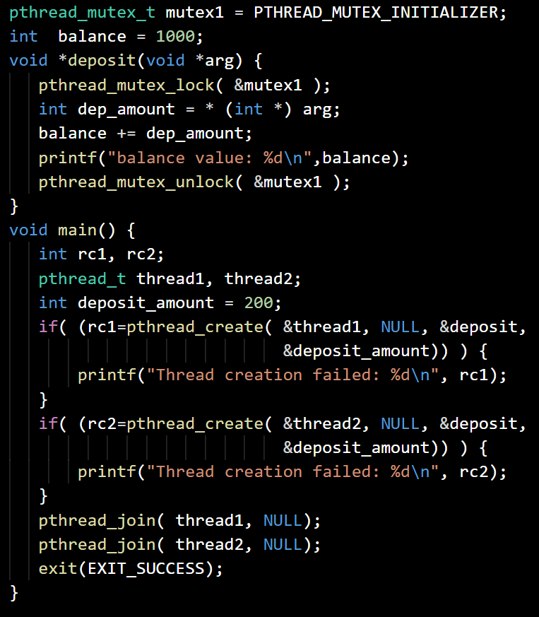
Mutex example
mutex.c
Define mutex and balance variables
Define thread function:
Lock the mutex
Add the deposit amount to the balance
Print the balance and unlock the mutex
Create thread one with deposit = 200, notify if failed
Create thread two with deposit = 200, notify if failed
Wait for both threads and exit with success

Slide 17
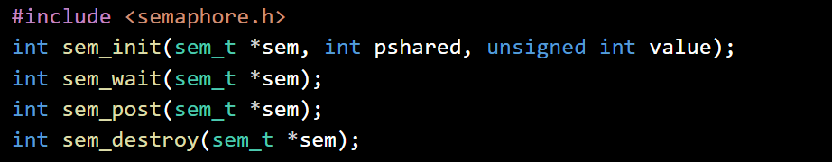
Synchronizing with semaphores
sem_init() - initializes the unnamed semaphore at the address pointed to by sem. The value argument specifies the initial value for the semaphore.
sem_wait() - decrements (locks) the semaphore pointed to by sem. If the semaphore currently has the value zero, then the call blocks.
sem_post()- increments (unlocks) the semaphore pointed to by sem.
sem_destroy() - destroys the unnamed semaphore at the address pointed to by sem.

Slide 18
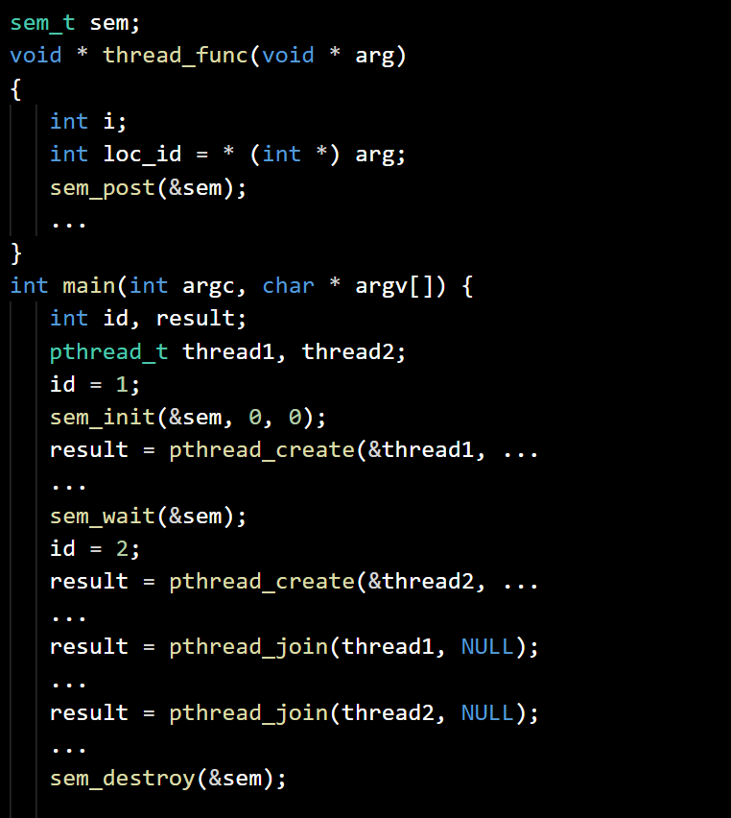
Semaphore Threads
semthreads.c
Initialize a semaphore
Define thread function - Process the argument and release semaphore.
In main function -
Set the common id variable to 1
Initialize semaphore with 0 (busy)
Start the first thread and pass id
Wait the semaphore, set id to 2 and start the second thread with the new id
Join both threads and destroy semaphore

Slide 19
Exercise
Project AdvancedChat:
Modify the network server/client pair of programs from the previous lecture with the following changes:
The server should support additional optional argument ‘-p’, which if present, identifies that the communication is in ‘polite mode’. In this mode, the server should accept the clients’ messages in rounds - when a client sends a message the next message from the same client will not be processed until all other connected clients send their messages. You may change the communication protocol between clients and server if you need to.
The server should store the chat history into a file ‘chat.log’.

