Slide 1
Linux System Programming
Part 10 - Daemons
IBA Bulgaria
2018

Slide 2
What are Daemons?
A daemon is a process that runs in the background, not connecting to any controlling terminal.
Daemons are normally started at boot time, are run as root or some other special user (such as apache or postfix), and handle system-level tasks. As a convention, the name of a daemon often ends in d (as in crond and sshd), but this is not required, or even universal.
A daemon has two general requirements:
it must run as a child of init;
it must not be connected to a terminal.

Slide 3
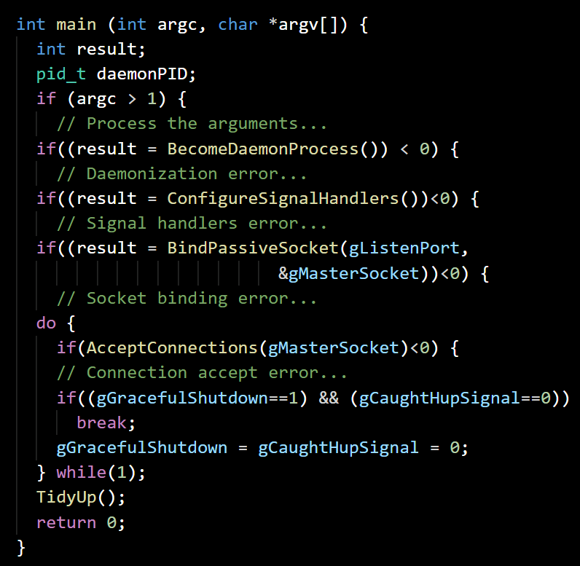
Our chat Daemon
chatdaemon.c
Check the arguments, exit on error
Daemonize the program, exit on error
Prepare the listening socket
Do until graceful exit is signalled
Accept and process a new connection
Reset the graceful exit and HUp flags
Clean up the resources and exit

Slide 4
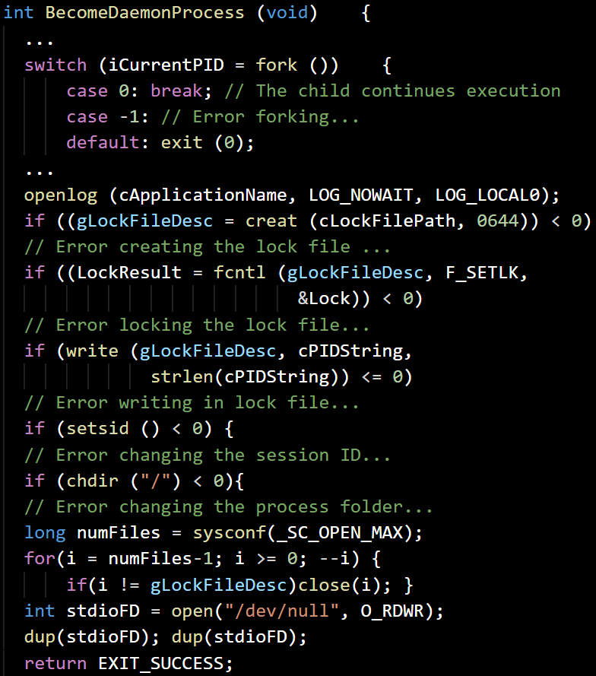
Daemonize
chatdaemon.c
Fork the process, exit the parent and on error
Open the application log
Create the lock file and lock it, exit on error
Write the pid of the process in lock file
Take the lead in a new session, exit on error
Change the process directory to ‘/’
Close all possible file descriptors, except for the lock file one
Open the standard streams (0 - 2), redirect to ‘/dev/null’ and exit with success
Notes:
1. Call fork( ). This creates a new process, which will become the daemon.
2. In the parent, call exit( ). This ensures that the original parent (the daemon's
grandparent) is satisfied that its child terminated, that the daemon's parent is no
longer running, and that the daemon is not a process group leader. This last point
is a requirement for the successful completion of the next step.
3. Call setsid( ), giving the daemon a new process group and session, both of
which have it as leader. This also ensures that the process has no associated
controlling terminal (as the process just created a new session, and will not assign
one).
4. Change the working directory to the root directory via chdir( ). This is done
because the inherited working directory can be anywhere on the filesystem.
Daemons tend to run for the duration of the system's uptime, and you don't want
to keep some random directory open, and thus prevent an administrator from
unmounting the filesystem containing that directory.
5. Close all file descriptors. You do not want to inherit open file descriptors, and,
unaware, hold them open.
6. Open file descriptors 0, 1, and 2 (standard in, standard out, and standard error)
and redirect them to /dev/null.

Slide 5
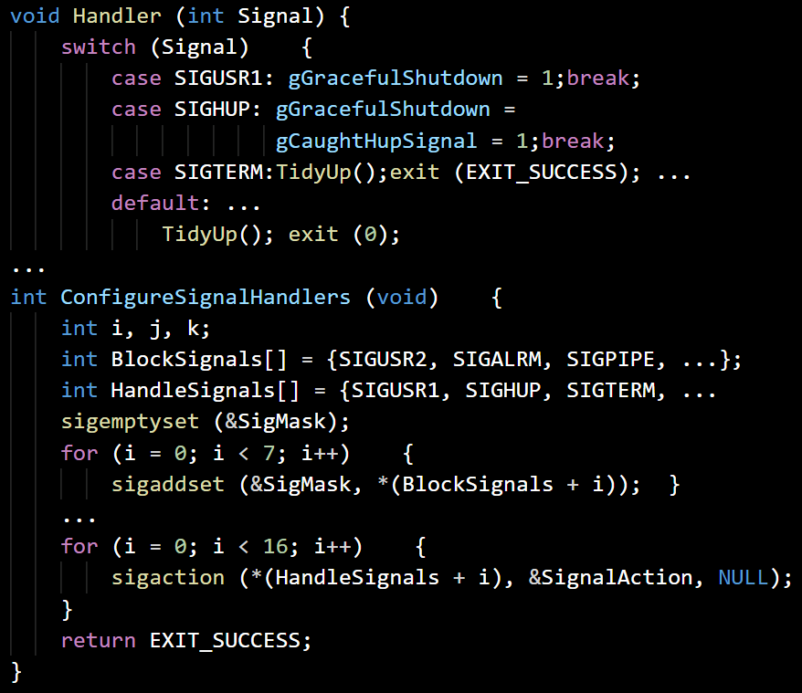
Singlas handling
chatdaemon.c
Define signals handler:
On SIGUSR1 - set the graceful flag
On SIGHUP - set graceful and HUp flags
On SIGTERM - cleanup and exit process
Block SIGUSR2, SIGALRM... flags (total 7)
Set the handler for SIGUSR1, SIGHUP, SIGTERM and other fatal signals (total 16)

Slide 6
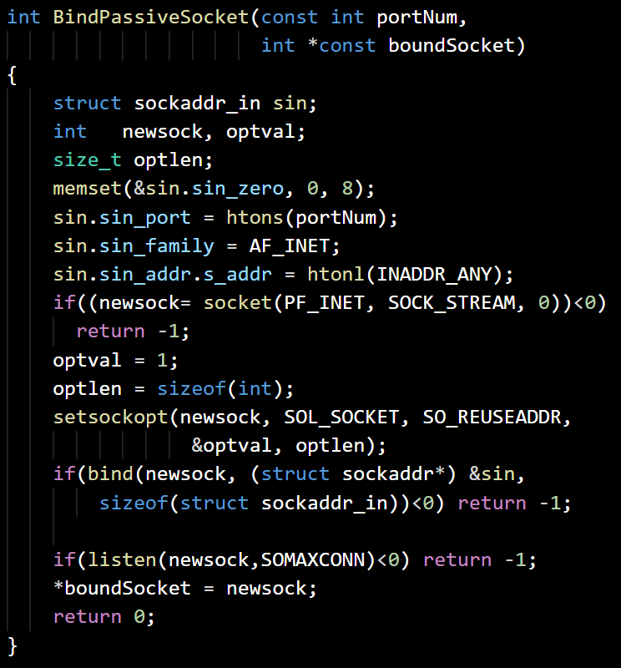
Set listening Socket
chatdaemon.c
Initialize socket configuration for INET family, provided port and all interfaces
Create the socket, exit on error
Set the socket to reuse the address
Bind the socket, exit on error
Listen on the socket, exit on error
Exit with success

Slide 7
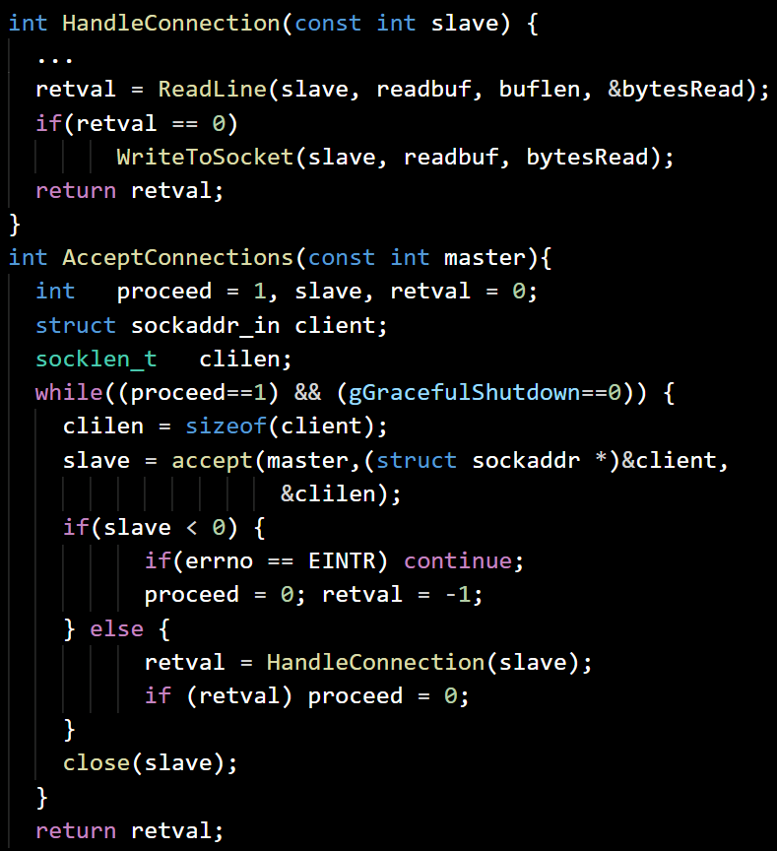
Connections handling
chatdaemon.c
Define connections handler:
Read text line from the passed socket
If no error - write the line back to socket
Return the result of the read/write
While connections accepting is ok:
Accept new connection, on EINTR try again, on other error exit the loop
Handle the accepted connection
Close the accepted socket

Slide 8
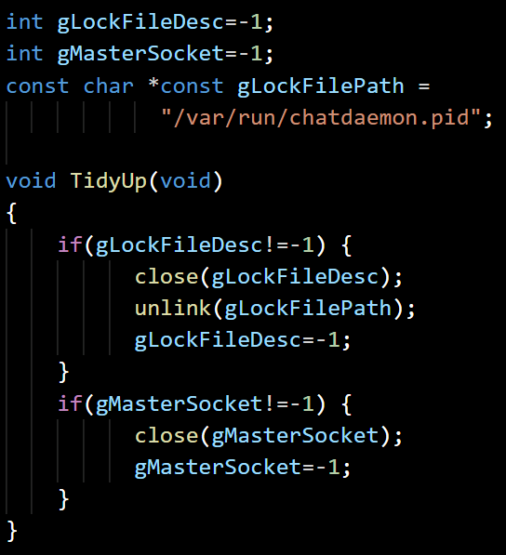
Tidy Up
chatdaemon.c
If we have open lock file descriptor:
Close the file descriptor
Delete the lock file
If we have open listening socket:
Close the listening socket

Slide 9
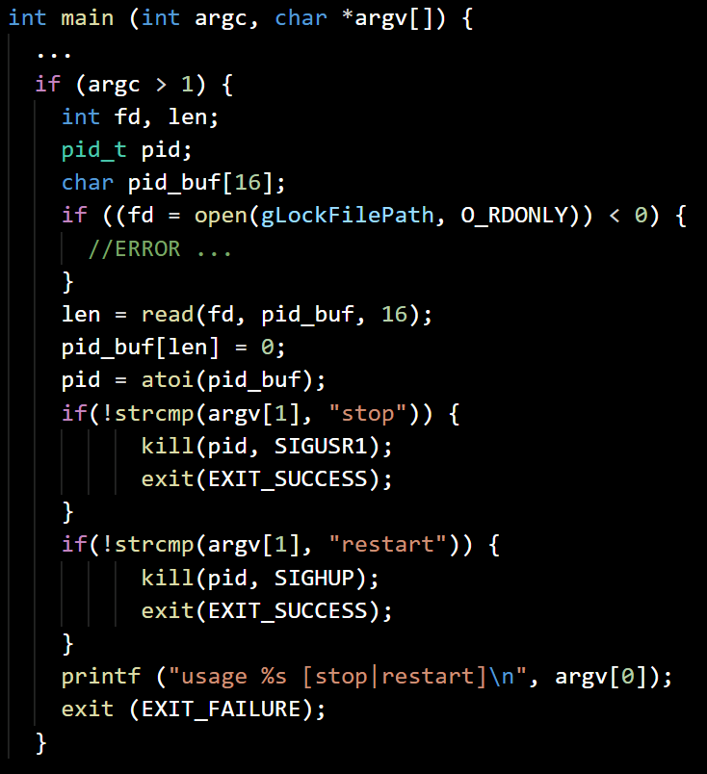
Startup arguments
chatdaemon.c
If arguments are passed, this first one should be ‘stop’ or ‘restart’ command
Open lock file, exit on error
Read and convert the pid from the lock file
If the command is ‘stop’, send SIGUSR1 to the pid process and exit with success
If the command is ‘restart’, send SIGHUP to the pid process and exit with success
If the command is not correct, print the usage and exit with error

