Slide 1
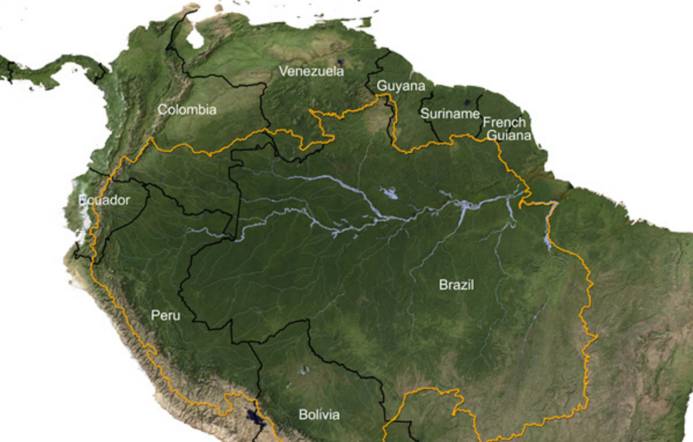
River-routing in CCAM

Slide 2
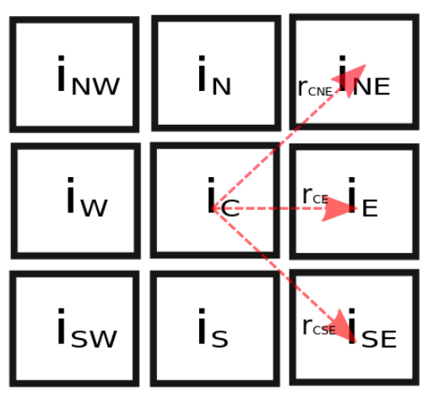
Method used for river-routing
Read “Water level” [kg/m^2]
Read Topography [m]
Calculate slope,
Calculate velocity:
Calculate nett mass flow
[kg/m^2]
Update water levels

Slide 3
Trapped water removal
Trapped water if water inflow from all sides
Water removed by adding it to soil moisture
Other modes will store water or leak it into soil at all grid points and not just for basins

Slide 4
Model specs
C48 grid 48*48*6 = 13 824 cells
Quasi-uniform resolution of:
  i.e.
Initially, no water: C-CAM spins up rivers as it runs
  Rain, ice-melt
Saves a water-body variable so it can be initialised from new values
Water-body output is given as surface water in the variable, swater

Slide 5

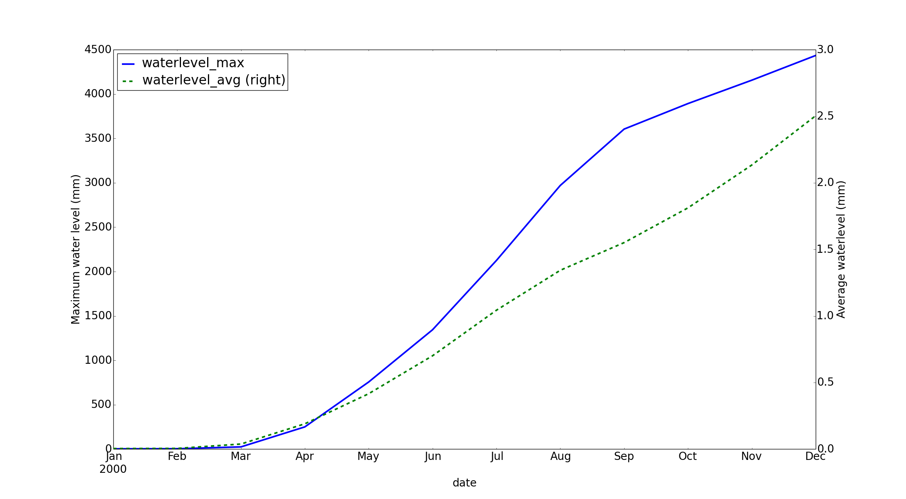
Simulation results: Year 2000
Not spinned-up just yet

Slide 6
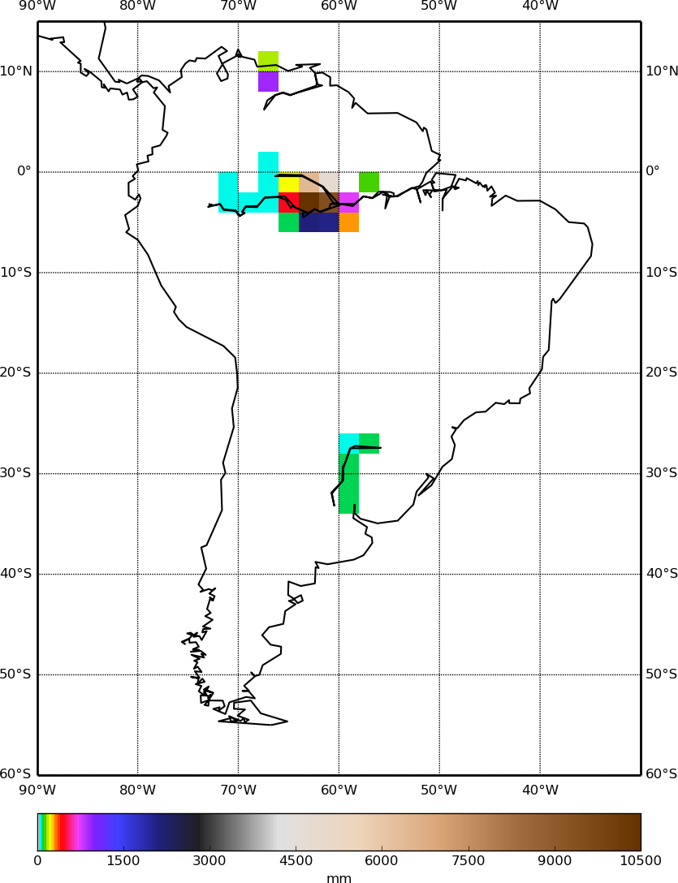
Simulation results continued: Water levels

Slide 7
What we're using currently:
Python: numpy, netCDF4's Dataset, matplotlib, mpl_toolkits (Basemap utility)
  EASY and available on my github
Version-control for scripts: git and github
Storage of massive output files: Prayer.
  Can we access your outputs via the CHPC? (Charles Crosby?)

Slide 8

Really (really) need the following
Water-level data for Amazon
Lat-lon coordinates with water-level over span of years.
The more the better
  Verification of C-CAM as is
  Verification of river-routing once detached from C-CAM
  Basis for machine learning training
Run scripts (nriver = 1??)
NetCDF output from your runs (with swater and runoff)
Has anyone tried to compare the swater output with data yet? (CSIR, CSIRO??). Perhaps on higher resolution?

Slide 9
SCRIPTS
DATA

