Slide 1

GIT: FAST VERSION CONTROL

Slide 2


About version control: VCS
A system that records changes to a file or set of files over time so that you can recall specific versions later.
Yep...you can do this yourself: error prone
Types of VCS:
  Local VCSs: on local pc keeps all changes to files under revision control.
    Your pc gone...all gone
  Centralized VCS CVCSs: collaboration—single server contains all the versioned files, an number of clients check out files from that central place.
    Server goes down, no collaboration or saving your own versions...if server gets corrupted: everyone loses everything.
  Distributed VCS DVCSs (Git): clients don't just check out latest snapshot of files: they fully mirror the repository. Server dies, any of the client repositories can be copied back to restore it: Every clone is full backup of the data.

Slide 3
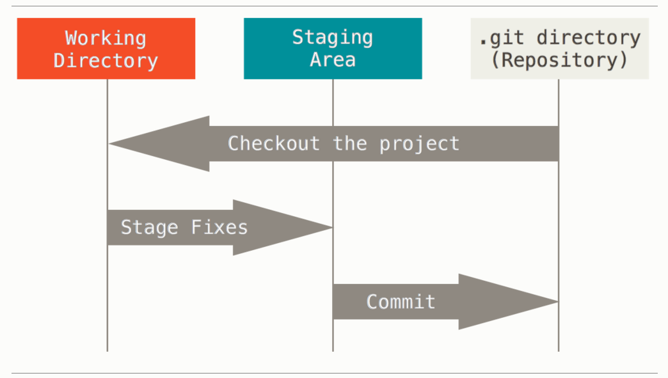
Basic Git workflow
Modify → stage → commit:

Slide 4
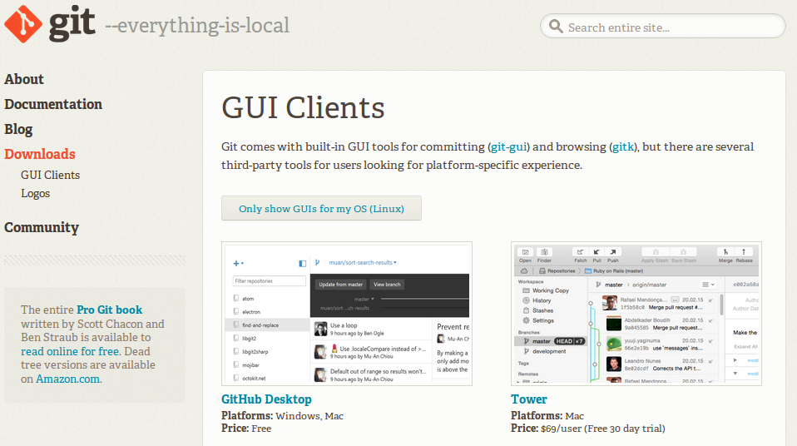
Getting started: Installing
Linux:
  $ sudo apt-get install git-all
Mac: Mavericks (10.9) or above you can do this simply by trying to run git from the Terminal
Windows: https://git-scm.com/download/win

Slide 5
First-time Git setup
Set your user name and email address.
  $ git config --global user.name "Jane Doe"
  $ git config --global user.email janedoe@example.com
Only once if you pass –global command: this is info git will use for anything you do on the system
Configure default text editor:
  $ git config --global core.editor emacs/scite/

Slide 6
Git basics: Getting a git repo
Two main approaches:
  Initializing repo in an existing directory:
    Navigate to the directory
    Type: $ git init
    Creates a .git directory
    Excluding files: create .gitignore
      Add files to be excluded into .gitignore
    Add files you want to start version-controlling
        $ git add *.f90
        $ git add *.doc
        $ git commit -m 'initial project version'
  Cloning an existing repository:
    $ git clone <path to remote repo>

Slide 7
Start working!
Check status of your files:
  $ git status
Should have a clean directory, your branch is master
Create a new file in the directory
  $ git status: nothing added to commit
  $ git add README
  $ git commit
Removing files you added but decided not to track:
  $ git rm --cached filename
  $ git add .
  $ git commit -am “Removed ignored Files”

Slide 8
Viewing exact differences
Viewing difference between committed and modified:
  $ git diff
  $ git diff --staged
Git Diff in an External Tool: I meld
http://www.wiredforcode.com/blog/2011/06/04/git-with-meld-diff-viewer-on-ubuntu/
Viewing a list of your commits:
  $ git log --oneline
Viewing diffs between two checkouts:
  $ git diff e3c0709 1c58e1e

Slide 9
Branches
Create a branch for something your not yet sure about:
  $ git branch <crazy experiment>
  $ git branch
  $ git checkout crazy experiment
Start doing wacky stuff
Commit wacky stuff and view log:
  $ git commit -m 'experiment00'
  $ git log --oneline
It works? Want to keep it? Let's merge
Git merges into the current branch:
  $ git checkout master
  $ git merge --no-ff branchname

Slide 10
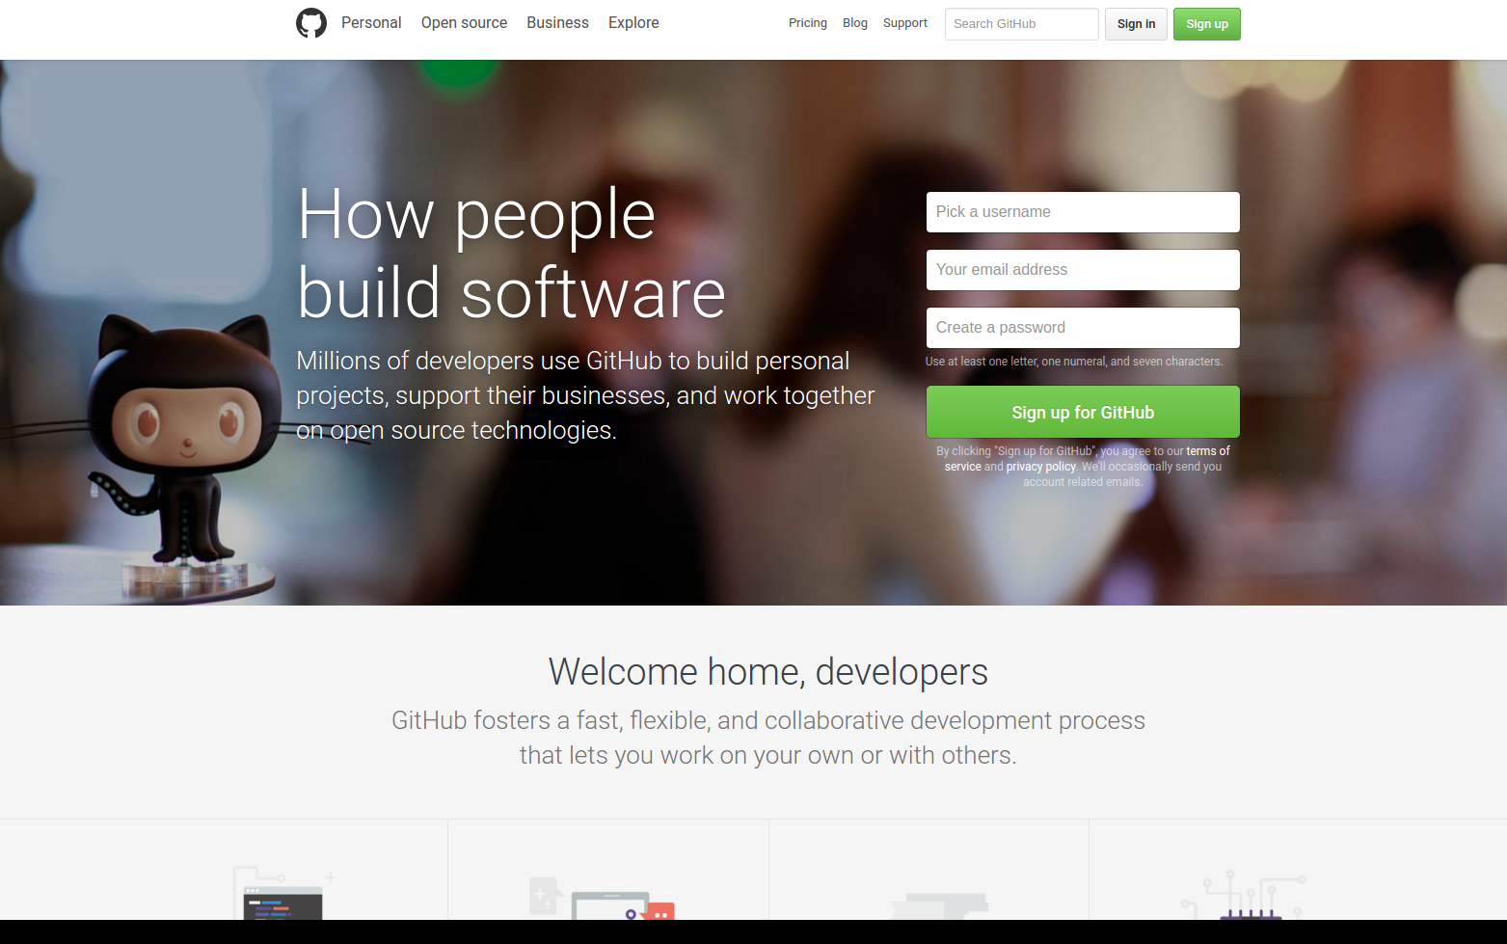
Using the distributed idea
https://github.com/

Slide 11
Pushing from local to online repo
Create new repository
On Local machine:
  $ git remote add origin https://github.com/FineWilms/newrepo.git
Check it:
  $ Git remote -v
Push your local to the remote site:
  $ Git push origin master
Now we have backup safely on server.
Work on local machine, commit there, push to remote

Slide 12
Cloning: Recovery or collaboration
Just shift-delete your thesis??
Clone it: COMPLETE COPY
  $ git clone <path to remote repo>
Collaboration:
  $ git fetch
  $ git merge
Automated back-ups: crontab
https://help.ubuntu.com/community/CronHowto
Create shell script

Slide 13
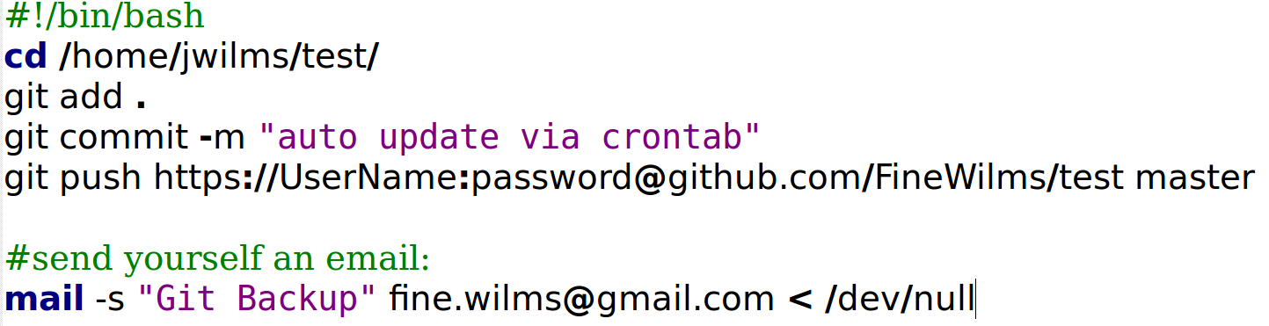
Example of shell script:
Create empty file run-git-push.sh and paste in working dir
Contents:

Slide 14
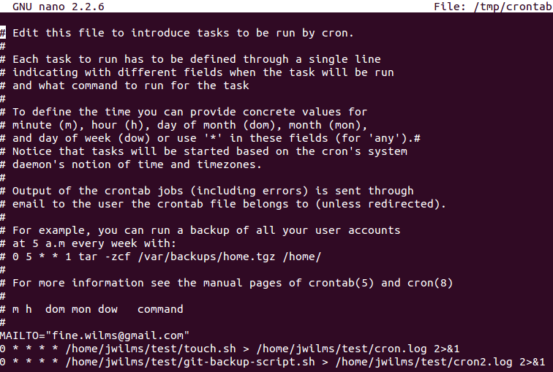
Example of $ crontab -e

