Slide 1
Computer Organization and Embedded systems
Edition: 6th edition
Authors: Carl Hamacher, Zvonko Vranesic, Safwat Zaky
-Dr. MINAVATHI
PROFESSOR
CS &E

Slide 2
Unit-1 TOPICS TO BE COVERED
BASIC STRUCTURE OF COMPUTERS: Basic operational Concepts, Performance.
INSTRUCTION SET ARCHITECTURE: Memory Location and Addresses, Memory Operations, Instruction and Instruction Sequencing, Addressing Modes, Assembly Language.

Slide 3
Basic Operational Concepts
Activity in a computer is governed by instructions.
To perform a task, an appropriate program consisting of a list of instructions is stored in the memory.
Individual instructions are brought from the memory into the processor, which executes the specified operations.
Data to be used as operands are also stored in the memory.
An Instruction consists of two parts, an Operation code and operand/s as shown below:
Opcode | Operands

Slide 4
Basic Operational Concepts
A Typical Instruction
Load R2, LOC
Reads the contents of a memory location whose address is represented symbolically by the Label LOC and loads them to processor register R2
LOC contents are preserved R2 Contents are overwritten.
Add LOCA, R0
Add the operand at memory location LOCA to the operand in a register R0 in the processor.
Place the sum into register R0.
The original contents of LOCA are preserved.
The original contents of R0 is overwritten.

Slide 5
Basic Operational Concepts CONTD
Add R4,R2,R3
Adds the contents of registers R2 and R3, then place their sum into R4
Store R4, LOC
Copies the operand in register R4 to memory location LOC
LOC content is overwritten, R4 content is preserved.

Slide 6
Basic Operational Concepts cont..
Add LOCA, R0
The following are the steps to execute the instruction:
Step 1: Fetch the instruction from main memory into the processor
Step 2: Fetch the operand at location LOCA from main memory into the processor
Step 3: Add the memory operand (i.e. fetched contents of LOCA) to the contents of register R0
Step 4: Store the result (sum) in R0.

Slide 7
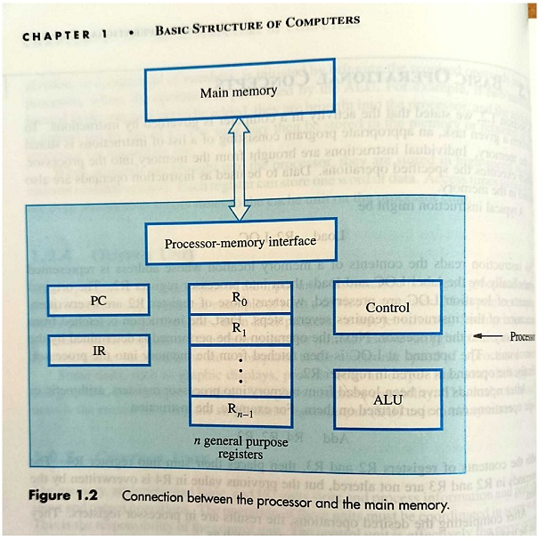
Connection Between the Processor and the Memory

Slide 8
REGISTERS
Instruction register (IR): is used to hold the instruction that is currently being executed.
Program counter (PC):it contains the memory address of the next instruction to be fetched & executed. During the execution of an instruction the contents of the PC are updated.
General-purpose register (R₀ – R_{n-1})

Slide 9
Processor Memory Interface is a circuit which manages the transfer of data between main memory and the processor.
Read Operation
If a word is to be read from the memory, the interface sends the address of that word to the memory along with read control signal.
Interface waits for the word , then transfers to appropriate register once it is received.
Write Operation
Writing a word to memory.
Interface transfers both address and the word content to the memory along with write control signal.

Slide 10
TYPICAL OPERATING STEPS
Programs reside in the main memory through input devices from secondary memory in order to execute.
PC is set to point to the first instruction.
The contents of PC are transferred from memory along with read control signal.
When the addressed word has been fetched from the memory and it is loaded into register IR, the instruction is ready to be interpreted and executed.
It checks for the operands in the instruction, if it needs memory operations then it is fetched by sending the address and read control signal.
Once the operands are retrieved instruction operation is performed by taking the operands values from registers and storing the result in registers.
If the result need to be stored in memory again the write operation is performed.

Slide 11
INTERRUPT:
Besides information transfer between processor and memory, computer accepts data from input devices and send data to output devices. Some instructions are their to perform I/O Operation.
Normal execution of programs may be preempted if some device requires urgent servicing.
The normal execution of the current program must be interrupted – the device raises an interrupt signal.
The processor provides the requested service by executing an Interrupt-service routine(ISR)
State of the processor will be altered, so the state must be saved in memory location before servicing the interrupt
ISR is completed, the state of the processor is restored.

Slide 12
List the steps needed to execute the machine instruction:
Load R2, LOC
In terms between the components shown in the diagram and some simple control commands. Assume that address of the memory location Containing this instruction is initially in register PC.
The steps are:
Send the address of the instruction word from register PC to the memory and issue read control command.
Wait until the requested word has been retrieved from the memory, then load it into register IR, where it is decoded by the control circuitry to determine the operation to be performed.
Increment the contents of register PC to point to the next instruction in memory.
Send the address value LOC from the instruction in Register IR to the memory and issue a read control signal.
Wait until the requested word has been retrieved from the memory, then load it into register R2.

Slide 13
PERFORMANCE:
The most important measure of the performance of a computer is how quickly it can execute programs.
The speed with which a computer executes programs is affected by the design of its instruction set, its hardware and its software, including the operating system, and the technology in which the hardware is implemented.
Because programs are usually written in a high-level language, performance is also affected by the compiler that translates programs into machine language.

Slide 14
TECHNOLOGY:
The technology of Very Large Scale Integration (VLSI) that is used to fabricate the electronic circuits for a processor on a single chip is a critical factor in the speed of execution of machine instructions.
The speed of switching between the 0 and 1 states in logic circuits is largely determined by the size of the transistors that implement the circuits. (Smaller transistors switch faster).
Advances in fabrication technology over several decades have reduced transistor sizes dramatically.
This has two advantages: instructions can be executed faster, and more transistors can be placed on a chip, leading to more logic functionality and more memory storage capacity.
Performance can be increased by performing a number of operations in parallel. Parallelism can be implemented on many different levels
Instruction-level Parallelism
Multicore Processors
Multiprocessors

Slide 15
Instruction-level Parallelism
If we overlap the execution of the steps of successive instructions, total execution time will be reduced.
For example, the next instruction could be fetched from memory at the same time that an arithmetic operation is being performed on the register operands of the current instruction.
Multicore Processors
Multiple processing units can be fabricated on a single chip.
In technical literature, the term core is used for each of these processors. The term processor is then used for the complete chip.
Hence, we have the terminology dual-core, quad-core, and octo-core processors for chips that have two, four, and eight cores, respectively

Slide 16
Multiprocessors
Computer systems may contain many processors, each possibly containing multiple
cores. Such systems are called multiprocessors.
These systems either execute a number of different application tasks in parallel, or they execute subtasks of a single large task in parallel.
All processors usually have access to all of the memory in such systems, and the term shared-memory multiprocessor is often used to make this clear.
The high performance of these systems comes with much higher complexity and cost.
The computers normally have access only to their own memory units.
When the tasks they are executing need to share data, they do so by exchanging messages over a communication network.
This property distinguishes them from shared-memory multiprocessors, leading to the name message-passing multicomputers.

Slide 17
Chapter 2 Instruction Set Architecture

Slide 18
Memory Locations, And Addresses
n
bits
Memory consists of many millions of storage cells, each of which can store 1 bit.
Data is usually accessed in n-bit groups. n is called word length.
first word
second word
•
•
•
i
th word
•
•
•
last word
Figure 2.5. Memory words.
Notes:
18

Slide 19
Memory Locations, Addresses
Modern computers word length 16 to 64 bits
32-bit word length example
32 bits
•
•
•
b
31
b
30
b
1
b
0
Sign bit:
b
31
=
0
for positive numbers
b
31
=
1
for negative numbers
(a) A signed integer
8 bits
8 bits
8 bits
8 bits
ASCII
ASCII
ASCII
ASCII
character
character
character
character
(b) Four characters
Notes:
19

Slide 20
Memory Locations, Addresses cont..
To retrieve information from memory, either for one word or one byte (8-bit), addresses for each location are needed.
A k-bit address memory has 2^{k} memory locations, namely 0 – 2^{k}-1, called memory space.
24-bit memory: 2²⁴ = 16,777,216 = 16M
32-bit memory: 2³² = 4G
1K(kilo)=2¹⁰
1T(tera)=2⁴⁰
1M=2²⁰
1G=2³⁰
Notes:
20

Slide 21
Memory Locations, Addresses cont..
Byte addressability
Three basic information quantities to deal bit, byte and word.
The most practical assignment is to have successive addresses refer to successive byte locations in the memory – byte-addressable memory.
Byte locations have addresses 0, 1, 2, … If word length is 32 bits, they successive words are located at addresses 0, 4, 8,…
There are two ways that byte addresses can be assigned across word:-
Big-Endian Assignments
Little-Endian Assignments

Slide 22
Big-Endian and Little-Endian Assignments
Big-Endian: lower byte addresses are used for the most significant bytes of the word
Little-Endian: opposite ordering. lower byte addresses are used for the less significant bytes of the word
W
ord
address
Byte address
Byte address
0
0
1
2
3
0
3
2
1
0
4
4
5
6
7
4
7
6
5
4
•
•
•
•
•
•
2
k
-
4
2
k
-
4
2
k
-
3
2
k
-
2
2
k
-
1
2
k
-
4
2
k
-
1
2
k
-
2
2
k
-
3
2
k
-
4
(a) Big-endian assignment
(b) Little-endian assignment
Figure 2.7. Byte and word addressing.
Notes:
22

Slide 23
What is Big-Endian?
In a big-endian system, the most significant byte (MSB) is stored at the
lowest memory address.
This means the “big end” (the most significant part of the data) comes
first.
For instance, a 32-bit integer 0x12345678 would be stored in memory as
follows in a big-endian system:
Big-Endian Representation - Example
Address: 00 01 02 03
Data: 12 34 56 78
Here, 0x12 is the most significant byte, placed at the lowest address (00),
followed by 0x34, 0x56, and 0x78 at the highest address (03).

Slide 24
What is Little-Endian?
A little-endian system stores the least significant byte (LSB) at the lowest
memory address.
The “little end” (the least significant part of the data) comes first.
For the same 32-bit integer 0x12345678, a little-endian system would store
it as:
Little-Endian Representation - Example
Address: 00 01 02 03
Data: 78 56 34 12
Here, 0x78 is the least significant byte, placed at the lowest address (00),
followed by 0x56, 0x34, and 0x12 at the highest address (03).

Slide 25
Memory Locations, Addresses cont..
Address ordering of bytes
Word alignment
Words are said to be aligned in memory if they begin at a byte addr. that is a multiple of the num of bytes in a word.
16-bit word: word addresses: 0, 2, 4,….
32-bit word: word addresses: 0, 4, 8,….
64-bit word: word addresses: 0, 8,16,….
Notes:
25

Slide 26
Memory Locations, Addresses cont..
Accessing numbers, characters, and character strings
Numbers can be accessed in the memory by specifying its word address.
Characters can be accessed by their byte address.
The beginning of the string is indicated by giving the address of the byte containing its first character. Successive byte location contain successive characters of the string
There are 2 ways to indicate the length of the string
1)A special control character “end of string” can be used as the last character in the string
2)Separate memory location or processor register can contain the number indicating the length of strings in bytes.

Slide 27
Memory Operations
Basic Operations
Load (or Read or Fetch)
Copy the contents from memory location to processor. The memory content doesn’t change.
Address is send to memory – Load
Registers can be used
Store (or Write)
Transfer an item from processor to memory.
Overwrite the content in memory
Address and Data is send to memory– Store
Registers can be used
Notes:
27

Slide 28
Instruction and Instruction Sequencing
The tasks carried out by a computer program consist of a sequence of small steps, such as adding two numbers, testing for a particular condition, reading a character from the keyboard, or sending a character to be displayed on a display screen.
A computer must have instructions capable of performing four types of operations:
Data transfers between the memory and the processor registers
Arithmetic and logic operations on data
Program sequencing and control
I/O transfers

Slide 29
Instruction and Instruction Sequencing cont..
Register Transfer Notation
Transfer of information from one location in the computer to another.
Locations are memory locations, processor registers or registers in the I/O subsystems.
Memory locations names: LOC, PLACE, A, VAR2
Processor registers names:R0, R1..
I/O register name: DATAIN,OUTSTATUS
Contents of a location are denoted by placing square brackets around the name of the location
R1←[LOC]
R3 ←[R1]+[R2])
This type of notation is known as Register Transfer Notation(RTN)

Slide 30
Instruction and Instruction Sequencing cont..
Assembly Language Notation
Notation to Represent machine instructions and programs.
Load R2, LOC ( r2← [LOC])
Add R1, R2, R3 (R1←[R2]+[R3])

Slide 31
Instruction and Instruction Sequencing cont..
RISC and CISC Instruction Sets
Computers can be Distinguish by the nature of instruction.
Reduced Instruction set Computers
Instruction occupies one word, all operands needed for execution are in processor registers.
Execution takes place sequentially and in pipelined manner.
Complexity of the instruction reduces.
Complex instruction Set Computers
Instruction span more than one word in memory.
The instructions are complicated.

Slide 32
Instruction and Instruction Sequencing cont..
Introduction to RISC Instruction Sets
Two key Characteristics of RISC Instruction Set are:
Each instruction fits in a single word.
A load/store architecture is used , in which
Memory operands are accessed only using load and store instructions.
All operands involved in ALU operation must either be in processor registers , or one of the operands may be given explicitly within the instruction word.
Bringing the operands to register is done by using load instruction

Slide 33
Instruction and Instruction Sequencing cont..
At the start of execution of a program, all instructions and data used in the program are stored in the memory of a computer.
Processor registers do not contain valid operands at that time.
It is necessary to first bring these operands into the registers.
This task is done by Load instructions which copy the contents of a memory location into a processor register.
Load instructions are of the form
Load destination, source
Load processor_register, memory_location
Memory_location can be specified in various ways called addressing modes

Slide 34
Instruction and Instruction Sequencing cont..
Let us now consider a typical arithmetic operation.
Adding two numbers :
C=A+B
The required action can be accomplished by a sequence of simple machine instructions. We choose to use registers R2, R3, and R4 to perform the task with four instructions
Load R2, A
Load R3,B
Add R4, R2,R3
Store R4,C
Three address instruction
Add destination, source1,source2
Store source, destination

Slide 35
Instruction and Instruction Sequencing cont..
Note that we can accomplish the desired addition by using only two registers, R2 and R3.
In this case the addition would be performed as
Add R3,R2,R3
and the last instruction would become
Store R3,C

Slide 36
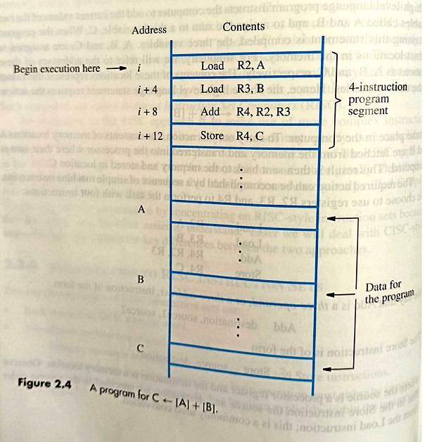
Instruction Execution and Straight-Line Sequencing
We assume that the word length is 32 bits and the memory is byte-addressable.
The four instructions of the program are in successive word locations, starting at location i.
Since each instruction is 4 bytes long, the second, third, and fourth instructions are at addresses i + 4, i + 8, and i + 12

Slide 37
Program execution
The address of the first instruction is placed in PC
The processor control circuits use the information in the PC to fetch & execute instructions at a time, in the order of increasing address. This is called straight-line sequencing, during the execution of each instruction PC is incremented.
After the i+12 instruction is executed PC ←i+16
2-phase procedure for execution
Instruction fetch: The instruction is fetched from the memory location whose address is in PC. This instruction is placed in IR.
Instruction execute: The instruction in IR is examined to determine which operation is to be performed. The specified operation is then performed by the processor.At some point the contents of PC is incremented.
In most computers the execute phase is itself divided into small number of distinct phases.
Fetch operands from the memory or from processor registers.
Performing ALU operations.
Storing the result in the destination location.

Slide 38
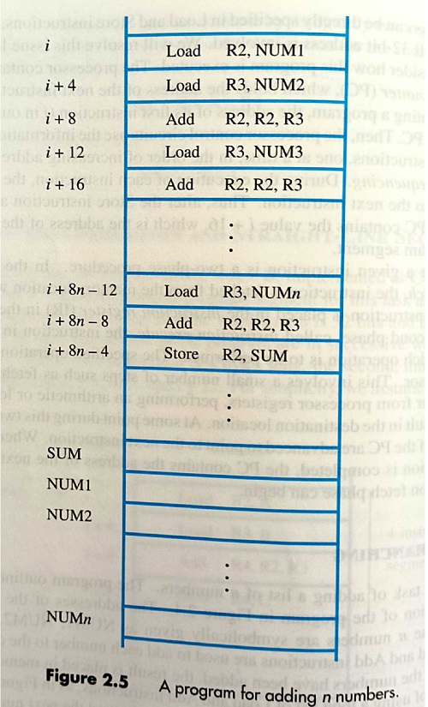
Branching
Adding list of n numbers

Slide 39
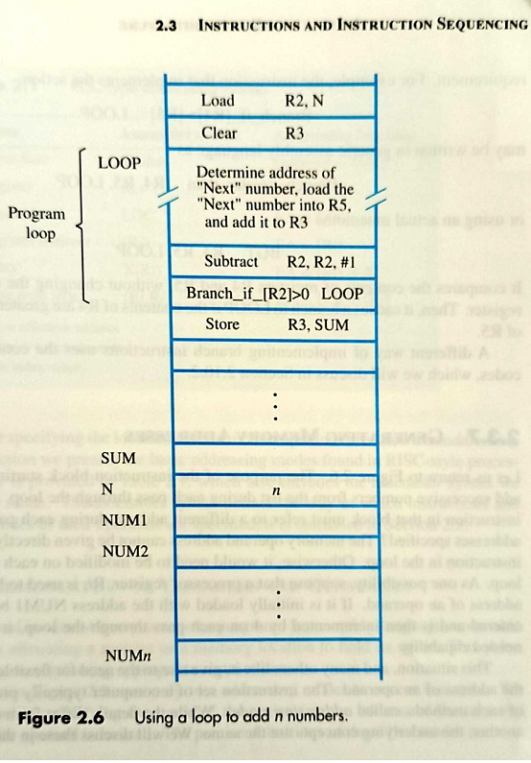
Branching

Slide 40
Branching
The loop is a straight line sequence of instruction executed as many times as needed.
Branch instruction loads a new value into the program counter.
The processor fetches and executes the instruction at this new address called the branch target.
The conditional branch instruction causes a branch only if it is specified condition is reached.

Slide 41
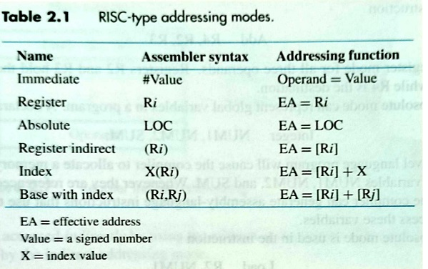
Addressing Modes
The program operates on data that reside in the computer memory
The different ways in which the location of an operand is specified in an instruction are referred as addressing modes.

Slide 42
Immediate Addressing Mode :
The operand is given explicitly in the instruction
The '#' symbol before constant data indicates that the operand is a data
The operand field contains the actual operand to be used in conjunction with the operation specified in the instruction.
Immediate-mode instructions are useful for initializing registers to a constant value
Eg: Add R4,R6, 200_{immediate}
Add R4,R6,#200
Move R2, #33
Register Addressing Mode :
In this mode the operands are in registers that reside within the CPU.
Instructions are shorter but operands cant be identified by looking at the instruction
The particular register is selected from a register field in the instruction
Eg: Add R4,R2,R3

Slide 43
Absolute Addressing Mode :
The operand is in the memory location
The address field of the instruction contains the effective address of the operand.
Only one reference to memory is required to fetch the operand.
Eg: Load R2, NUM1
Store R1, Loc

Slide 44
Write a RISC-style program to compute the value of W=25+33-X
Clear R1
Move R2, #33
Add R1, R2, #25
Load R2, X
Sub R1, R1, R2
Store R1, W
Write a RISC-style program to compute the value of W=X+Y+Z
Load R1, X
Load R2, Y
Add R1, R1, R2
Load R2, Z
Add R1, R1, R2
Store R1, W

Slide 45
Write a RISC-style program to compute the value of X=A-B+C+98
Load R1, A
Load R2, B
Sub R1, R1, R2
Load R2, C
Add R1, R1, R2
Add R1, R1, #98
Store R1, X

Slide 46
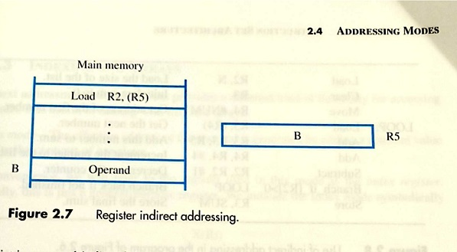
Indirect Addressing Mode:
In this addressing mode, the address field of the instruction specifies the address of memory location that contains the effective address of the operand.
Two references to memory are required to fetch the operand.
We denote the indirection by placing the name of the registers in the parenthesis
Ex: Load R2, (R1)

Slide 47
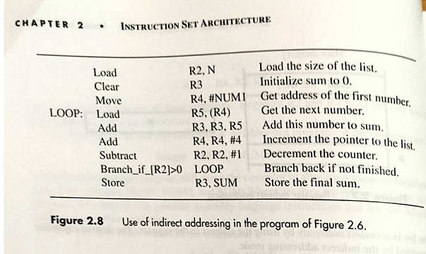
Adding a list of numbers

Slide 48
Indexed Addressing Mode:
In this mode the content of an index register is added to the address part of the instruction to obtain the effective address.
The index register is a special CPU register that contains an index value.
It is useful for dealing with lists & arrays
In Index mode, EA of the operand is generated by adding a constant value to a contents of register
Symbolically represented as:
x(Ri)
x → denotes constant value
EA=x+[Ri]
Ex: Load R1, 50(R5)
Load R2, 1000(R6)

Slide 49
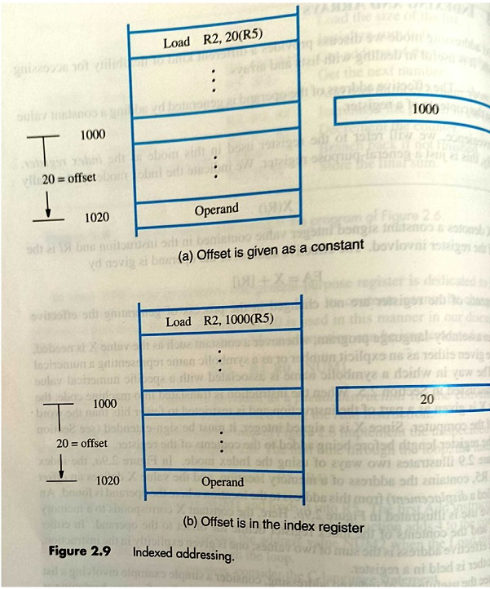

Slide 50
Base Indexed Addressing Mode:
In this mode the content of a base register is added to the address part of the instruction to obtain the effective address.
This is similar to the indexed addressing mode except that the register is now called a base register instead of an index register.
An index register is assumed to hold an index number that is relative to the address part of the instruction.
A base register is assumed to hold a base address and the address field of the instruction gives a displacement relative to this base address.
EA= [Ri]+[Rj]
For example, a second register Rj may be used to contain the offset X, in which case we can write the Index mode as (Ri,Rj)
Or
X(Ri,Rj)

Slide 51
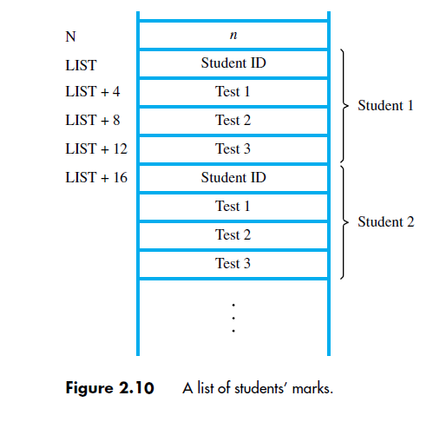

Slide 52
Analyze the given code snippet for N=3 and the memory locations
NUM1=10,
NUM1+4=12
NUM1+8 = 22.
Find the value stored in Sum memory location
Load R2, N
Clear R3
Move R4, #NUM1
LOOP: Load R5, (R4)
Add R3, R3, R5
Add R4, R4, #4
Subtract R2, R2, #1
Branch_if_[R2]>0 LOOP
Store R3, SUM

Slide 53
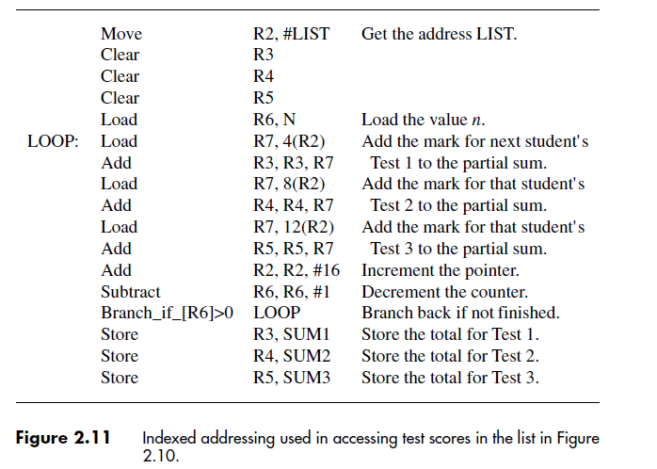

Slide 54
Analyze the given code snippet for N=3 and the memory locations
NUM1=10,
NUM1+4=12
NUM1+8 = 22.
Find the value stored in Sum memory location
Load R2, N
Clear R3
Move R4, #NUM1
LOOP: Load R5, (R4)
Add R3, R3, R5
Add R4, R4, #4
Subtract R2, R2, #1
Branch_if_[R2]>0 LOOP
Store R3, SUM

Slide 55
Assembler Directives
To assemble a program automatically the assembler needs information in the form of assembler directives that controls the assembly.
These assembler directives are command placed in the program by the designer that provides information to the assembler.
They do not become part of the final program as they are not the part of the instruction set of the microprocessor nor did they translate into executable code.
They are also known as pseudo-instruction or false instructions.
In addition to providing a mechanism for representing instructions in a program, assembly language allows the programmer to specify other information needed to translate the source program into the object program using Assembler Directives.
Each assembler has its own unique pseudo instructions or assembler directives.
These instructions differ from assembler to assembler but most of the assembler contains an equivalent set of pseudo instructions written in assembly language format.

Slide 56
ORG:
The origin (ORG) instruction tells the assembler the address of the memory location for the next instruction or data byte should be assembled.
ORG is entered at the beginning of a program.
The origin instruction has the following form,
ORG expression
where expression evaluates to a 16-bit address, i.e., ORG is followed by an address.
If no origin pseudo instruction appears before the first instruction in the program, assembly will begin, by default, at memory location 0000H.
For example:
ORG 0100H
This tells the assembler to start assembling the immediately following program at 0100H in memory.

Slide 57
EQU assembler directive:
EQU assembler directive (short for equate) is used in assembly language programming to assign a constant value, label, or expression to a symbol.
Once defined, the symbol can be used throughout the program instead of writing the constant directly.
Suppose that the name TWENTY is used to present the value 20. This fact may be conveyed to the assembler program through an equate statement such as
Ex: TWENTY EQU 20
Assembler directives does not denote an instruction that will be executed when the object program is run; in fact, it will not even appear in the object program. It simply informs the assembler that the name TWENTY should be replaced by the value 20 wherever it appears in the program.
Such statements, called assembler directives (or commands), are used by the assembler while it translates a source program into an object program.

Slide 58
DATAWORD Assembler Directive:
The DATAWORD directive is used to reserve memory locations and initialize them with 16-bit (word) data values.
Syntax: LABEL DATAWORD value1, value2, ...
LABEL → Optional name given to the first memory location.
DATAWORD → Directive to store word-sized data (16 bits = 2 bytes).
value1, value2, … → The actual values (constants) to be stored.
Each DATAWORD allocates 2 bytes per value in memory.
If multiple values are specified, they are stored in consecutive words.
The label can be used in the program to refer to the starting address.
Example 1: Single word
NUM DATAWORD 1234H
Reserves 2 bytes of memory.
Stores 1234H (low byte 34H, high byte 12H).
NUM points to the first byte.
Address | Content
2000H | 34H
2001H | 12H

Slide 59
RESERVE Assembler Directive:
The RESERVE directive is used to allocate memory locations without initializing them.
It simply reserves the required number of bytes (or words), but the contents remain
undefined until the program modifies them.
LABEL → (optional) name pointing to the first reserved location.
RESERVE → Directive to allocate space.
n → Number of memory locations to be reserved.
The memory is allocated but not initialized.
Useful when space is required for variables, buffers, arrays, or stack.
The assembler only sets aside memory, the programmer must later store values.
Example 1: Reserve bytes
BUFFER RESERVE 20
This reserves 20 consecutive bytes of memory.
BUFFER points to the first byte.
Example 2: Reserve words
ARR RESW 10
Reserves space for 10 words (20 bytes).

Slide 60
End of Program
END marks the end of source program so the assembler stops processing.
END

Slide 62
Below figure shows the memory addresses where the machine instructions and the required data items are to be found after the previous slide program is loaded for execution.
If the assembler is to produce an object program according to this arrangement, it has to know
• How to interpret the names
• Where to place the instructions in the memory
• Where to place the data operands in the memory

Slide 63
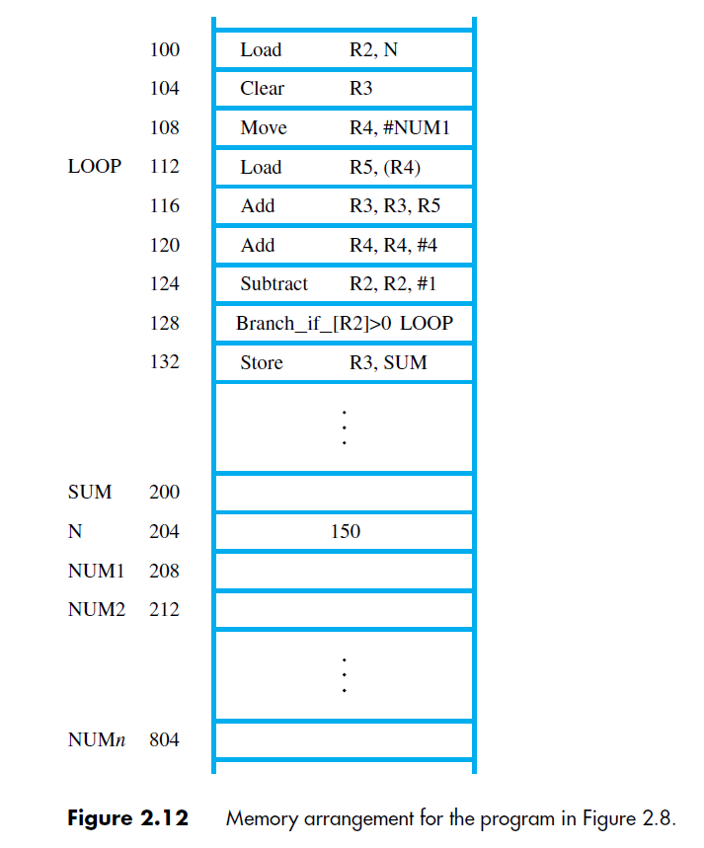
The figure shows the memory addresses where the machine instructions and the required data items are to be found after the program is loaded for execution.

Slide 64
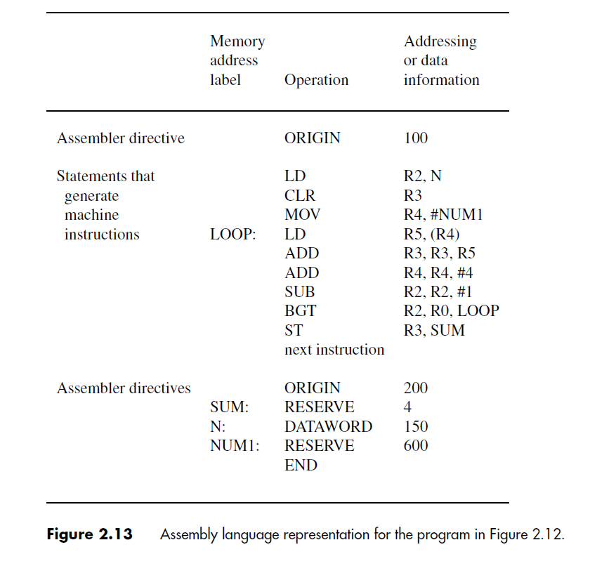

Slide 65
The assembler automatically assigns the address of that location to the label.
For example, in the data block that follows the second ORIGIN directive, we used the labels SUM, N, and NUM1.
Because the first RESERVE statement after the ORIGIN directive is given the label SUM, the name SUM is assigned the value 200.
Whenever SUM is encountered in the program, it will be replaced with this value
A 4-byte space for the sum is reserved by means of the assembler directive RESERVE
The next word, at address 204, has to contain the value 150 which is the number of entries in the list.
The DATAWORD directive is used to inform the assembler of this requirement.
The next RESERVE directive declares that a memory block of 600 bytes is to be reserved for data
This directive does not cause any data to be loaded in these locations. Data may be loaded in the memory using an input procedure
Directive END tells the assembler that this is the end of the source program text.
Similarly, the labels N and NUM1 are assigned the values 204 and 208, respectively

Slide 66
Number Notation:
Most assemblers allow numerical values to be specified in different ways, using conventions that are defined by the assembly-language syntax.
Ex: ADDI R2, R3, 93 → decimal number 93
ADDI R2, R3, %01011101 → binary number
ADDI R2, R3, 0x5D → hex number

Slide 67
Solved Problems:
List the steps needed to execute the machine instruction
Load R2, LOC
in terms of transfers between the components shown in Figure 1.2 and some simple control commands. An overview of the steps needed is given in Section 1.3. Assume that the address of the memory location containing this instruction is initially in register PC.
Solution: The required steps are:
Send the address of the instruction word from register PC to the memory and issue a Read control command.
Wait until the requested word has been retrieved from the memory, then load it into register IR, where it is interpreted (decoded) by the control circuitry to determine the operation to be performed.
Increment the contents of register PC to point to the next instruction in memory.
Send the address value LOC from the instruction in register IR to the memory and issue a Read control command.
Wait until the requested word has been retrieved from the memory, then load it into register R2

