Slide 1
BXD Mice and TAS1R2 Sweet Taste Receptor Expression: A Hypothesis Generating Study
Presenter: Ian Brown
Contributors: Dr. Kendall King and Dr. George Kyriazis

Slide 2
Outline
Background
Study Goal
Materials and Methods
Results
Discussion

Slide 3
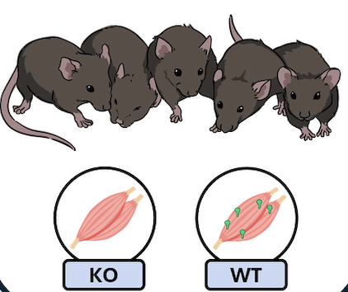
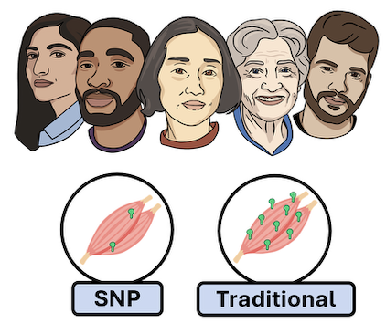
Background
KO mouse models and SNPs main approach to gene LOF
Total vs Partial LOF
A systematic survey of loss-of-function variants in human protein-coding genes (MacArthur)
The population genomics of adaptive loss of function (Monroe)
The construction of transgenic and gene knockout/knockin mouse models of human disease (Doyle)
Direct Comparison of a Natural Loss-Of-Function Single Nucleotide Polymorphism with a Targeted Deletion in the Ncf1 Gene Reveals Different Phenotypes (Sareila)
Notes:
Laboratory-generated mouse models and single nucleotide polymorphisms – referred to as (SNPs) are two of the most commonly used approaches when studying gene loss-of-function, which is indicated here as (LOF).
Loss-of-function via laboratory-generated knock-out mouse models induces complete gene inactivation, which can be useful in helping researchers more fully understand gene function and promotes an environment to model human conditions [3,4].
On the other hand, when humans experience loss-of-function, it is induced by single nucleotide polymorphisms that often cause only partial function impairment. This can give insights into gene redundancy, evolutionary adaption, and population-level variability [1,2].

Slide 4
Background
Difficulties in translating and interpreting
Direct Comparison of a Natural Loss-Of-Function Single Nucleotide Polymorphism with a Targeted Deletion in the Ncf1 Gene Reveals Different Phenotypes (Sareila)
Notes:
Due to the differences in how loss-of-function is brought about, translating and interpreting results between knock-out mouse models and human SNP carriers is very difficult. Often times, mouse models can not fully address observations seen in these human carriers.
Another issue is that partial and complete loss-of-function introduces distinct phenotypic outcomes, species-specific differences in gene regulation, genomic context, and compensatory mechanisms. This makes comparisons more complicated [4].
The way these populations are created also differ between the two methods. Humans are observed within outbred populations, whereas mouse models are typically observed within inbred populations. These anomalies highlight the need to integrate both genetically diverse and graded functional loss mouse models.

Slide 5
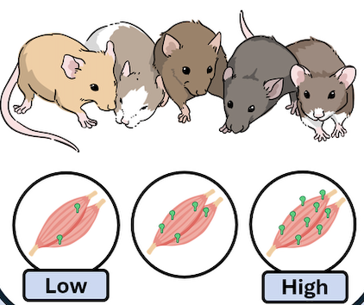
Background
BXD RI panel help bridge gap.
Largest genetic reference population.
~160 isogenic strains
Common in systems genetics
A new set of BXD recombinant inbred lines from advanced intercross populations in mice (Peirce)
A platform for experimental precision medicine: The extended BXD mouse family (Ashbrook)
Systems Genetics of Metabolism: The Use of the BXD Murine Reference Panel for Multiscalar Integration of Traits (Andreux)
Modeling the quantitative nature of neurodevelopmental disorders using Collaborative Cross Mice (Molenhuis)
Systems Genetics: a Powerful Approach for Gene-Environment Interactions (Voy)
Notes:
The need to integrate both genetically diverse and graded functional loss mouse models can be addressed by the BXD recombinant inbred panel. BXD mice are derived from 2 mouse strains (C57BL/6J and DBA/2J) and it is the largest and most extensively characterized genetic reference population. With around 160 isogenic strains, the BXD recombinant inbred panel has a broad range of naturally occurring genetic variation and preserves experimental reproducibility [5]. Unlike traditional recombinant inbred panels, BXD strains exhibit increased recombination events, leading to more genetic diversity, which makes it an improved representative model of human populations [5,6].
Using BXD mice is common in systems genetics studies of complex traits; metabolism, behavior, and molecular regulation are good examples of this [7]. Public databases, such as GeneNetwork.org, utilize this panel to facilitate quantitative trait locus mapping and genome-wide-association studies. This enables researchers to identify genetic determinants of metabolic and other complex disorders [6].
Having genetic diversity similar to human populations while retaining experimental control of traditional recombinant inbred mouse models, the BXD panel enables paralleling the graded loss-of-function effects often seen in human SNP carriers by investigating gene function across expression levels [6,8,9].

Slide 6
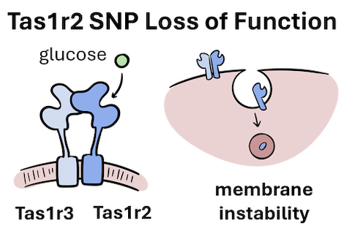
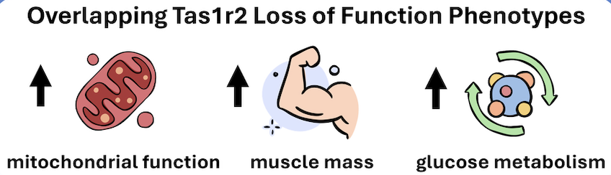
Background
Tas1r2 encodes GPCR sweet taste receptor
Metabolic associations observed in human SNP carriers
Mouse model observations have similar phenotypes
Sweet taste receptors and metabolic regulations^{[10-15, 22]}
Sweet taste receptor variations^{[16-21]}
Low TAS1R2 sweet taste receptor expression in skeletal muscle of genetically diverse BXD mice mirrors transcriptomic signatures of loss-of-function mice (King)
Notes:
Tas1r2 is a gene of interest that encodes the G-protein-coupled receptor involved in taste sensing on the tongue [10] and in peripheral nutrient metabolism [11]. Partial loss of function is a result of receptor complex membrane instability [19]. There are a number of metabolic associations [16-18] observed in human Tas1r2 SNP carriers.
Carriers have been observed to have reduced glucose excursions during an oral glucose challenge [19], which is also seen in whole body knock-out mice. The effects of the Tas1r2 polymorphism on glucose metabolism are further strengthened in two independent studies that had individuals with partial loss-of-function displaying lower glycosylated hemoglobin, an essential measure of glucose homeostasis [20,21].
Significant impacts in insulin secretion [12-14] and GLP-2 induced intestinal glucose absorption [15] have also been shown from whole-body knockout studies of Tas1r2.
Carriers have also shown improved muscle mass, mitochondrial functions, and endurance following an exercise training intervention [20]. Utilizing muscle-specific Tas1r2 deletion on a traditional recombinant inbred panel, findings similar to human carriers were seen [22].

Slide 7
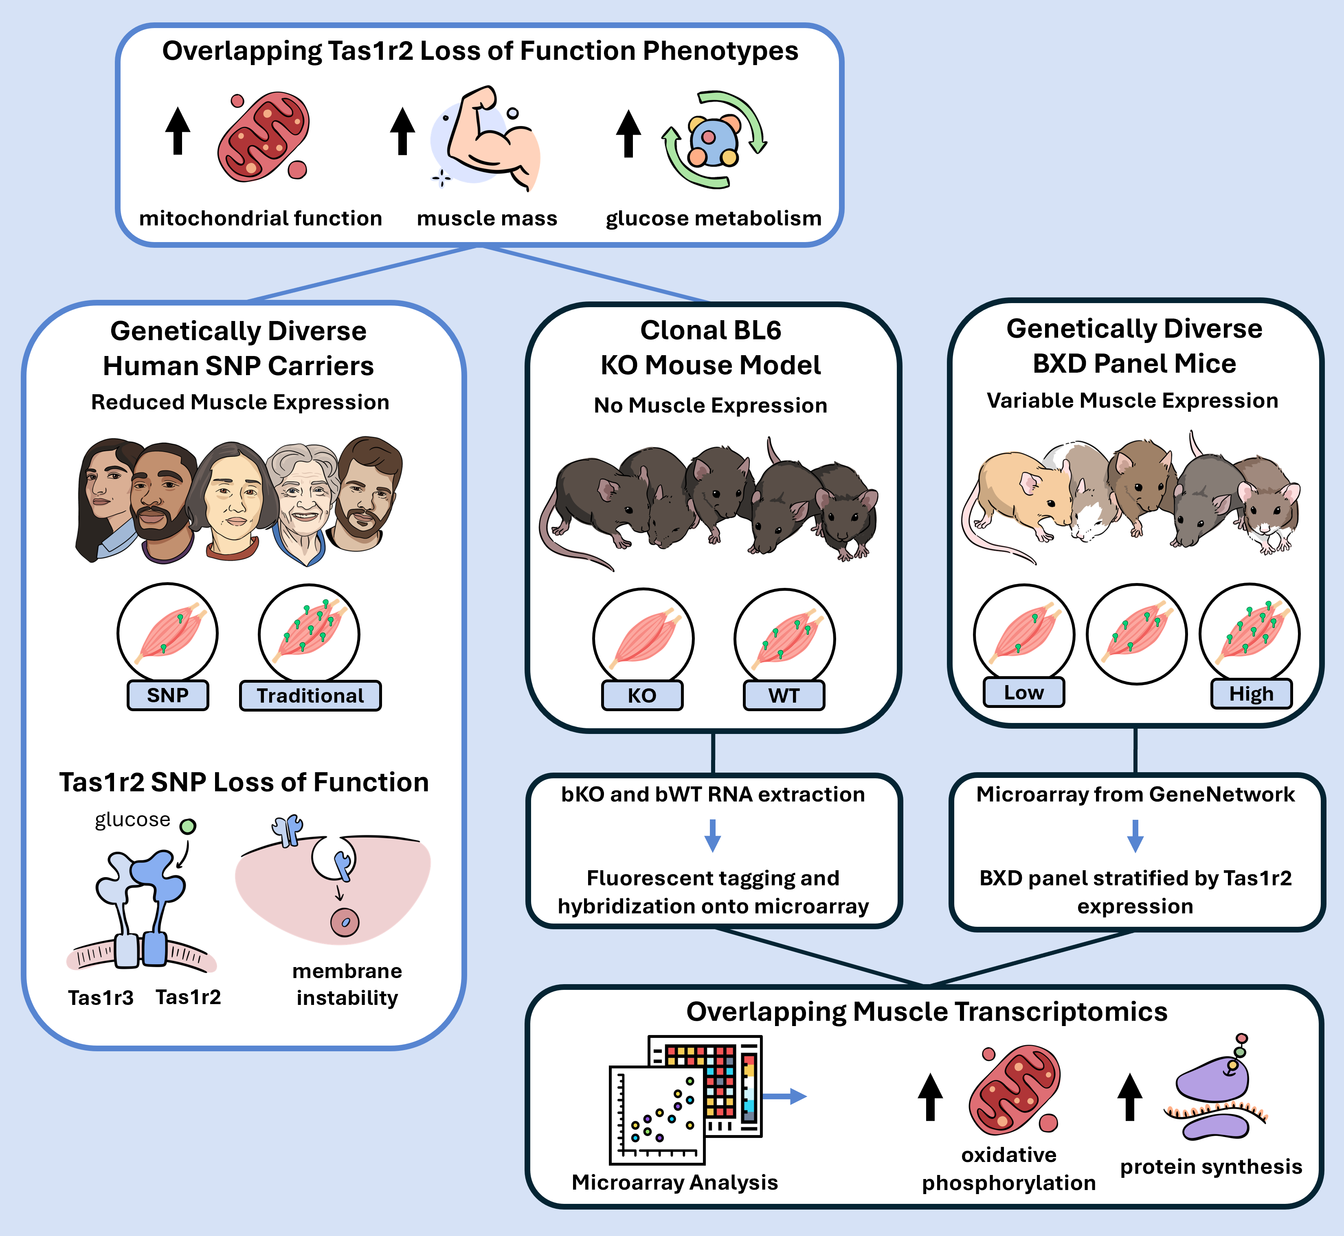
Background
Previous study’s integration
BXD representative of human population
Low TAS1R2 sweet taste receptor expression in skeletal muscle of genetically diverse BXD mice mirrors transcriptomic signatures of loss-of-function mice (King)
Notes:
A previous study [23] has demonstrated the utility of integrating the BXD panel to bridge the gap between clonal knockout models’ outcomes and human loss-of-function SNPs for the Tas1r2 gene within the muscle. Here we have a graphical abstract of the study, which was provided to me by Dr. Kendall King. This study was shown to have similar outcomes, such as oxidative phosphorylation and protein synthesis, between the BXD panel and the clonal knockout panel. This is a wonderful example of how BXD mice can be used as a representative model for human populations.

Slide 8
Study Goals
Explore pathways in metabolically relevant tissues to Tas1r2.
Provide foundational logic for hypothesis generation.
Notes:
In this study, we are exploring metabolically relevant tissues and identifying any affected pathways between high and low expression of Tas1r2 in BXD mice. This will provide the foundational logic for hypothesis generation to be used in future research using traditional recombinant inbred panels. The future research to be done will obtain phenotypic data, which outcomes will be viewed against this study’s findings to provide meaningful biological interpretations.

Slide 9



Materials and Methods
Transcriptomics
GeneNetwork.org
Statistics
RStudio
Overrepresentation Analysis
WebGestalt
Gene Set Enrichment
GeneTrail
Brown adipose tissue (BAT), Heart, Liver
Notes:
Transcriptomics, statistics, overrepresentation analysis, and gene set enrichment analysis were performed on a specific Tas1r2 probe that was selected for their lack of cross-hybridization, normal expression distribution, and broad dynamic range across mouse strains on brown adipose tissue, heart, and liver.
Transcriptomics was performed via GeneNetwork. Data was from the EPFL/LISP BXD mouse cohort at the exon level, which consists of 29-week-old male BXD mice. Each tissue had its own microarray data that needed cleaned and prepped prior to analysis.
Statistics were performed in Rstudio. Pearson’s correlation analysis identified genes significantly associated with Tas1r2. T-tests were also run between BXD high Tas1r2 expression and BXD low Tas1r2 expression. High and low expression was determined by stratifying the top and bottom quartiles of BXD strains.
Overrepresentation analysis was performed using the WEB-based Gene SeT AnaLysis Toolkit, also known as WebGestalt. Overrepresentation analysis was applied to WikiPathways to identify functionally enriched gene sets within significantly correlated genes.
After splitting the BXD strains into high and low groups, data were entered into GeneTrail for gene set enrichment analysis. Gene set enrichment analysis were also applied to WikiPathways for the same purpose.

Slide 10
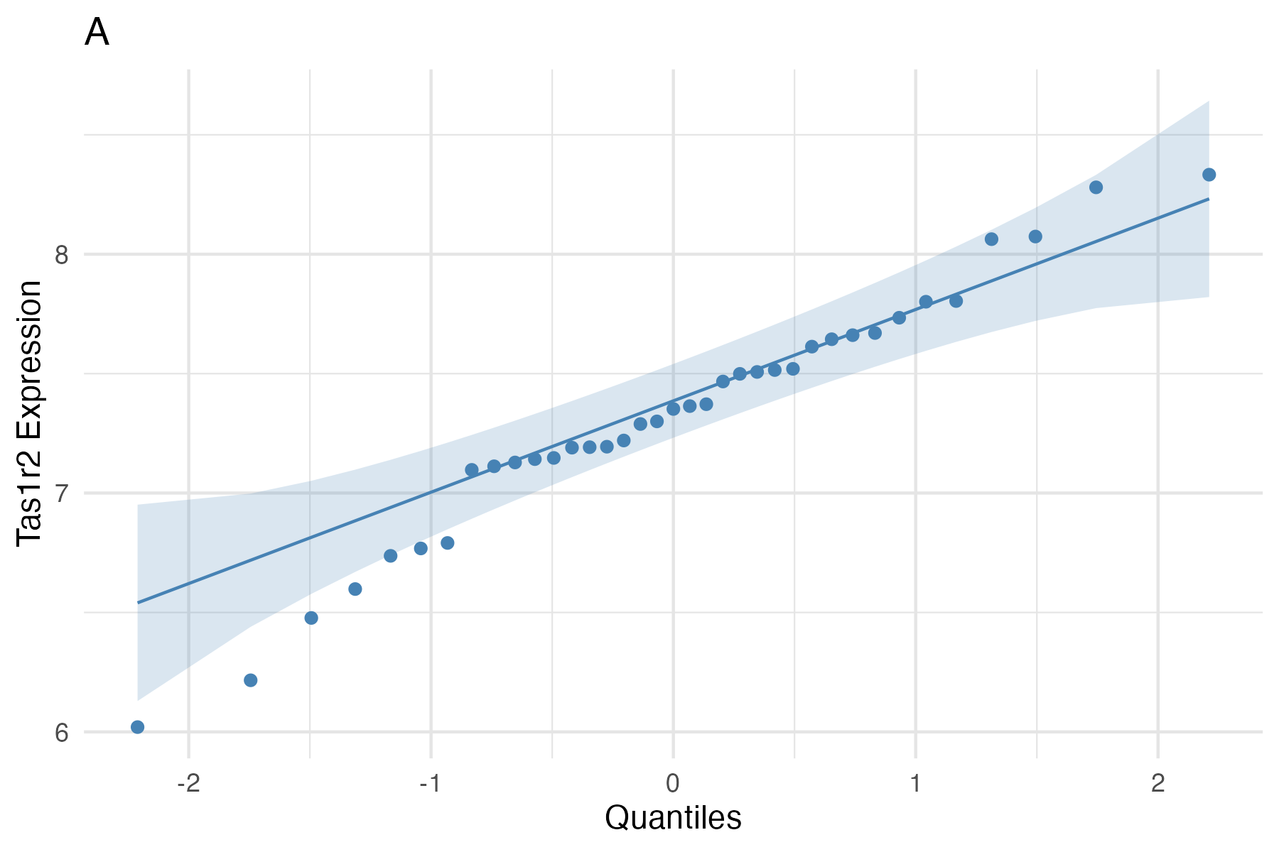
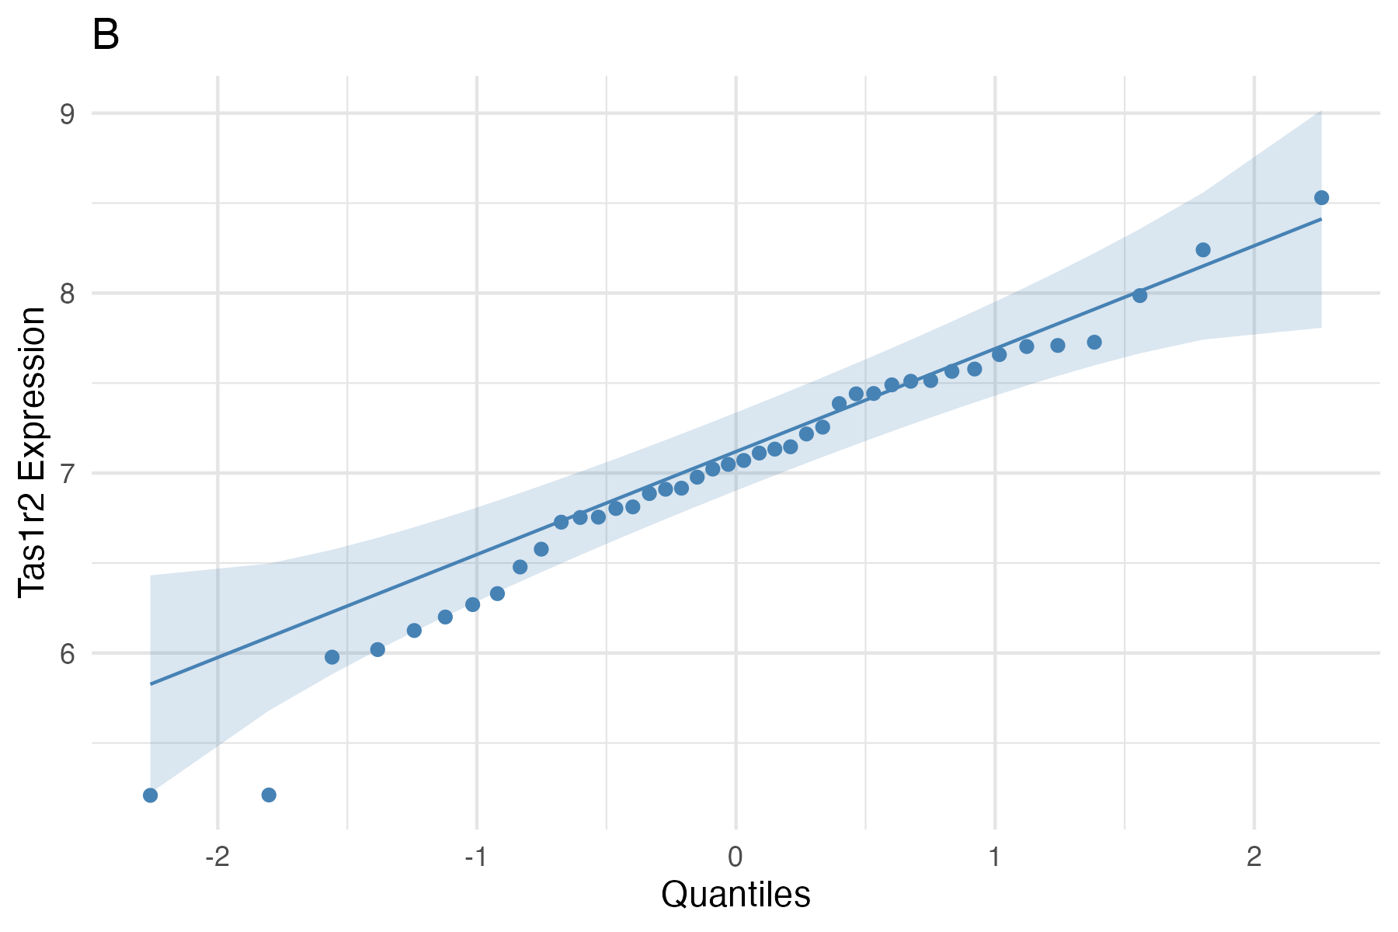
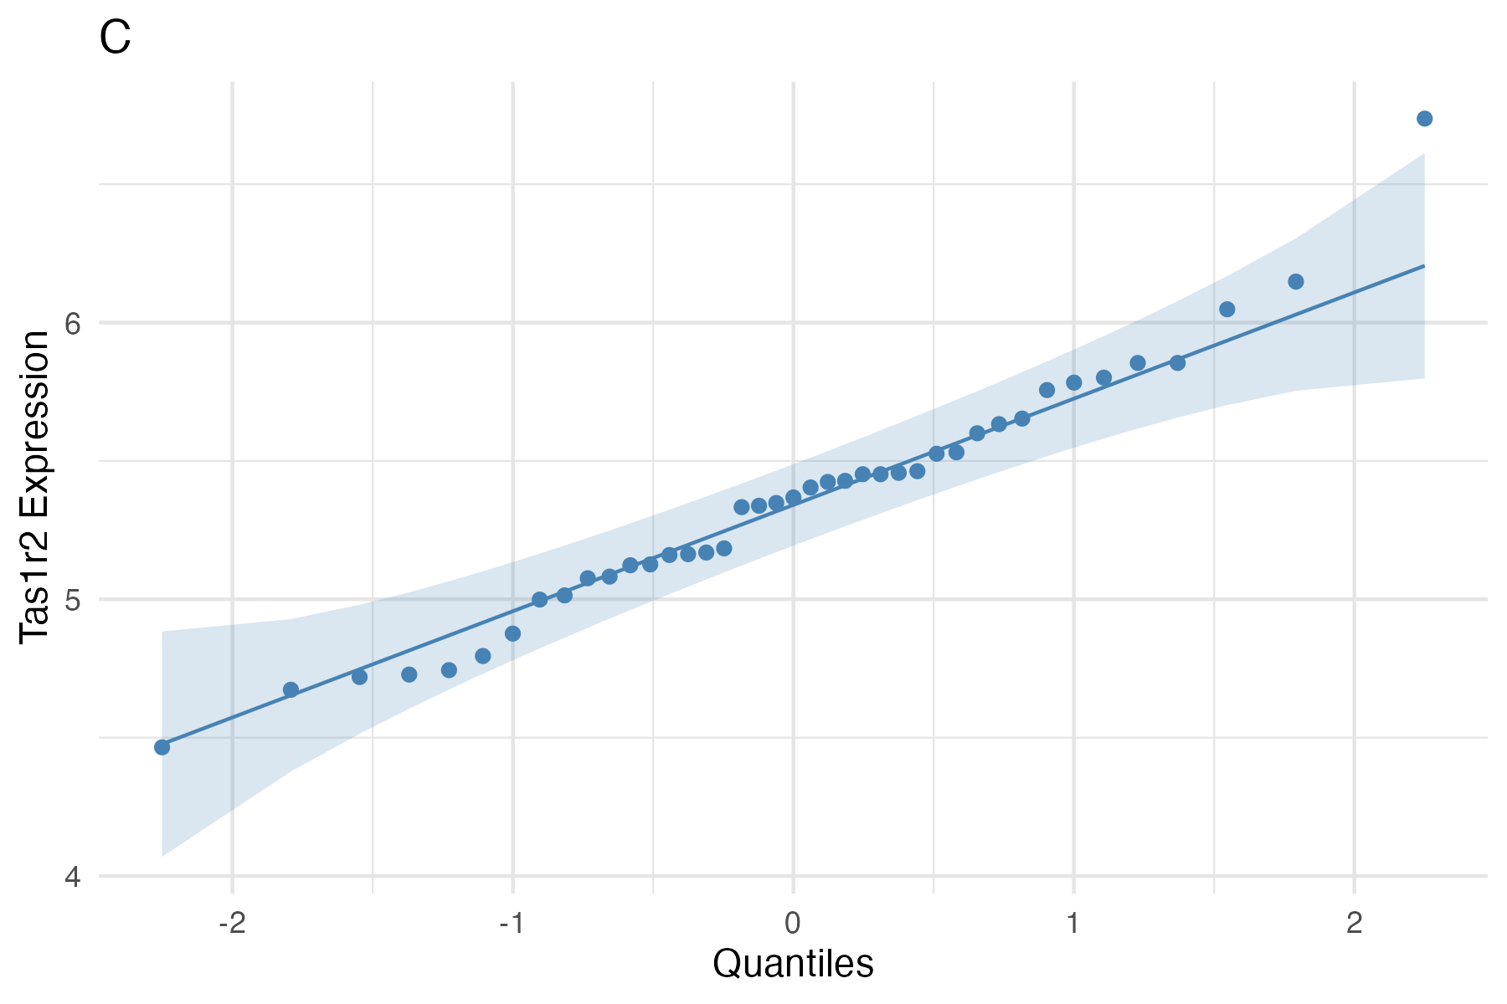
Results – QQ-Plots
BAT
Heart
Liver
Notes:
These are QQ-Plots describing each tissue’s normal distribution, obtained from GeneNetwork.org. Brown adipose tissue may be on the edge of normal distribution; however, we felt that it would suffice for this study.

Slide 11
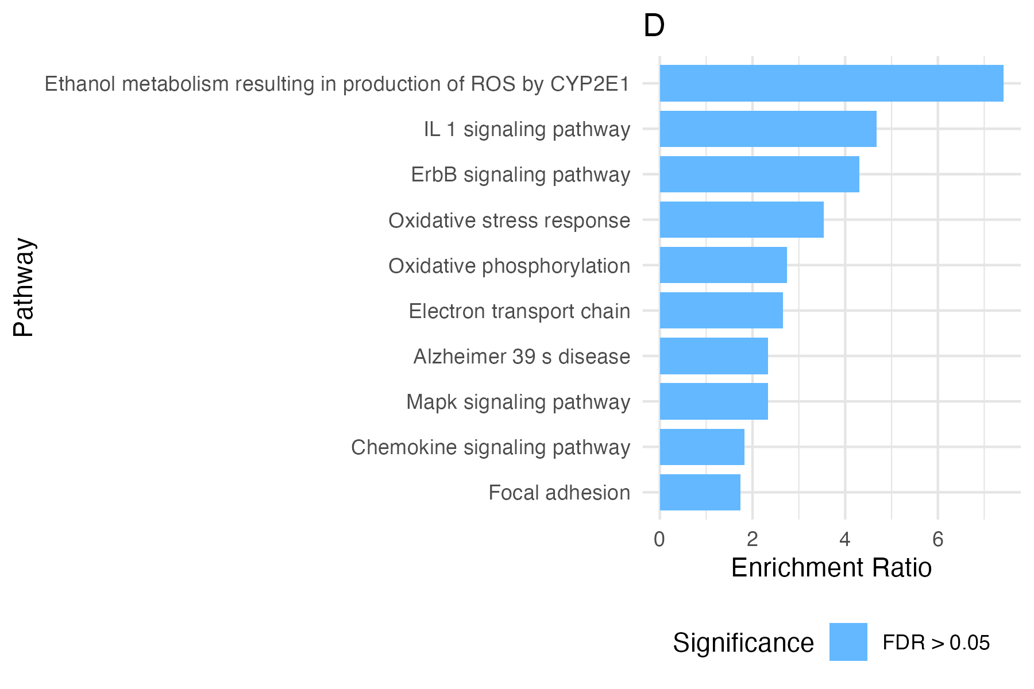
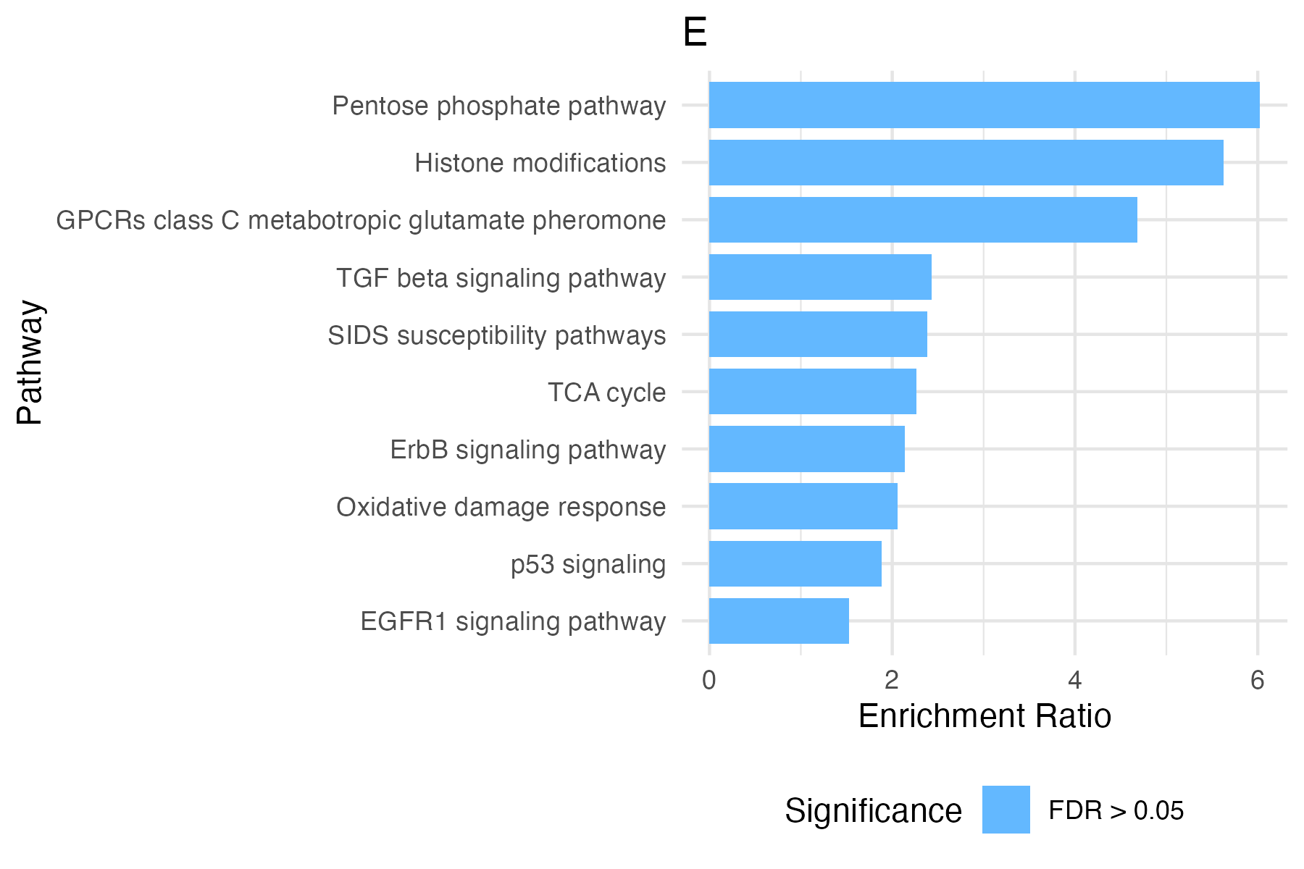
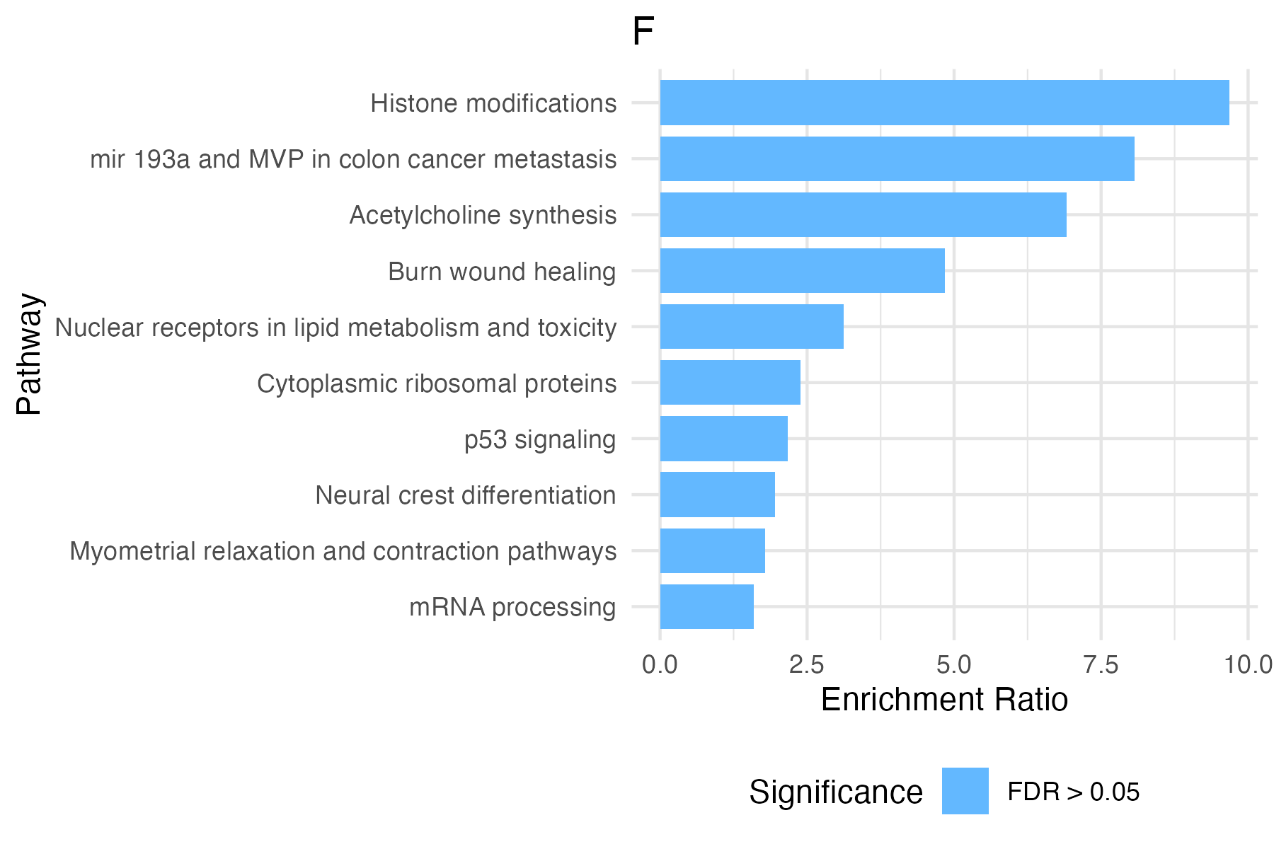
Results – Overrepresentation Analysis
BAT
Heart
Liver
Notes:
The overrepresentation analysis for each tissue was obtained via WebGestalt. It is describing each pathway that is associated with genes significantly correlated with Tas1r2. Unfortunately, none of these pathways past FDR adjustment.

Slide 12
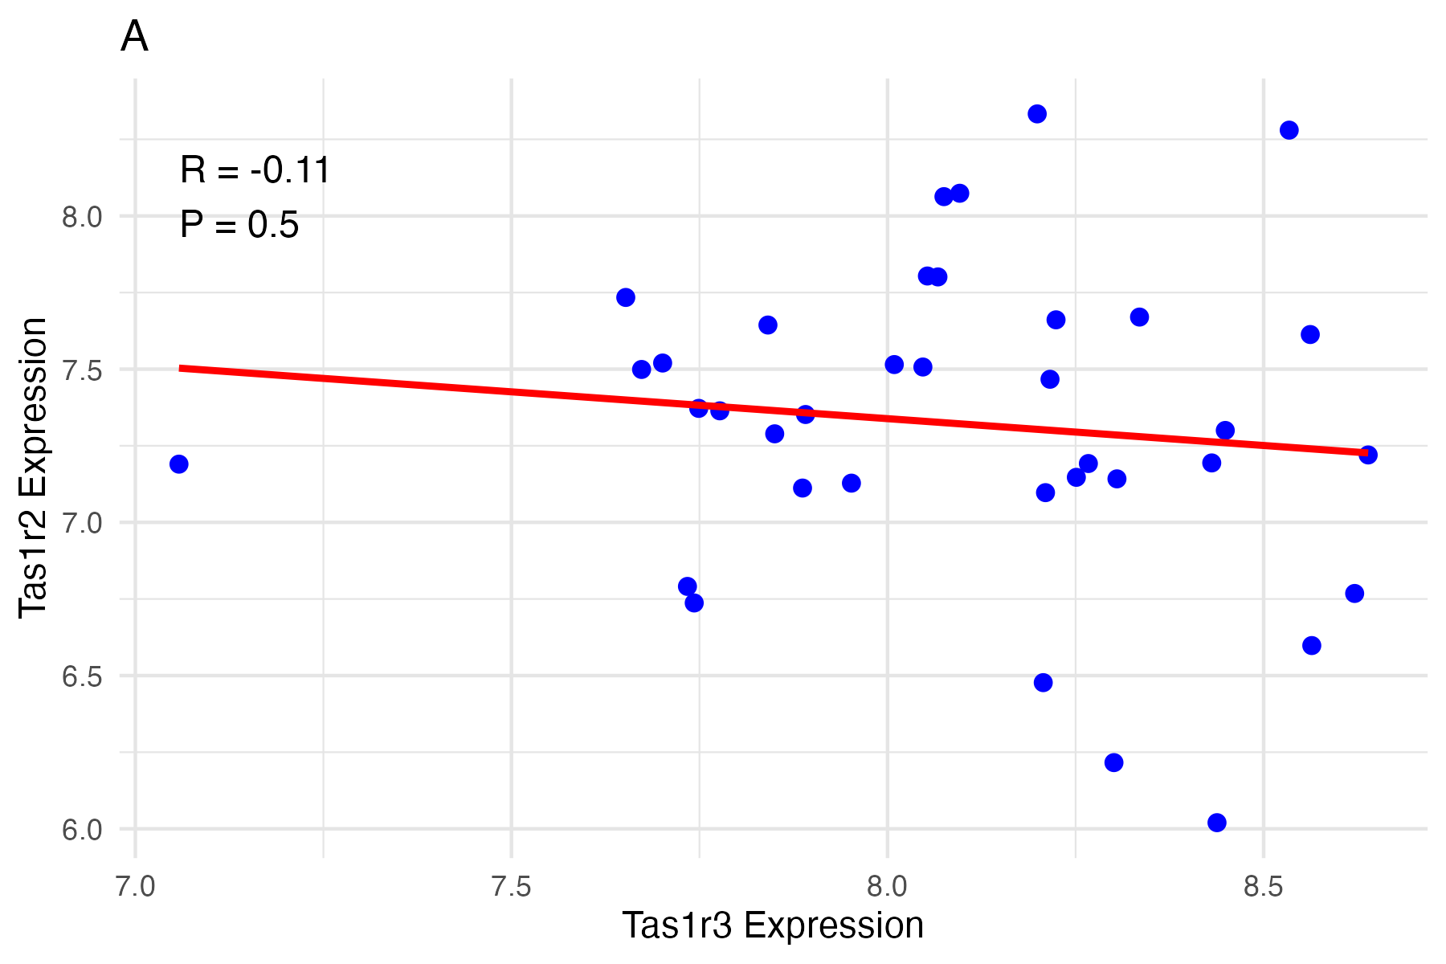
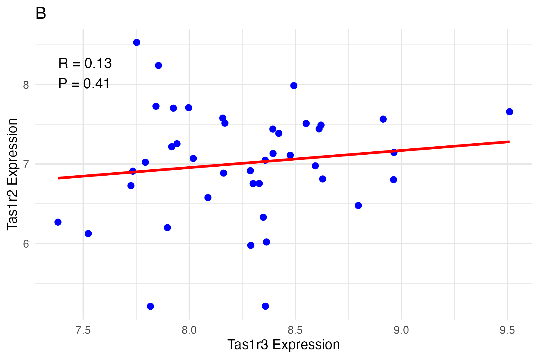
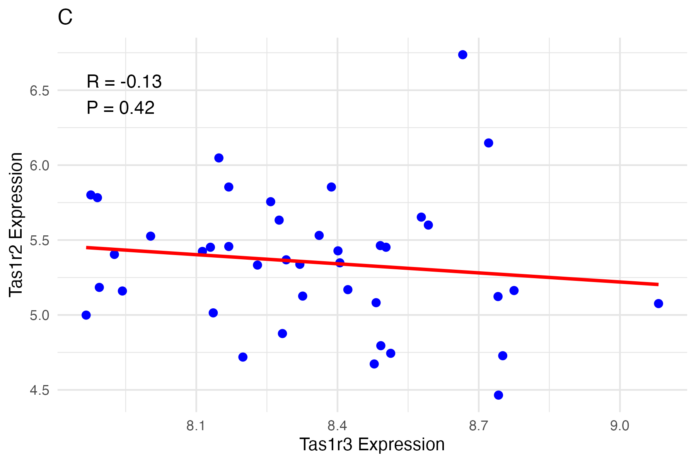
Results – Tas1r2 and Tas1r3 Correlations
BAT
Heart
Liver
Notes:
Due to Tas1r2 forming an obligate heterodimer with Tas1r3, correlation between Tas1r2 and Tas 1r3 expression were assessed via RStudio. There was no significant correlation found between the two genes in any of the analyzed tissues. This was done so ensure observed associations were specific to Tas1r2 and not Tas1r3.

Slide 13
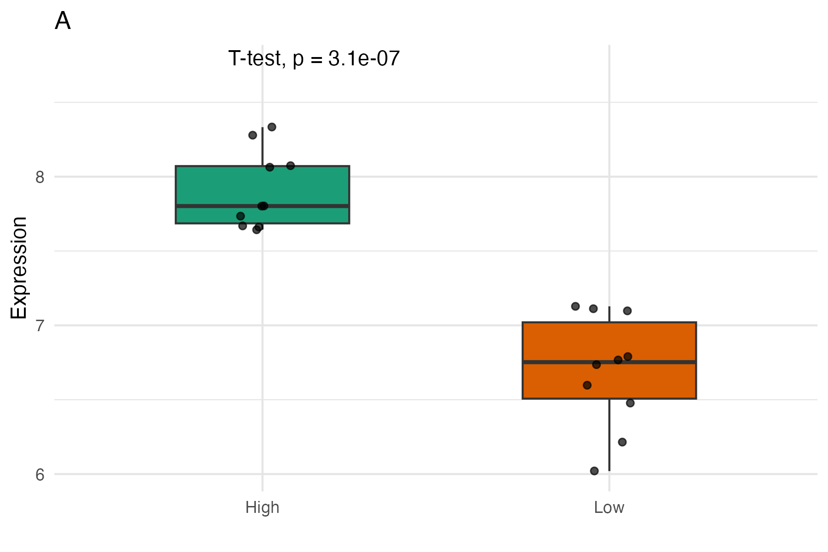
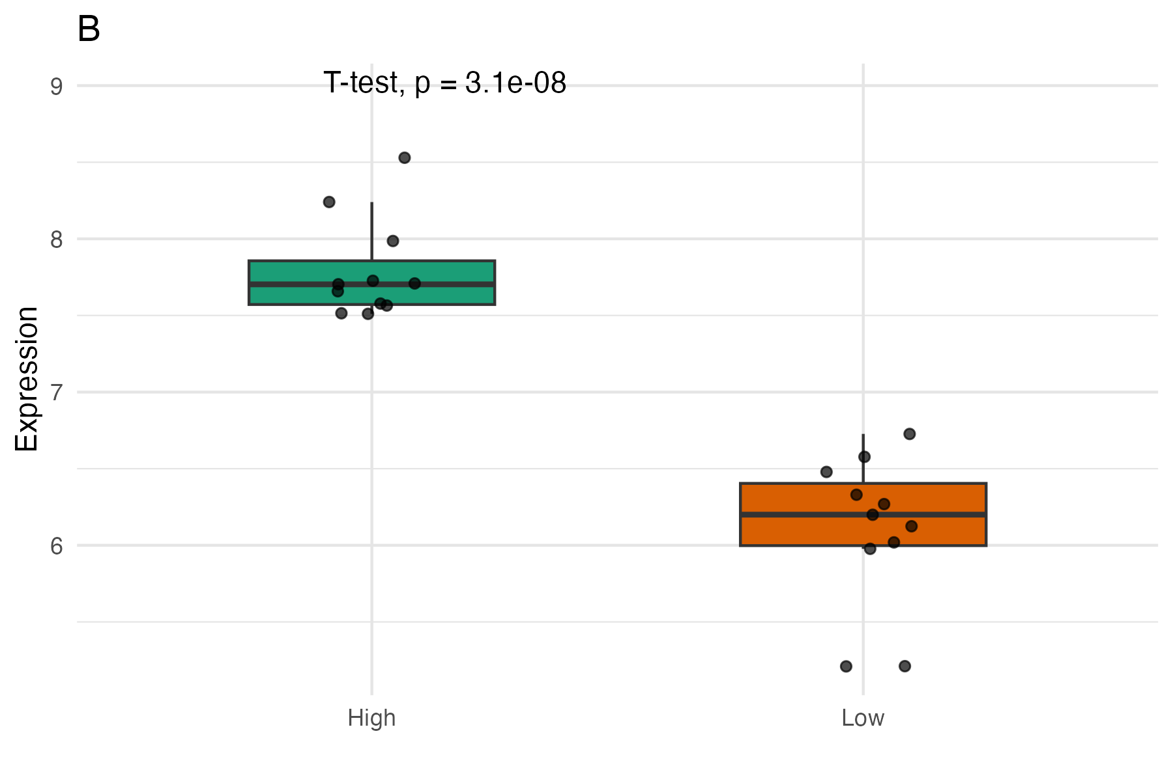
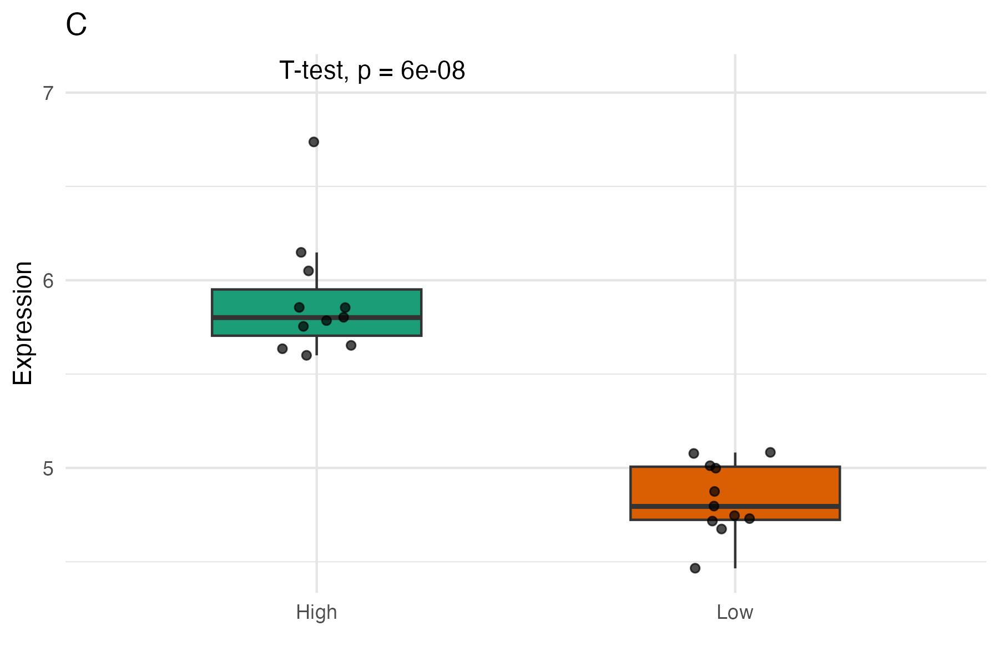
Results – Tas1r2 t-tests
BAT
Heart
Liver
Notes:
Here we have boxplots for each analyzed tissue, testing the variability in Tas1r2 expression. Results show each tissue have significant differences between high and low expressing groups supporting patterns are likely due to Tas1r2 expression.

Slide 14
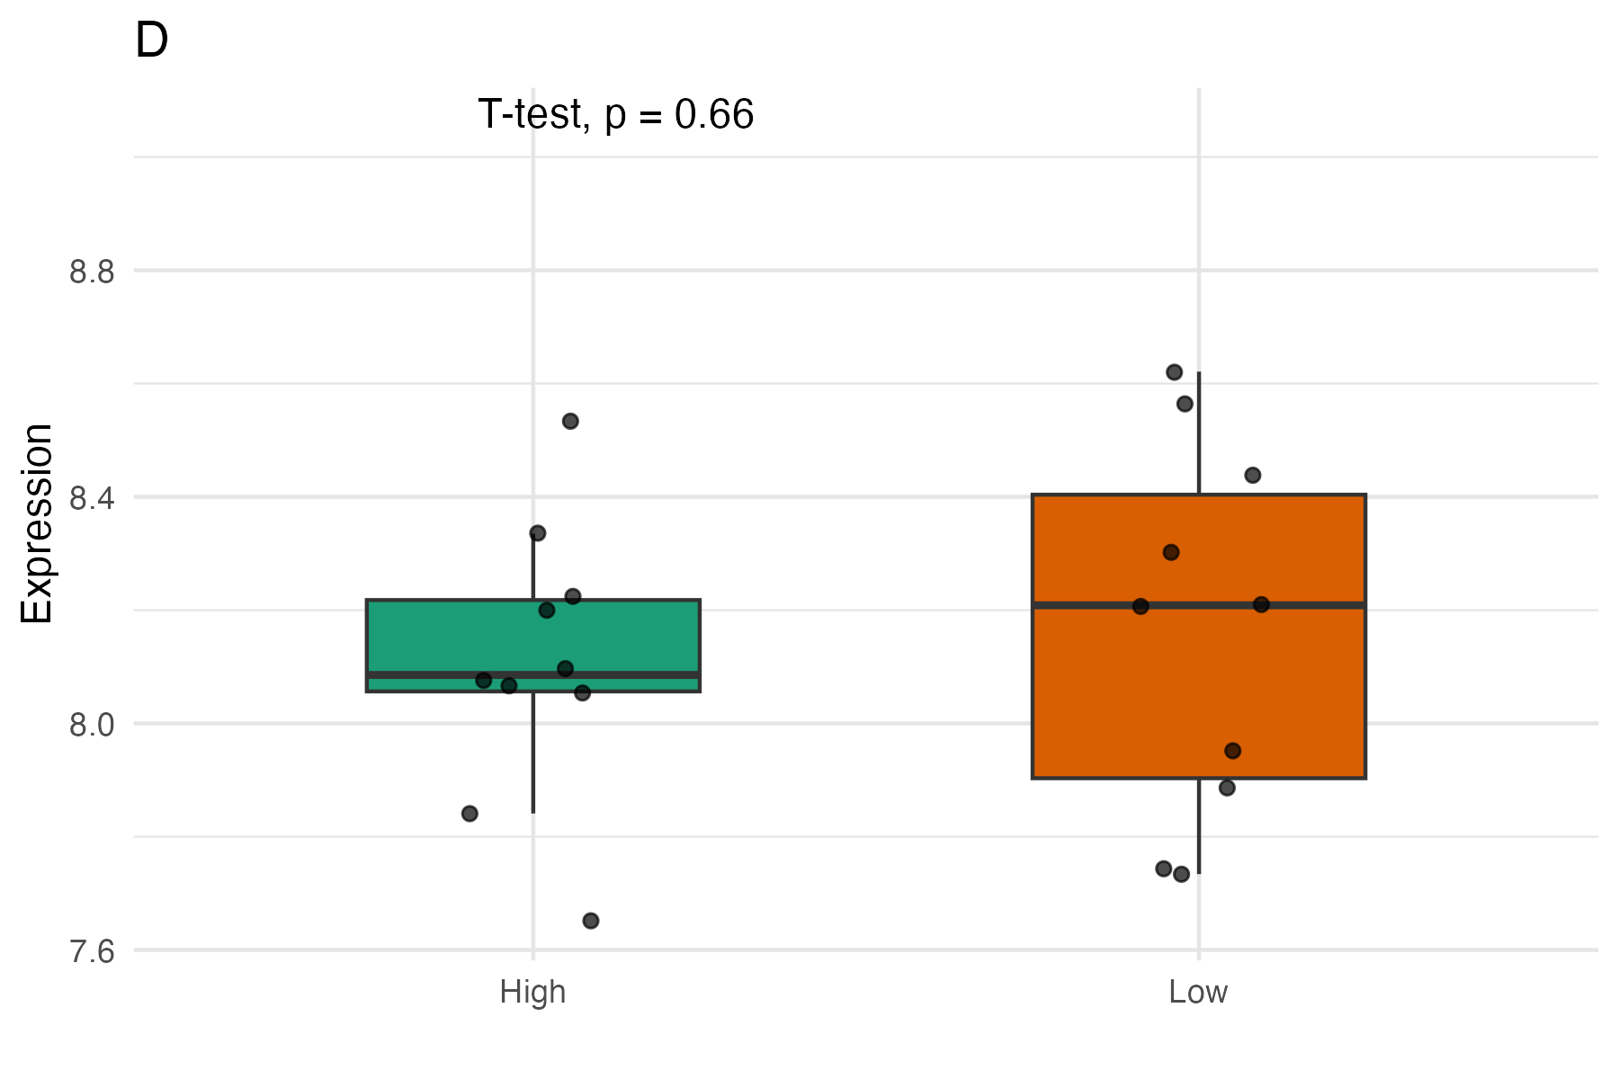
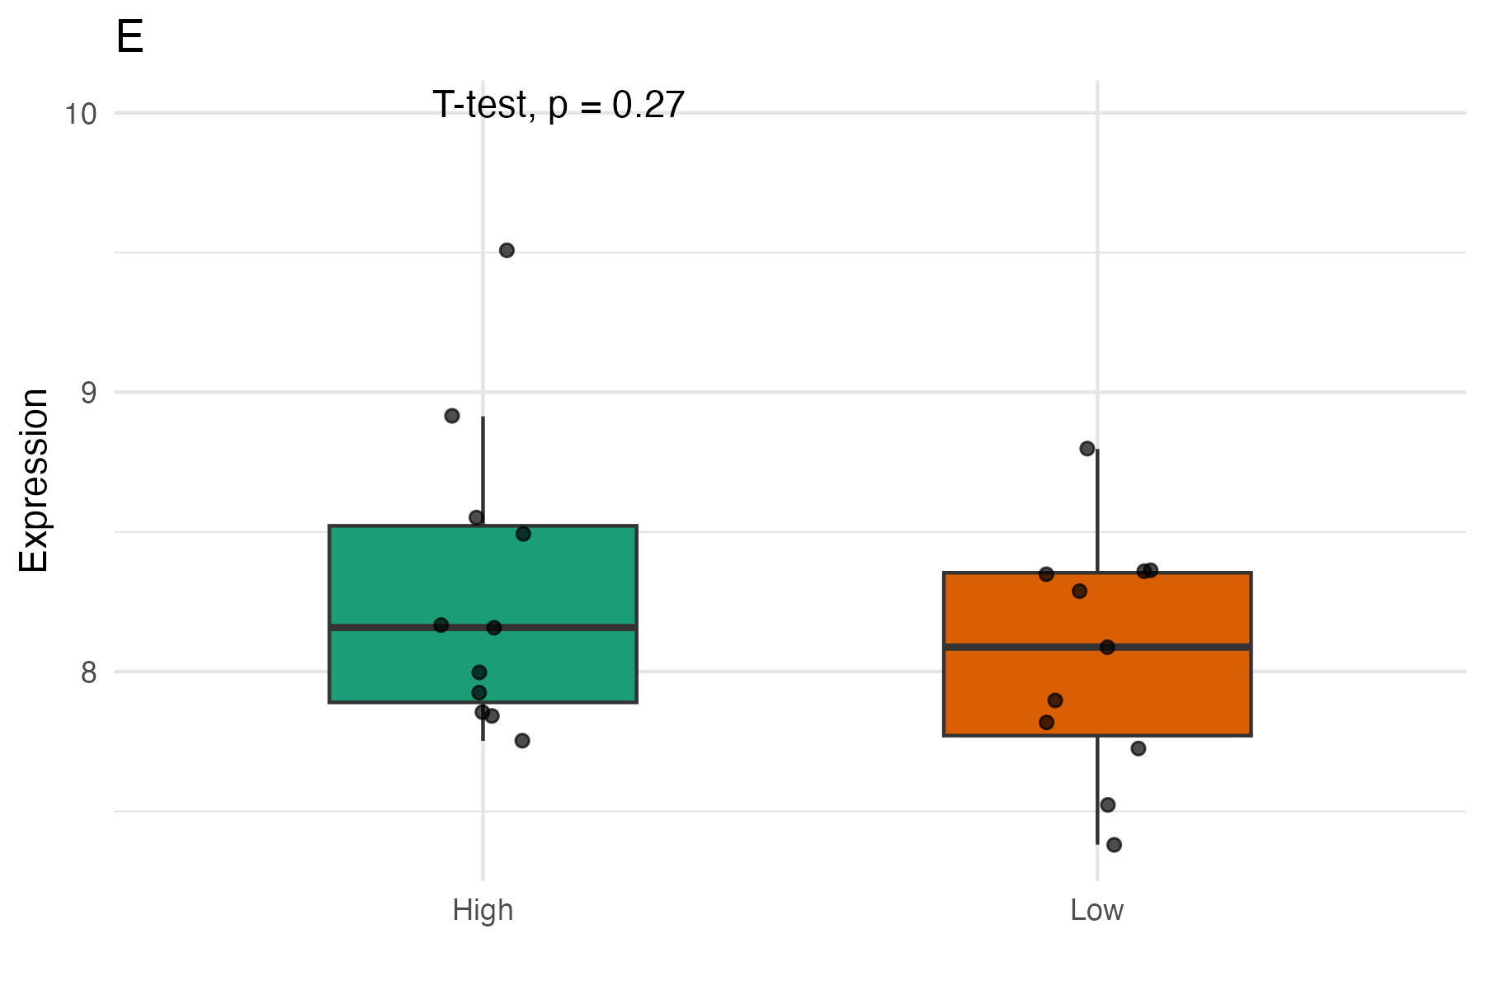
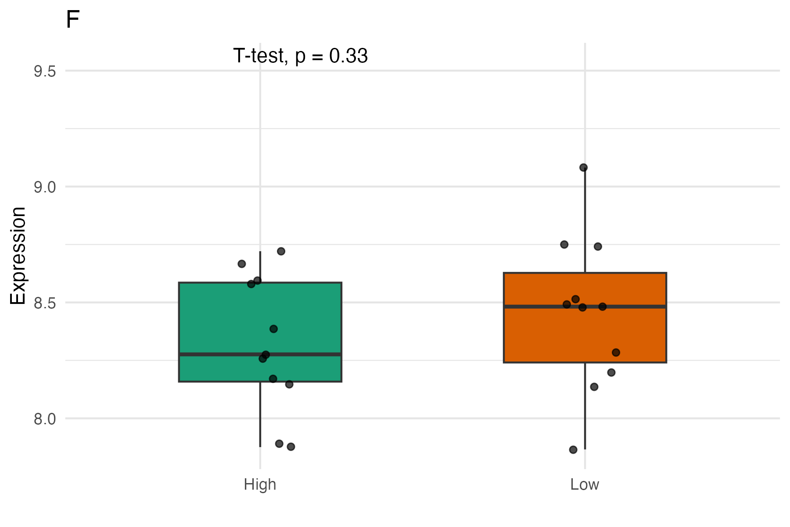
Results – Tas1r3 t-tests
BAT
Heart
Liver
Notes:
Next, tests were run to look at expression variability in Tas1r3. Results show that none of the tissues have a significant differences between high and low expressing groups. This again reaffirms that any findings are likely due to Tas1r2 specifically and not Tas1r3.

Slide 15
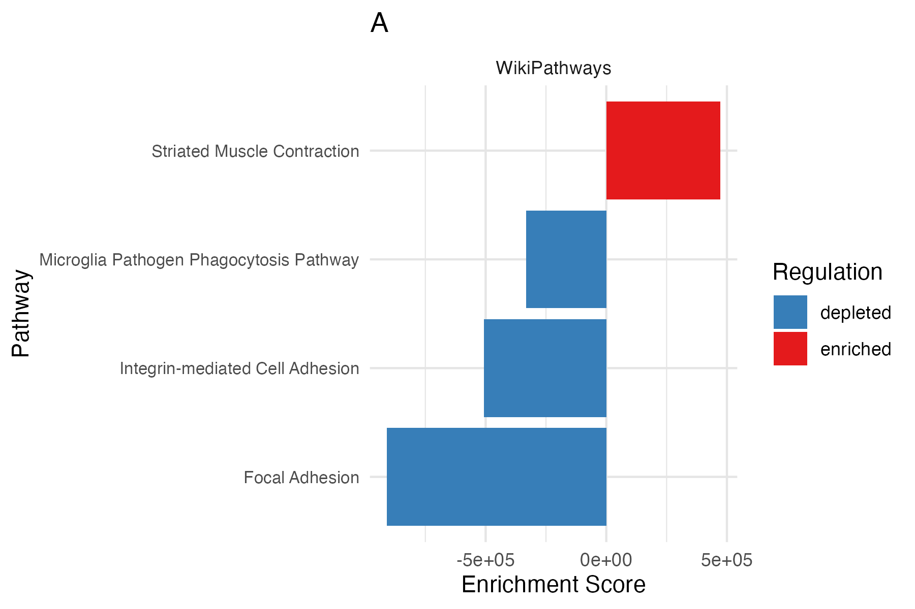
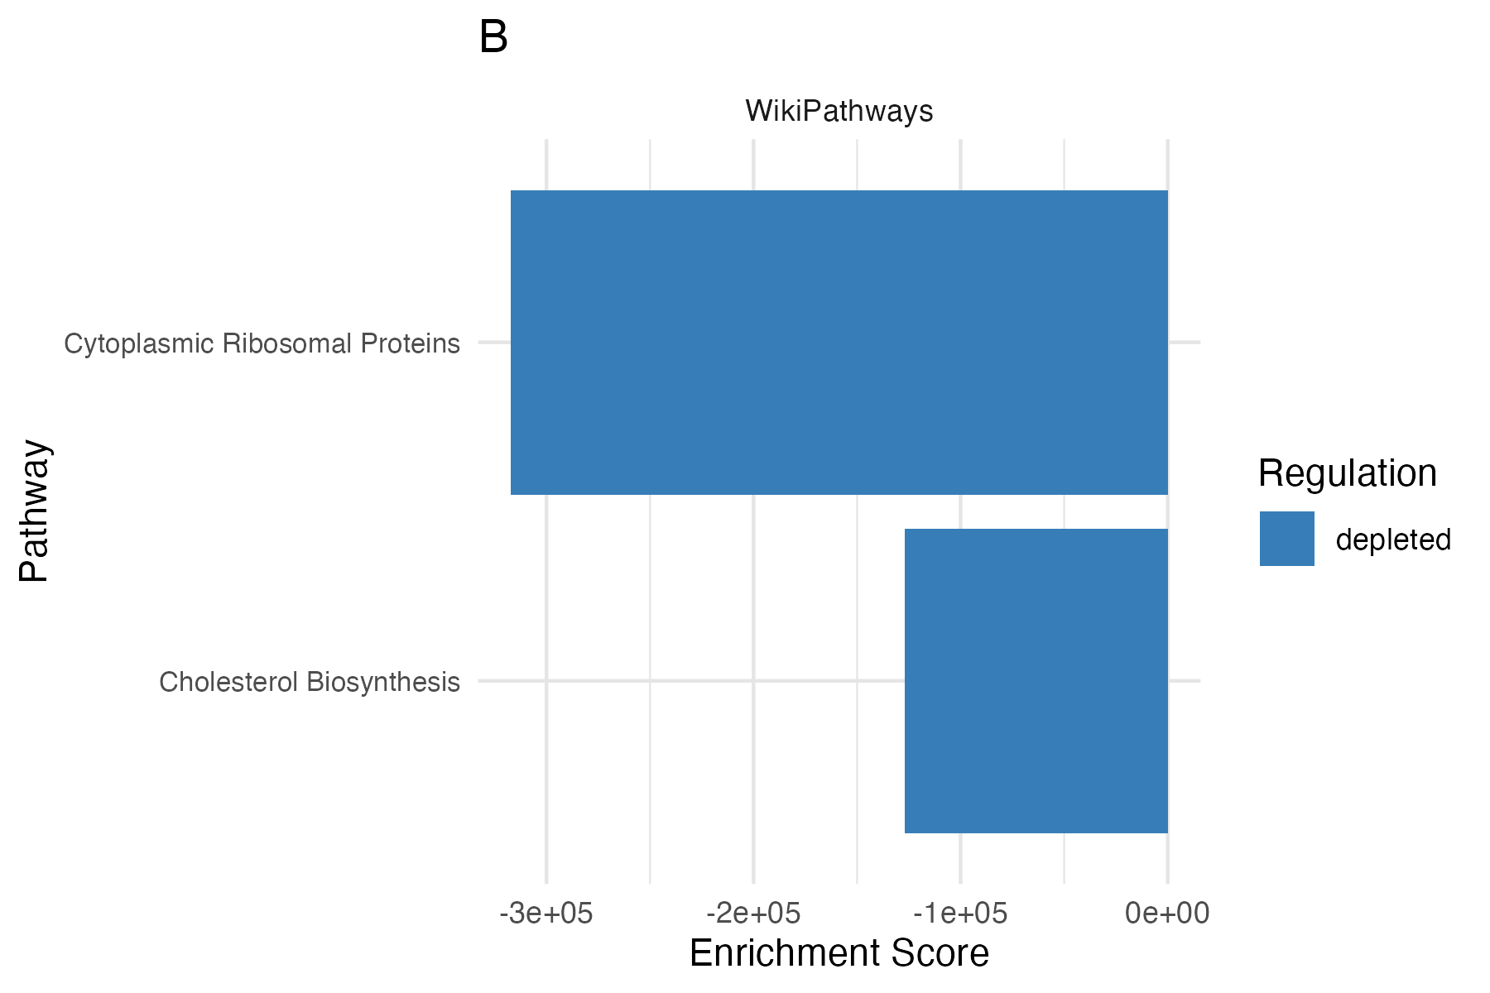
Results – Gene Set Enrichment Analysis
BAT
Liver
Notes:
Gene Set Enrichment Analysis was done for each tissue. Some of these results don’t align with understood biological functions, such as brown adipose tissue having the striated muscle contraction pathway being enriched. I would also like to note that there were no enriched pathways detected in the heart.

Slide 16
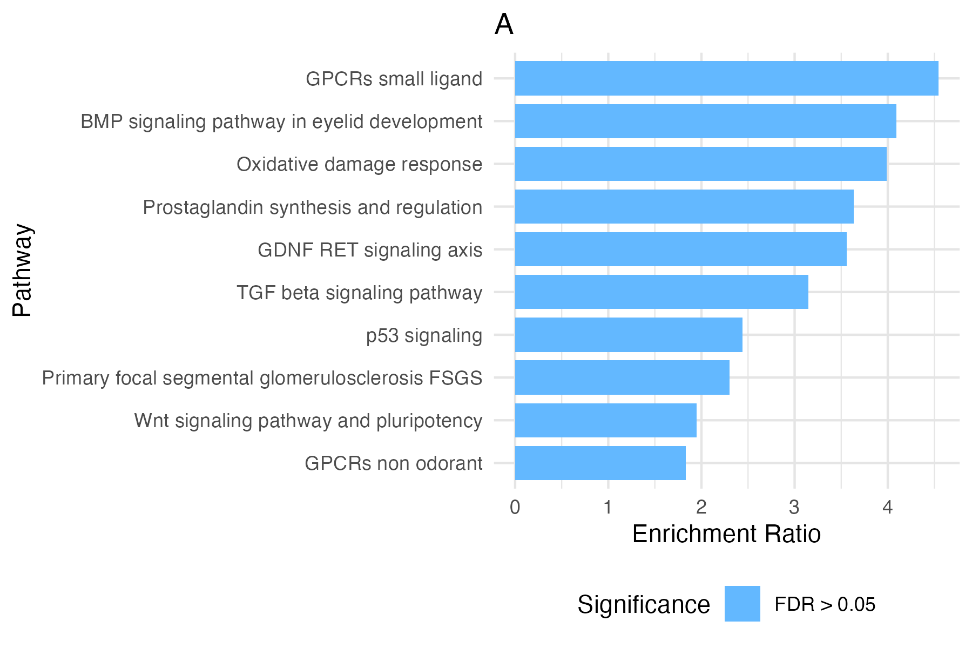
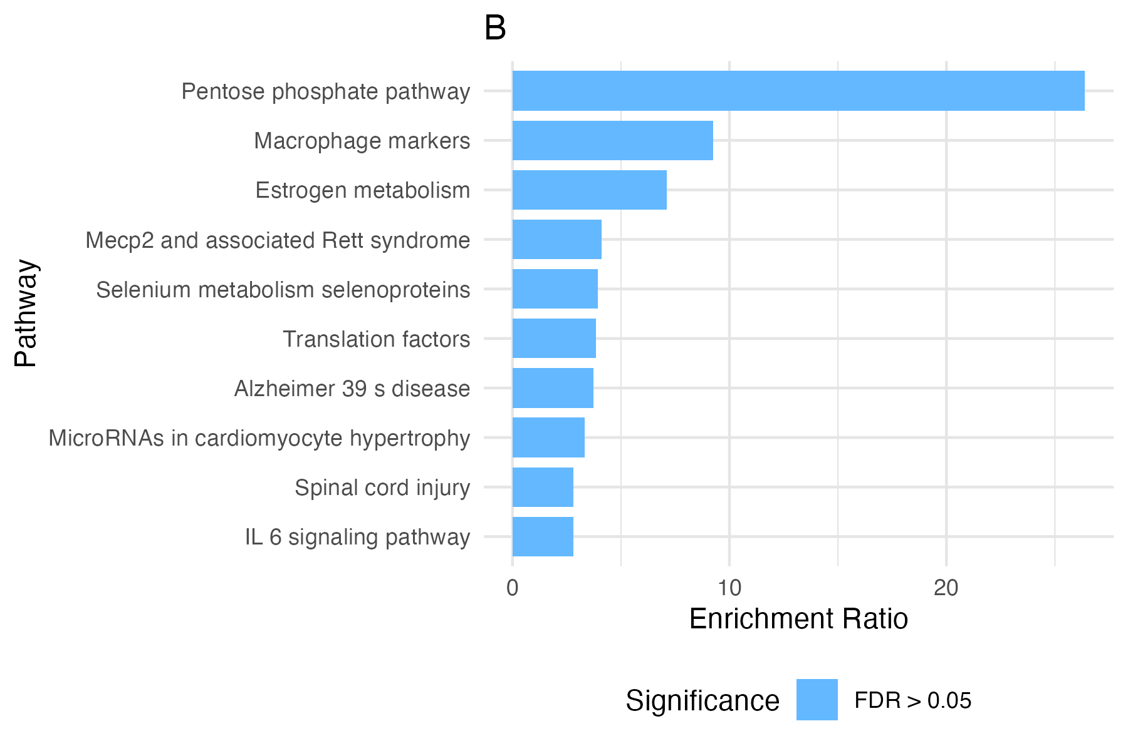
Results – Heart H_{Tas1r2} and L_{Tas1r2} ORA
H_{Tas1r2}
L_{Tas1r2}
Notes:
Due to the lack of GSEA identified pathways for the heart, overrepresentation analysis was performed on the stratified BXD mice for both the high expressing Tas1r2 group and low expressing Tas1r2 group. These results are more indicative of what is expected, such as GPCR and oxidative damage response pathways being affected in the high group and the pentose phosphate pathway being affected in the low group.

Slide 17
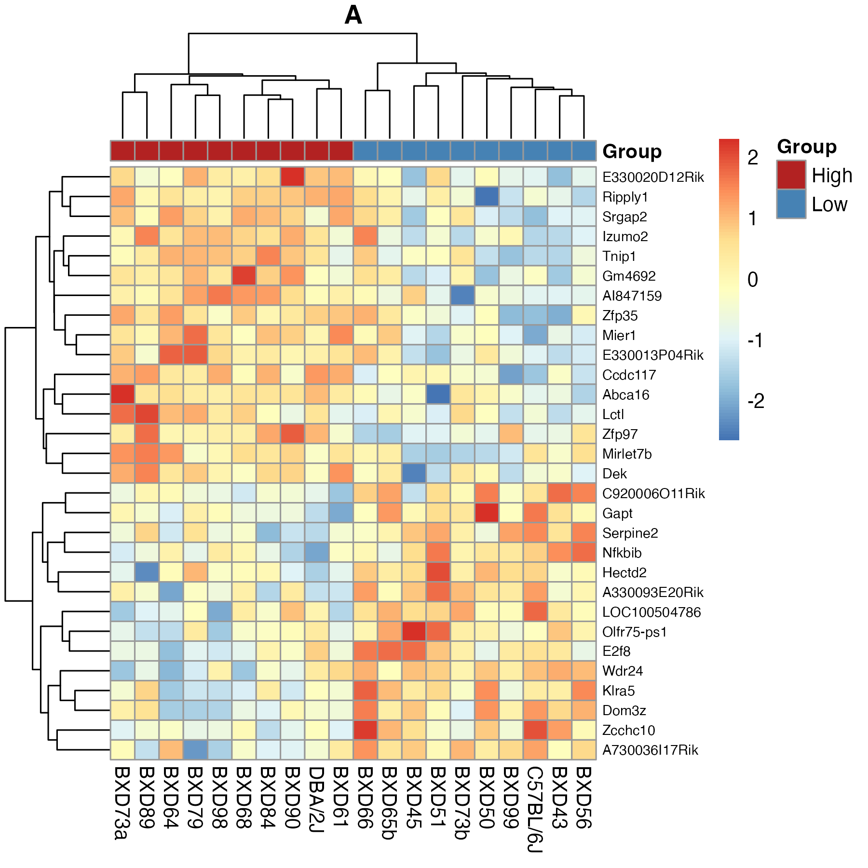
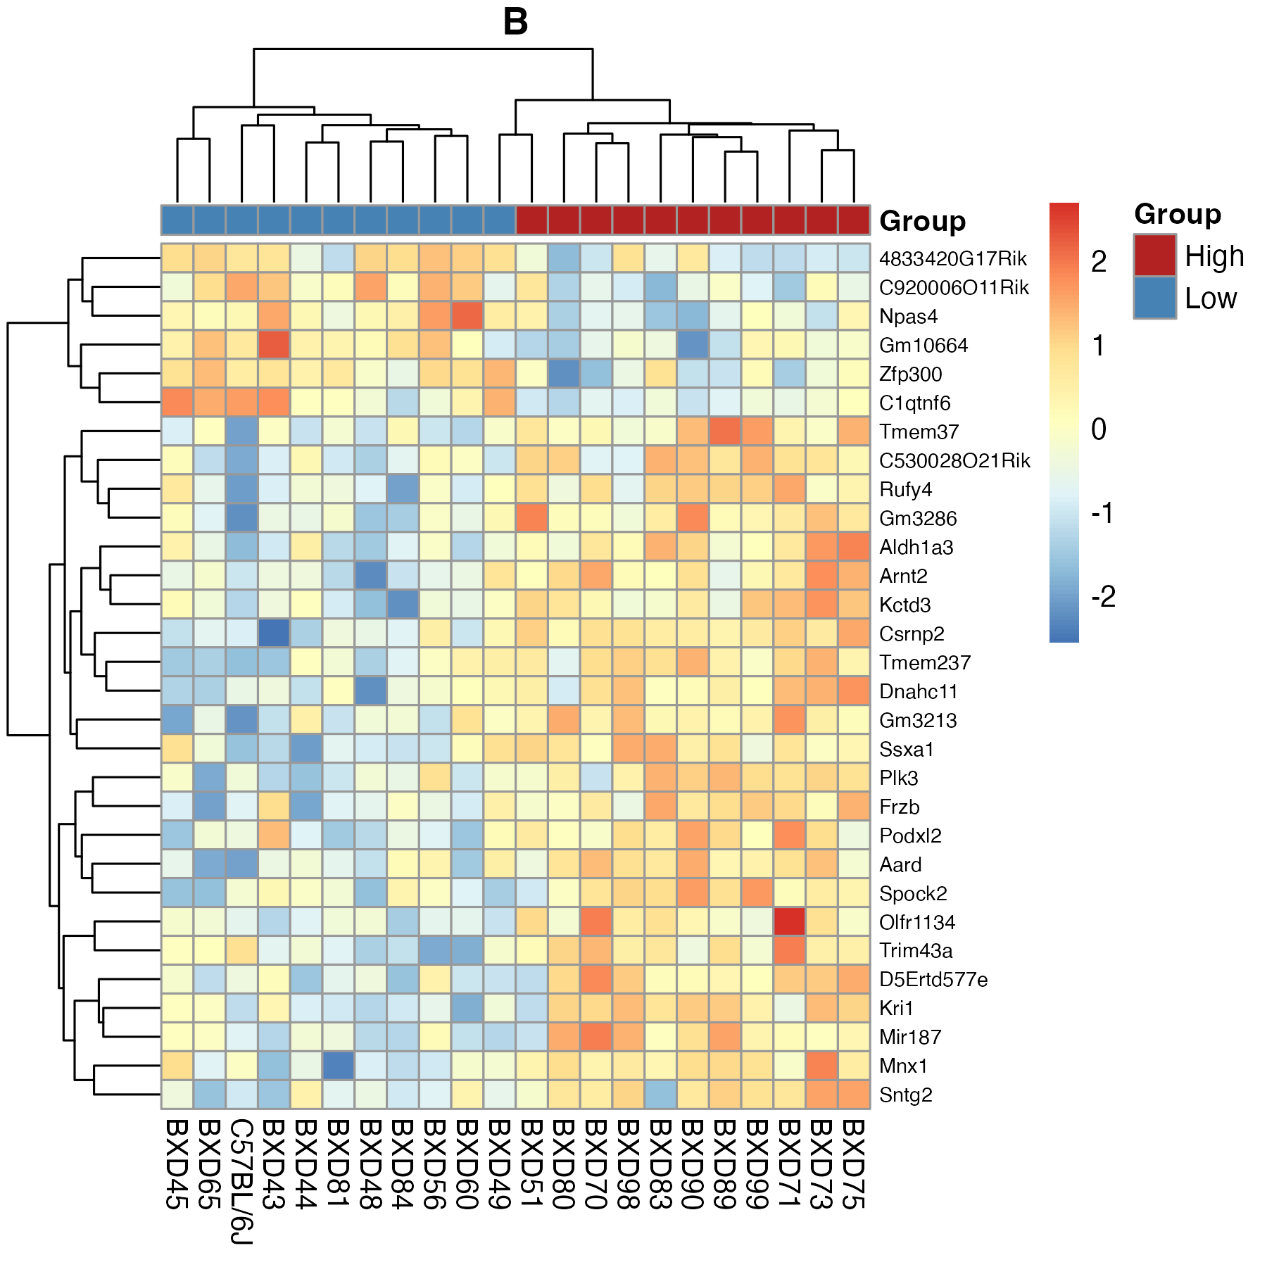
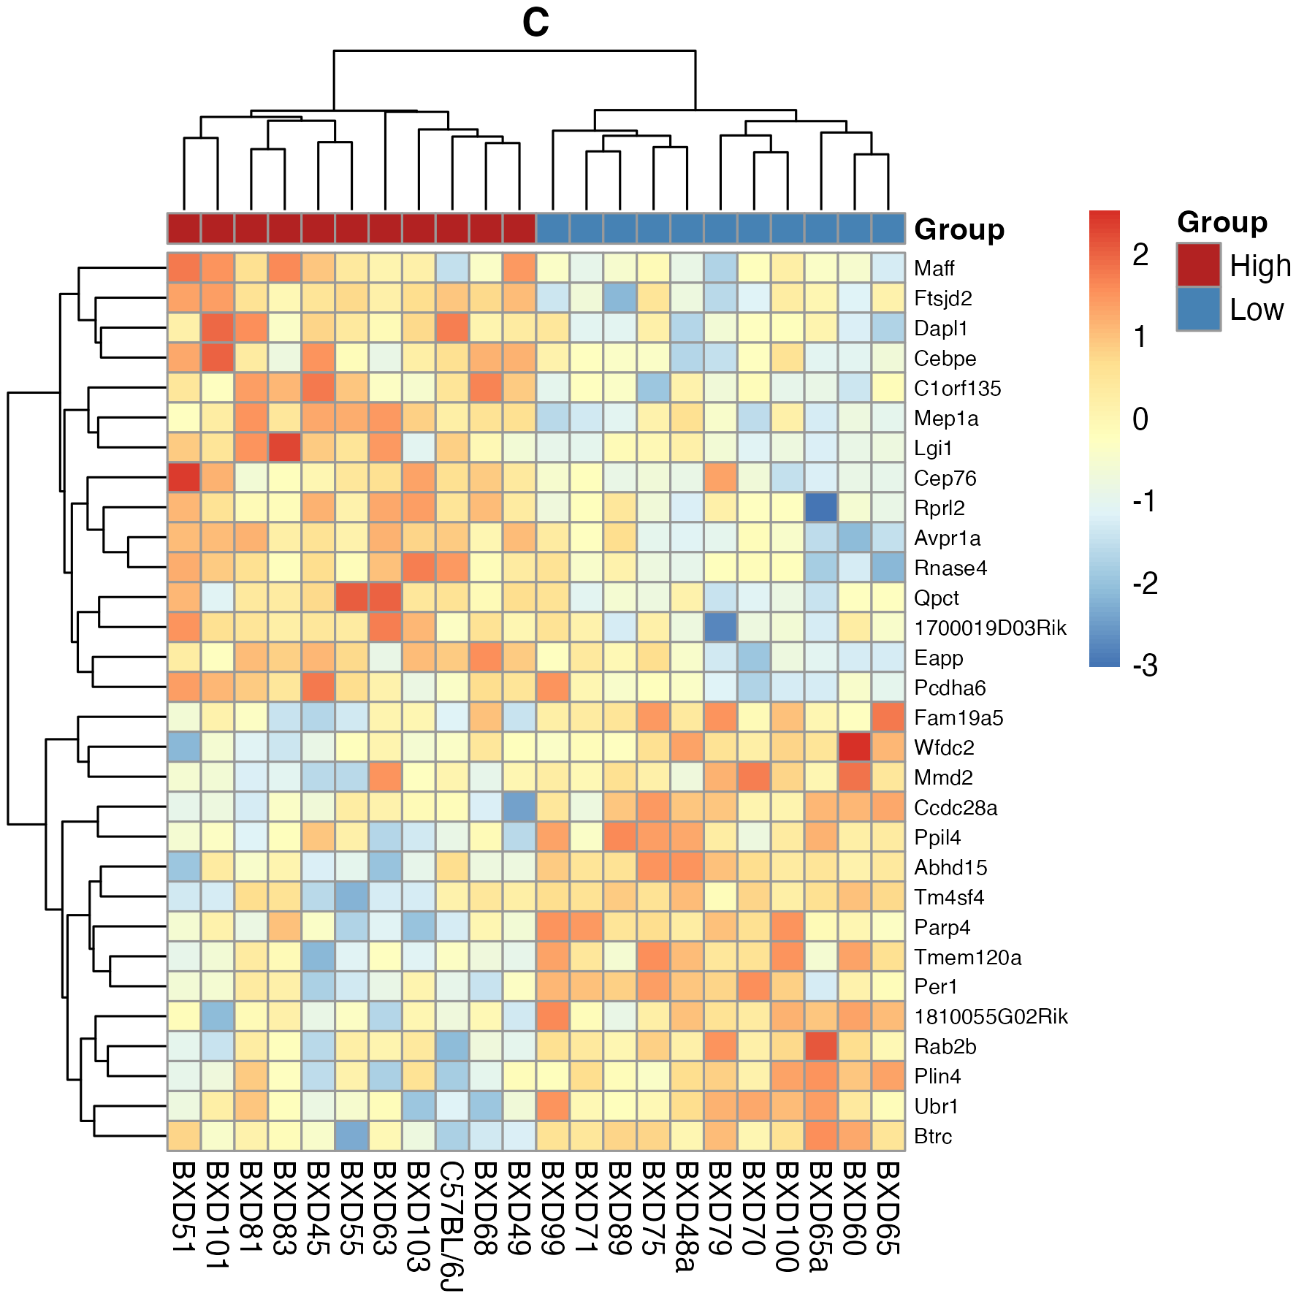
Results – Heatmaps
BAT
Heart
Liver
Notes:
With the lack of FDR adjusted significance, heat maps for each tissue were created to visualize the top 30 differentially expressed genes. These heat maps may give insight as to why less than ideal results were obtained.

Slide 18
Discussion
Nutrient sensing and response
Exploratory analysis using genotype data
Tas1r2 expression in metabolically active tissues
Notes:
Maintaining metabolic homeostasis depends on a cell being able to sense and respond to nutrients in the body. Tas1r2, although primarily associated with gustatory perception, evidence suggests roles in peripheral metabolic regulation.
Since there is no phenotypic data and with the sole reliance on publicly available genetic expression data, these analyses should only be considered exploratory.
This aligns with this study’s goals to identify pathways from potential transcriptomic patterns associated with Tas1r2 expression.

Slide 19
Key Observations
Excellent dynamic variation in gene expression across tissues
No ORA results passed FDR correction
Tas1r2 gene-specific effects
GSEA results limited
Notes:
Each tissue analyzed present a wide dynamic range of gene expression across BXD mouse strains. Fold range was around 5 for both brown adipose tissue and liver, while heart fold range was around 10.
Despite these high fold ranges, no overrepresentation analyses passed FDR correction. This suggests that the signal-to-noise ratio may be insufficient to detect meaningful enrichment, especially under strict multiple testing correction.
With Tas1r2 being an obligate heterodimer with Tas1r3, concerns regarding gene-specific effects arise. Between Tas1r2 and Tas1r3 correlation, along with testing for significant differences in high and low expressing groups, these concerns are remediated.
A final key observation is that GSEA results were either limited or not present.

Slide 20
Analytical Limitations
Potentially missed signals due to GSEA limitations
Low group separation shown in heatmaps
Notes:
A big analytical limitation occurs due to gene set enrichment analysis, which assesses whether predefined gene sets are overrepresented in either high or low expressing groups. Enrichment score in GSEA is highly sensitive to the distribution of gene rankings. If the list is relatively symmetric, the enrichment score will remain near zero, potentially missing enriched pathways. This is especially true regarding the heart data set.
There was also low separability of gene expression between the 2 groups, indicating potentially low effect sizes or noise inherent to the dataset.

Slide 21
Future Direction
Integrate phenotypic data
Include multi-omics
Applying other statistical and machine learning models
Notes:
Robust integration of phenotypic and other omic analyses is required to provide meaningful biological interpretations. Applying other statistical and machine learning models may give more evidence to these interpretations.

Slide 22
Public Health Relevance
BXD mouse panel representative of human populations
Tas1r2 associated with nutrient sensing and energy regulation
Potential interventions for obesity, diabetes, and cardiometabolic disease
The cell biology of taste (Chaudhari)
Notes:
The BXD mouse panel is representative of human populations due to it mimicking human genetic diversity. With Tas1r2 being associated with nutrient sensing and energy regulation [24], future work may facilitate interventions for obesity, diabetes, and cardiometabolic disease in humans.

Slide 23
References
MacArthur, D.G.; Balasubramanian, S.; Frankish, A.; Huang, N.; Morris, J.; Walter, K.; Jostins, L.; Habegger, L.; Pickrell, J.K.; Montgomery, S.B.; et al. A systematic survey of loss-of-function variants in human protein-coding genes. Science 2012, 335, 823-828, doi:10.1126/science.1215040.
Monroe, J.G.; McKay, J.K.; Weigel, D.; Flood, P.J. The population genomics of adaptive loss of function. Heredity (Edinb) 2021, 126, 383-395, doi:10.1038/s41437-021-00403-2.
Doyle, A.; McGarry, M.P.; Lee, N.A.; Lee, J.J. The construction of transgenic and gene knockout/knockin mouse models of human disease. Transgenic Research 2012, 21, 327-349, doi:10.1007/s11248-011-9537-3.
Sareila, O.; Hagert, C.; Rantakari, P.; Poutanen, M.; Holmdahl, R. Direct Comparison of a Natural Loss-Of-Function Single Nucleotide Polymorphism with a Targeted Deletion in the Ncf1 Gene Reveals Different Phenotypes. PLOS ONE 2015, 10, e0141974, doi:10.1371/journal.pone.0141974.
Peirce, J.L.; Lu, L.; Gu, J.; Silver, L.M.; Williams, R.W. A new set of BXD recombinant inbred lines from advanced intercross populations in mice. BMC Genetics 2004, 5, 7, doi:10.1186/1471-2156-5-7.
Ashbrook, D.G.; Arends, D.; Prins, P.; Mulligan, M.K.; Roy, S.; Williams, E.G.; Lutz, C.M.; Valenzuela, A.; Bohl, C.J.; Ingels, J.F.; et al. A platform for experimental precision medicine: The extended BXD mouse family. Cell Syst 2021, 12, 235-247 e239, doi:10.1016/j.cels.2020.12.002.
Andreux, Pénélope A.; Williams, Evan G.; Koutnikova, H.; Houtkooper, Riekelt H.; Champy, M.-F.; Henry, H.; Schoonjans, K.; Williams, Robert W.; Auwerx, J. Systems Genetics of Metabolism: The Use of the BXD Murine Reference Panel for Multiscalar Integration of Traits. Cell 2012, 150, 1287-1299.
Molenhuis, R.T.; Bruining, H.; Brandt, M.J.V.; van Soldt, P.E.; Abu-Toamih Atamni, H.J.; Burbach, J.P.H.; Iraqi, F.A.; Mott, R.F.; Kas, M.J.H. Modeling the quantitative nature of neurodevelopmental disorders using Collaborative Cross mice. Molecular Autism 2018, 9, 63, doi:10.1186/s13229-018-0252-2.
Voy, B.H. Systems Genetics: a Powerful Approach for Gene-Environment Interactions. The Journal of Nutrition 2011, 141, 515-519.
Nelson, G.; Hoon, M.A.; Chandrashekar, J.; Zhang, Y.; Ryba, N.J.; Zuker, C.S. Mammalian sweet taste receptors. Cell 2001, 106, 381-390.
Calvo, S.S.; Egan, J.M. The endocrinology of taste receptors. Nat Rev Endocrinol 2015, 11, 213-227, doi:10.1038/nrendo.2015.7.
Kyriazis, G.A.; Smith, K.R.; Tyrberg, B.; Hussain, T.; Pratley, R.E. Sweet taste receptors regulate basal insulin secretion and contribute to compensatory insulin hypersecretion during the development of diabetes in male mice. Endocrinology 2014, 155, 2112-2121, doi:10.1210/en.2013-2015.
Kyriazis, G.A.; Soundarapandian, M.M.; Tyrberg, B. Sweet taste receptor signaling in beta cells mediates fructose-induced potentiation of glucose-stimulated insulin secretion. Proc.Natl.Acad.Sci.U.S.A 2012, 109, E524-E532, doi:1115183109 [pii];10.1073/pnas.1115183109 [doi].
Serrano, J.; Meshram, N.N.; Soundarapandian, M.M.; Smith, K.R.; Mason, C.; Brown, I.S.; Tyrberg, B.; Kyriazis, G.A. Saccharin Stimulates Insulin Secretion Dependent on Sweet Taste Receptor-Induced Activation of PLC Signaling Axis. Biomedicines 2022, 10, doi:10.3390/biomedicines10010120.
Smith, K.; Karimian Azari, E.; LaMoia, T.E.; Hussain, T.; Vargova, V.; Karolyi, K.; Veldhuis, P.P.; Arnoletti, J.P.; de la Fuente, S.G.; Pratley, R.E.; et al. T1R2 receptor-mediated glucose sensing in the upper intestine potentiates glucose absorption through activation of local regulatory pathways. Mol Metab 2018, 17, 98-111, doi:10.1016/j.molmet.2018.08.009.
Eny, K.M.; Wolever, T.M.; Corey, P.N.; El-Sohemy, A. Genetic variation in TAS1R2 (Ile191Val) is associated with consumption of sugars in overweight and obese individuals in 2 distinct populations. Am J Clin Nutr 2010, 92, 1501-1510, doi:10.3945/ajcn.2010.29836.
Melo, S.V.; Agnes, G.; Vitolo, M.R.; Mattevi, V.S.; Campagnolo, P.D.B.; Almeida, S. Evaluation of the association between the TAS1R2 and TAS1R3 variants and food intake and nutritional status in children. Genet Mol Biol 2017, 40, 415-420, doi:10.1590/1678-4685-GMB-2016-0205.
Ramos-Lopez, O.; Panduro, A.; Martinez-Lopez, E.; Roman, S. Sweet Taste Receptor TAS1R2 Polymorphism (Val191Val) Is Associated with a Higher Carbohydrate Intake and Hypertriglyceridemia among the Population of West Mexico. Nutrients 2016, 8, 101, doi:10.3390/nu8020101.
Serrano, J.; Seflova, J.; Park, J.; Pribadi, M.; Sanematsu, K.; Shigemura, N.; Serna, V.; Yi, F.; Mari, A.; Procko, E.; et al. The Ile191Val is a partial loss-of-function variant of the TAS1R2 sweet-taste receptor and is associated with reduced glucose excursions in humans. Mol Metab 2021, 54, 101339, doi:10.1016/j.molmet.2021.101339.
Serrano, J.; Kondo, S.; Link, G.M.; Brown, I.S.; Pratley, R.E.; Baskin, K.K.; Goodpaster, B.H.; Coen, P.M.; Kyriazis, G.A. A partial loss-of-function variant (Ile191Val) of the TAS1R2 glucose receptor is associated with enhanced responses to exercise training in older adults with obesity: A translational study. Metabolism 2024, 156045, doi:10.1016/j.metabol.2024.156045.
Serrano, J.; Yi, F.; Smith, J.; Pratley, R.E.; Kyriazis, G.A. The Ile191Val Variant of the TAS1R2 Subunit of Sweet Taste Receptors Is Associated With Reduced HbA1c in a Human Cohort With Variable Levels of Glucose Homeostasis. Front Nutr 2022, 9, 896205, doi:10.3389/fnut.2022.896205.
Serrano, J.; Boyd, J.; Brown, I.S.; Mason, C.; Smith, K.R.; Karolyi, K.; Maurya, S.K.; Meshram, N.N.; Serna, V.; Link, G.M.; et al. The TAS1R2 G-protein-coupled receptor is an ambient glucose sensor in skeletal muscle that regulates NAD homeostasis and mitochondrial capacity. Nat Commun 2024, 15, 4915, doi:10.1038/s41467-024-49100-8.
King, K., Serrano, J., Meshram, N. N., Saadi, M., Moreira, L., Papachristou, E. G., & Kyriazis, G. A. (2025). Low TAS1R2 sweet taste receptor expression in skeletal muscle of genetically diverse bxd mice mirrors transcriptomic signatures of loss-of-function mice. Nutrients, 17(11), 1918. https://doi.org/10.3390/nu17111918.
Chaudhari, N., & Roper, S. D. (2010). The cell biology of taste. Journal of Cell Biology, 190(3), 285–296. https://doi.org/10.1083/jcb.201003144

