Slide 1
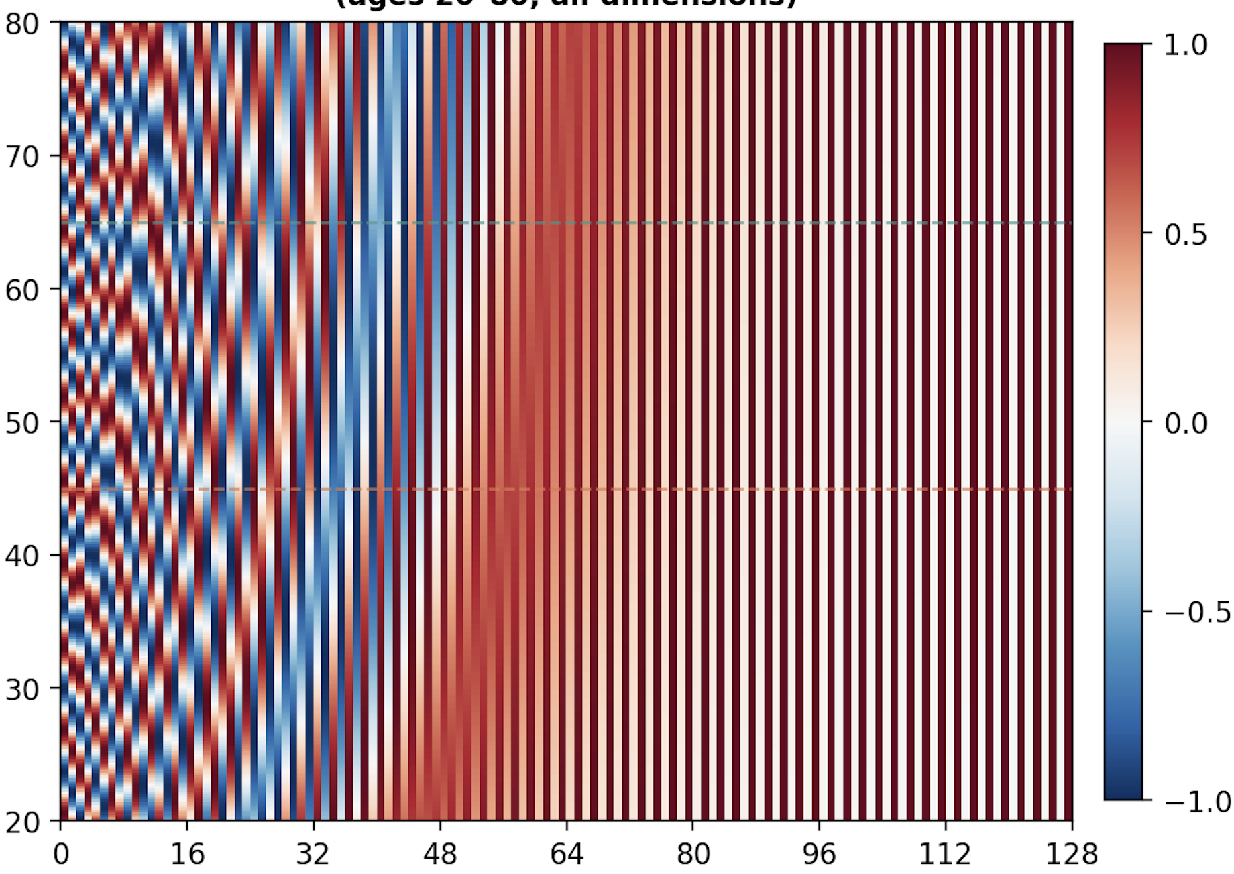
Setting 1: Traditional statistics
Patient | Sex | Drink | HDL | Asthma
1 | Male | yes | 145 | yes
Age
Preprocessor
Raw features
Sex token
Lifestyle tokens
Setting 2: Ordinal token stream - Delphi
Disease tokens
Age (yrs)
0
16.2
42.0
52.1
Delphi
(GPT-based)
Disease words
Event
Male
Drink
J45
F32
Output features
Setting 3: Prose and Full Prose
Disease history
“At age 42.0, patient was diagnosed with J45 asthma.
At age 52.1, patient was diagnosed with F32 major depression.”
LLM Encoder
Prose embeddings
Fusion
Raw features
Setting 4: Trajectory
Disease history (Decoupled age + event)
Age Encoder
Sin/cos
Age (yrs)
42.0
52.1
Event
F32 major depression
Traj embeddings
J45 asthma
Concat
LLM Encoder
Disease embeddings
Fusion
Raw features
Input expression
Encoding process

