Slide 1

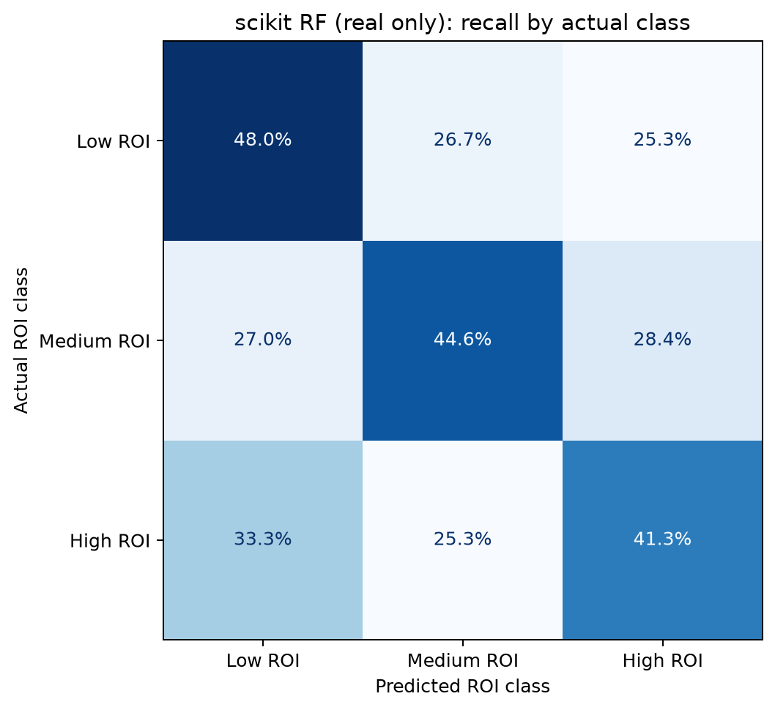
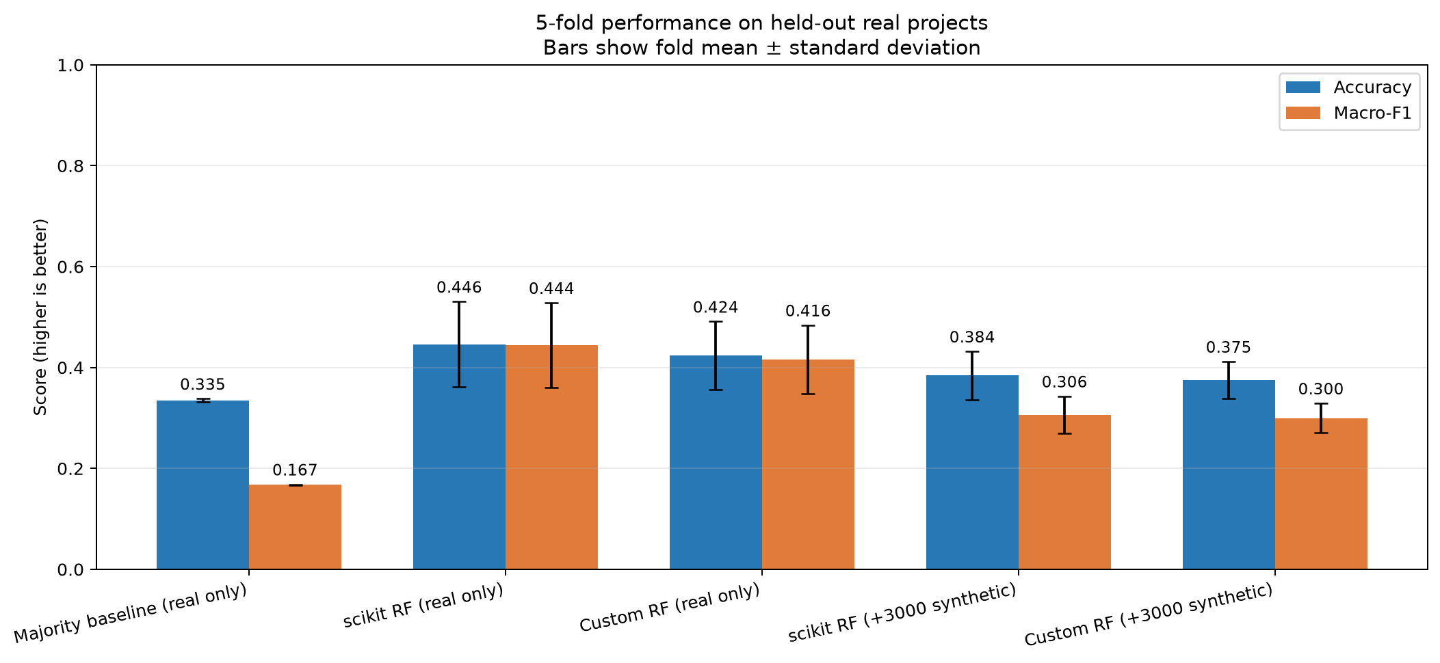
Calgary Residential Development
ROI Classifier
SCHOOL OF
COMPUTING SCIENCE
Finley Thomson · Monem Moheq · Srinivas Suggu · Jarrod Hwang
CMPT 310 – D100 Introduction to Artificial Intelligence, Summer 2026
Leakage-safe evaluation · held-out real projects · responsible-use framing
Motivation & Purpose
AI & Evaluation Pipeline
Key Results
Screening development opportunities requires financial, neighbourhood, and accessibility evidence. We tested whether seven public pre-outcome features can classify completed Calgary projects as Low, Medium, or High ROI.
The prototype is intended to rank candidates for deeper expert review—not replace professional due diligence or provide financial advice.
1
2
3
4
5
44.6%
44.4%
+11.1 pp
Public data
Prepare
Engineer
Validate
Compare
accuracy · real-only RF
macro-F1 · real-only RF
accuracy over baseline
Permits · assessments
income · amenities
Clean addresses
group projects
7 pre-outcome
inputs + ROI labels
5-fold stratified
held-out real rows
Baseline · scikit RF
custom RF
Fold uncertainty is large: ±8.5 percentage points in accuracy.
Best tested model: scikit-learn RF trained on real projects only
Optional branch: generate 3,000 synthetic rows inside each training fold only
Project Overview & Target
Selected Model: Class Recall
224 completed Calgary projects · completed 2018–2023
75 Low · 74 Medium · 75 High
Results on Held-Out Real Projects
ROI = [Final Assessment − (Initial Assessment + Project Cost)]
÷ (Initial Assessment + Project Cost)
Sources: City of Calgary permits, assessments, transit, parks and schools; CMHC neighbourhood income.
Inputs, Methods & Technologies
7 PRE-OUTCOME INPUTS
VALUATION & ECONOMICS
• Initial assessment
• Community income
• Cost per housing unit
ACCESSIBILITY DISTANCES
• Downtown
• Nearest transit stop
• Nearest park
• Nearest public school
Synthetic Data: Negative Result
Conclusions, Limitations & Next Steps
+3,000 synthetic rows/fold → 38.4% accuracy, 30.6% macro-F1, and 0% Medium recall. The generated distribution did not preserve the real decision structure.
• The real-only scikit-learn forest performed best and exceeded the majority baseline.
• Synthetic augmentation reduced performance and produced no Medium predictions.
• Training accuracy was 85.0% versus 44.6% test accuracy: a 40.5-point overfit gap.
• 44 severe Low↔High errors (19.6%) make operational use unsafe.
NEXT: audit matching/units/outliers · add more real data · nested tuning · temporal or external-city holdout · probability calibration.
MODELS & EVALUATION
• Majority-class baseline
• scikit-learn and custom random forests
• 100 trees · depth 7 · 3 candidate features
• Stratified 5-fold CV · seed 310
• Accuracy · macro-F1 · ordinal MAE · severe errors
Python · pandas · NumPy · scikit-learn · Matplotlib
References
1. City of Calgary Building Permits (c2es-76ed)
2. Historical Property Assessments (4ur7-wsgc)
3. Transit Stops (muzh-c9qc); Parks (kami-qbfh); Schools (fd9t-tdn2)
4. CMHC Housing Market Information Portal
5. scikit-learn documentation; project repository
Course proof of concept · not financial advice · evaluation uses held-out real projects

