Slide 1
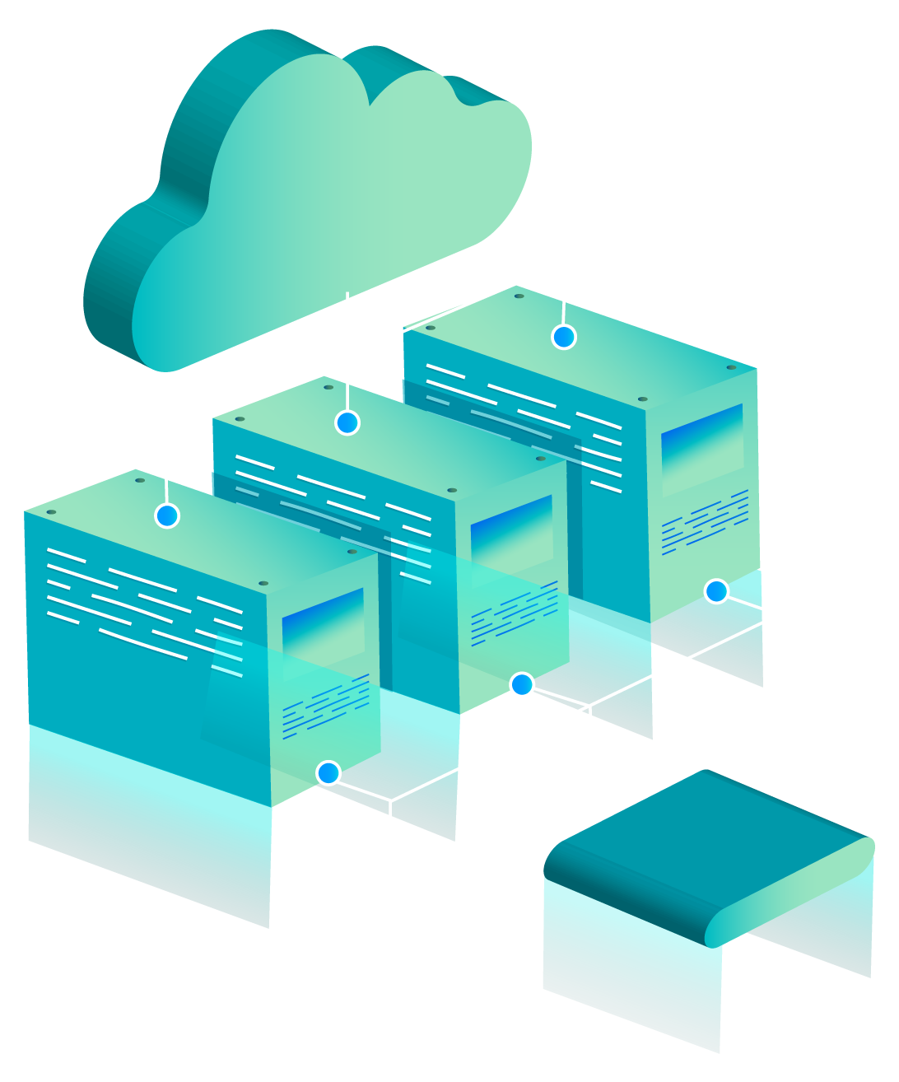
Pep Two
Group Three
Scrum Master Finn Mikkola
Data Engineers Max Ross, Jason Fearnall

Slide 2
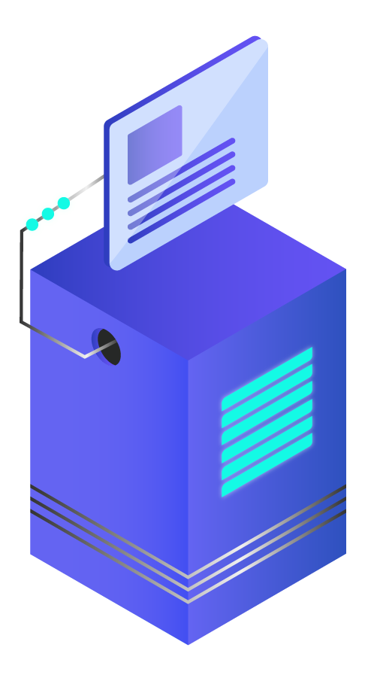
INTRODUCTION
Cardiovascular Data set
Setting up Pipeline
S3
Lambda
Building RDS MySql Database
Connections and Queries

Slide 3
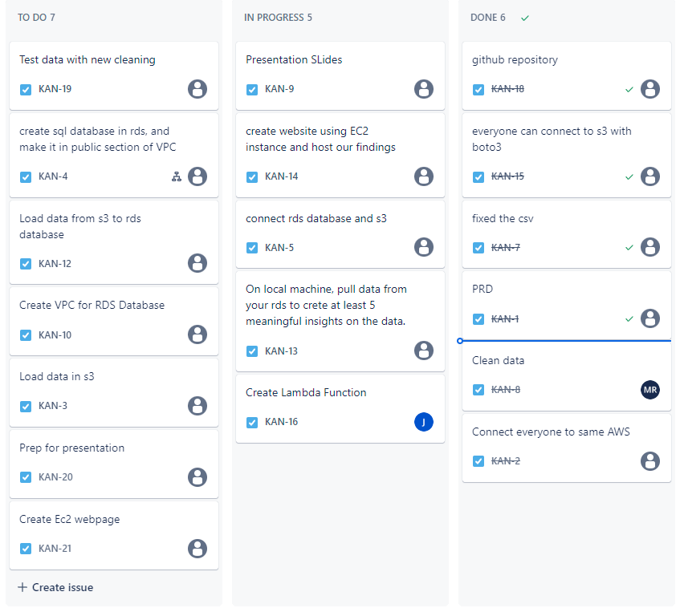

Jira Board

Slide 4

The Data
Id, blood pressure, height, weight, smoking, alcohol, cardio disease etc
Cleaning
Pandas
Nice data set to work with
Way better than filthy restaurant data

Slide 5
Architecture Design
Transform
Load

Slide 6
Challenges
Reading CSV
Permissions
Packages
Lambda needs permission to connect to our database and access VPC
Reading and loading CSV files with Lambda is not very intuitive
Lambda does not have all of Pythons libraries & packages

Slide 7
Architecture
S3 Bucket
Lambda
Load in Csv
S3
L
Clean Data

Slide 8
Architecture
S3 Bucket
Lambda
Load in Csv
S3
L
Clean Data
S3 Bucket 2
Lambda 2
Clean CSV
S3
L
Send To RDS
RDS

Slide 9

Lambda
“Lambdas are like Ogres. They have Layers.”
“That’ll do boto3, that’ll do.”
“What er ya doin in meh VPC?”

Slide 10
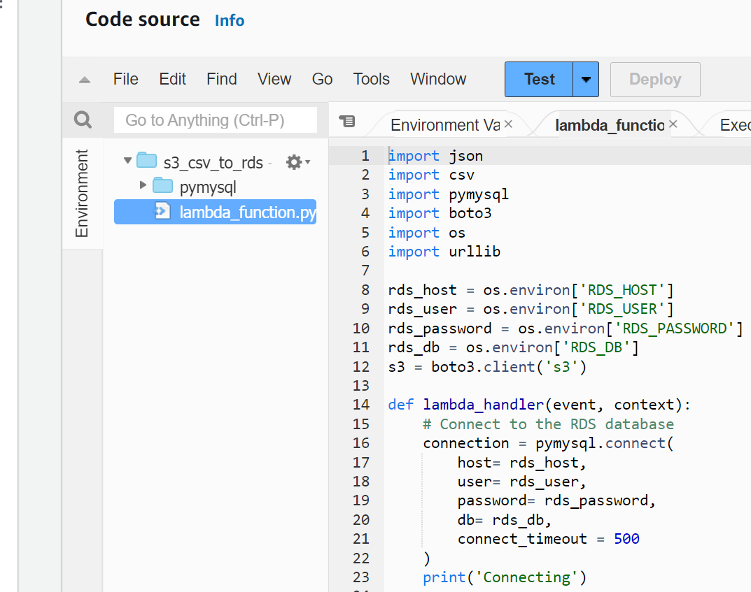
Pymysql Packaged

Slide 11

Cloud Watch
Cloud watch is invaluable for providing insights into your code.

Slide 12
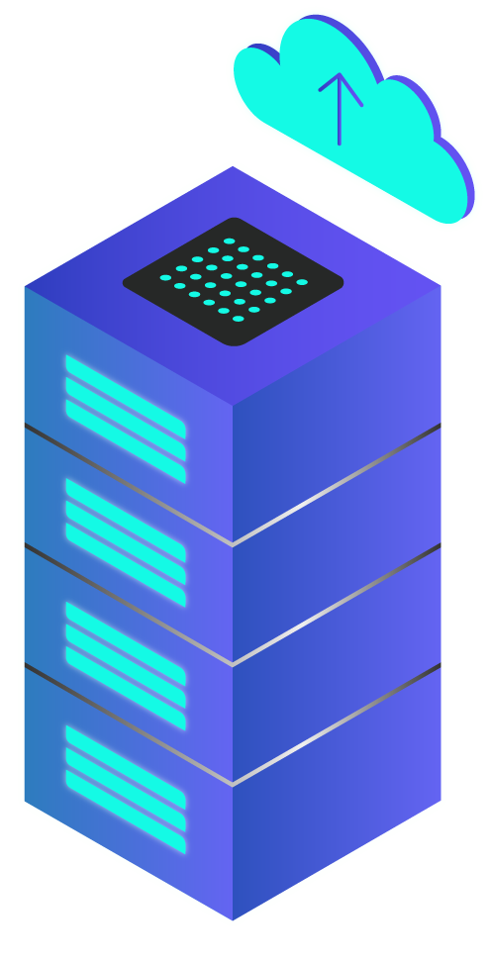
RDS MySQL
Receives Clean Data
From Lambda
The Process
Connect to Lambda
Load in clean CSV
PyMySQL
Connect to RDS
Profit

Slide 13
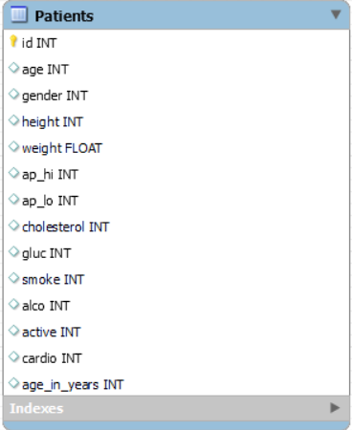


Slide 14

Queries
Important Information
Blood Pressure and cardiovascular disease
Avg bp for active and inactive people
Average blood pressure rate as a smoker and drinker vs non smoker and drinker.
How blood pressure and cardiovascular disease relates to height and weight
Cardiovascular disease and age

Slide 15

EC2 Webpage
35.174.153.127

Slide 16

Takeaways
How much data is TOO much data
Be cautious of information that is being resourced online
AWS has reliable documentation!
If the shoe fits….!

Slide 17

Conclusion And Lessons Learned
Permissions
Print Statements!
Online Resources
Aws is great until you don’t have permission to do something
Simple print statements were so useful for us while debugging our lambdas
There’s a lot of good and bad documentation out there..

