Slide 1
Docker

Slide 2
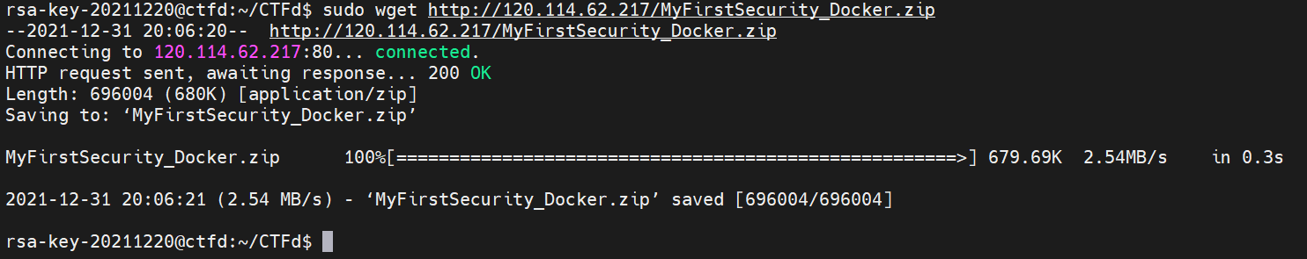
17.安裝docker問題 17-1 sudo wget http://120.114.62.217/MyFirstSecurity_Docker.zip //安裝問題

Slide 3
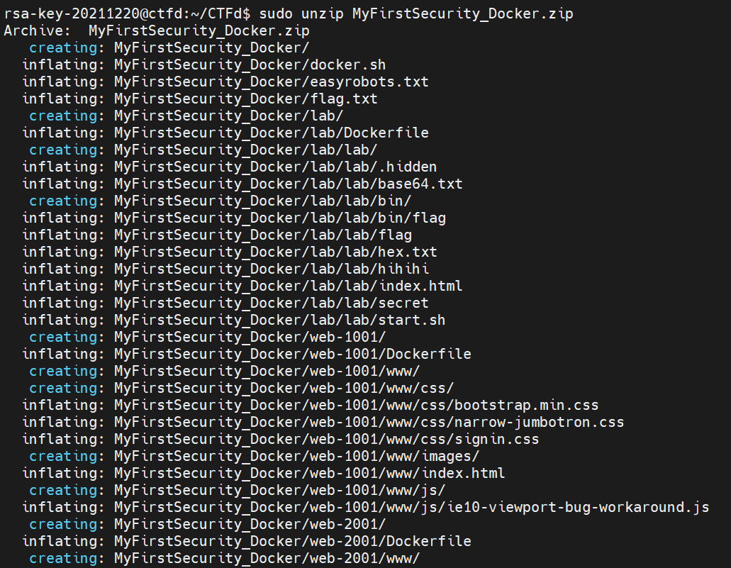
17-2 sudo unzip MyFirstSecurity_Docker.zip //解壓縮MyFirstSecurity_Docker.zip

Slide 4
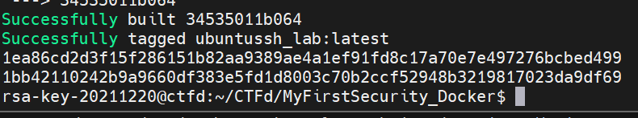
17-3 sudo sh docker.sh //執行docker.sh

Slide 5
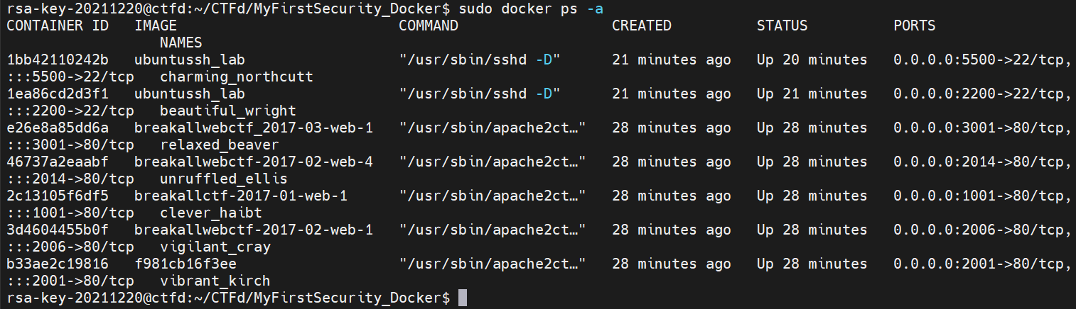
17-4 sudo docker ps -a //確保有無運作

Slide 6
17-5 sudo docker exec -ti [CONTAINER ID] bash//連接docker questionsbash [CONTAINER ID] => 17-4紅框

Slide 7
17-6 sh /bin/start.sh //執行start.sh(按enter繼續)

Slide 8
17-7 exit //離開docker questions bash

Slide 9
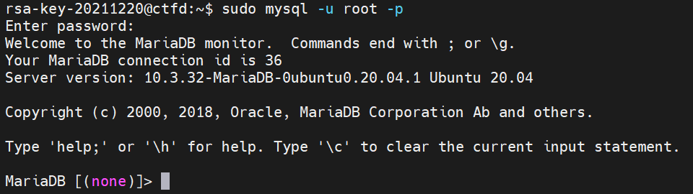
18.更換questions IP 18-1 sudo mysql –u root –p //登入mariadb(root)

Slide 10
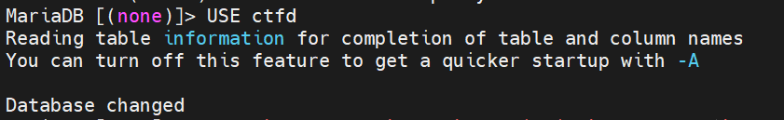
18-2 USE ctfddatabase; // 選擇database

Slide 11
- 18-3 UPDATE `challenges` SET `description` = replace(`description`, 'old', 'new');// 變更IP

