Slide 1

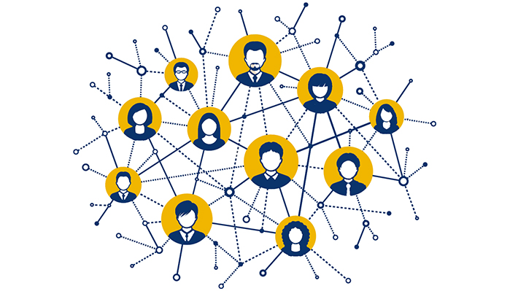
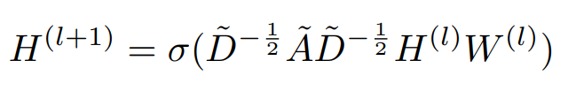
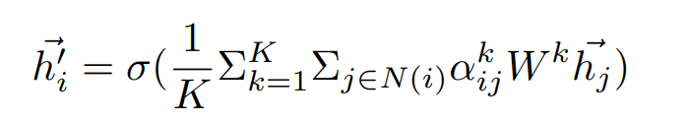

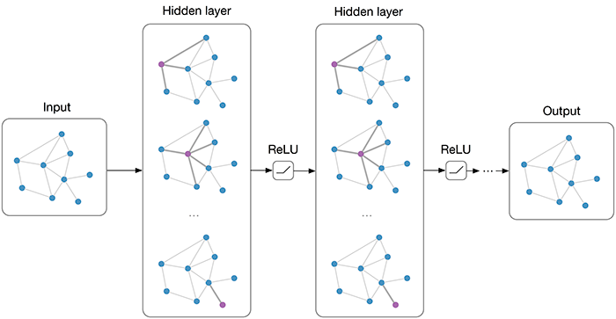
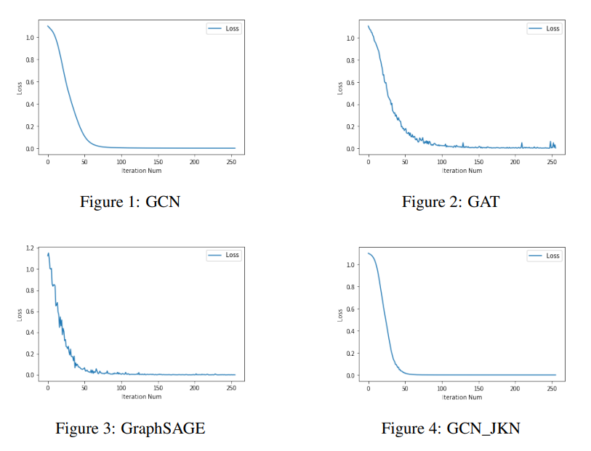
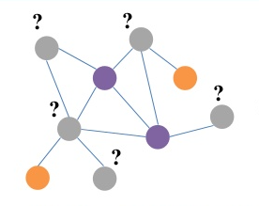
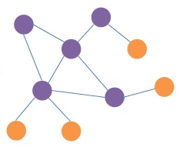
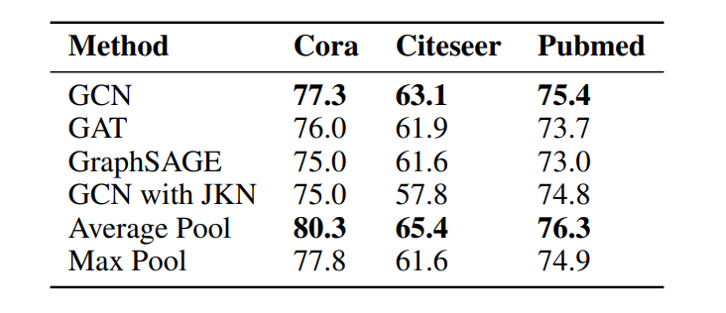
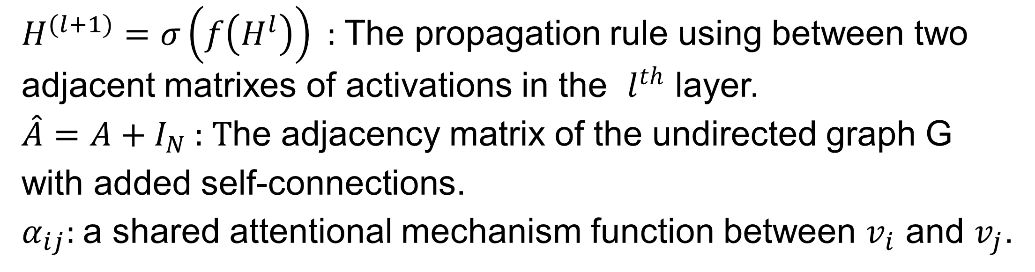
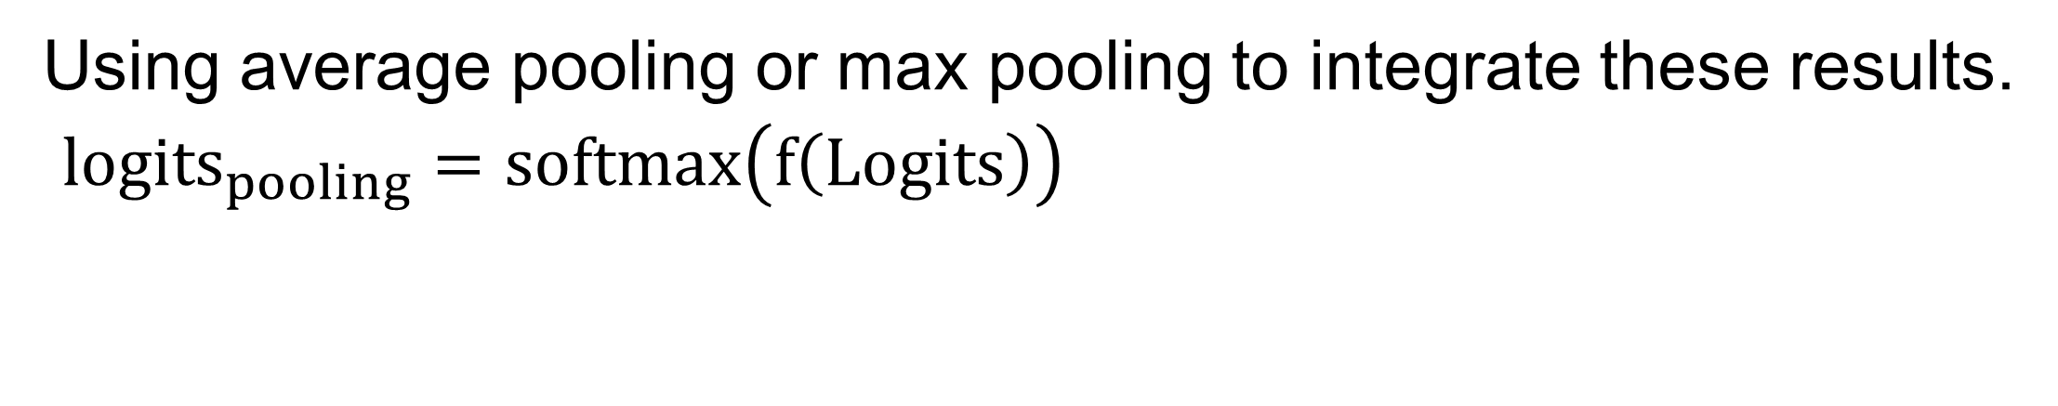
Methods and Optimizations for Node Classification
Yifan Ren (ivan-ren@sjtu.edu.cn)
ACM Class, Shanghai Jiao Tong University
Background
Our Approach
Node Classification
Graph Convolutional Networks
Graph Attention Networks
GraphSAGE
Graph Neural Network
GCN with Jump Knowledge Networks
All layers jump to the last layer and aggregate, so that nodes can adaptively choose the size of receptive domain.
Terminologies
$H^{(l+1)}=σ\left(f\left(H^{l}\right)\right)$ : The propagation rule using between two adjacent matrixes of activations in the $l^{th}$ layer.
$\hat{A}=A+I_{N}$ : The adjacency matrix of the undirected graph G with added self-connections.
$α_{ij}$: a shared attentional mechanism function between $v_{i}$ and $v_{j}$.
Task
Average pooling and Max pooling
Original Graph
True Result
Using average pooling or max pooling to integrate these results.
${logits}_{pooling}=softmax\left(f\left(Logits\right)\right)$
Classification
Experiments
Setup
Dataset: Cora(2708 nodes), Citeseer(3327 nodes) and Pubmed(19717 nodes).
Metrics: to measure the correct rate between the predict labels with the true labels on each test mask.
Compared Models
3-layer GCN : uses the Laplacian matrix when propagation.
3-layer GAT : add attention mechanism.
3-layer GraphSAGE: learning of aggregator.
6-layer GCN with JKN optimization.
Predict unknown node labels by node features and the known labels of some specific nodes.
Challenges
Graph Convolutional Networks: has a poor scalability, and cannot simply increase the layers number.
Graph Attention Networks: the lack of training methods, sampling nodes also have room to improve.
Graph SAmple and aggreGatE: the number of sampling nodes increases exponentially with the number of layers, resulting in the poor performance of
the model on time per batch.
These models all have some defects, so we want to give some optimizations or mix them up to make them perform better.
Results
Apex Data & Knowledge Management Lab
http://apex.sjtu.edu.cn

