Slide 1
Midterm Deep Dive
What we built, what we tested, and what we found
Current-source results | 100,000 Monte Carlo draws | seed 42
Research spine
Key improvement
Research question -> experiment setup -> assumptions -> results -> discussion -> quality outlook.
This version interprets sensitivity and scenario analysis instead of only showing figures.

Slide 2
Research Question
What the thesis is trying to answer
Main question
Which emitting sectors should implement carbon capture, and which should investigate alternative decarbonization technologies?
The thesis is not asking whether CCS works technically; it asks where CCS is economically preferred under uncertainty.
Carbon capture demand is therefore treated as a probability distribution generated by competition between technologies.
The midterm work tests this framework on electricity and cement before extending to aluminium and chemicals.
Midterm findings | 2

Slide 3
What We Built
Project work completed so far
Electricity NPV model: deterministic and Monte Carlo calculations for fossil, CCS, nuclear, renewable, and biogas technologies.
Cement NPV model: deterministic and Monte Carlo calculations for BAU, CCS, alternative production routes, and BAU-relative retrofits.
Aligned Monte Carlo run IDs: each simulation ID represents one shared uncertain world for fair rankings.
Comparison layer: total NPV, normalized NPV, rank probabilities, sign counts, sensitivity heatmaps, scenario analysis, and cement MACC.
Documentation layer: README, handover guide, changelog, notebooks, figures, and reproducible CLI workflows.
Midterm findings | 3

Slide 4
Experiment Setup
How the current research experiment works
1 TWh/y
1 Mt/y
80
8%
electricity output
cement output
EUR/tCO2
discount rate
Decision metric
Uncertainty metric
NPV is computed from annual revenue, CAPEX, fixed OPEX, variable OPEX, fuel/electricity cost, and carbon cost. Higher NPV is better.
Rank probabilities estimate how often a technology wins or lands in the top three under sampled techno-economic futures.
Midterm findings | 4

Slide 5
Assumptions We Had To Make
Important modeling choices
Market and policy assumptions: carbon price, discount rate, fuel prices, electricity price, and cement price.
Technology assumptions: CAPEX, OPEX, energy intensity, emissions intensity, full-load hours, and lifetime.
Cement retrofits are modeled relative to BAU; CCS strongly reduces emissions but can increase energy use.
Alternative fuels were corrected: fuel costs now use a 25-60% alternative-fuel share and blended fuel price.
Fuel use and emissions are currently sampled independently; this is a simplifying assumption that should be tested in future work.
Midterm findings | 5

Slide 6
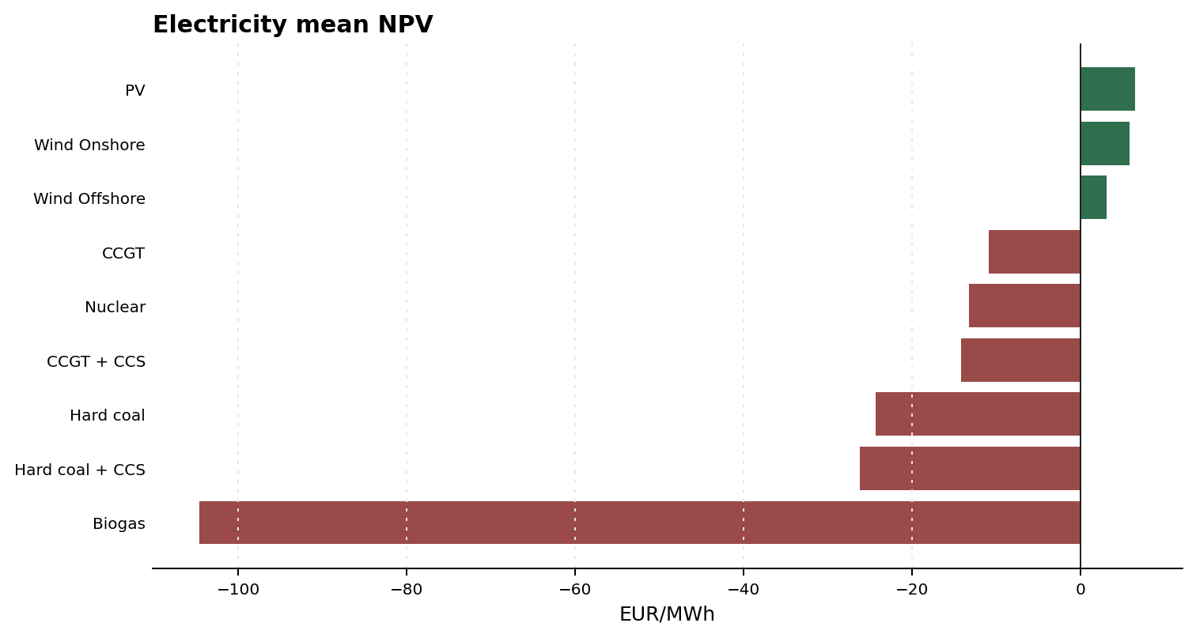
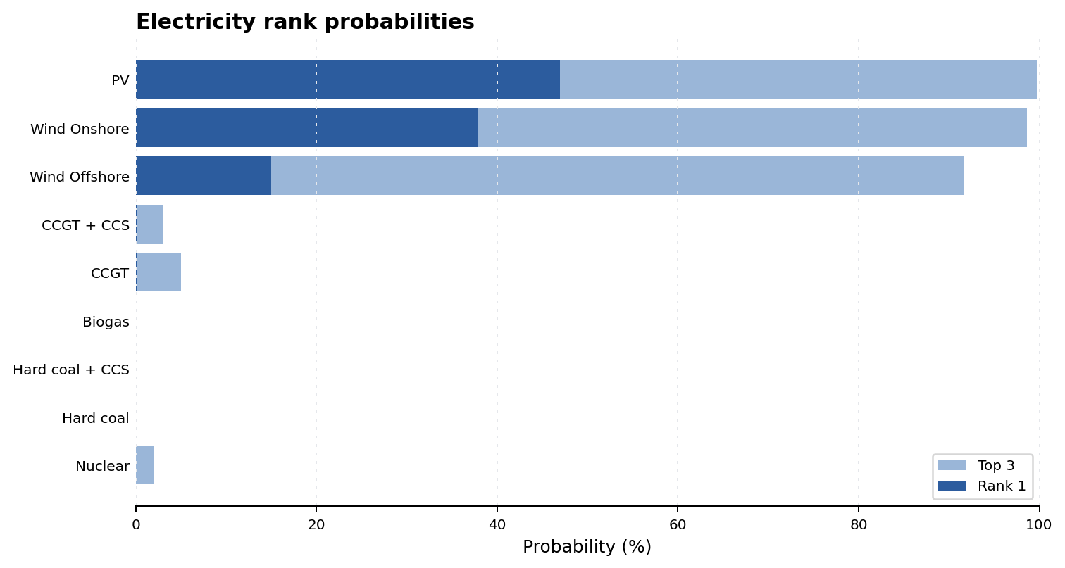
Result 1: Electricity Baseline
Current model says electricity CCS demand is weak
Midterm findings | 6

Slide 7
Electricity Interpretation
What happened in the electricity model
PV is the strongest technology in mean NPV: 6.56 EUR/MWh.
PV and onshore wind both have almost always non-negative NPV; offshore wind is non-negative in 75% of draws.
CCGT is the best fossil option, but remains negative on average and only occasionally reaches positive NPV.
CCGT+CCS and hard coal+CCS reduce emissions exposure but do not overcome added cost and energy penalties.
Nuclear remains negative on average because high CAPEX dominates even with high full-load hours and long lifetime.
Midterm findings | 7

Slide 8
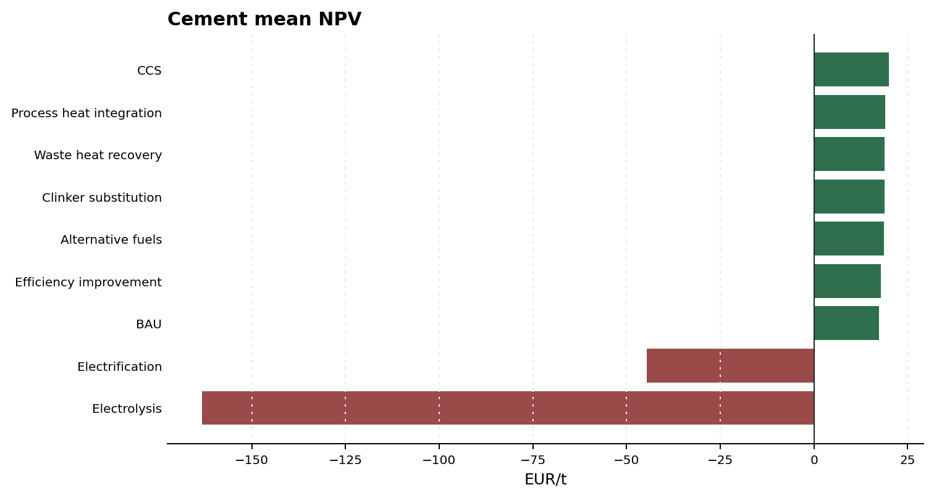
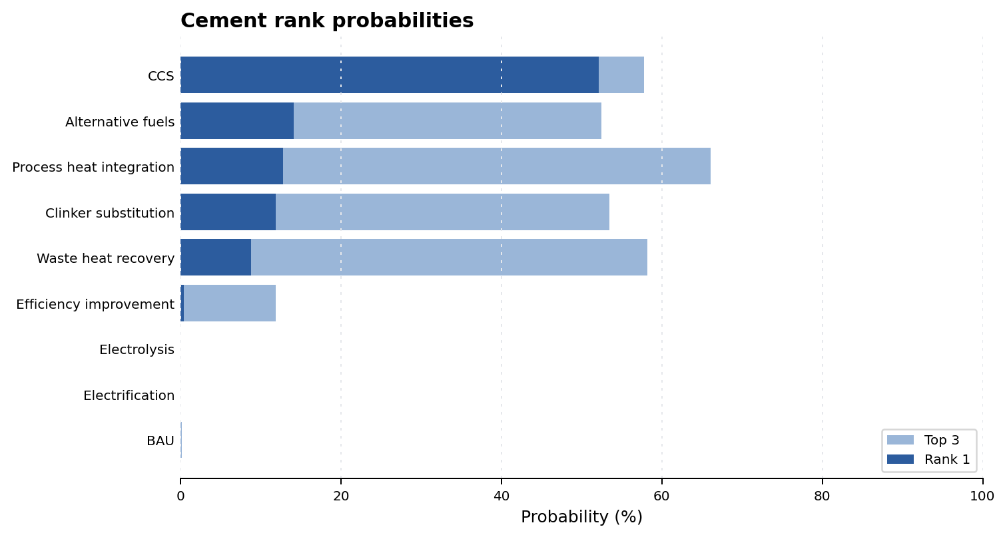
Result 2: Cement Baseline
Cement is the stronger CCS-demand candidate
Midterm findings | 8

Slide 9
Cement Interpretation
What happened in the cement model
CCS has the highest mean cement NPV in the current 100,000-draw run: 20.01 EUR/t.
CCS also has the highest rank-1 probability: 52.1%.
Process heat integration, waste heat recovery, clinker substitution, and alternative fuels cluster close to CCS, so CCS is competitive rather than uncontested.
Electrification and electrolysis are strongly negative because electricity demand dominates the economics under current electricity-price assumptions.
All conventional and retrofit cement options are non-negative in the sampled baseline; the hard problem is ranking and abatement depth, not basic viability.
Midterm findings | 9

Slide 10
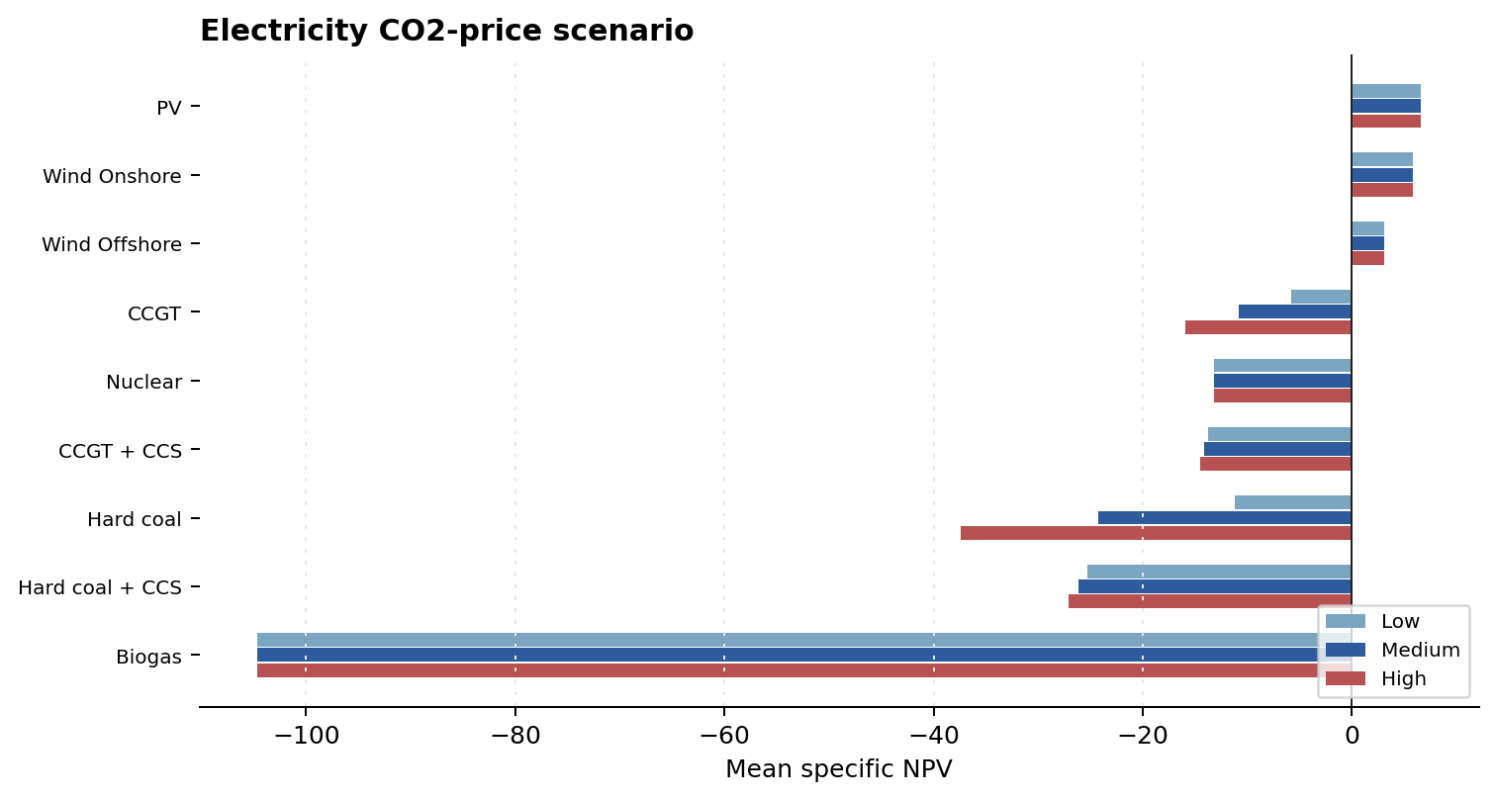
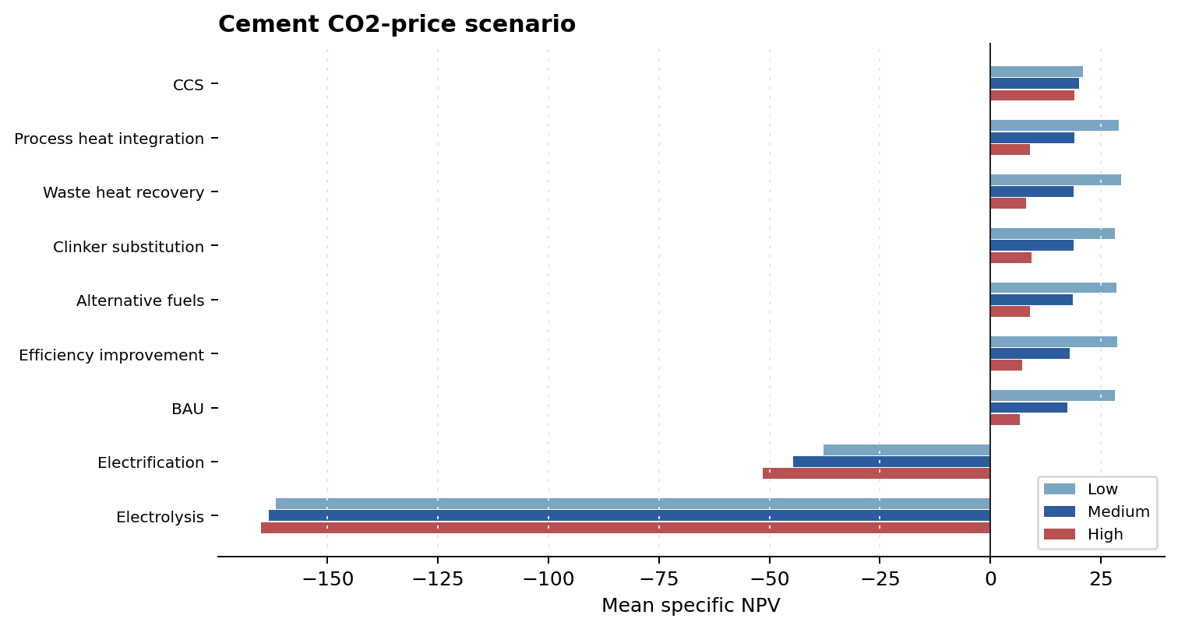
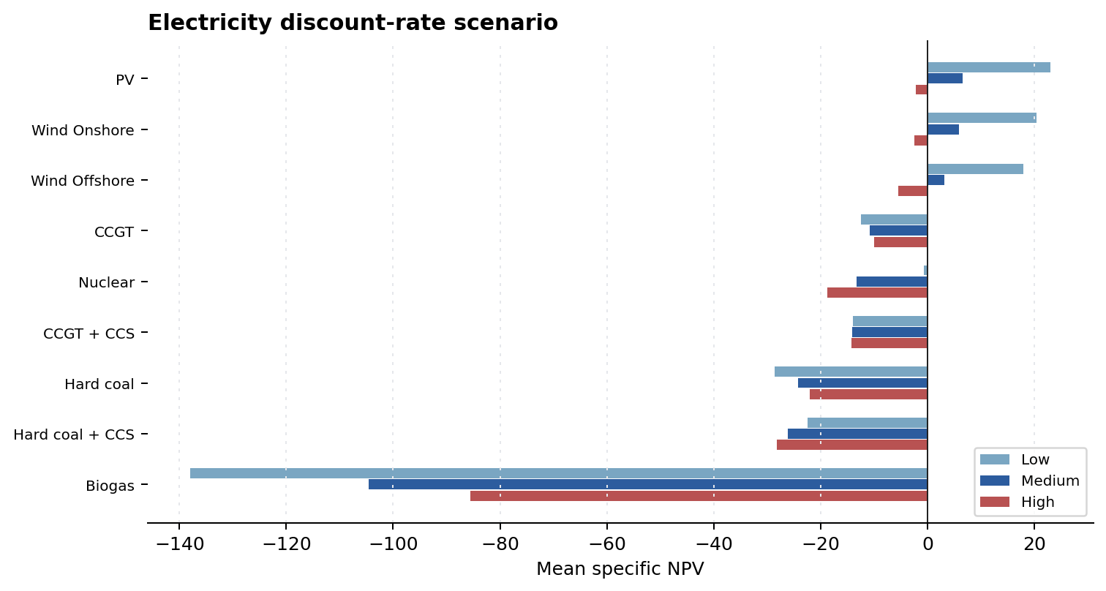
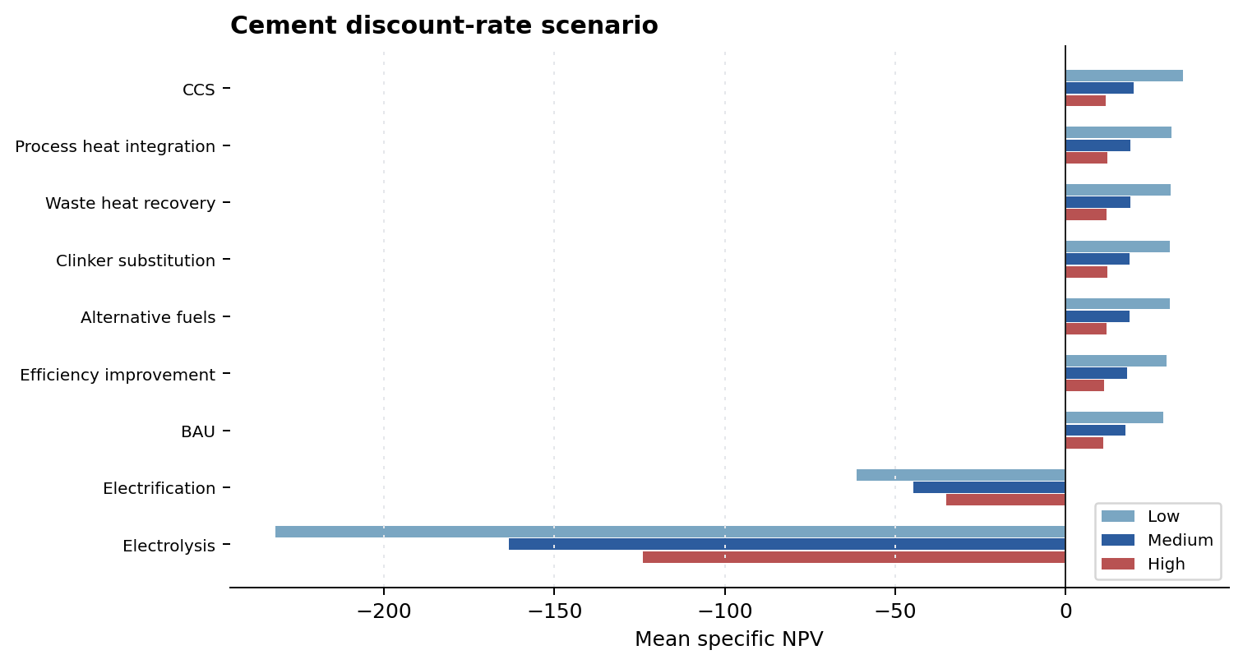
Result 3: Scenario Analysis
CO2 price and discount rate tell different stories
Midterm findings | 10

Slide 11
Scenario Interpretation
What we learned from the scenario notebook
CO2 price mostly affects technologies with direct emissions. PV, wind, nuclear, and biogas do not move in the direct-emissions-only setup.
Higher CO2 price makes unabated coal and gas worse, so CCS narrows the fossil gap, but does not make fossil CCS beat renewables in electricity.
In cement, higher CO2 price lowers all directly emitting routes; CCS moves less because residual emissions are small.
Lower discount rates strongly improve capital-heavy low-carbon technologies, especially PV, wind, nuclear, and cement CCS.
Even at 4% discount rate, nuclear remains close to break-even but still negative on average in the current 100,000-draw run, so its problem is not only financing; CAPEX remains too high relative to revenue.
Midterm findings | 11

Slide 12
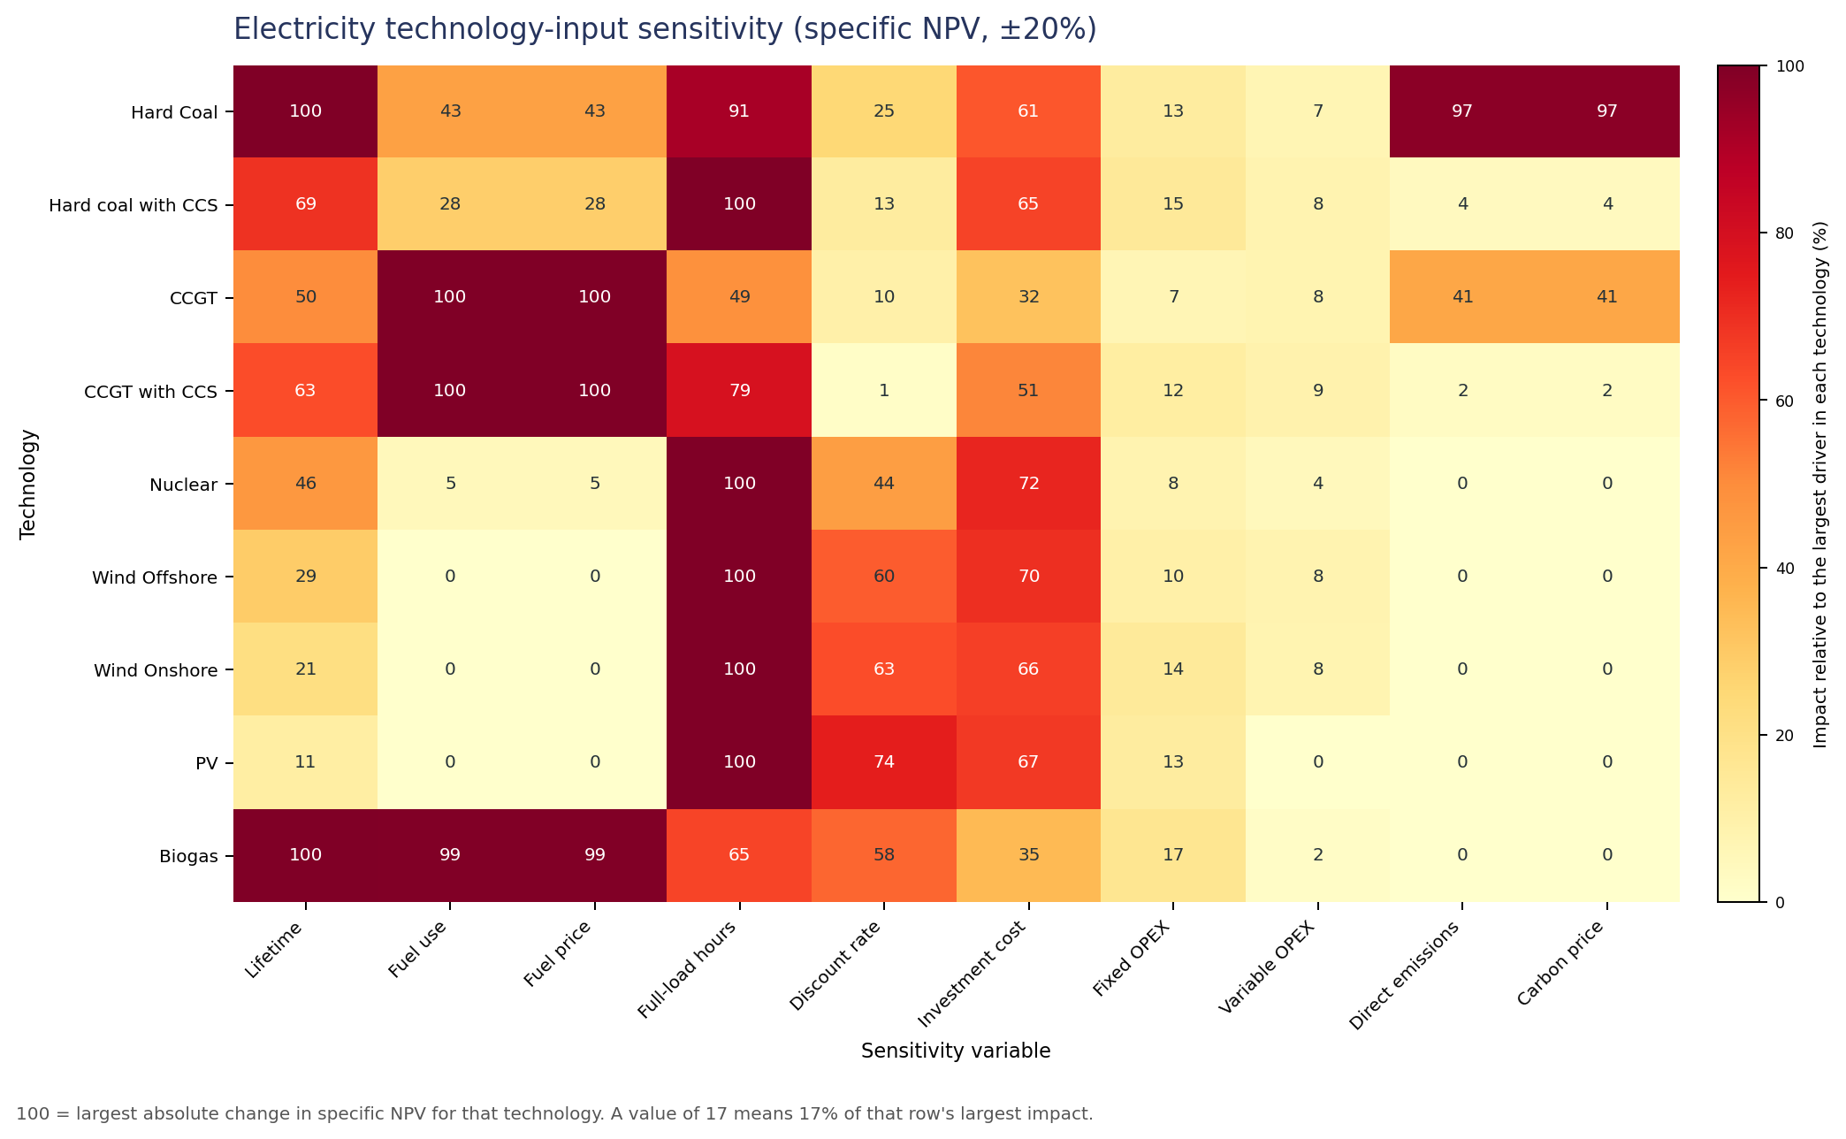
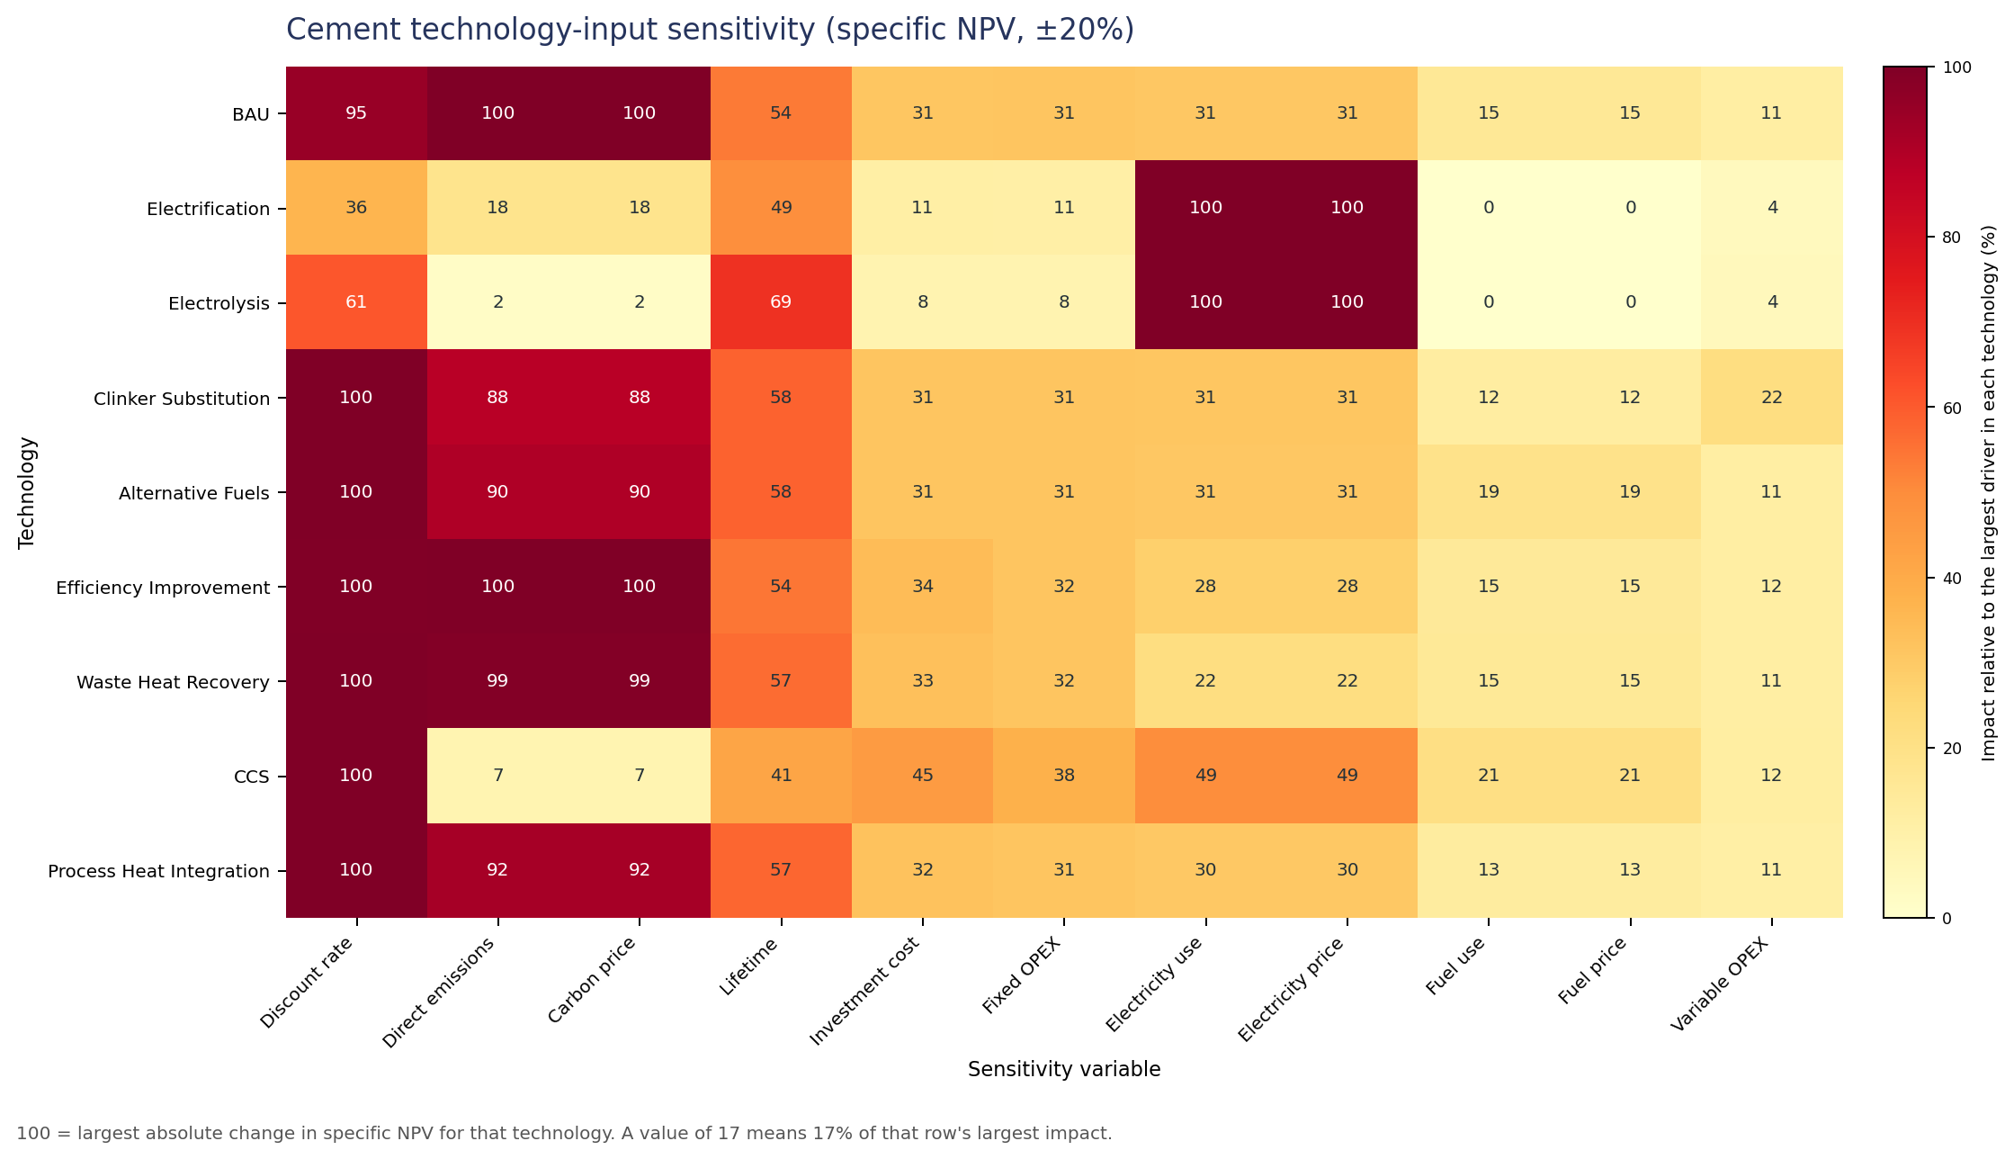
Result 4: Sensitivity Analysis
The heatmaps show why scenarios move the way they do
Midterm findings | 12

Slide 13
Sensitivity Interpretation
Main drivers by technology family
Electricity
Cement
Renewables: full-load hours, CAPEX, discount rate. Fossil electricity: fuel price/use, emissions, carbon price. Nuclear: full-load hours, CAPEX, lifetime.
Conventional/retrofit cement: emissions, carbon price, discount rate. CCS cement: discount rate plus electricity penalty. Electrification/electrolysis: electricity use and electricity price.
This is why the scenario analysis should be discussed, not merely shown: it explains which uncertain assumptions can change the CCS-demand conclusion.
Sensitivity results also point to quality improvements: better electricity-price scenarios, better emissions modeling, and clearer source quality for technology assumptions.
Midterm findings | 13

Slide 14
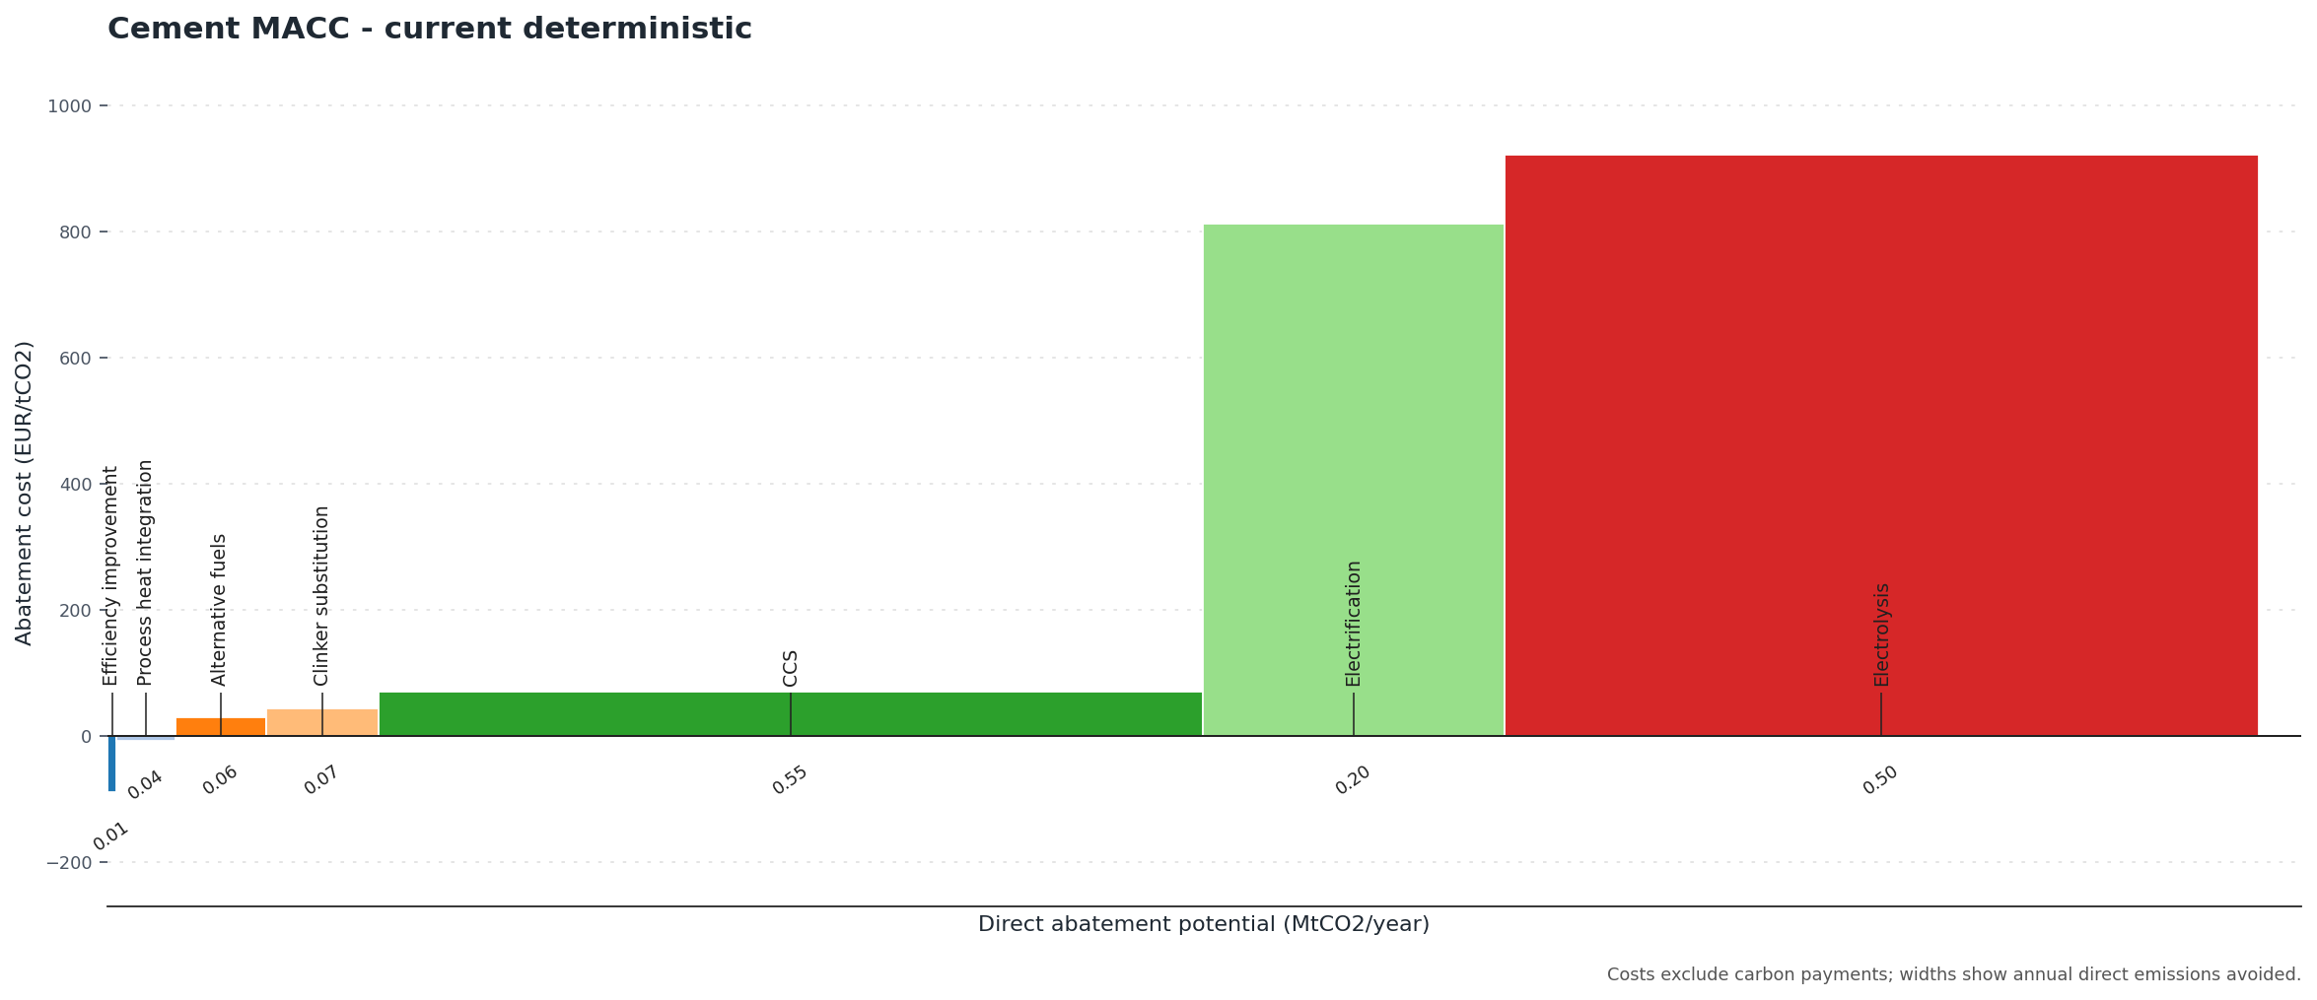
Result 5: Cement MACC
NPV ranking alone misses abatement depth
MACC finding
CCS avoids about 0.55 MtCO2/y at 70.5 EUR/tCO2 in the deterministic current model.
Interpretation
Efficiency and heat-integration measures can be cheap or cost-saving, but their abatement depth is small. CCS is more expensive than small retrofits, but its abatement depth is much larger.
Midterm findings | 14

Slide 15
Discussion
Current answer to the thesis question
Electricity: CCS demand looks weak under current assumptions because non-capture renewables are economically dominant.
Cement: CCS demand looks conditional but significant because CCS is often economically competitive and provides deep direct-emissions abatement.
The thesis mechanism is visible: CCS demand depends on sector-specific alternatives, not only on the cost of CCS itself.
The model should eventually classify sectors into robust CCS demand, conditional CCS demand, weak CCS demand, and unresolved cases.
Midterm findings | 15

Slide 16
Quality-Level Improvements
How the research should get better
Strengthen parameter sourcing and uncertainty ranges, especially for emerging industrial technologies.
Separate technology-development uncertainty from market and policy uncertainty more explicitly.
Replace weak independent assumptions with mechanistic links where possible: fuel use, emissions, capture rate, and energy penalty.
Add incremental comparisons: CCS versus unabated counterpart in electricity, and retrofits versus BAU in cement.
Add abatement-depth interpretation alongside NPV ranking so small cheap measures are not overinterpreted as complete CCS substitutes.
Midterm findings | 16

Slide 17
Outlook
How the project proceeds scientifically
Aluminium
Chemical industries
Add aluminium industry pathways and compare CCS with process integration, electrification, inert anodes, recycling, and fuel switching where relevant.
Add chemical-sector cases where feedstock, process emissions, hydrogen, electrification, and CCU/CCS alternatives differ by product.
Cross-sector conclusion
Move from technology rankings to sector-level CCS demand categories and identify the conditions that make each category robust.
Midterm findings | 17

Slide 18
Technical Steps TODO
Implementation items, separate from research outlook
Regenerate official tracked cement figures after the alternative-fuels correction.
Add tests for finance identities, unit conversions, sign counts, and ranking consistency.
Write reusable sector templates for aluminium and chemicals.
Archive parameter sources next to assumptions.
Record sample size, seed, scenario values, and model version for every exported figure.
Midterm findings | 18

