Slide 1
Midterm Findings
How uncertainty of technology development shapes carbon capture demand uncertainty
Finn | Master thesis project | ETH Zurich | July 2026
Midterm thesis question
Current implemented scope
Under techno-economic uncertainty, when is carbon capture the most economically viable option, and when do non-capture alternatives dominate?
Two mature sectors: electricity and cement. Both use deterministic calculations, Monte Carlo rankings, sensitivity analysis, and tracked figures.

Slide 2
What The Thesis Asks
Reframed from the project proposal
CCS is important for net-zero, but deployment can be reduced if plants choose alternative decarbonization technologies.
The thesis therefore studies CCS demand as a competitive investment problem, not as a standalone technology assessment.
The core output is probabilistic: how often does CCS become the economically preferred option under uncertain technology development?
Research question
Which emitting sectors should implement carbon capture, and which should investigate alternative decarbonization technologies?
Midterm answer format
For each sector: compare CCS against non-capture options using NPV distributions, rank probabilities, sensitivity heatmaps, and marginal abatement costs.
Midterm findings | 2

Slide 3
Current Scope
Implemented applications and comparison technologies
Electricity
Cement
Hard coal, hard coal + CCS, CCGT, CCGT + CCS, nuclear, offshore wind, onshore wind, PV, biogas.
BAU, CCS, clinker substitution, alternative fuels, efficiency improvement, waste heat recovery, process heat integration, electrification, electrolysis.
Both sectors are normalized to a common annual output before comparison.
The model compares technology choices within a sector, not electricity versus cement directly.
Steel, metals, and chemicals remain thesis-scope candidates, but are not yet mature midterm result sectors.
Midterm findings | 3

Slide 4
Model Logic
From assumptions to CCS demand insight
1. Inputs
2. Sampling
3. Cash Flow
4. NPV
5. Decision
Technology assumptions, market prices, carbon price, discount rate.
Monte Carlo draws techno-economic uncertainty for each simulation world.
Annual revenue minus CAPEX, OPEX, fuel, electricity, and carbon costs.
Discount future annual cash flows over the technology lifetime.
Rank technologies and estimate the probability that CCS is preferred.
The same sampled market conditions are reused across comparable technologies where appropriate.
Higher NPV is better; NPV = 0 is treated as non-negative.
Outputs are reported as total NPV and normalized NPV: EUR/MWh for electricity and EUR/t for cement.
Midterm findings | 4

Slide 5
Core Assumptions
Common assumptions used in the current model
80
8%
100k
42
EUR/tCO2 carbon price
discount rate
Monte Carlo draws
default random seed
Electricity normalization
Cement normalization
All electricity technologies are sized to produce 1,000,000 MWh/year. Full-load hours determine installed capacity.
All cement technologies are compared at 1,000,000 t/year. Cement retrofits modify a BAU baseline.
Current revenue assumptions
Electricity price is fixed at 94.07 EUR/MWh for electricity-sector revenue. Cement price is fixed at 150 EUR/t for cement-sector revenue.
Midterm findings | 5

Slide 6
Shared Market Inputs
Uncertain energy prices and fixed fuel assumptions
Gas price
Coal price
Electricity price
Scaled beta: 12.5 / 39.3 / 89.7 EUR/MWh_th
Scaled beta: 8.14 / 12.11 / 24.17 EUR/MWh_th
Scaled beta: 74.8 / 183.7 / 255.2 EUR/MWh
Biofuel price
Nuclear fuel
Biogas fuel
Uniform: 5.4-32.4 EUR/MWh_th
Fixed: 2.8 EUR/MWh_th
Fixed: 87.5 EUR/MWh_th
Energy-price assumptions are intentionally separated from technology-specific assumptions.
This keeps technology development uncertainty and market/policy uncertainty traceable.
Midterm findings | 6

Slide 7
Technology Parameters
What is sampled or fixed for each option
CAPEX: upfront investment cost.
Fixed OPEX: annual capacity- or output-linked fixed operating cost.
Variable OPEX: non-fuel variable operating cost.
Fuel and electricity intensity: translate energy requirements into annual costs.
Direct emissions: translate residual emissions into carbon cost.
Lifetime and full-load hours: determine discount horizon and installed capacity.
Cement retrofit detail
Retrofits are represented as changes relative to BAU. CCS, for example, lowers emissions strongly but can increase fuel and electricity use.
Recent assumption correction
Alternative fuels now use a 25-60% alternative-fuel share and a blended fuel price, rather than assuming 100% alternative fuel use.
Midterm findings | 7

Slide 8
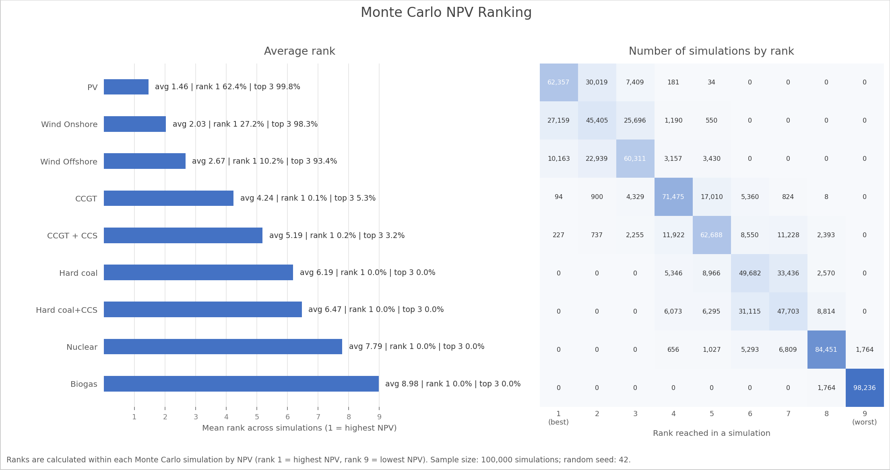
Electricity Results
Mean NPV and rank probabilities
Dominant options
PV: average rank 1.46, rank-1 probability 62.4%. Onshore wind: average rank 2.03, top-3 probability 98.3%. Offshore wind: average rank 2.67, top-3 probability 93.4%.
CCS implication
CCGT+CCS and hard coal+CCS do not reach top-3 probability above 3.2% and 0.0%, respectively.
Midterm findings | 8

Slide 9
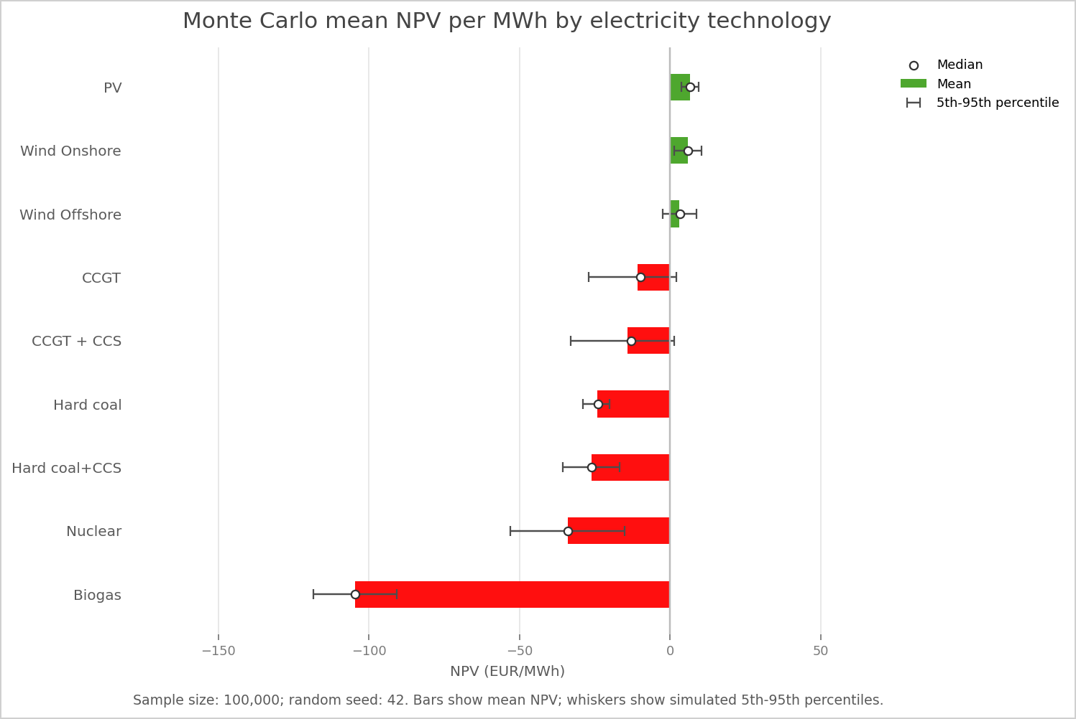
Electricity Interpretation
What the ranking says about CCS demand
In the current model, electricity-sector CCS demand is weak because renewable options dominate the economic ranking.
CCS reduces carbon costs for fossil generation, but added CAPEX, OPEX, and fuel consumption keep CCS behind PV and wind.
Nuclear is disadvantaged by high upfront CAPEX despite high full-load hours and a 45-year lifetime.
Biogas is penalized by high fixed fuel cost.
Midterm findings | 9

Slide 10
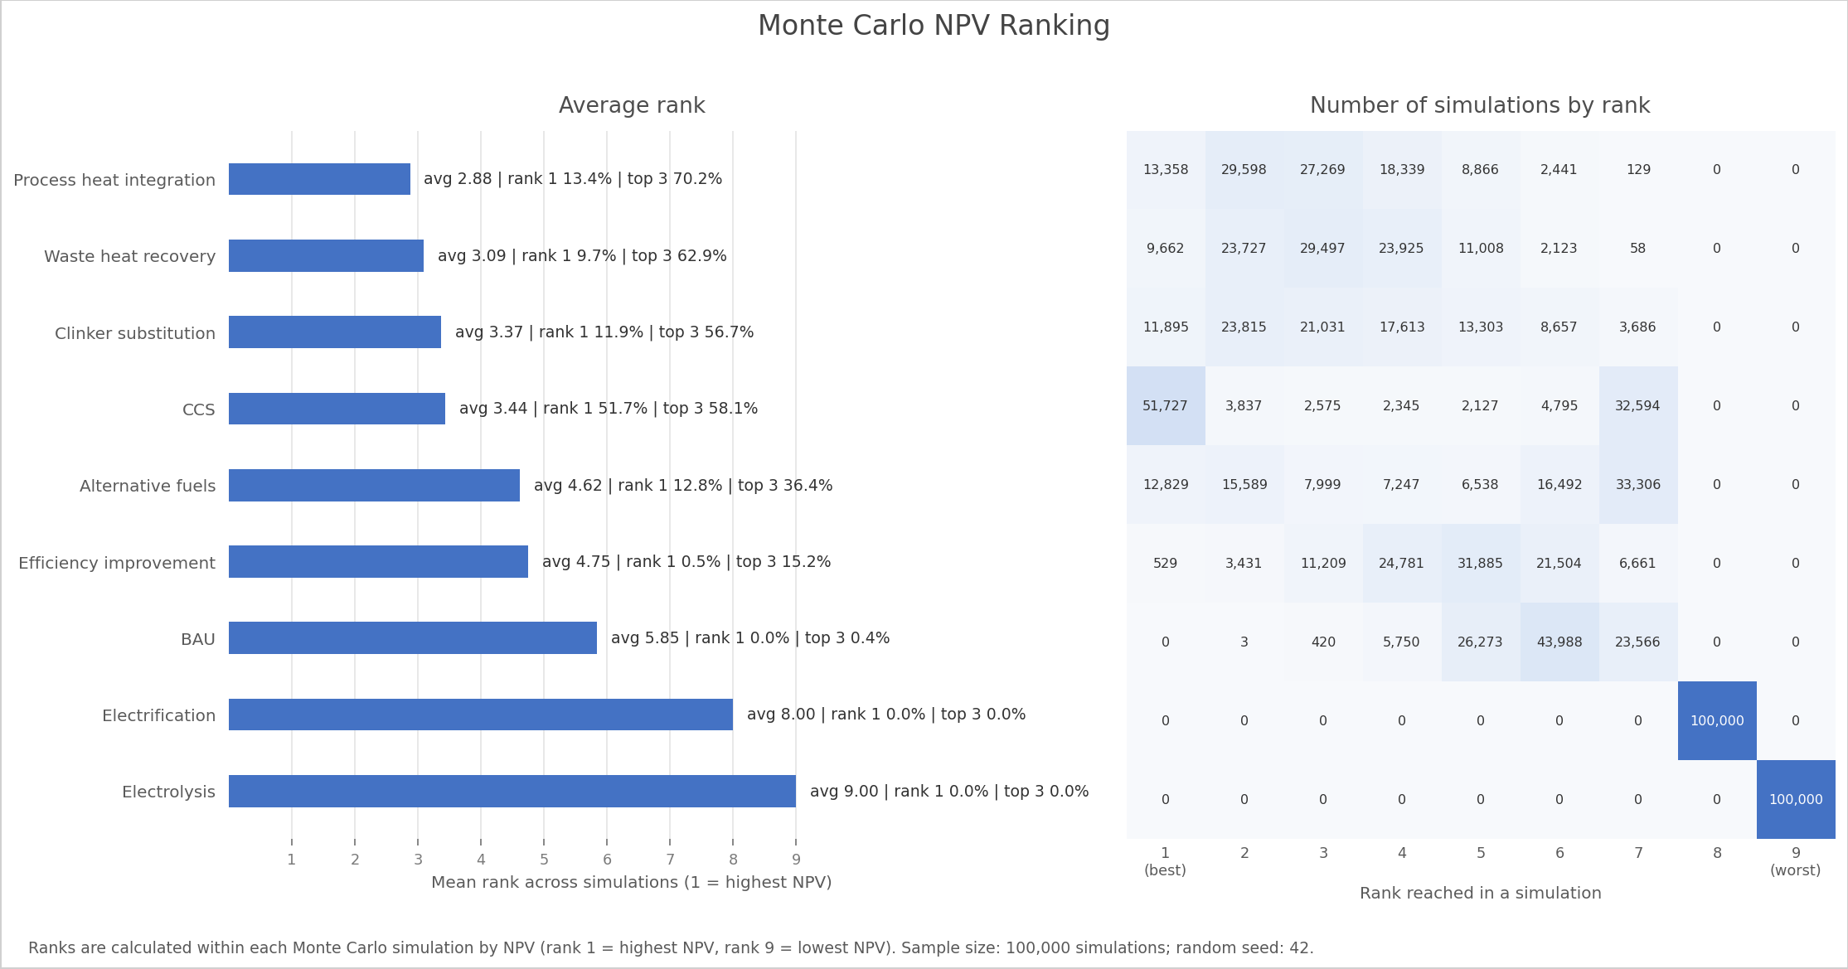
Cement Results
A stronger but uncertain case for CCS
CCS probability signal
CCS has rank-1 probability 51.7%, the highest in cement. But its average rank is 3.44, showing high volatility.
Competing non-capture options
Process heat integration, waste heat recovery, and clinker substitution all have top-3 probabilities above 56.7%.
Midterm findings | 10

Slide 11
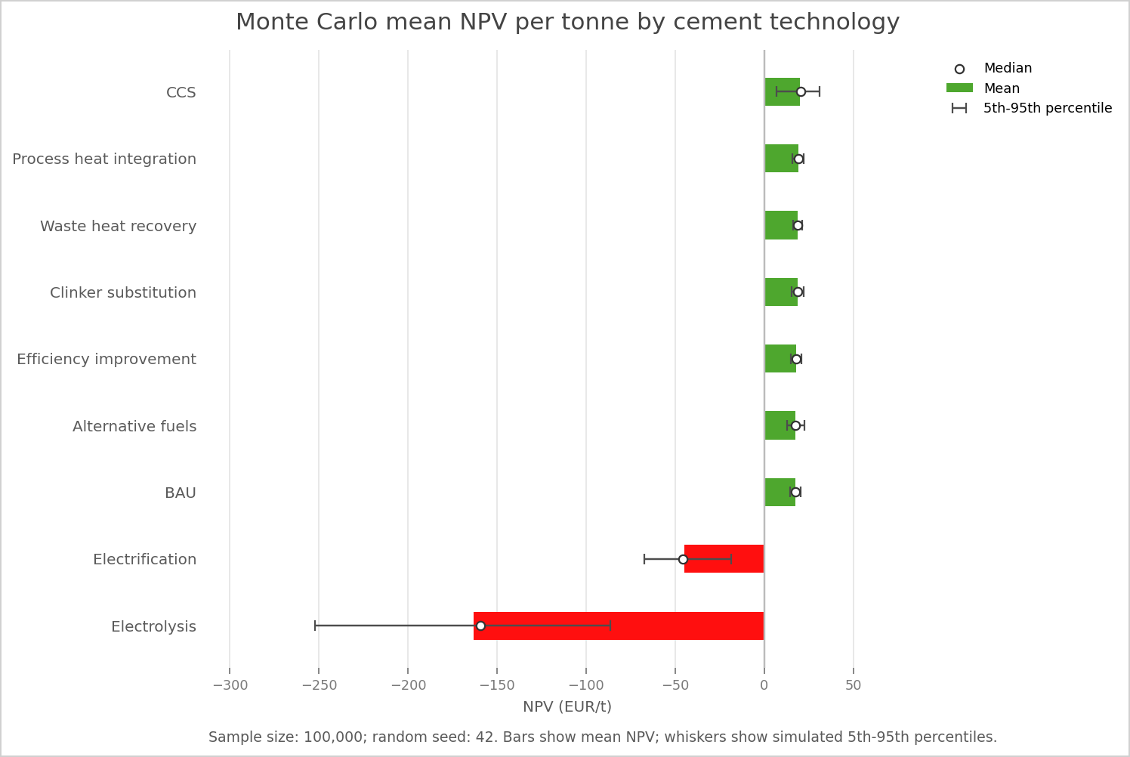
Cement Interpretation
CCS competes with low-cost retrofits
Cement is currently the stronger CCS-demand candidate because CCS provides large direct emissions reduction.
However, non-capture retrofits can remain economically attractive because they add little CAPEX and reduce energy or emissions intensity.
Electrification and electrolysis are currently unattractive because electricity demand is high under the present electricity-price assumption.
Therefore, cement CCS demand depends on the trade-off between abatement depth and retrofit cost.
Midterm findings | 11

Slide 12
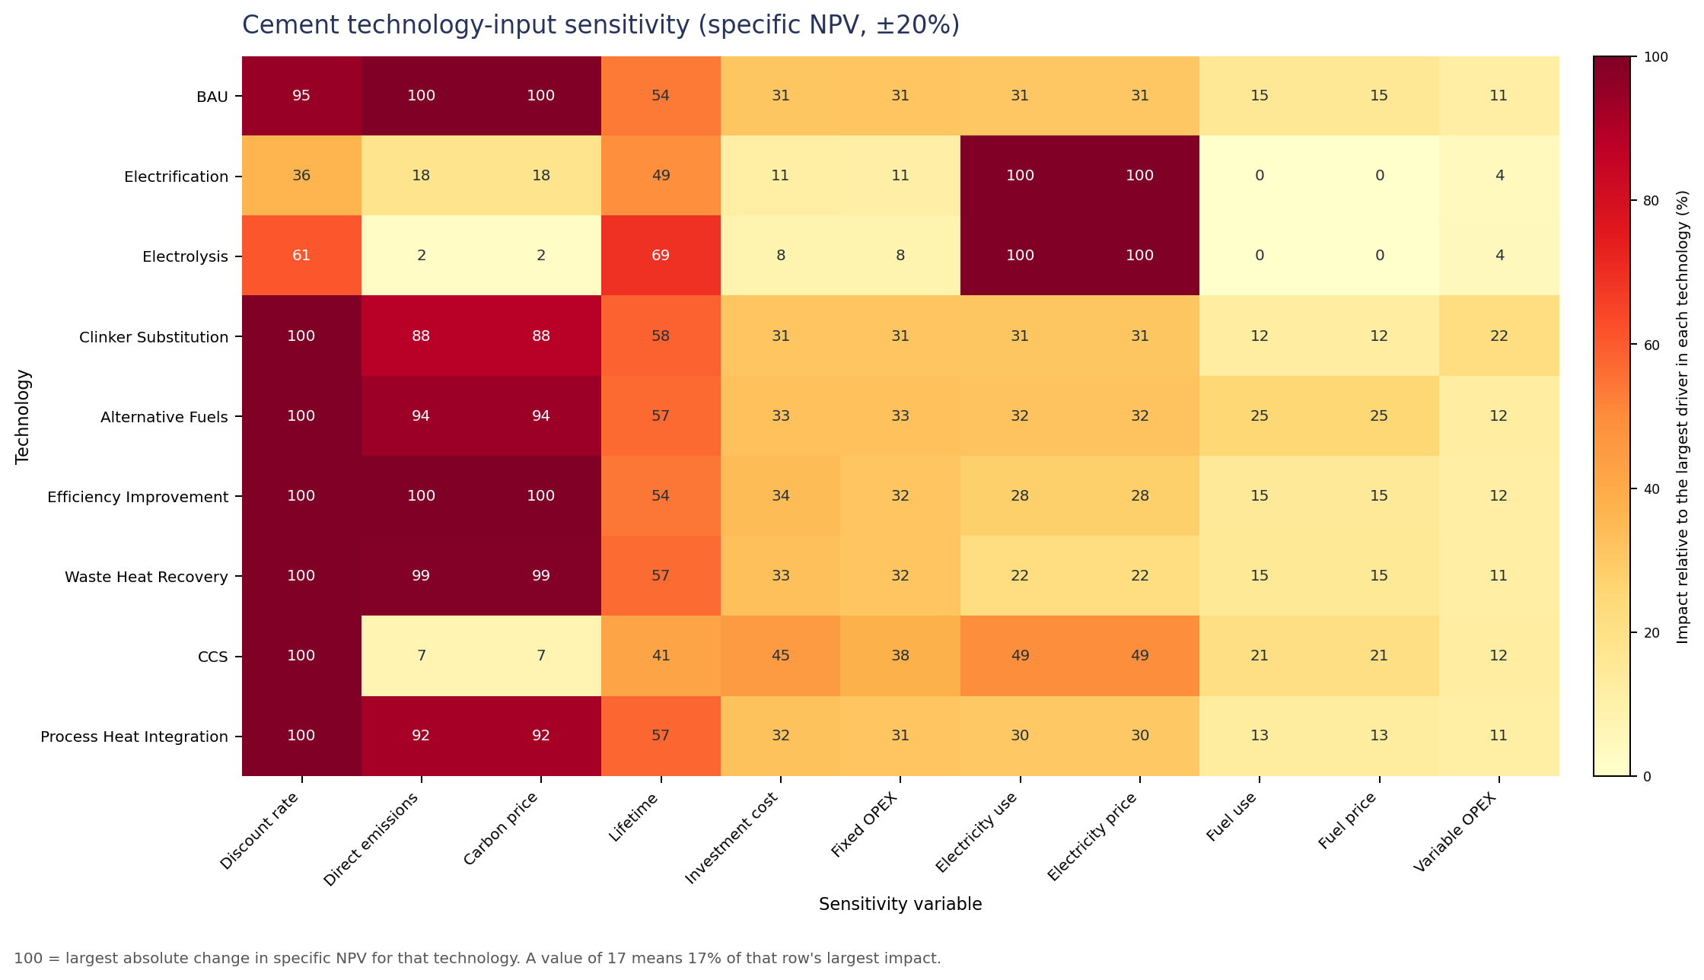
Sensitivity: Cement
Standardized +/-20% changes in model inputs
Main insight
Electricity-intensive cement routes are highly sensitive to electricity price and electricity use. Conventional and retrofit routes are more sensitive to emissions, carbon price, and financial assumptions.
Interpretation for CCS
CCS attractiveness is coupled to carbon price, residual emissions, energy penalty, and discount rate.
Midterm findings | 12

Slide 13
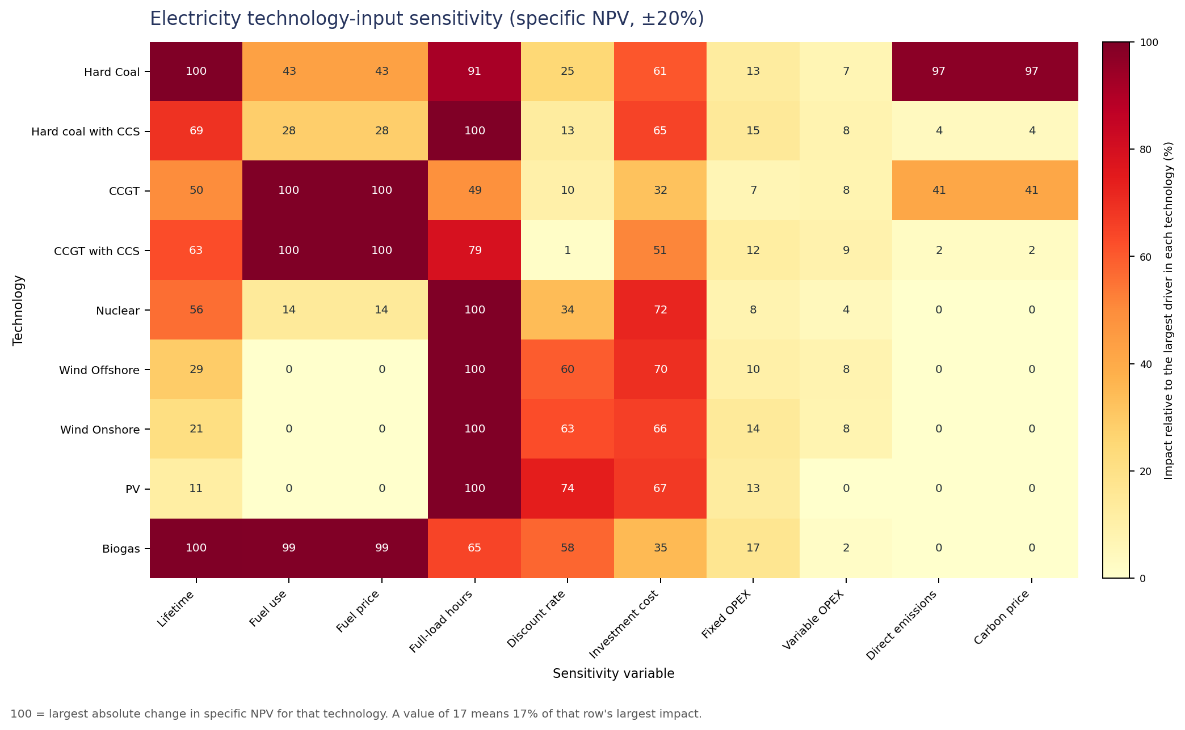
Sensitivity: Electricity
Standardized +/-20% changes in model inputs
Main insight
Fossil technologies are exposed to fuel price, fuel use, emissions, and carbon price. Renewable technologies are mainly exposed to investment cost, fixed OPEX, and full-load hours.
Interpretation for CCS
CCS can reduce carbon-price exposure but adds cost and efficiency penalties, so it does not become dominant in electricity under the current setup.
Midterm findings | 13

Slide 14
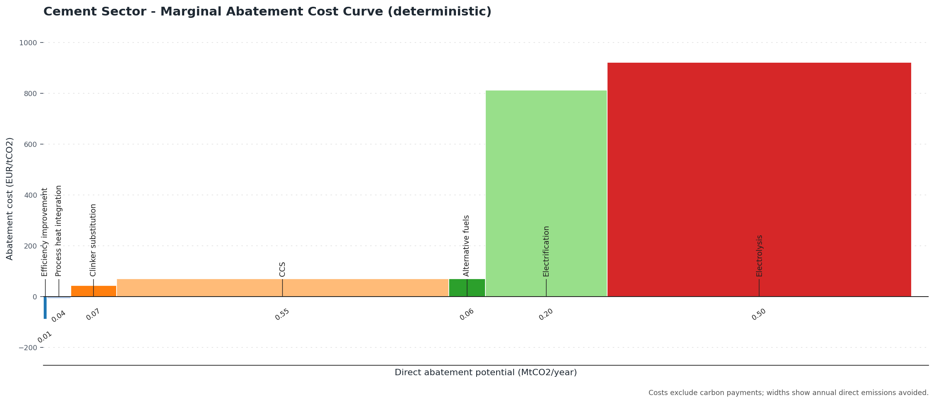
Cement MACC
Abatement cost connects economics with emissions reduction
Deterministic MACC
Efficiency improvement: -87.9 EUR/tCO2. Process heat integration: -8.0 EUR/tCO2. CCS: 70.5 EUR/tCO2.
Simulated CCS range
CCS median: 68.4 EUR/tCO2. p05-p95: 25.3 to 118.9 EUR/tCO2.
Midterm findings | 14

Slide 15
What This Means For CCS Demand
Midterm synthesis
Electricity
Cement
Low expected CCS demand in the current setup. Renewables dominate the NPV ranking; CCS is not frequently the preferred electricity option.
Stronger CCS-demand signal. CCS often ranks first and provides high abatement, but low-cost retrofits remain strong competitors.
The thesis question is sector-specific: CCS is not universally dominant or universally unattractive.
A useful demand indicator is the probability that CCS ranks first or in the top three, not only the mean NPV.
Abatement depth matters: small retrofits can be cheap, while CCS can deliver larger emissions reductions.
Midterm findings | 15

Slide 16
Current Limitations
What should be caveated in the midterm
Only electricity and cement are mature enough for results; other proposed sectors are not yet modeled.
There is no formal automated test suite yet; validation uses compilation, smoke runs, and notebook execution.
Some physical correlations are simplified, especially between fuel use and emissions.
Results depend strongly on assumed product prices, carbon price, energy prices, and discount rate.
Stored June 23 cement summary figures predate the June 29 alternative-fuels correction and should be regenerated before final claims.
Midterm findings | 16

Slide 17
Next Steps
From midterm results to final thesis
Regenerate
Extend
Improve uncertainty
Regenerate cement summary outputs after the alternative-fuels correction.
Add further emitting sectors if needed: steel/metals/chemicals.
Add correlation checks and stronger unit-identity tests.
Scenario analysis
Final narrative
Presentation polish
Use CO2 price and discount-rate scenarios to test when CCS becomes robust.
Translate model outputs into CCS demand categories by sector and application.
Update deck figures after reruns and add source references for final defense.
Midterm findings | 17

Slide 18
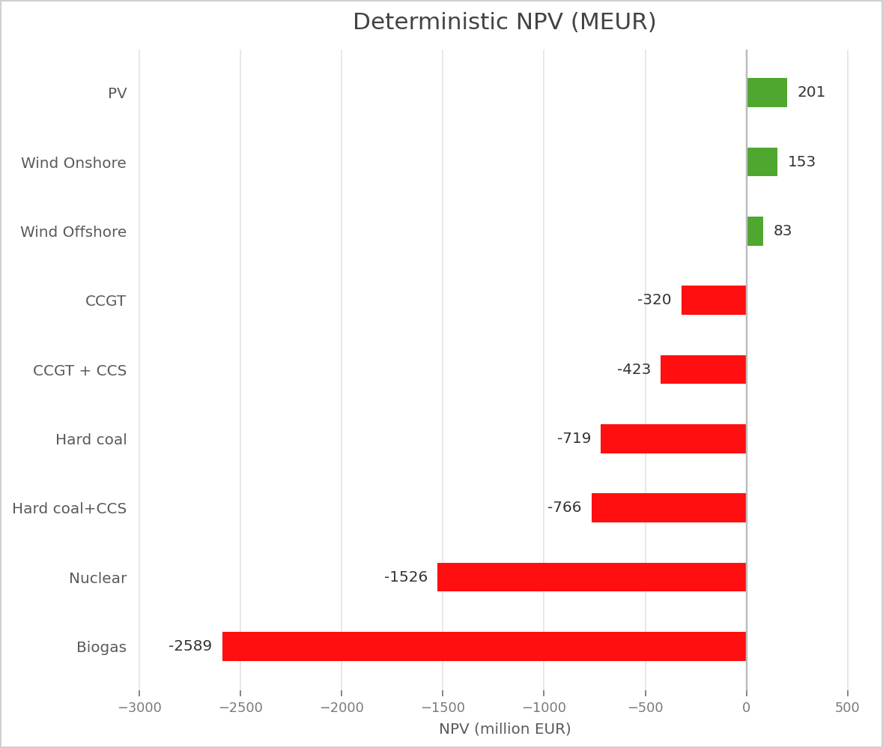
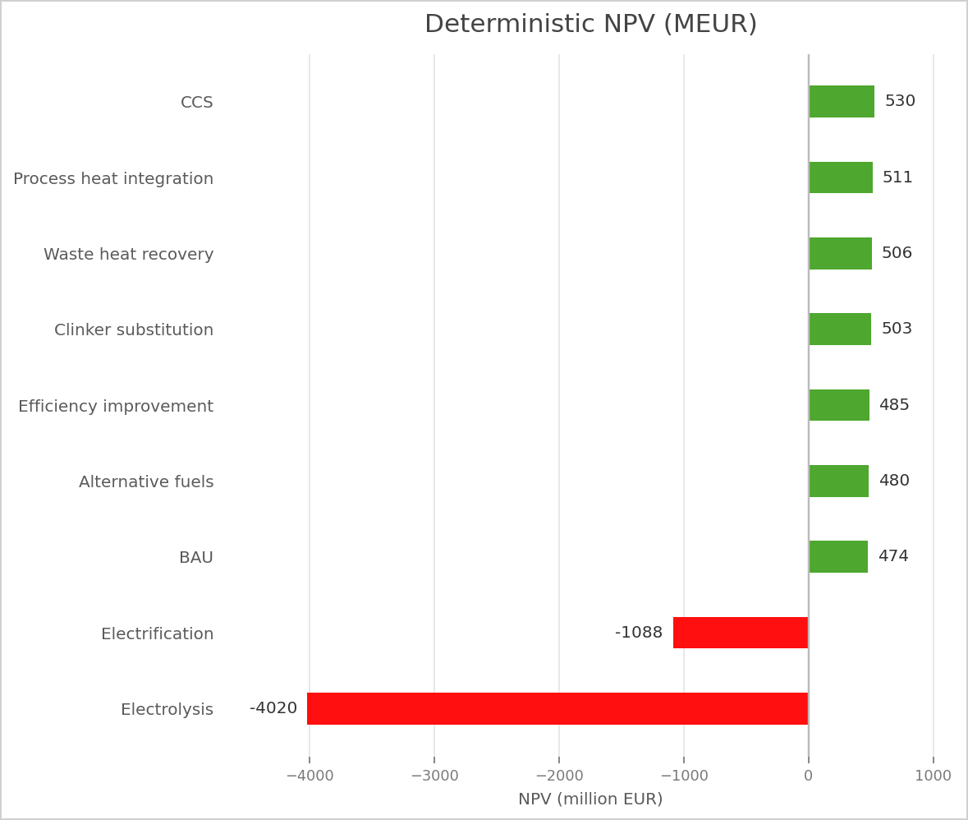
Appendix: Deterministic Baselines
Representative calculations for checking intuition
Midterm findings | 18

Slide 19
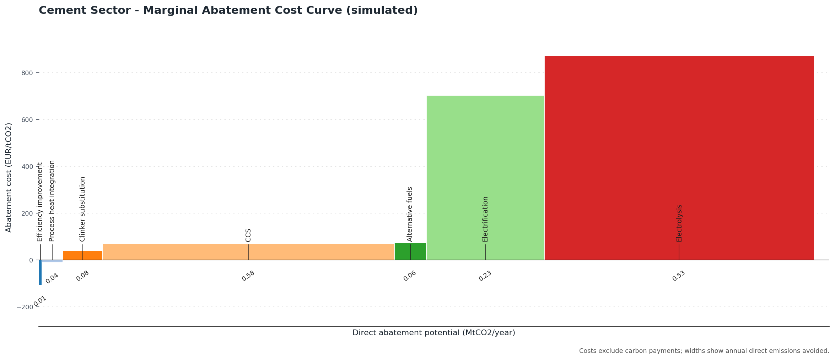
Appendix: Simulated Cement MACC
Uncertainty around abatement costs
Midterm findings | 19

