Slide 1
Midterm Research Presentation
Impact of technology-development uncertainty on carbon-capture demand uncertainty
Research midterm | Master thesis | ETH Zurich | July 2026
Central idea
Current midterm scope
Carbon capture demand is modeled as an uncertain outcome of competition between CCS and alternative decarbonization technologies.
The implemented model currently compares electricity and cement technologies using deterministic and Monte Carlo NPV analysis.

Slide 2
Research Question
The project question from the thesis proposal
Main research question
Which emitting sectors should implement carbon capture, and which should investigate alternative decarbonization technologies?
The question is sector-specific: CCS may be attractive in one application and unattractive in another.
The question is probabilistic: technology costs, operating costs, energy requirements, energy prices, and carbon prices are uncertain.
The question is competitive: CCS must be compared against non-capture options, not evaluated in isolation.
Midterm findings | 2

Slide 3
What We Want To Find Out
Research objective translated into measurable outputs
1. Economic preference
2. CCS probability
3. Abatement value
Which technology has the highest NPV under a given sampled future?
How often does CCS rank first or near the top across uncertain techno-economic conditions?
How much emissions reduction does each option provide, and at what marginal cost?
The midterm model therefore reports NPV distributions, ranking probabilities, sensitivity results, and cement marginal abatement costs.
The final thesis should connect these outputs to sector-level CCS demand: strong, conditional, weak, or not yet assessable.
Midterm findings | 3

Slide 4
Experiment Setup
Current modeled sectors and technology options
Electricity sector
Cement sector
Hard coal, hard coal + CCS, CCGT, CCGT + CCS, nuclear, offshore wind, onshore wind, PV, and biogas.
BAU, CCS, clinker substitution, alternative fuels, efficiency improvement, waste heat recovery, process heat integration, electrification, and electrolysis.
Within each sector, technologies are normalized to the same annual output so rankings are not driven by plant size.
Electricity technologies are modeled as absolute production options.
Cement contains both absolute technologies and retrofit technologies relative to BAU.
Midterm findings | 4

Slide 5
Model Assumptions
Baseline setup used for the current midterm results
1 TWh/y
1 Mt/y
80
8%
electricity output
cement output
EUR/tCO2 carbon price
discount rate
Revenue assumptions
Uncertainty approach
Electricity revenue uses 94.07 EUR/MWh. Cement revenue uses 150 EUR/t.
Monte Carlo simulation samples technology and market inputs. Default setup uses 100,000 draws and seed 42.
Decision metric
Higher NPV is better. Results are evaluated as total NPV and normalized NPV: EUR/MWh for electricity and EUR/t for cement.
Midterm findings | 5

Slide 6
Input Parameters
Main parameter groups driving the experiment
Technology cost: CAPEX, fixed OPEX, variable OPEX.
Energy requirements: fuel consumption, electricity consumption, full-load hours.
Environmental performance: direct emissions and residual emissions after CCS.
Market and policy inputs: electricity price, cement price, fuel prices, carbon price, discount rate.
Cement retrofit inputs: CAPEX/OPEX changes and reductions in fuel use, electricity use, and emissions relative to BAU.
Recent modeling correction
Alternative fuels in cement now use a 25-60% alternative-fuel share with a blended fuel price. This avoids assuming 100% alternative-fuel use while emissions reductions only reflect partial substitution.
Research implication
Model assumptions directly influence CCS demand conclusions, so transparent parameter ownership is part of the research method.
Midterm findings | 6

Slide 7
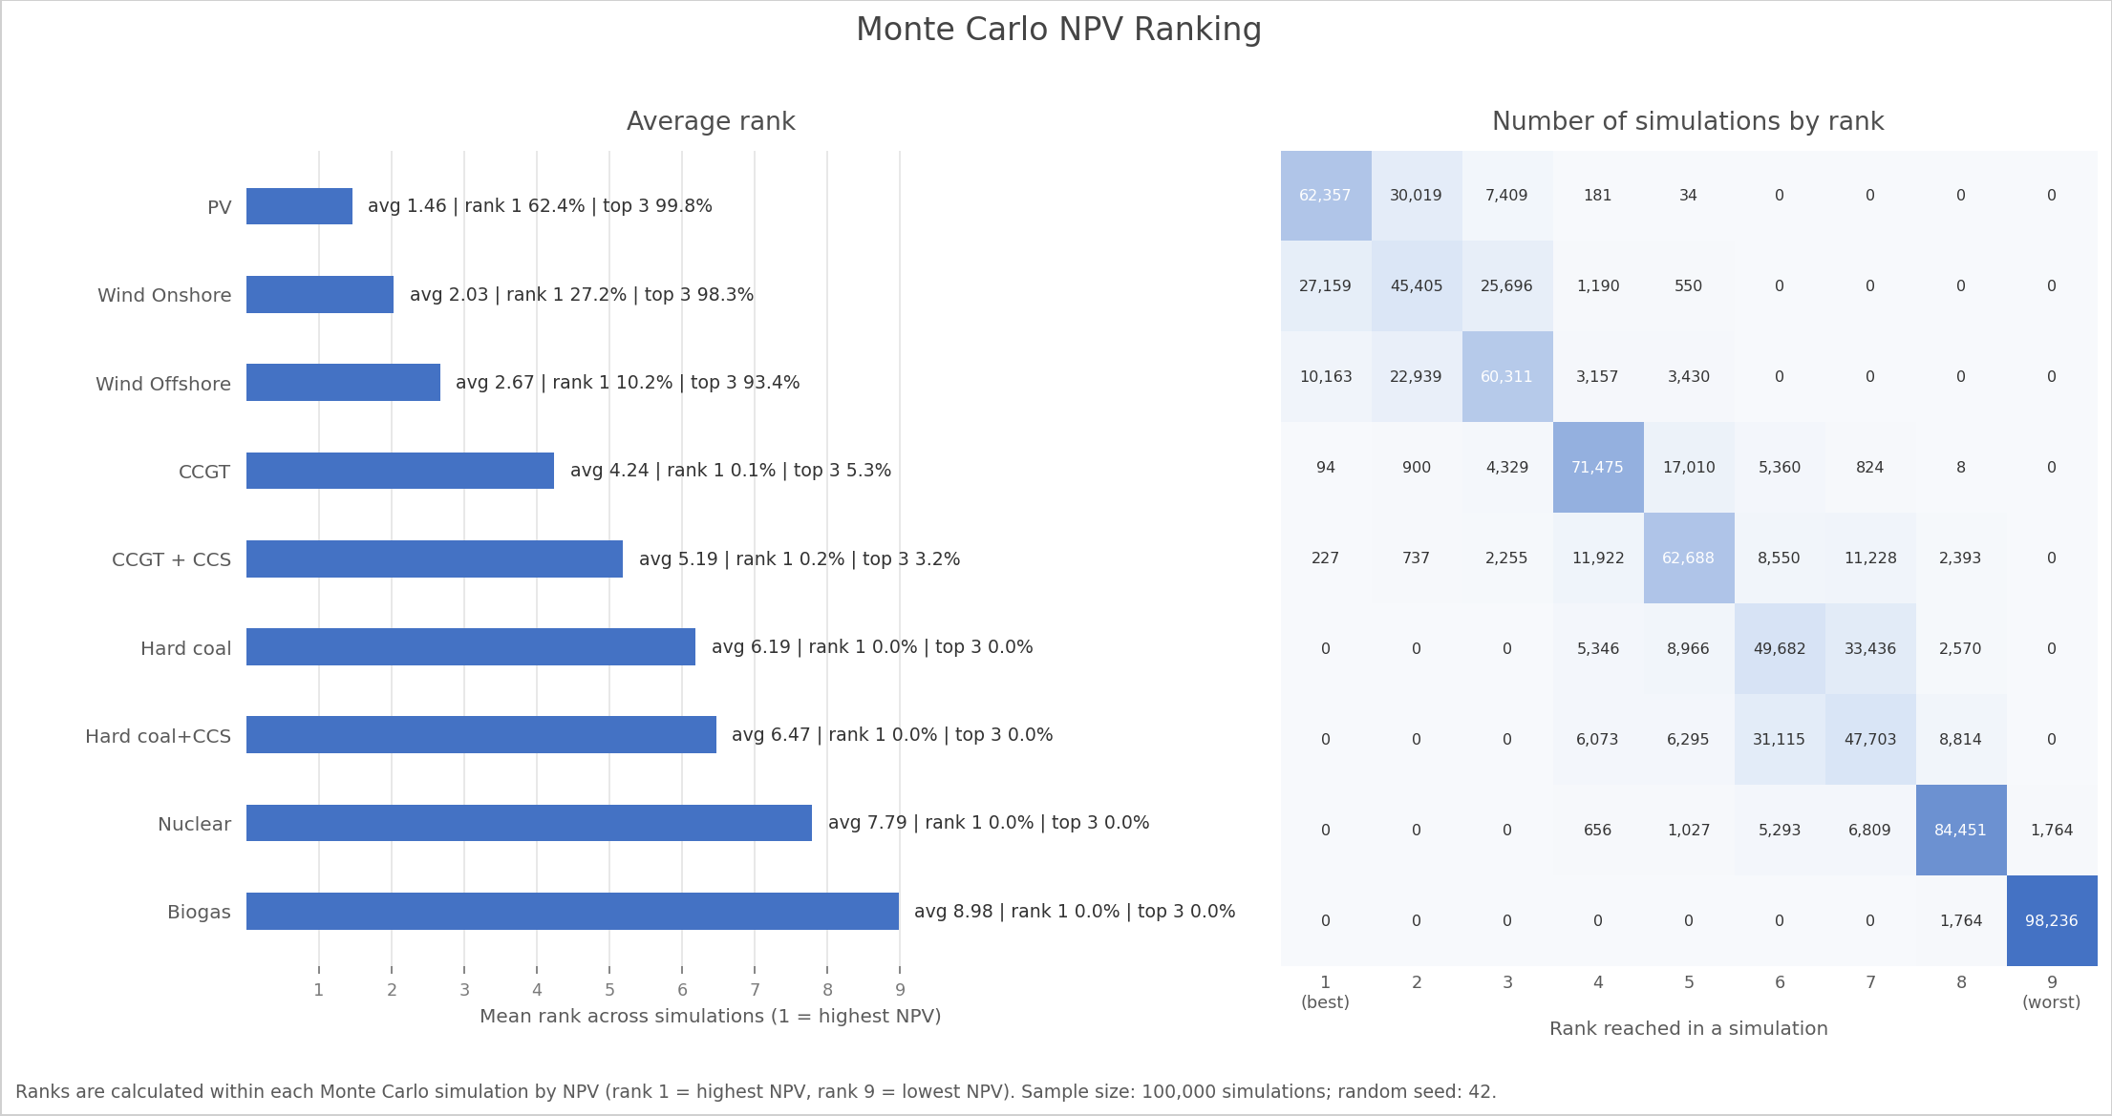
Result 1: Electricity
Renewables dominate current NPV rankings
Ranking result
PV has average rank 1.46 and rank-1 probability 62.4%. Onshore and offshore wind have top-3 probabilities of 98.3% and 93.4%.
CCS signal
CCGT+CCS top-3 probability is 3.2%; hard coal+CCS top-3 probability is 0.0%.
Midterm findings | 7

Slide 8
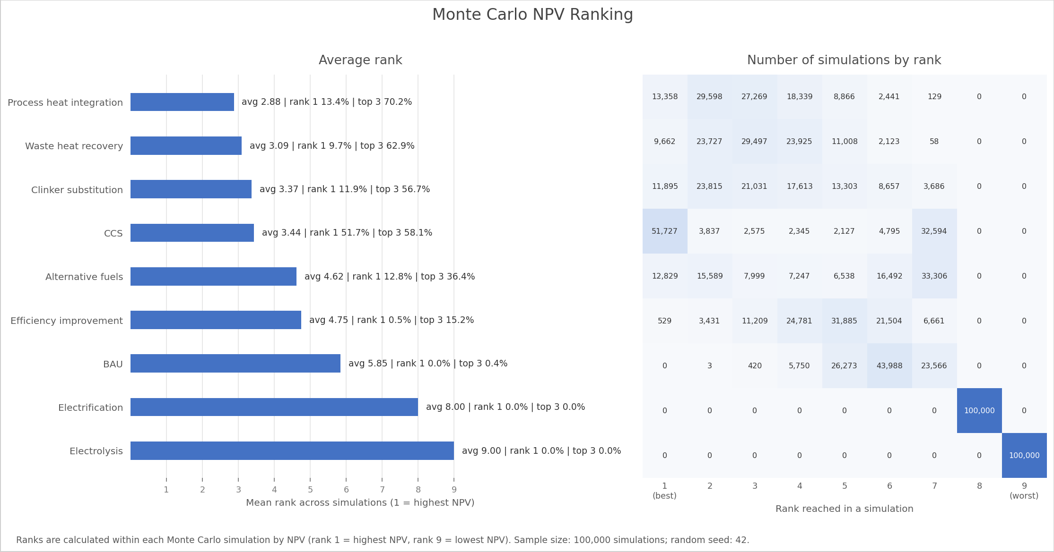
Result 2: Cement
CCS is competitive, but not uncontested
CCS result
CCS has the highest rank-1 probability in cement: 51.7%. Its average rank is 3.44, showing that outcomes are highly scenario-dependent.
Non-capture competition
Process heat integration, waste heat recovery, and clinker substitution are strong competitors because they improve economics without very high CAPEX.
Midterm findings | 8

Slide 9
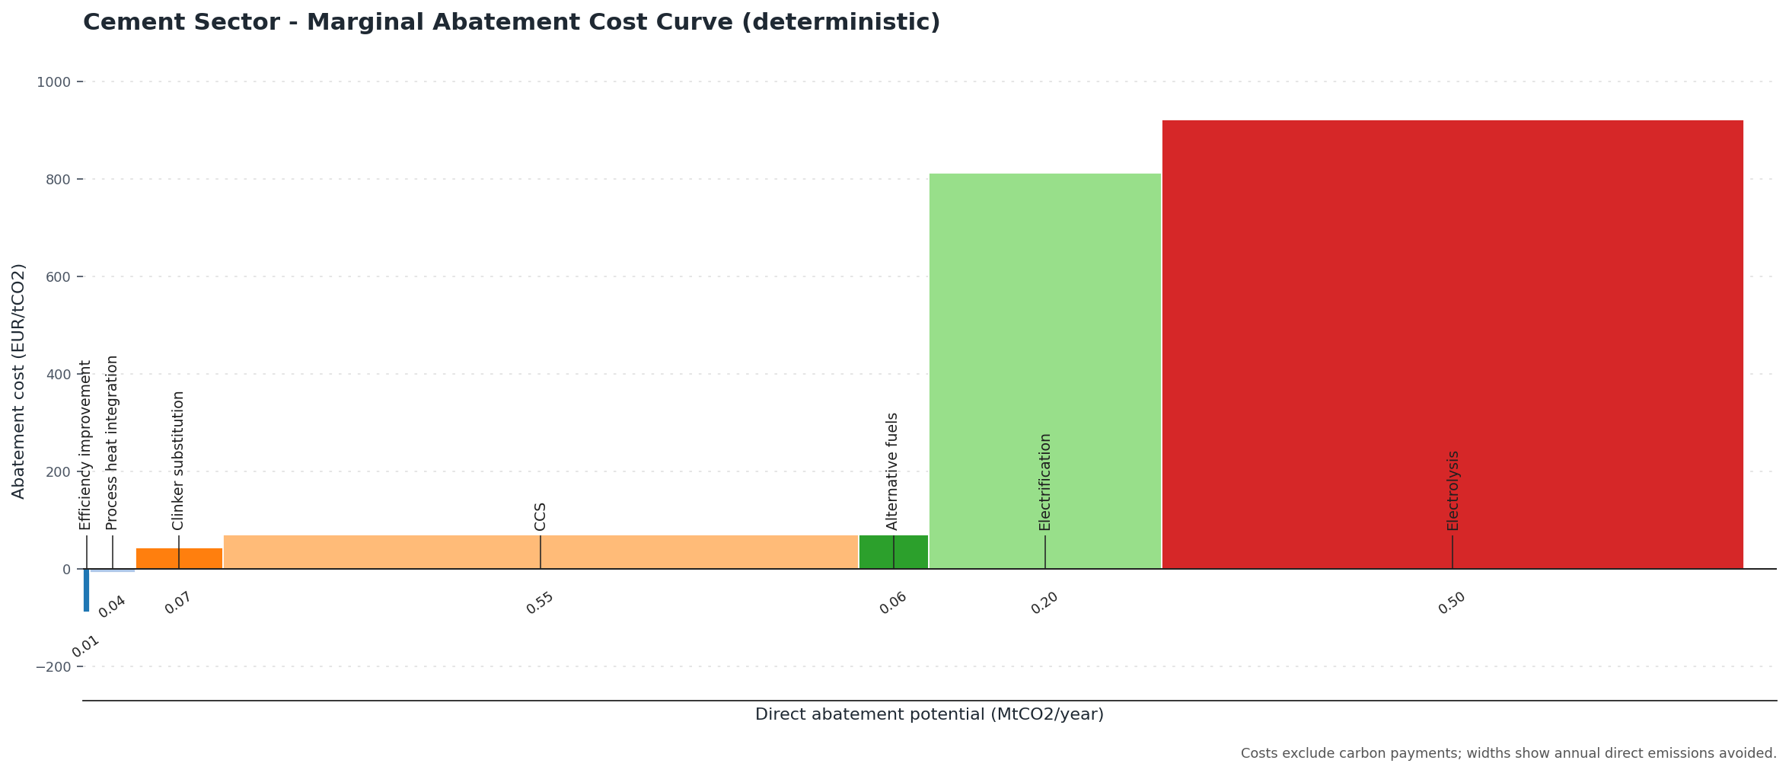
Result 3: Cement MACC
CCS has large abatement potential at moderate cost
Deterministic abatement cost
Efficiency improvement: -87.9 EUR/tCO2. Process heat integration: -8.0 EUR/tCO2. CCS: 70.5 EUR/tCO2.
Simulated CCS range
CCS median: 68.4 EUR/tCO2. p05-p95: 25.3 to 118.9 EUR/tCO2.
Midterm findings | 9

Slide 10
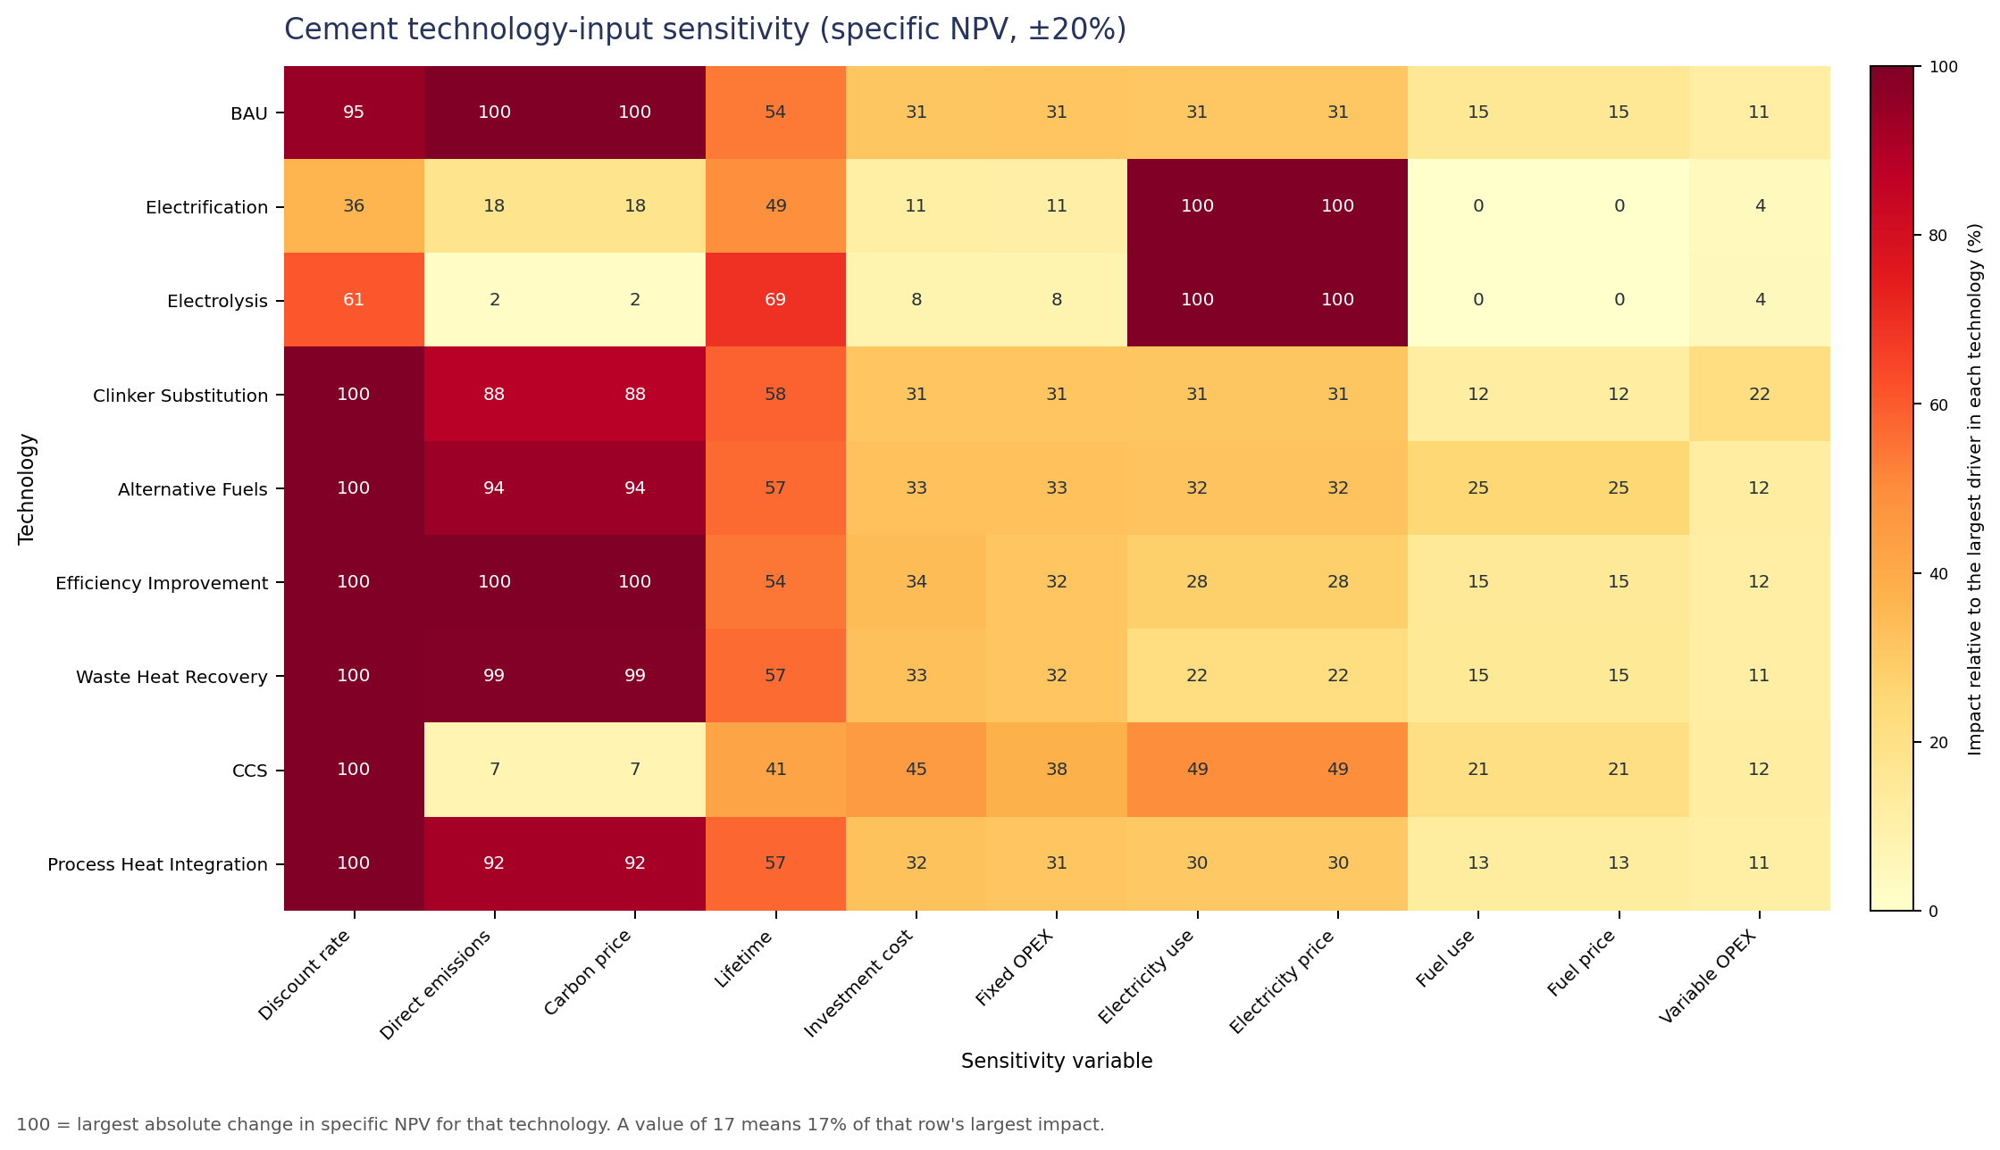
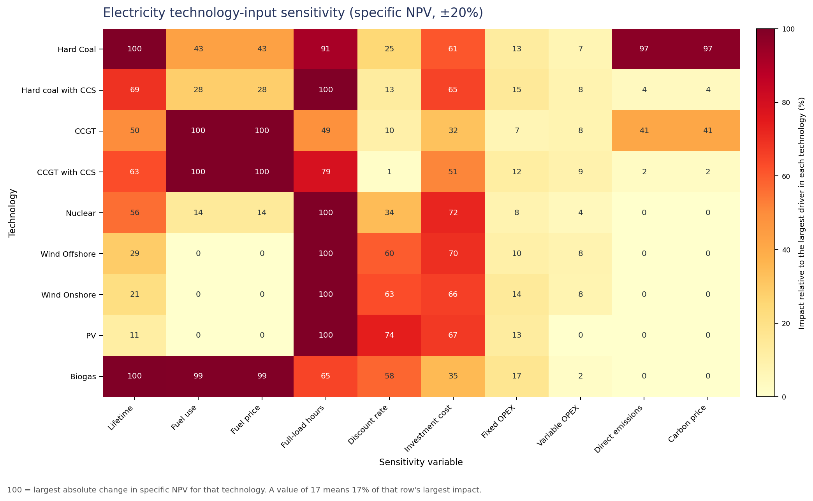
Result 4: Sensitivity
Which assumptions drive the results?
Midterm findings | 10

Slide 11
Discussion
Interpreting the midterm evidence
Electricity: current model results suggest weak CCS demand because renewable generation dominates economically.
Cement: current model results suggest conditional CCS demand because CCS frequently ranks first and offers deep abatement, but low-cost retrofits compete strongly.
The same technology, CCS, has different demand implications by sector because alternatives, emissions sources, and energy requirements differ.
This supports the thesis framing: CCS demand uncertainty should be modeled through sector-specific competition under uncertainty.
Preliminary conclusion
CCS should not be treated as a universal decarbonization default. Its role is strongest where alternatives are costly, incomplete, or unable to address process emissions.
Midterm findings | 11

Slide 12
Quality-Level Improvements
How the research design can become stronger
Improve source quality and traceability for every parameter range, especially emerging technologies.
Represent uncertainty correlations where independent sampling is physically weak, for example fuel use and emissions.
Separate market, policy, and technology-development uncertainty more explicitly.
Use scenario families to test robustness rather than relying only on one central assumption set.
Clarify the decision criterion: highest expected NPV, probability of rank 1, probability of top 3, or abatement-adjusted value.
Move from technology ranking to sector-level CCS demand categories.
Midterm findings | 12

Slide 13
Outlook
How the project proceeds scientifically
Broaden sector coverage
Deepen interpretation
Next modeled sectors: aluminium and chemical industries. These extend the thesis beyond electricity and cement toward industrial CCS demand.
For each sector, classify CCS demand as robust, conditional, weak, or dependent on unresolved assumptions.
Compare across sectors
Build final thesis argument
Identify common drivers of CCS competitiveness: process emissions, energy penalties, electricity intensity, carbon price exposure, and retrofit availability.
Translate probabilistic technology rankings into a clear narrative about where carbon capture demand is likely, uncertain, or displaced by alternatives.
Midterm findings | 13

Slide 14
Technical Steps TODO
Implementation tasks separated from the research outlook
Regenerate cement summary figures and CSV outputs after the alternative-fuels correction.
Add automated identity checks for NPV, fuel costs, emissions costs, and normalized units.
Create reusable templates for adding aluminium and chemical-sector technologies.
Document parameter sources directly alongside assumptions.
Keep generated outputs reproducible with sample size, seed, date, and model version.
Midterm findings | 14

Slide 15
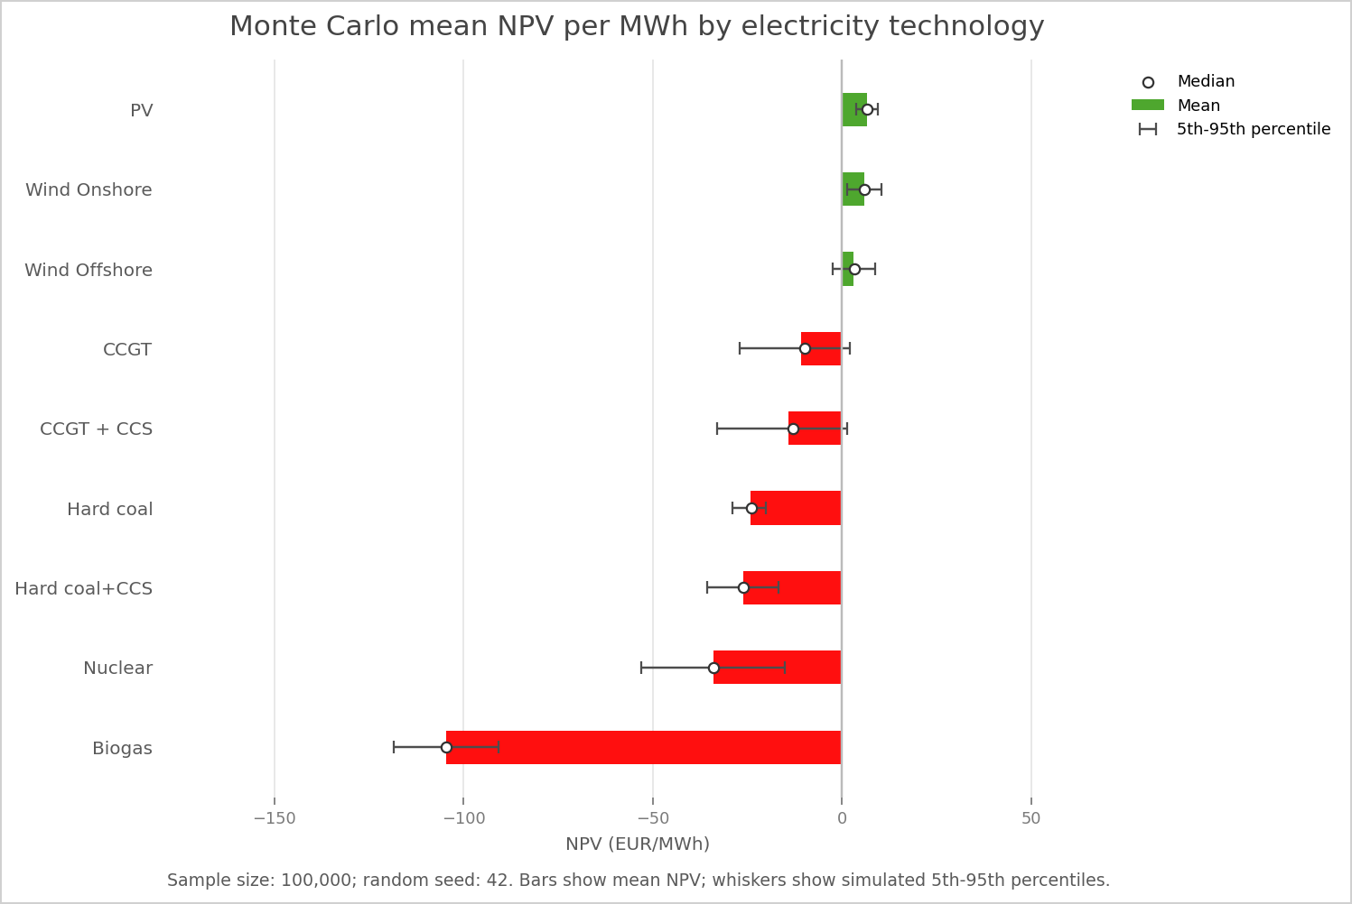
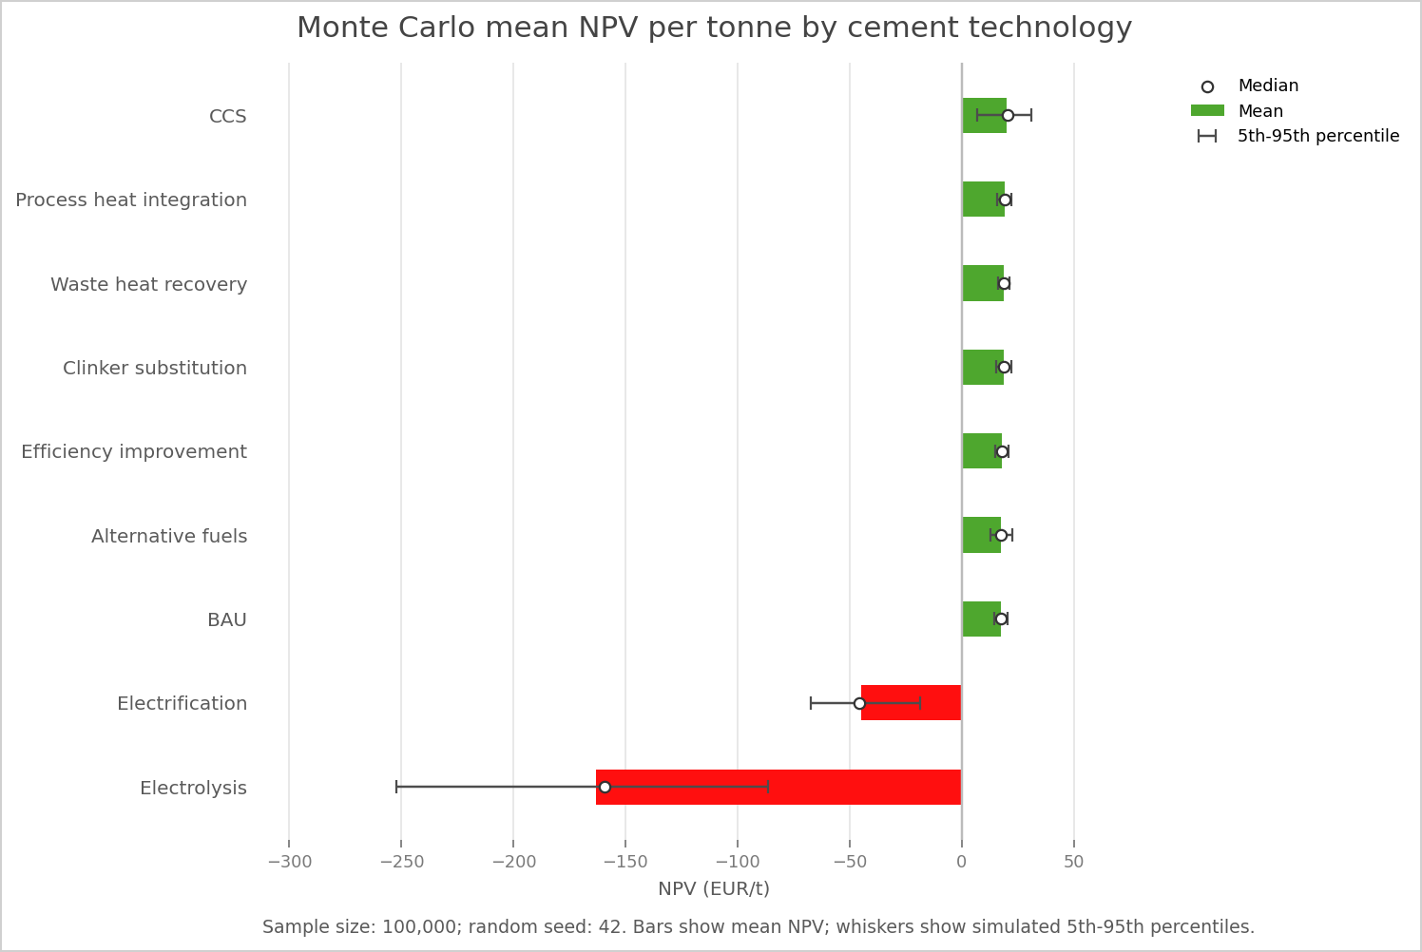
Appendix: Baseline NPV Figures
Representative deterministic and mean results
Midterm findings | 15

