Slide 1
Bomber – Game Design
刘道畅
赵世雨
马文韬 1352966
王浩旭 1352963
Presentation

Slide 2
Dance with rhythm！
Our vision, your choice

Slide 3
Background
Go on a splendid space travel to a remote alien planet
With your bomb!!!!!!

Slide 4
Introduction
Dance with rhythm
You & your enemies can only move on the rhythm.
Diverse buff
Blood
Bomb
Speed
Ghost
Fantastic tool
Trigger
pusher

Slide 5
Introduction
Enemy
Try to eliminate them
Monster
Your supply? aha..
Level
Naive
Normal
Expert
Impossible

Slide 6




Tools/Editor
+
Mono Develop

Slide 7

Technology
Unity Particle System
C#
Unity GUI

Slide 8
Overall Architecture
Initial Game
LoadGame
Game State Manager
GameManager
Map Manager
MapDataHelper
Rhythm Manager
RhythmRecorder
Game Data
GameDataProcessor

Slide 9
Overall Architecture
MapEditor
LoadGame
MapData
RhythmRecorder
GameManager
GamaData
BuffSystem BombSystem AI
DamageSystem ToolSystem ScoreSystem
etc.

Slide 10
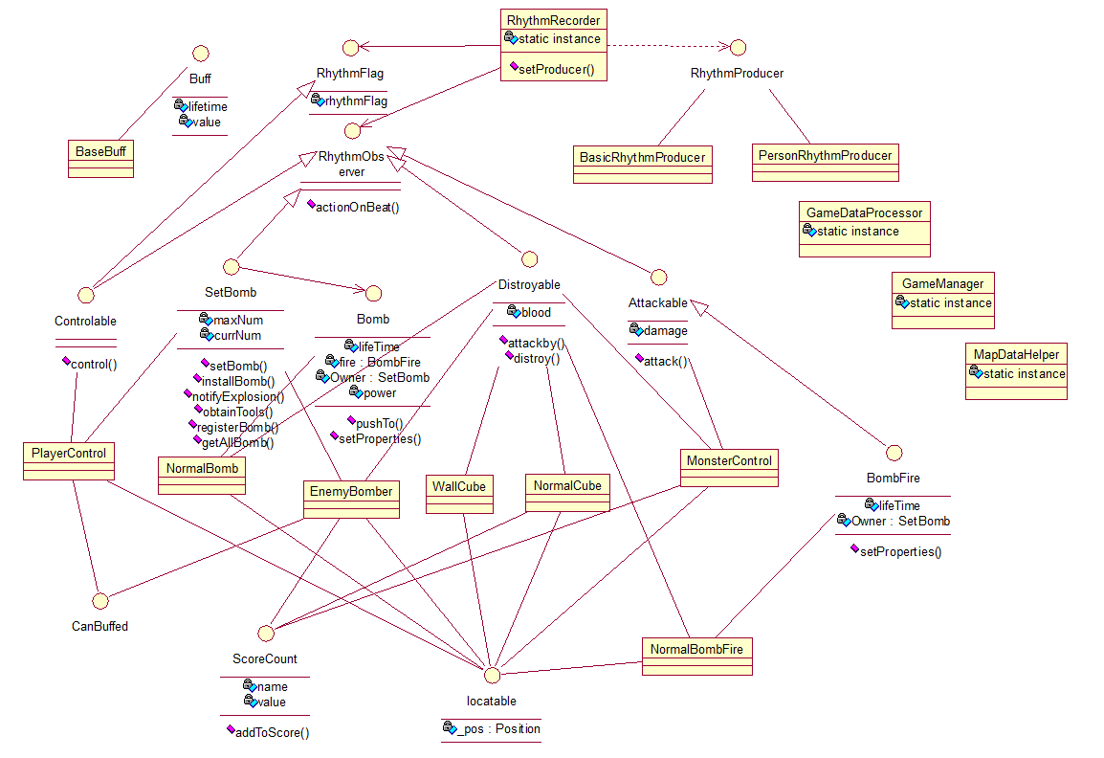
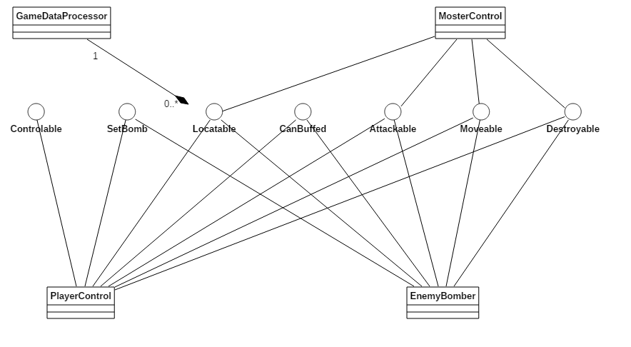
Overall Architecture

Slide 11
Data Management – Map Data
.CSV File To Save Map Data
Code | Meaning
0 | No Cube
1 | Player
2 | Enemy Bomber
3 | Breakable Cube
4 | Wall Cube
5 | Monster
8,8
4,4,4,4,4,4,4,4
4,1,0,0,0,3,0,4
4,0,0,3,0,0,0,4
4,0,0,0,3,0,0,4
4,0,0,0,0,5,0,4
4,0,0,3,0,0,0,4
4,2,0,0,3,0,0,4
4,4,4,4,4,4,4,4
Map Data Load From TextAsset OR External Path

Slide 12
Data Management – Rhythm Data
A Simple Time Array Load form TextAsset
1 1.5 2 2.5 3 3.5 4 4.5 5 5.5 6 6.5 7 7.5 8 8.5 9 9.5 10 …
For each time point,
Player has ±0.1s to act
Enemy, Monster, Bomb… will act on time

Slide 13
Data Management – Game Running Data
Each Locatable item,
Will add itself to GameDataProcessor on Initial Stage & remove on destroy

Slide 14
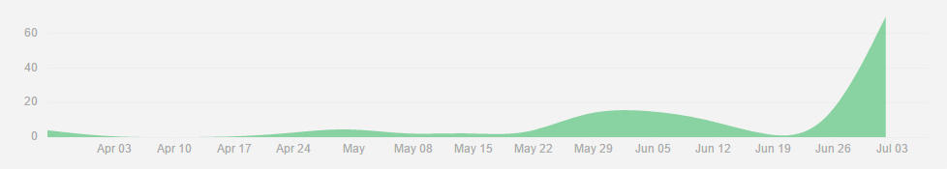
Team Work
One push, Other pull and test.

Slide 15
Implement Details

Slide 16
Map Create / Edit
Read Map Files List
Select Map
Split and Decode Map Data
Generate Map Model
Custom Map
Input File Name
Save with Specific format

Slide 17
GameDataProcessor
Interface: Locatable
Position.x Position.y
Method:
add()
remove()
getObject(position,direction);

Slide 18
RhythmRecorder
Flag Method
Fixed Method
Player
Enermy, Bomb,Reminder...

Slide 19
RhythmRecorder: Design Pattern
Observer
Strategy

Slide 20
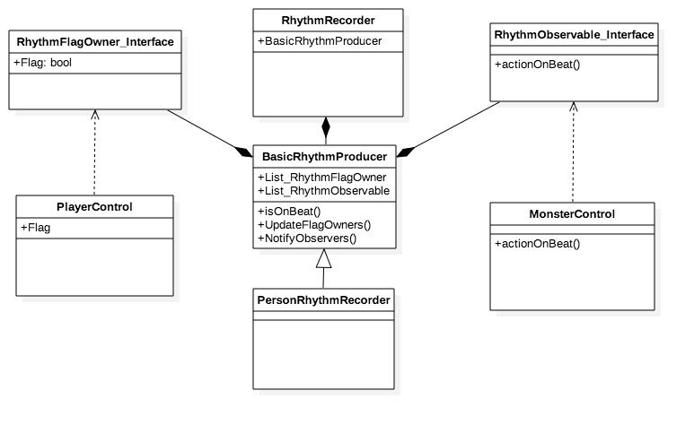
RhythmRecorder: Design Pattern

Slide 21
Bomb system
Interface Bomb
Class BaseBomb
NormalBomb
PosionBomb
Interface SetBomb
Strategy pattern, free to change bomb type

Slide 22
Damage System
Interface Attackable
Attack()
Interface Destroyable
Attackby(Attackable source)

Slide 23
Buff System
Why not decorator?
Interface Buff
Class BaseBuff
Interface CanBuffed
Empty interface for filter gameobjects
Type
Add blood
Add bomb number
Add fire time&fire length
Speed up & Slow down
Ghost form(what can a ghost do?)

Slide 24
Tool System
Interface BoomTool
Tool list for player
SetBomb.obtainTools(BoomTool tool)
Work together with buff system
GetBombPusher
GetBombTriggler

Slide 25
Score System
Interface ScoreCount
Ready for extension
Name&Score
GameManager.playerScoreList
-> Map<string,float> scoreMap

Slide 26
AI-Overview
Enemy Bomber
Compete with player
Monster
Get bomb tool from them.(actually their dead body…)

Slide 27
AI-Pathfinding
Flood method
WFS with queue to mark distance
Backtrack for path

Slide 28
AI-Enemy
Think()
Get valueMap&sort
Avoid
Walk
Idle
Set Bomb
Walk()
Walk()
Install Bomb
Walk()
Four main states

Slide 29
AI-Monster
Think()
Idle
No player approach
Pre Attack
Distance<3
Attack
Last state=pre
Back
Too far from initial position
Walk()
Walk()
Walk()
Pursue
Distance<4
Five main states

Slide 30
IT’S SHOW TIME!

