Slide 1
Introduction to Scrum
Version 1.1
August 2, 2018
This document is provided under the international Creative Commons Attribution + Share Alike 4.0 license.
Introduction to Scrum ©2018 TIS INC. Creative Commons License (International Attribution + Share Alike 4.0)

Slide 2
Why Scrum is needed

Slide 3
Changes in business environments
In the age when anything released would sell, the structure was simple: it was a matter of how much can be invested and how much can be made.
A few bugs were not an issue, as the product would still sell.
Predictable
Difficult to predict
Competed on price
Competing on added value
We are now dealing with an uncertain market, where we cannot be sure what will sell. No matter how much we invest, we cannot be sure that we will get a return on that investment. Business models are becoming increasingly short-lived.
We need to keep up with rapid changes in the market.

Slide 4
Definition of Scrum
Scrum is a framework within which people can address complex adaptive problems, while productively and creatively delivering products of the highest possible value.
Characteristics
Lightweight
Easy to understand
Difficult to master
Only 19 roles and rules.
PMBOK V6 has 49 processes.
Scrum is experience-based.
Team members learn by making judgments based on practical experience and existing knowledge.
The rules for Scrum can be found in the Scrum Guide at the URL below.
https://www.scrumguides.org/scrum-guide.html

Slide 5
Agile, Scrum and Waterfall

Slide 6
Agile
Being agile means navigating a situation quickly and skillfully.
It is not just a practice but a way of being.
❝
❞
Don’t do agile, be agile
It is important to see agile development not as a purpose in itself but as the manner in which you approach your development.
The core principles can be summed up as the Agile Manifesto and the principles behind it.

Slide 7

Manifesto for Agile Software Development
In 2001, 17 prominent figures in what was then known as lightweight software development came together to integrate their areas of focus and document the result.
The six who are best known in Japan are:
• Kent Beck (creator of XP and JUnit)
• Martin Fowler (writer of PoEAA, coined the term “microservice”)
• Dave Thomas (author of books such as The Pragmatic Programmer.)
• Robert C. Martin (Author of Clean Code, Clean Coder, etc. “Uncle Bob”.)
• Ken Schwaber (creator of Scrum)
• Jeff Sutherland (creator of Scrum)
Notes:
They met at a ski resort in Utah, USA.

Slide 8
Manifesto for Agile Software Development
We are uncovering better ways of developing
software by doing it and helping others do it.
Through this work we have come to value:
Individuals and interactions over processes and tools
Working software over comprehensive documentation
Customer collaboration over contract negotiation
Responding to change over following a plan
That is, while there is value in the items on the right, we value the items on the left more.
Kent Beck Mike Beedle Arie van Bennekum Alistair Cockburn Ward Cunningham Martin Fowler | James Grenning Jim Highsmith Andrew Hunt Ron Jeffries Jon Kern Brian Marick | Robert C. Martin Steve Mellor Ken Schwaber Jeff Sutherland Dave Thomas
© 2001, the above authors
This declaration may be freely copied in any form,
but only in its entirety through this notice.
http://agilemanifesto.org

Slide 9
Principles behind the Agile Manifesto
We follow these principles:
Our highest priority is to satisfy the customer
through early and continuous delivery of valuable software.
Welcome changing requirements, even late in development.
Agile processes harness change for the customer's competitive advantage.
Deliver working software frequently, from a couple of weeks to a couple of months, with a preference to the shorter timescale.
Business people and developers must work
together daily throughout the project.
Build projects around motivated individuals.
Give them the environment and support they need
and trust them to get the job done.
The most efficient and effective method of conveying information to
and within a development team is face-to-face conversation.
http://agilemanifesto.org/principles.html

Slide 10
Principles behind the Agile Manifesto (continued)
Working software is the primary measure of progress.
Agile processes promote sustainable development.
The sponsors, developers, and users should be able to maintain a constant pace indefinitely.
Continuous attention to technical excellence
and good design enhances agility.
Simplicity— the art of maximizing the amount
of work not done—is essential.
The best architectures, requirements, and designs
emerge from self-organizing teams.
At regular intervals, the team reflects on how to become
more effective,
then tunes and adjusts its behavior accordingly.
http://agilemanifesto.org/principles.html

Slide 11
The waterfall process
The familiar V-Model development processse
Definitions of requirements
Acceptance testing
External design
System testing
Internal design
Integration testing
Implementation and unit testing

Slide 12

Differences in process between agile development and waterfall model
Waterfall model
Agile development
Time
Definitions of requirements
Definitions of requirements
Design
Implementation
Testing
Design
Definitions of requirements
Design
Implementation
Testing
Implementation
Definitions of requirements
Design
Implementation
Testing
Testing
Definitions of requirements
Design
Implementation
Testing

Slide 13
Differences in process between agile development and waterfall model
Process | Waterfall model | Agile development
Measurement of success | Whether processes were executed according to plan. Measurement by QCD. | Adapting to change. Customer satisfaction. Greater competitive advantage.
Management | Directive orders Top-down | Servant leadership Flat
Plan | Man-hours estimated by scope. | Man-hours estimated by schedule.
Requirements and design | Requirements identified first. All requirements designed. | Requirements received continuously. Designed at the necessary timing.
Implementation | All functions developed simultaneously. | Functions developed in order of priority.
Testing and QA | Done at end. | Testing done continuously from beginning.
Source: Scaling Software Agility

Slide 14
Relationship between agile and Scrum
Scrum is an element of agile.
Other elements include XP and Kanban, which is used for lean processes.
Agile
Lean
XP
Scrum
Crystal
Kanban

Slide 15
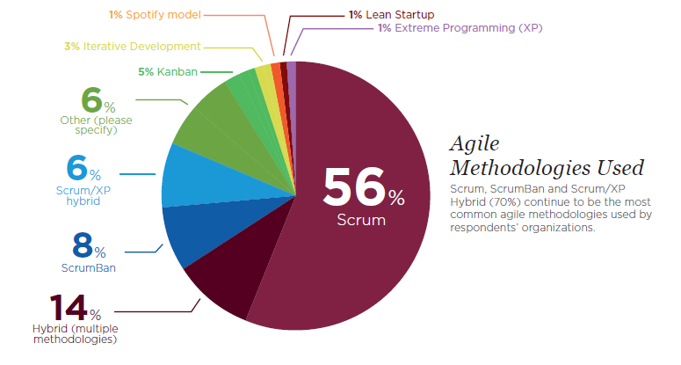
Adoption rate of Scrum in agile
Scrum has a 70% adoption rate including hybrids
VersionOne 12th Annual State of Agile Report
http://stateofagile.versionone.com/

Slide 16
About Scrum

Slide 17
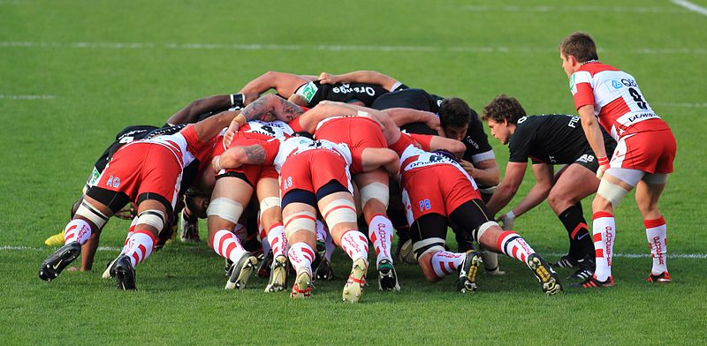
Origin of Scrum
Scrum itself was announced by Jeff Sutherland and Ken Schwaber in 1995, but it first appeared in The New New Product Development Game, a research paper published by Ikujiro Nonaka and Hirotaka Takeuchi in 1986.
This report likened the approach to development that had emerged in Japan to a scrum in rugby.
Scrum is actually older than agile.
Luke Burgess introduces the ball into the scrum.
https://ja.wikipedia.org/wiki/%E3%83%95%E3%82%A1%E3%82%A4%E3%83%AB:ST_vs_Gloucester_-_Match_-_23.JPG

Slide 18
Definition of Scrum(reiterated)
Scrum is a framework within which people can address complex adaptive problems, while productively and creatively delivering products of the highest possible value.
Characteristics
Lightweight
Easy to understand
Difficult to master
Only 19 roles and rules.
PMBOK V6 has 49 processes.
Scrum is experience-based.
Team members learn by making judgments based on practical experience and existing knowledge.
The rules for Scrum can be found in the Scrum Guide at the URL below.
https://www.scrumguides.org/scrum-guide.html

Slide 19
Projects that are unsuitable for Scrum
Projects that are simple
Projects in which a predetermined work is created
• Projects whose team life is short
• Techniques and processes will not be developed if the period is shorter than 3 months
Requirement
Indeterminate
Chaos
Territory suited to Scrum
Simple
Fixed
Techniques
Refined
Uncertain

Slide 20
Theory of Scrum
Scrum is rooted in experience-based (empirical) process control.
Making and acting on a judgment builds experience
Actual experience
Using repetitive, gradual methods to optimize predictability
and manage risks
Judgment and Action
Knowledge
Making and acting on judgment leads to new knowledge

Slide 21
The three pillars of Scrum
The following three elements are needed to achieve experience-based process control.
Transparency
Visualization for those responsible for the results.
Standardizing so that everyone who views the content is on the same page.
Inspect
Frequent inspection of created content and progress to detect changes.
With that said, inspections must not be so frequent that they impede work.
Adapt
If a process is insufficient, adapt its components.
Adapt processes as early as possible to prevent deviation.
One of these applies to every event, work and role in a scrum.

Slide 22
The Five Standards for Value in Scrum
To achieve transparency, inspection and adaptation, these five standards for value need to be adopted.
Commitment
Each individual must be committed to achieving the goal of the scrum team.
The focus must not be on finishing at all costs.
Courage
Members of a scrum team must have the courage to do what is right.
They must tackle difficult issues.
Focus
All members of the scrum team must focus on the work in each sprint
and the goal of the project.
Openness
The scrum team and stakeholders must agree to be
open about their work, issues and progress.
Respect
Members of the scrum team must respect each other as skilled,
independent individuals.

Slide 23




The 19 rules of Scrum
Transparency
Inspection
Adaptation
Product backlog refinement (5～10%)
Sprint(1-4weeks)
Daily
scrum
Daily
scrum
Sprint planning:
Part 1
Sprint backlog
Definition of “done”
Sprint planning:
Part 2
Deliverable product
Daily
scrum
Sprint review
Sprint
retrospective
Fault list
Development team(7±2)
Daily
scrum
Daily
scrum
Product owner
Daily
scrum
Product backlog
Scrum master
Cancellation of sprint

Slide 24
The three roles in Scrum

Slide 25
The three roles in Scrum
Transparency
Inspection
Adaptation
Product backlog refinement (5～10%)
Sprint(1-4weeks)
Daily
scrum
Daily
scrum
Sprint planning:
Part 1
Sprint backlog
Definition of “done”
Sprint planning:
Part 2
Deliverable product
Daily
scrum
Sprint review
Sprint
retrospective
Fault list
Development team(7±2)
Daily
scrum
Daily
scrum
Product owner
Daily
scrum
Product backlog
Scrum master
Cancellation of sprint

Slide 26

Scrum team
A scrum team comprises a product owner, development team and scrum master.
Scrum teams are self-organized with cross-sectional functions.
The best practices to achieve the goal of the project are decided autonomously by the team.
Scrum team
Responsible for explanations
Work requests and explanations
Requirements
Deliverables and questions
Product owner
Stakeholders
Development
team
(7±2)
Support
Support
Scrum master

Slide 27
Product owner (PO)
Required skills
Consistency
Strategic thinking
Cost perception
Negotiation
Explanation
Decision-making
Role
Responsible for maximizing the value
of the development team’s work and the product
Decides the release date and content to be released
Only person responsible for management of product backlog
Decides priority order of product backlog (there can be a committee, but the PO is responsible for the decision)
Work requests to development team (only the PO can request work by the development team)
Acceptance and rejection of work results
Job
Clearly indicates product backlog items (PBIs)
Rearranges PBIs to achieve goal and mission
Optimizes the value of the development team’s work
Makes PBIs visible, transparent and explicit to all team members and indicates the work that the scrum team needs to do next
Ensures that the development team understands the PBIs at the necessary level

Slide 28
Development team
Required skills
Development
Autonomous organization
Estimation
Cross-sectional work skills (the collective skills of the members must be sufficient to create the product)
Role
Creates something that can be released
Manages the members’ work (considers and decides on best practices)
Responsible for working to improve productivity
Job
Fulfilling promises made during sprint planning
Consistently considering and carrying out actions to improve productivity

Slide 29
Scrum master
Required skills
Servant leadership
Teaching
Facilitation
Coaching
Understanding of processes other than Scrum
Understanding of group psychology
Expressing facts (figures)
Role
Responsible for understanding and formation of scrums
Supports the product owner
Supports the development team
Job
Explains scrums in a way that can be understood
Considers effective ways to manage product backlog
Facilitates events (as necessary)
Eliminates factors that impede the development team’s progress

Slide 30
Counterproductive scrum team process:
Scrum master in multiple roles
Product owner
Development team(7±2)
Issues
Scrum master and member of development team
As a scrum master, sometimes this individual is strict with the development team.But in many cases, the rest of the team is unsure of whether the remarks as a scrum master or member of the development team.
This is particularly problematic in cases where the scrum master has worked as a team leader for conventional development projects, which often results in the individual gaining outstanding technical skills. In cases like this, the individual has to balance their role as a scrum master with work such as architectural judgments, design and develop, which places a large burden on them.
Solution
If the individual is an experienced scrum master, they should train other members of the team so that they can act as scrum masters or develop technical skills that can be relied on, and then step down from the role of scrum master.
If the individual is inexperienced, they should choose a scrum master from the development team and focus on development in their own work.

Slide 31
Counterproductive scrum team process:
PO committee
Product owner committee
Development team(7±2)
Scrum master
Issues
As there are multiple product owners, they will not agree on everything, which will confuse the development team.
Clashes may occur in the product owner committee, which will delay judgments.
The development team will not know who to contact with questions about specifications.
Solution
While there can be a committee, there needs to be only one product owner making decisions.
The scrum master should block work requests from parties other than the product owner.

Slide 32
Counterproductive scrum team process: Stakeholders who want to be too involved
Stakeholders
Development team(7±2)
Issue
If stakeholders get actively involved, they will give the development team advice and information, but this will not be consistent with what the product owner says. They will also directly ask the development team to do work such as investigation work that will be applied to the product backlog.
This will lead to an increasing amount of work and information that the product owner is not aware of, leading to decreases in the velocity of the product and causing tasks that should be prioritized to be put off.
Solution
The scrum master should block direct requests from stakeholders and give explanations that ensure that the product owner’s decisions are heard.
The product owner should collect information from stakeholders and provide them with explanations.

Slide 33
The three items produced by Scrum

Slide 34
The three items produced by Scrum
Transparency
Inspection
Adaptation
Product backlog refinement (5～10%)
Sprint(1-4weeks)
Daily
scrum
Daily
scrum
Sprint planning:
Part 1
Sprint backlog
Definition of “done”
Sprint planning:
Part 2
Deliverable product
Daily
scrum
Sprint review
Sprint
retrospective
Fault list
Development team(7±2)
Daily
scrum
Daily
scrum
Product owner
Daily
scrum
Product backlog
Scrum master
Cancellation of sprint

Slide 35
Product backlog
A list of everything required for the product, in order of priority.
The only source of information on changes that need to be made in the project.
Each element in the product backlog is called a product backlog item (PBI).
The product backlog is constantly changing according to factors such as the business requirements, market situation and technical changes.
The process of making changes to the details, estimates and order of the PBIs is called product backlog refinement.
The timing of refinements is decided by the scrum team.
Backlog refinement tends to account for 10% or less of the development team’s work.
Estimates are relative. The values can be a Fibonacci sequence, S/M/L or anything that works.
Explicit
Priority | Story | Estimate
1 | Complete XX as A. | 2
2 | Make YY referenceable in list form as B. | 3
3 | Improve performance of process C | 5
... | ... | ...
100 | Create report as D | 8
Clarify through refinement
Uncertain and vague

Slide 36
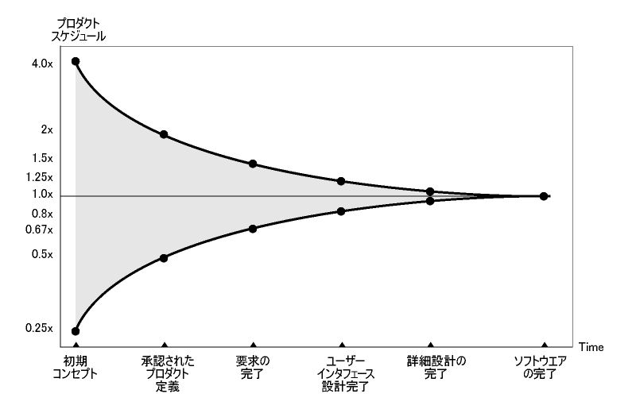

Cone of uncertainty
This expresses the transition of variance in estimates as the project progresses.
Project schedule
At the beginning, the maximum estimate is 16 times the
minimum.
Uncertainty decreases with each sprint
If a mistake occurs, simply make adjustments early
http://itpro.nikkeibp.co.jp/article/COLUMN/20131001/508039/

Slide 37
Confirmation of progress toward goal
Resources such as a release burndown chart can be used to track progress and confirm that the desired content will be released at the desired time. Confirming this during sprint reviews makes it possible to provide the product owner with materials for scope adjustment.
If you know the number of points required for release and the timing that is required, it is possible to tell whether a delay is occurring from one sprint.

Slide 38
Sprint backlogs
Sprint backlogs are plans used to ensure that the product backlog items selected for a sprint can be submitted as deliverable products.
They are lists of the work that the development team must do to achieve the sprint goals.
They are written in the level of detail that is needed, and may be changed during the sprint.
Only the development team can change the sprint backlog.
Estimates indicate the ideal time.
Tasks should be broken into small units, as this enables more accurate estimation.
At a maximum, tasks should be small enough to be completed within the time allocated for development work in one day.
Story | Task | Estimate
Complete XX as A | UI coding | 3.0h
 | Data model design, changes, entity creation | 3.0h
 | Action coding | 2.0h
Make YY referenceable in list form as B. | UI coding | 4.0h
 | Action coding | 2.0h

Slide 39
Confirmation of progress of sprints
The work remaining in the sprint backlog is tracked to confirm progress.
The burndown chart is often checked during daily scrums.

Slide 40





Deliverable products
This term encompasses the products created so far and the product backlog items that have been completed in the current sprint.
Deliverable products must be completed by the end of the sprint.
Products that meet the definition of “done” set by the scrum team are deliverable products.
Parts alone cannot be delivered. Usable items, no matter how small, need to be created.

Slide 41
Transparency of created items

Slide 42
Definition of “done”
The definition of “done” indicates the point at which a product is deliverable. This is used to evaluate whether work is completed.
This needs to be done before releasing products.
Done
Undone
All sprints are completed
Not all sprints have been executed
Development
UT
80% coverage or greater
IT
Regression testing
Document creation
• Static analysis
Scenario testing
Load testing
Security testing
Release
It is important to get undone tasks done

Slide 43
The five events in Scrum

Slide 44
The five events in Scrum
Transparency
Inspection
Adaptation
Product backlog refinement (5～10%)
Sprint(1-4weeks)
Daily
scrum
Daily
scrum
Sprint planning:
Part 1
Sprint backlog
Definition of “done”
Sprint planning:
Part 2
Deliverable product
Daily
scrum
Sprint review
Sprint
retrospective
Fault list
Development team(7±2)
Daily
scrum
Daily
scrum
Product owner
Daily
scrum
Product backlog
Scrum master
Cancellation of sprint

Slide 45
Sprint planning
Time box: 4 hours every 2 weeks
Sprint planning: Part 1
This answers the question “What can be delivered as an additional component of the deliverable product that will be created in the sprint?”
The input consists of the product backlog, latest products and the predicted capacity and previous record of the development team.
This is used to determine the number of product backlog items to be selected. The development team is responsible for deciding on the number of items.
After predicting the product backlog that can be delivered during the sprint, sprint goals are set.
Sprint goals are objectives for the sprint that need to be achieved by carrying out the tasks in the product backlog.
Priority | Story | Estimate
1 | Complete XX as A | 2
2 | Make YY referenceable in list form as B. | 3
3 | Improve performance of process C | 5
... | ... | ...
100 | Create report as D | 8
Select PBIs to be executed
during the sprint

Slide 46
Sprint planning
Sprint planning: Part 2
This part answers the question “How will we complete the work that is needed in order to deliver this additional component of the deliverable product?”
The product backlog items selected for execution in part 1 are placed in the sprint backlog.
This is when tasks for the first few days of the sprint are broken down to a workable size.
The tasks may also be broken down during the sprint period as necessary.
The product owner helps to clarify the product backlog and make tradeoffs.
If there is too much or too little work after breaking down the tasks, the product owner is consulted to make adjustments.
The development team must be able to explain how the sprint goals will be achieved.
Story
Complete XX as A
Make YY referenceable in list form as B.
Break down into
specific tasks
Task | Estimate
UI coding | 3.0h
Data model design, changes, entity creation | 3.0h
Action coding | 2.0h
UI coding | 4.0h
Action coding | 2.0h

Slide 47

Sprints
Time box: Maximum 1 month
A continuous period of development work with a time box no larger than one month to create a deliverable product.
Sprints comprise sprint planning, daily scrums, development work, sprint reviews and sprint retrospectives.
Note
Changes that will adversely affect the sprint goals cannot be made
Quality targets must not be lowered
Negotiation between the product owner and development team may become necessary as studying progresses and the scope is clarified.
Cancellation of sprints
Sprints can be canceled before the end of the time box, but only the product owner has the authority to cancel a sprint.
If a sprint is canceled, the completed items from the product backlog are reviewed.
Uncompleted backlog items are returned to the product backlog after a re-estimation.

Slide 48


Daily scrums
Time box: 15 minutes per day
During daily scrums, the work performed after the previous daily scrum is inspected and a plan is made for work to be performed by the next daily scrum.
This is a time to inspect the progress of work from the sprint backlog.
Daily scrums need to be held at the same time and in the same place every day.
Each member of the development team explains the following points during daily scrums.
What they did the previous day to enable the development team to achieve the sprint goals
What they will do on this day to enable the development team to achieve the sprint goals
Issues that they or the development team faced that affected their ability to achieve the sprint goals
If a detailed point is raised during a daily scrum, all or some of the development team meets after the daily scrum to discuss the matter in detail and then adapt and re-plan.

Slide 49

Sprint reviews
Time box: 2 hours every 2 weeks
At the end of the sprint, the addition to the deliverable product is inspected and the product backlog is adapted if necessary.
During sprint reviews, the scrum team and other relevant personnel review the results of the sprint.
The purpose of sprint reviews is not to confirm progress but to elicit feedback and further cooperation.
Sprint reviews include the following:
The product owner invites participants
The product owner explains completed and uncompleted PBIs
The development team discusses strong points from the sprint, along with issues that they faced and how they solved them
The development team demonstrates what they have completed and answers questions
The product owner confirms the current product backlog and predicts when it will be completed
The whole group discusses what to do next and uses this as input for the planning of the next sprint
The schedule, budget, performance and market for the next product release is reviewed

Slide 50

Sprint retrospectives
Time box: 1.5 hours every 2 weeks
These are an opportunity for the scrum team to conduct an inspection and create a plan for improvements to be made in the next sprint.
Sprint retrospectives are held after the sprint review, before the planning of the next sprint.
The sprint is inspected from the perspectives of people, relationships, processes and tools
Strong points and points requiring improvement in future are identified and organized
Improvement measures to be applied in the next sprint are identified
An improvement plan for the scrum team’s work is created
The definition of “done” is adjusted as appropriate
No specific method is required, but KPT is often used.
Information on practical usage of KPT is provided in the Practical Guide to Project Facilitation: Retrospective Guide[1].
Information on other methods is provided in Agile Retrospectives: Making Good Teams Great[2].
[1]: http://objectclub.jp/download/files/pf/RetrospectiveMeetingGuide.pdf (only Japanese)
[2]: http://shop.ohmsha.co.jp/shopdetail/000000001770/

Slide 51
Meetings and Attendees
Guideline on meeting attendees | Sprint planning: Part 1 | Sprint planning: Part 2 | Daily scrums | Sprint reviews | Sprint retrospectives
Product owner Responsible for maximizing the value of the development team’s work and the product. Responsible for management of product backlog. | A | A[1] | C[2] | A | C[4]
Scrum master Responsible for understanding and formation of scrums. | A | A | C[3] | A | A
Development team Develops the product. Responsible for fulfilling promises made during sprint planning. | A | A | A | A | A
Stakeholders Interested parties such as product users, investors and/or managers | D | B | D | D | B
A:Must attend
B:Cannot attend
C:May attend depending on the context
D:Can attend but does not have speaking rights
Notes:
It is just a rough standard.
For example, in the Scrum Guide, the retrospective is for the "Scrum Team". (Not the development team).

Slide 52
Meetings and Attendees (continued)
[1] Involvement of product owner in sprint planning: Part 2
The product owner does not need to attend sprint planning: Part 2, as this meeting is to discuss practical methods and make a plan to achieve them.
With that said, the product owner must answer questions when needed.
The development team also needs to provide the product owner with an explanation of how they will achieve the sprint goals.
[2] Involvement of product owner in daily scrums
Useful in cases such as those where obstacles for achieving the sprint goals occur frequently and support from the product owner is needed.
[3] Involvement of scrum master in daily scrums
The scrum master asks the development team to hold daily scrums, but the development team itself is responsible for holding them.
At the beginning of a team’s work, the scrum master may also need to ensure that time boxes are met and rules are followed.
The scrum master does not need to be involved if the development team can run daily scrums well by themselves.
[4] Involvement of product owner in sprint retrospectives
Retrospectives are held without the PO if there are issues related to the inspection and improvement of processes that cannot be described freely if the PO is present.

Slide 53
Scrum and quality

Slide 54

Quality issues in waterfall
Definitions of requirements
Good
Quality is guaranteed by phase gates, but
it is not possible to tell whether the desired
product was created until acceptance testing.
The major risks are at the end.
Design
Good
Implementation
Good
Integration testing
Normal
Acceptance testing
Bad

Slide 55

Quality in Scrum
The degree to which the product meets business requirements is confirmed during sprint reviews
Time
Definition of
requirements
Design
Implementation
Testing
Bad
Definition of
requirement
Design
Implementation
Testing
Normal
Definition of
requirement
Design
Implementation
Testing
Good
Definition of
requirement
Design
Implementation
Testing
Good

Slide 56




The Kano model
Customer satisfaction
Attractive
Satisfied
Attractiveness
Unavoidable
Physical performance
Inferior performance
Superior performance
Unified quality
(performance)
Must-have
Must-have
(basic quality)
Unattractive
Dissatisfied
Notes:
The quality required by customers is divided into three categories: Must-have, Unified quality and Attractiveness
Must-have
If it is not satisfied, customers are dissatisfied. It is natural for customers to be satisfied
Unified quality
If it is not satisfied, customers are dissatisfied. If it is satisfied, customers are satisfied.
Attractiveness
Even if it is unsatisfied, customer are not unsatisfied. If it is satisfied, customers are satisfied.

Slide 57
The Kano model
Customer satisfaction
Scrum makes it
easy to increase
attractive and
unified quality
Attractive
Satisfied
Unique functions
Physical performance
Unavoidable
Inferior performance
Superior performance
Throughput, response time, operation rate, etc.
Must-have
Whether the function works correctly/as expected
Must-have quality is the same as waterfall
Unattractive
Dissatisfied
Notes:
The quality required by customers is divided into three categories: Must-have, Unified quality and Attractiveness
Must-have
If it is not satisfied, customers are dissatisfied. It is natural for customers to be satisfied
Unified quality
If it is not satisfied, customers are dissatisfied. If it is satisfied, customers are satisfied.
Attractiveness
Even if it is unsatisfied, customer are not unsatisfied. If it is satisfied, customers are satisfied.

Slide 58
QCD + S
Delivery
Quality
Scope
Cost
Quality： Fixed
Cost： Fixed
Delivery： Fixed
Scope： Adjustable
Notes:
・Quality is fixed in both Waterfall and Scrum, and quality is not to be sacrificed.
・Delivery is basically fixed.
・In the case of waterfall, it is adjusted with a large amount of buffer cost.（In waterfall, the scope is basically fixed）
・In the case of scram, it is adjusted with scope.（The bulk of the cost is labor cost, which should not be easily increased or decreased in the case of Scrum.）

Slide 59
Automation of testing
Testing is done more frequently than with waterfall, as development is done repeatedly. Automation is essential for purposes such as regression testing of functions added in the previous sprint.
Time
Points such as the types of tests to be
automated are decided by the scrum team,
as these points are dependent on context.
Definition of
requirements
Design
Implementation
Testing
Definition of
requirement
Design
Implementation
Testing
Definition of
requirement
Design
Implementation
Testing
Definition of
requirement
Design
Implementation
Testing

Slide 60
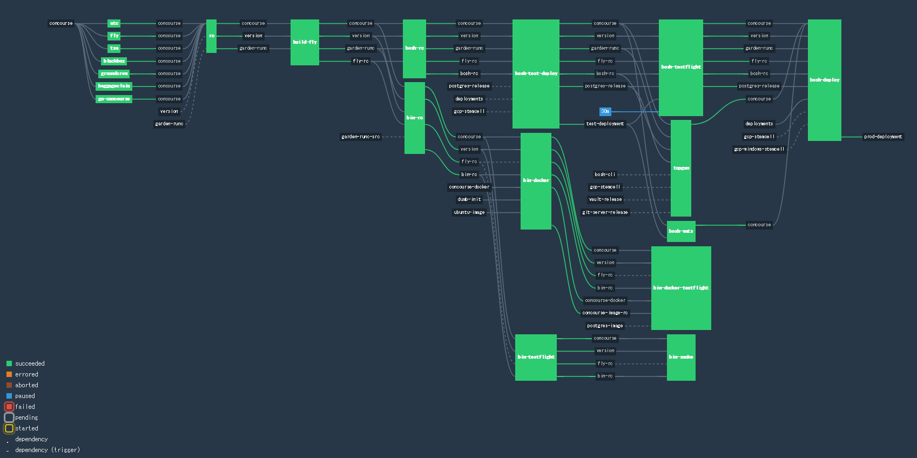
Continuous integration and delivery
As with testing, automating this is recommended as frequent build and deployment work is required.

Slide 61
Metrics of Scrum

Slide 62
Velocity
Velocity is the total of completed story points for one sprint.
It indicates the productivity of the development team.
This is used as a reference when deciding the capacity during sprint planning.
Sprint 1
Sprint 2
Sprint 3
Sprint 4
3
2
5
5
1
3
1
5
Completed
stories
5
1
9
5
7
10
Velocity

Slide 63

Using velocity
Determining whether a release is behind schedule
Release points ≦ velocity (expected or performance so far) x remaining sprints
Example: 100 ≦ 10 points × 10 sprints → on schedule
100 ≧ 9 points × 10 sprints → behind schedule
Calculating capacity
Capacity = average effective velocity for 5 sprints
The effective velocity is calculated by removing
the first velocity and the maximum and
minimum velocity so far.
If five sprints have not been completed,
the most recent velocity is used for the effective velocity.

Slide 64
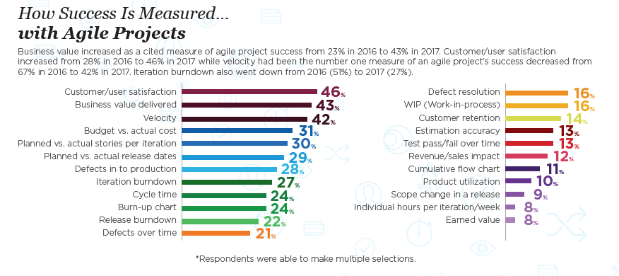
How success is measured in agile projects
VersionOne 12th Annual State of Agile Report
http://stateofagile.versionone.com/

Slide 65
Common misunderstandings about Scrum and agile

Slide 66
Scrum is more productive
When making a predetermined item, waterfall is more productive.
Scrum is best suited for complex situations such as those where rapid changes occur and the correct answer can only be determined by gauging the reaction of the market and users. Scrum enables a shorter lead time and faster market release.
Lead time until market release = P + (S + Q + W)
Element | Definition | System development
Setup time | The preparation time. | The time required for planning and design
Process time | Processing and operation time | The time required for implementation and delivery
Queue time | The wait time caused by resource restrictions | Time during which a task is not handled as all team members are working
Wait time | The wait time for dependent tasks | Time spent waiting for dependent modules and delivery of items to be tested

Slide 67
Resource efficiency and flow efficiency
Resource efficiency
High operation rate
High operation rate
High
Long lead time
Short lead time
Long lead time
Short lead time
Low
Poor operation rate
Poor operation rate
Flow efficiency
Low
High
Notes:
productivity＝resource efficiency ? flow efficiency?

Slide 68
Resource efficiency and flow efficiency
Resource
Resource
Resource
Resource
Resource
Allocation to enable 100% operation of one resource
Maximizing resources to get the most out of flow units
Flow unit
Flow unit
Flow unit
Flow unit
Flow unit
e.g. multitasking
e.g. pair programming

Slide 69
Resource efficiency and flow efficiency
Resource efficiency
Water
Fall
High
Scrum
Low
Chaos
Lean
Flow efficiency
Low
High

Slide 70
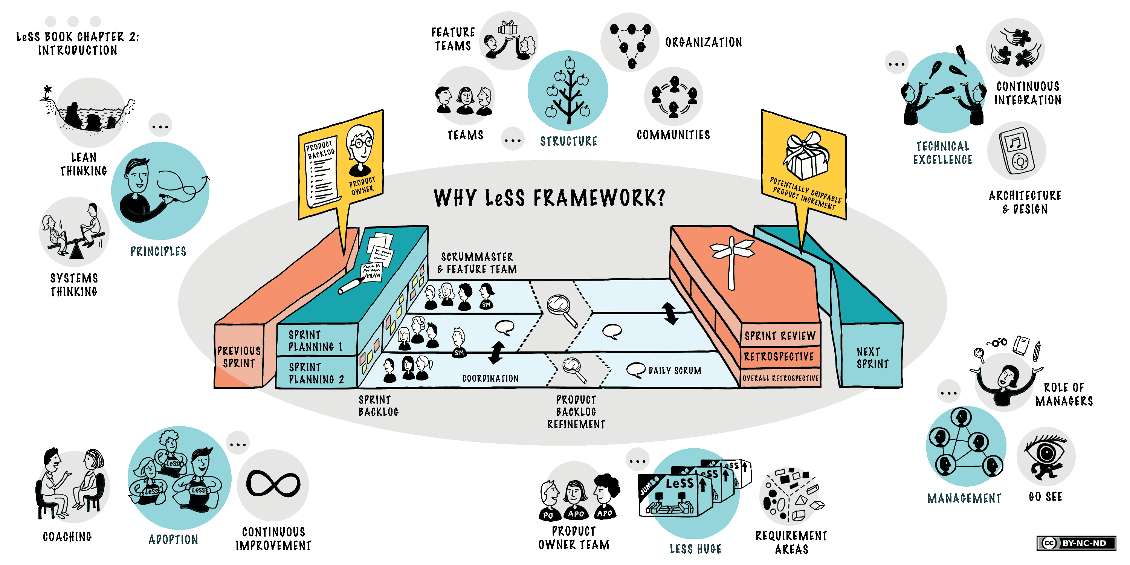
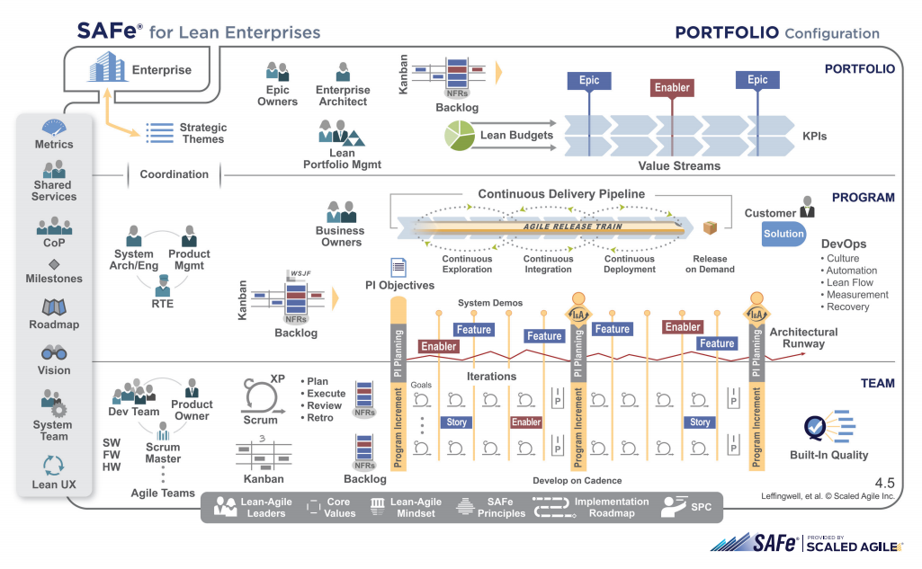
Scrum is not suited to large-scale projects
Suited to development in teams of 2-8
One scrum master can manage 1-3 teams
One product backlog and one product owner per product
Same sprint cycle for each team
The LeSS Huge framework can be used for
teams with more than 8 members
https://less.works/less/homepage?preferred_lang=en
This is used for agile frameworks at a
company level.
Retrospectives are held in 8- to 12-week cycles.
There are 5-15 teams (50-125 people) for each
release.
http://www.scaledagileframework.com/

Slide 71
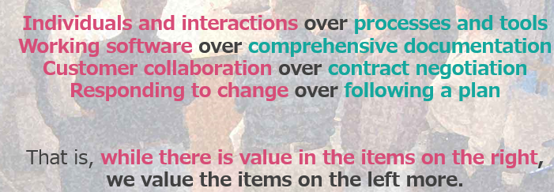
Documents are not created in Scrum
Scrum values working software over comprehensive documentation, although the necessary documents are, of course, created.
http://agilemanifesto.org/iso/en/manifesto.html

Slide 72
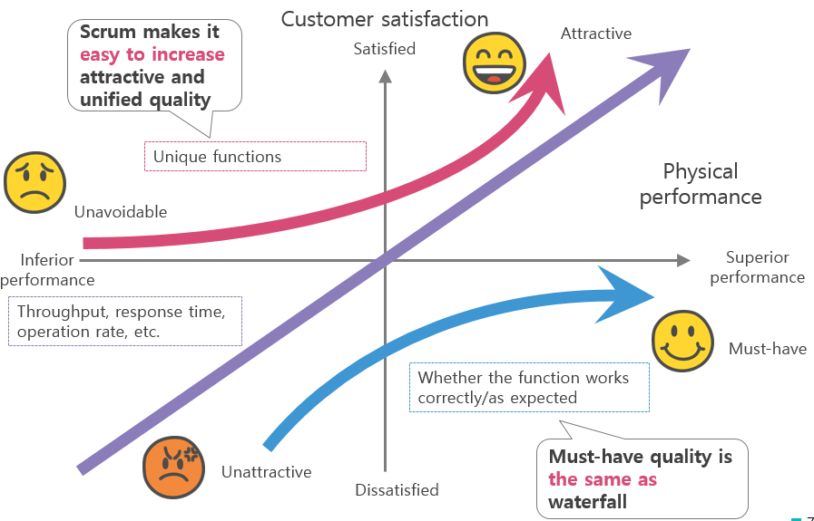
Scrum produces lower quality than waterfall
The test types and test cases are the same, regardless of the development process, so there is no difference in the basic quality.

Slide 73
Appendix

Slide 74
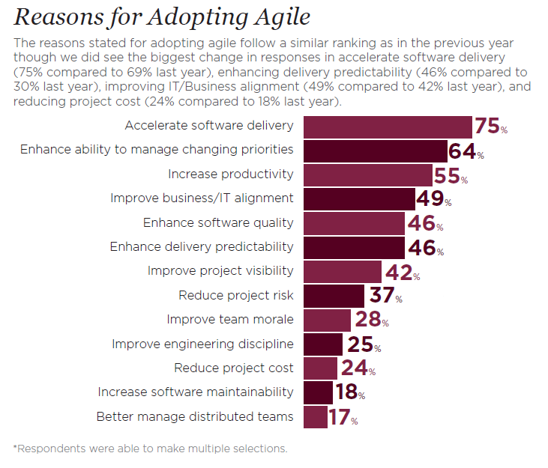
Reasons for adopting agile
To focus more on accelerating software delivery.
VersionOne 12th Annual State of Agile Report
http://stateofagile.versionone.com/

Slide 75
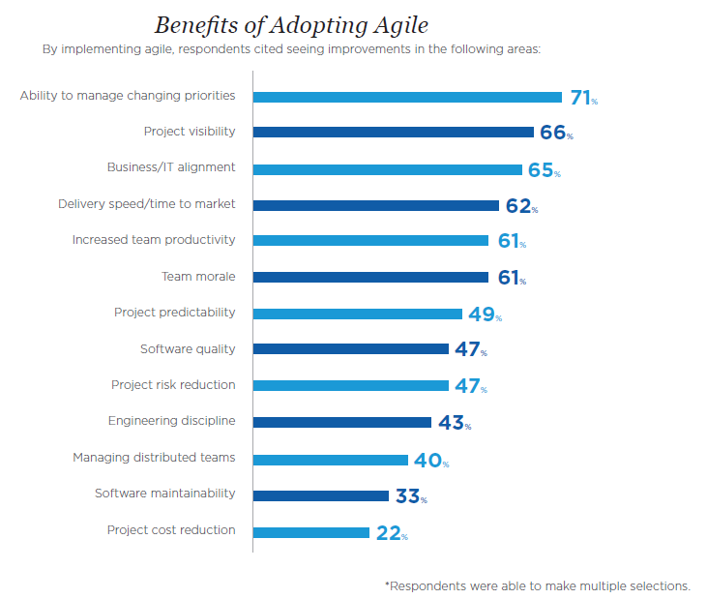
Benefits of adopting agile
An unexpectedly small number of
respondents cited project cost
reduction.
VersionOne 12th Annual State of Agile Report
http://stateofagile.versionone.com/

Slide 76
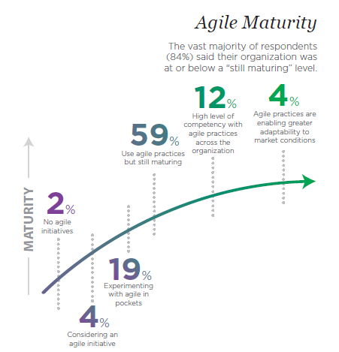
Agile maturity
Cannot be mastered easily
VersionOne 12th Annual State of Agile Report
http://stateofagile.versionone.com/

Slide 77
Maturity model of configuration and release management
Practice | Build management and continuous integration | Environment and deployment | Release management and compliance | Testing | Data management | Configuration management
Level 3 – Optimization: The focus is on improvement of processes | There is a venue for regular team discussion, which covers points such as integration issues, automation-based solutions, prompt feedback and better visualization. | All environments are well managed. Provisioning is fully automated. Virtualization is used appropriately. | The system operation team and delivery team work together to manage risks and reduce cycle times. | Changes to the full-scale environment are rarely canceled. Any issues are immediately detected and fixed. | Feedback about points such as the database performance and the deployment process itself is received on each release. | Change management policies are constantly verified to confirm that efficient teamwork and prompt deployment are taking place. Checks are also carried out to confirm the auditability of the change management process.
Level 2 – Quantitative management: Processes are measurable and controlled | Build metrics are collected and visualized, and work is conducted accordingly. Builds are not left broken. | Procedures for integrated deployment management and cancellation of releases and re-releases are tested. | The environment is actively managed by monitoring the health of the application. Cycle times are monitored. | Quality metrics and their trends are tracked. Non-functional requirements are defined and measured. | Database updates and rollbacks are tested for each deployment. Database performance is monitored and optimized. | Developers check in on the main line at least once per day. Branches are only used for release work.
Level 1 – Consistent: Automated processes are applied to the entire life cycle of the application | Automated build and test cycles are executed each time a change is committed. Dependency relationships are managed. Scripts and tools are reused. | Software deployment is fully automated and can be completed by simply clicking a button. The same procedure is deployed for all environments. | A process for managing and approving changes is defined and followed. Protocols are followed | Testing such as unit testing and acceptance testing is automated. Acceptance tests are written by the tester. Testing is incorporated into the development process. | Changes to the database are performed automatically as part of the deployment process. | Libraries and dependency relationships are managed. Usage policies for version management systems are defined in the change management process.
Level 0 – Repeatable: Processes are documented and some are automated | Standard builds and tests are automated. All builds can be recreated with an automated procedure using a source management system. | Deployment is automated in some environments. New environments can be created easily. All configuration management information is used externally for version management. | Releases are considered a nuisance, and are infrequent and unreliable. Traceability of release requirements is also limited. | Automated tests are written as part of story development. | An automated script is used to make changes to the database, and the versions of both the script and the application are managed. | Everything that is needed for software creation (source code and settings files, build and deployment script, data migration, etc.) is managed using a version management system.
Level -1 – Frequent regression errors: Processes are not repeatable and management is inadequate. These issues are being addressed. | Software build procedures are manual. Deliverables and build results are not managed. | Software deployment procedures are manual. Binary is environment-dependent. Environment distribution is manual. | Releases are infrequent and unreliable. | Testing is done manually after development. | Data migration is done manually and versions are not managed. | A version management system is not used, or check-ins are rarely done.
Wachi, Yukei; Takagi, Masahiro; translators. Keizokuteki Deribarī: Shinrai Dekiru Sofutowea Rirīsu No Tame No Birudo/Tesuto/Depuroimento No Jidōka
(Continuous Delivery: Reliable Software Releases through Build, Test, and Deployment Automation). Kadokawa/ASCII Media Works, 2012.

Slide 78
Quick but rough vs. polished but slow
Execution
Polished but slow
Quick and polished
Polished
Slow and rough
Quick but rough
Rough
Speed
Quick
Slow

Slide 79
Quick but rough vs. polished but slow
Execution
Water
Fall
Polished
Scrum
Rough
Chaos
Lean
Speed
Slow
Quick

Slide 80
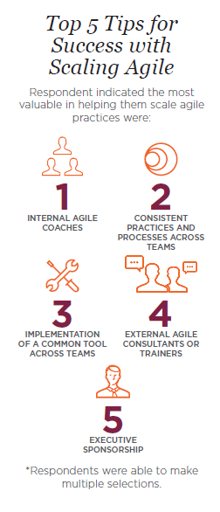
Scaling agile
VersionOne 12th Annual State of Agile Report
http://stateofagile.versionone.com/

