Slide 1
VIXCoin
General conlclusions on ML developing to predict VIXM

Slide 2
0. filter model for important variables – DONE
1. Learn to include tuning model per depth of decision trees. DONE
2. Create Function to predict VIX. Arguments are tickers and adaboost parameters. Good to apply modular concept for functions
X_filtered
VIX close, volatility, volume
(DONE)
VIX prediction
VIXM>0
X
Y
3. Study on seasonality of VIXM in prophet (PAOLA - DONE)
4. Create VIXM jupyter lab code to run VIXM prediction (PAOLA)
5. Tunning VIXM model to get maximum accuracy & profitability (as of now we have only care about accuracy metrics)

Slide 3
t
PCA t-1
PCA t-2
PCA t-3

Slide 4
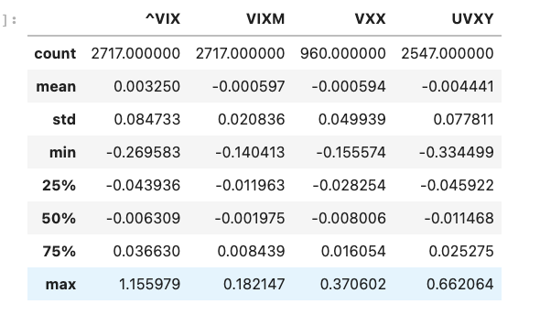
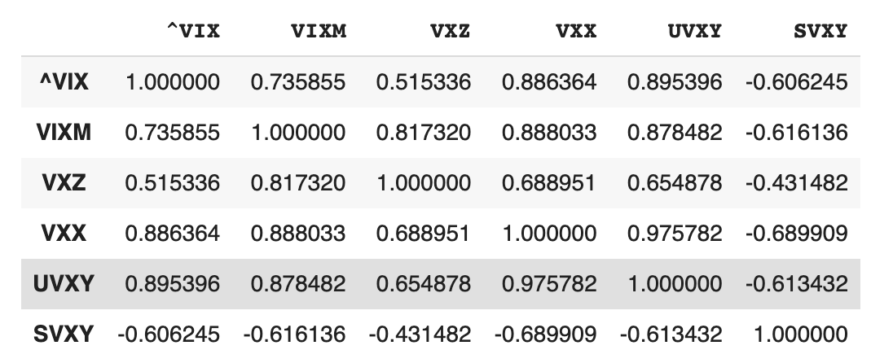
CORRELATION ANALYSIS UVXY is the instrument with more correlation in returns, but not much history. Symbol (Availability of first close price): VIXM: Feb 1st 2011 – decent correlation VXX, UVXY, SVXY: Jan 26th 2018 VXZ: Feb 13th 2018 Ideally, it would be good to include VXX and UVXY in the strategy after 2018, because they have higher returns. However if VIXM works, that would be enough for the project.
Returns statistics
Correlation

Slide 5
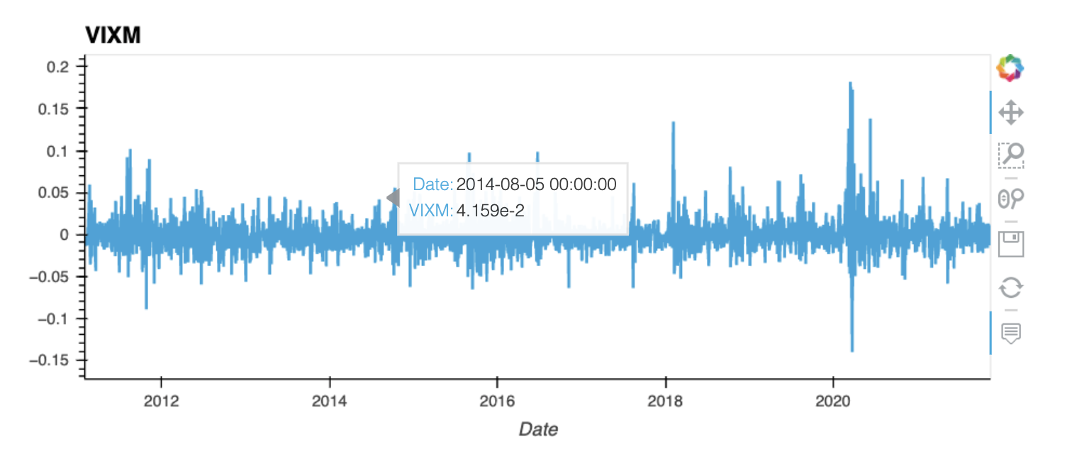
GARCH models also would apply to VIXM returns, because of the clusters of volatility. SO we will include VIX and VIXM GARCH models to the features as well.

Slide 6
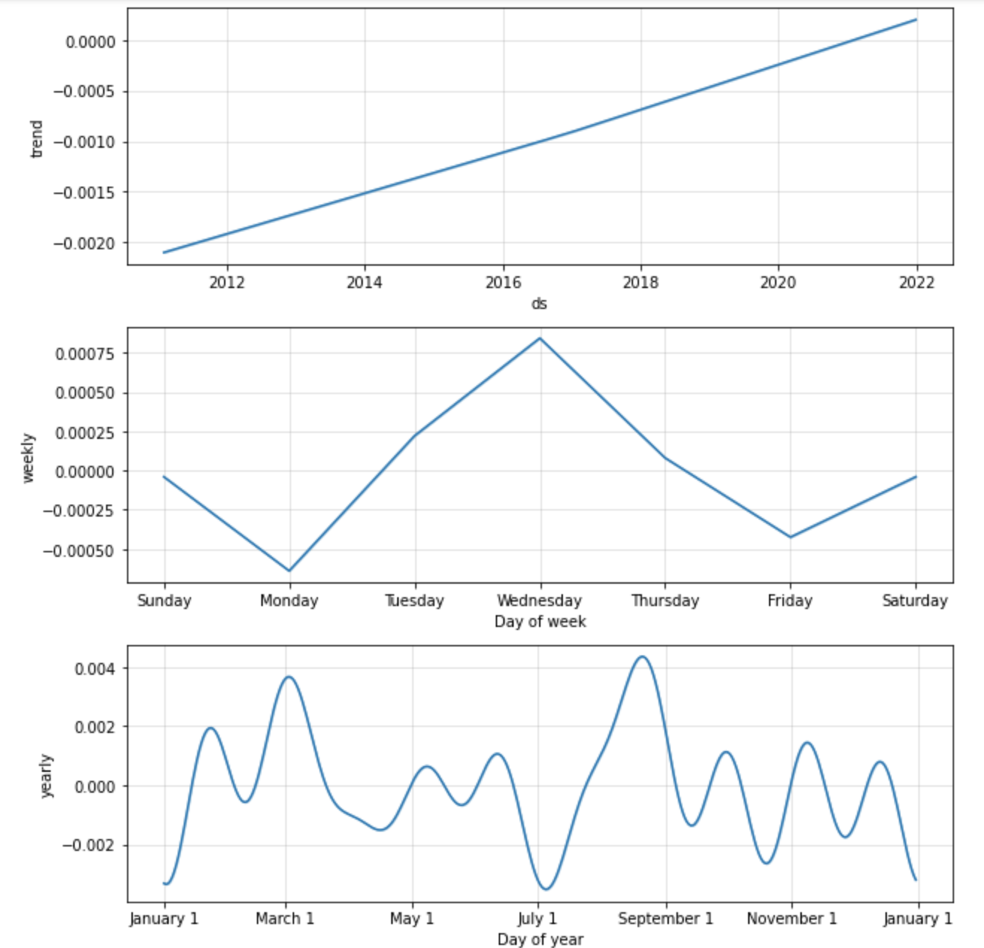
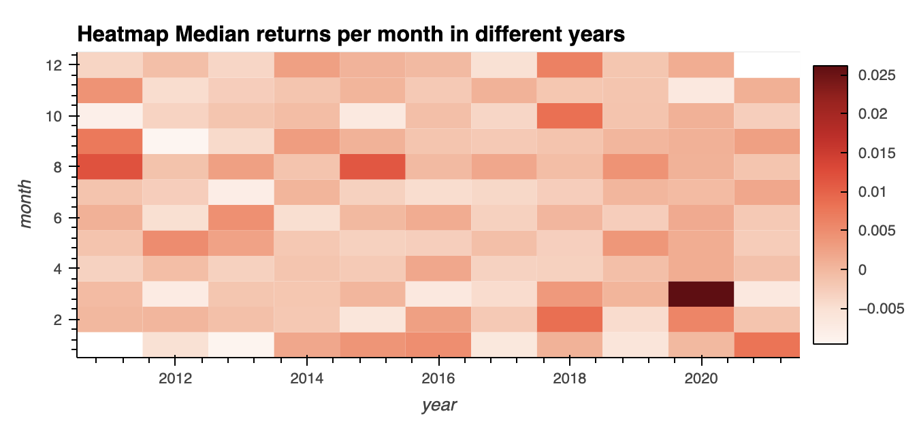
PROPHET ANALYSYS:
VIXM Returns seasonal patterns
Wednesday tend to be the higher level of the index. This happens probably because the expiration of VIX future contracts are on Wednesday, and so there is more volume and need of selling that day.
There are some months that have better returns than others:
March: it may be effect of the covid shock in 2020
August, February: it looks to be more of a pattern here. So we will add month of the year to the features
Sometimes Tue/Wed appear as key variables in tunning, but not always

Slide 7
Missing items: 1) Predictive Function
Prediction Function
Close prices
Volume
Squared returns
Returns
Garch models
PC lagged
Volatilities
More
Predictions (0 or 1)
X
Y
X_train_scaled
Y_train_scaled
Adaboost model
Ticker list
Adaboost parameters
Start date
End Date
Months for training (for train/test split)

Slide 8
2) Tunning function
X_train_scaled, Y_train_scaled
Tunning Function
Best n_estimators
Depth
Learning rate
Accuracy results
Profitability
Table of best results
Threshold for results
Ej. Prof>300%
Accuracy_score>50%
And for several measurements...
Ranges for the tunning
N_estimators between 1 and 50
Depth between 1 and 5
Learning_rate between 0.1 and 2

Slide 9
3) Performance results
Performance Output Function
Comparative line time series graph
Histogram of good and bad predictions
Predictions
Y
Benchmark ticker

Slide 10
4) Analysis of feature importance
Performance Output Function
Coeficients
Trees
Adaboost model

Slide 11
FINAL MODEL SHOULD CALCULATE VALUE OF THE TOKEN EVERY DAY
Date of last close
Date and time
VIXCOIN Token Prediction and Valuation Function
*Signal predicted for the next day (0 or 1)
*Value of token on date and time
*DataFrame with all historical values
*Dataframe with all historical signals

Slide 12
Final Function
VIX prediction
VIXM Prediction
Tunning
FINAL MODEL
Keep the previous results in a database or somewhere, so we don’t need to wait for the calculations every time
VIXCOIN Token Prediction and Valuation Function
*Signal predicted for the next day (0 or 1)
*Value of token on input Date
*DataFrame with all historical values
*Dataframe with all historical signals
Date of last close

Slide 13
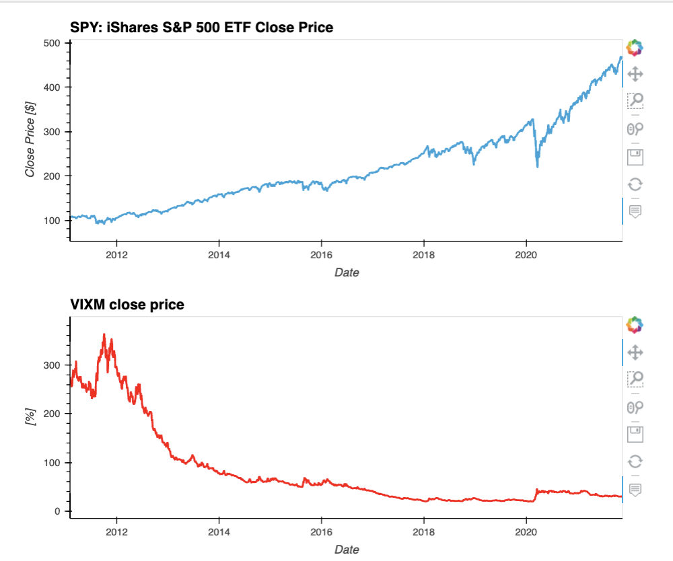
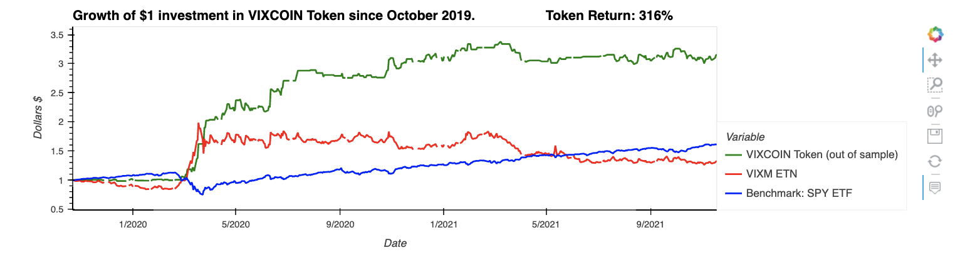
Possible to have this plots as transparent, or black background for the presentation?

Slide 14
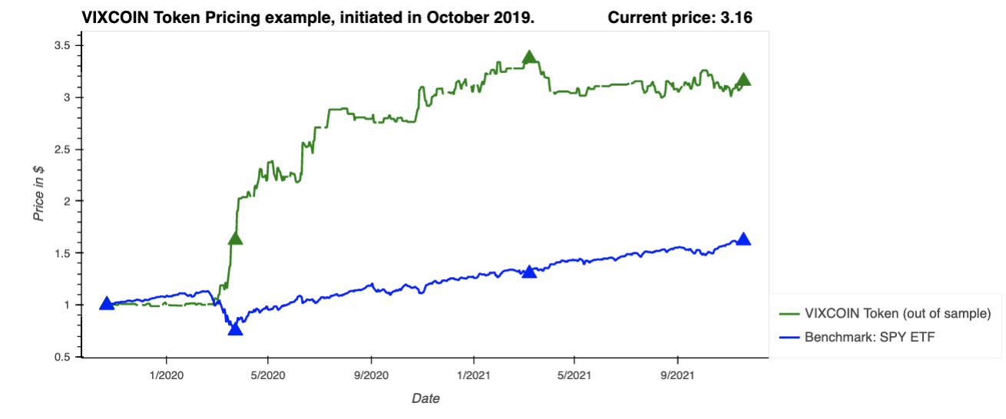
3.16
3.37
1.5
1.0
1.62
1.33
1.0
0.75
How to add the values on the key points permanently

