Slide 1
Effect of Critic and User Scores on players in Video Games
Another Study by Patrick Walsh

Slide 2
Data
Data is from the video game sales dataset on Kaggle
Variables:
| Name | Platform | Year_of_Release | Genre | Publisher | NA_players | EU_players | JP_players | Other_players | Global_players | Critic_Score | Critic_Count | User_Score | User_Count | Developer | Rating
https://www.kaggle.com/datasets/gregorut/videogamesales

Slide 3
Theory of Data
Video games have increased total global players
Have not retained a total global player increase for titles as time goes on.
increase in user scores have increased consistently over time
total global players for a title do not increase consistently by year.

Slide 4
Argument to Explain
How does critic score relate to North American players?
How does User Score relate to/increase North American players?
Which video game maker benefits the most by critic and user scores?

Slide 5
Descriptive Statistics
Title
Min. : 1 Length:16719 Length:16719 Length:16719 1st Qu.: 4180 Class :character Class :character Class :character Median : 8360 Mode :character Mode :character Mode :character Mean : 8360 3rd Qu.:12540 Max. :16719
NA Players Length:16719 Length:16719 Min. : 0.0000 Min. : 0.000 Class :character Class :character 1st Qu.: 0.0000 1st Qu.: 0.000 Mode :character Mode :character Median : 0.0800 Median : 0.020 Mean : 0.2633 Mean : 0.145 3rd Qu.: 0.2400 3rd Qu.: 0.110 Max. :41.3600 Max. :28.960

Slide 6
Decriptive Statistics, cont
Min. : 0.0000 Min. : 0.00000 Min. : 0.0100 Min. :13.00 1st Qu.: 0.0000 1st Qu.: 0.00000 1st Qu.: 0.0600 1st Qu.:60.00 Median : 0.0000 Median : 0.01000 Median : 0.1700 Median :71.00 Mean : 0.0776 Mean : 0.04733 Mean : 0.5335 Mean :68.97 3rd Qu.: 0.0400 3rd Qu.: 0.03000 3rd Qu.: 0.4700 3rd Qu.:79.00 Max. :10.2200 Max. :10.57000 Max. :82.5300 Max. :98.00

Slide 7
Standard Critic Score Result
Coefficients: Estimate Std. Error t value Pr(>|t|) (Intercept) -0.7149775 0.0486996 -14.68 <2e-16 *** Critic_Score 0.0154849 0.0006921 22.37 <2e-16

Slide 8
Standard User Score Result
Coefficients: Estimate Std. Error t value Pr(>|t|) (Intercept) 3.099e-01 1.072e-02 28.90 <2e-16 *** User_Count 4.065e-04 1.835e-05 22.15 <2e-16 ***

Slide 9


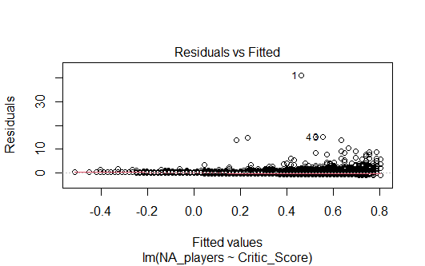
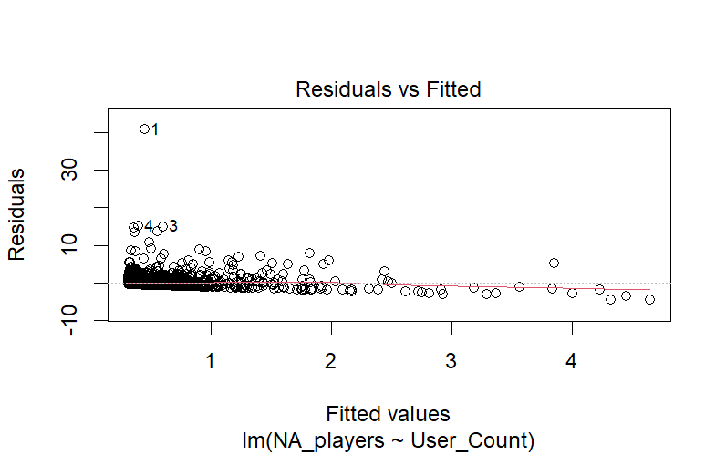
The graphs look awesome

Slide 10
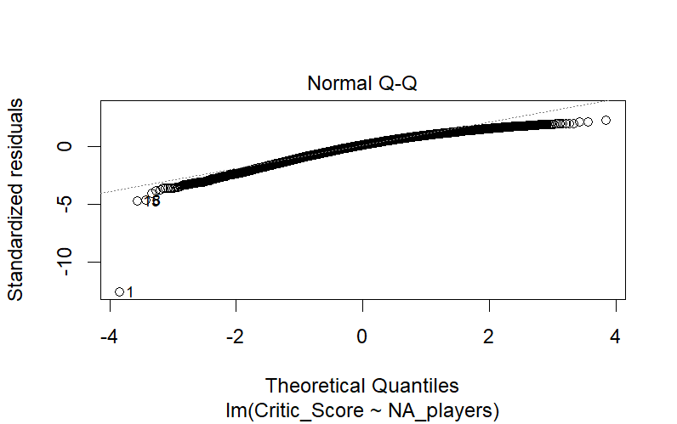
Pure Quantile Prediction. Linear Combination of predictors.

